Slide 1

“The Revelation of Jesus Christ, which God gave Him to show His servants - things which must shortly take place. And He sent and signified it by His angel to His servant John.”
Revelation 1:1

Slide 2
Keys to Understanding Revelation
Remember HOW the book was written: it is a book of signs and symbols.
Remember WHY the book was written: it was written to help Christians in the First Century who were suffering for their faith.
“The Revelation of Jesus Christ, which God gave Him to show His servants - things which must shortly take place. And He sent and signified it by His angel to His servant John.”
Revelation 1:1

Slide 3
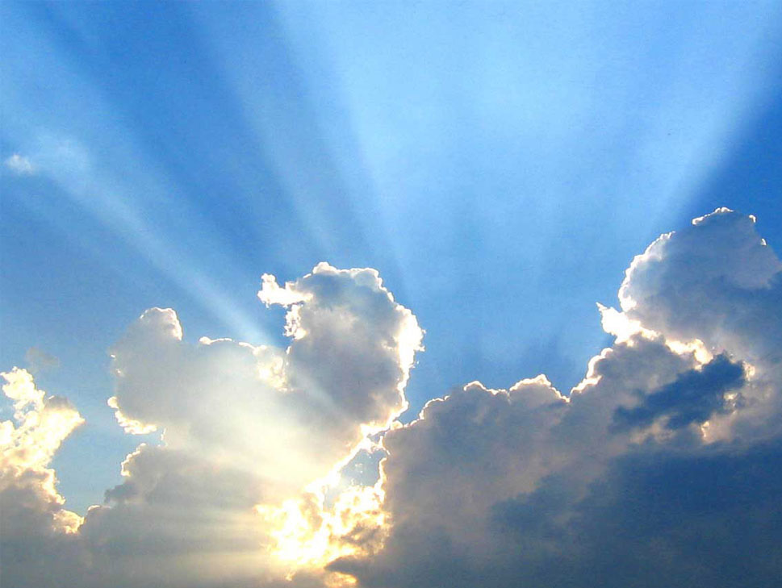
In Revelation, Heaven is a Place of...
God’s Presence (21:1-8)
God’s Protection (21:9-27)
God’s Provision (22:1-5)

Slide 4
Revelation chapter twenty-two
And he showed me a pure river of water of life, clear as crystal, proceeding from the throne of God and of the Lamb.
In the middle of its street, and on either side of the river, was the tree of life, which bore twelve fruits, each tree yielding its fruit every month. The leaves of the tree were for the healing of the nations.

Slide 5
Revelation chapter twenty-two
And there shall be no more curse, but the throne of God and of the Lamb shall be in it, and His servants shall serve Him.
They shall see His face, and His name shall be on their foreheads.
There shall be no night there: They need no lamp nor light of the sun, for the Lord God gives them light. And they shall reign forever and ever.

Slide 6
Revelation chapter twenty-two
Then he said to me, “These words are faithful and true.” And the Lord God of the holy prophets sent His angel to show His servants the things which must shortly take place.
“Behold, I am coming quickly! Blessed is he who keeps the words of the prophecy of this book.”

Slide 7
Revelation chapter twenty-two
Now I, John, saw and heard these things. And when I heard and saw, I fell down to worship before the feet of the angel who showed me these things.
Then he said to me, “See that you do not do that. For I am your fellow servant, and of your brethren the prophets, and of those who keep the words of this book. Worship God.”

Slide 8
Revelation chapter twenty-two
And he said to me, “Do not seal the words of the prophecy of this book, for the time is at hand.
He who is unjust, let him be unjust still; he who is filthy, let him be filthy still; he who is righteous, let him be righteous still; he who is holy, let him be holy still.”

Slide 9
Revelation chapter twenty-two
“And behold, I am coming quickly, and My reward is with Me, to give to every one according to his work.
I am the Alpha and the Omega, the Beginning and the End, the First and the Last.”

Slide 10
Revelation chapter twenty-two
Blessed are those who do His commandments, that they may have the right to the tree of life, and may enter through the gates into the city.
But outside are dogs and sorcerers and sexually immoral and murderers and idolaters, and whoever loves and practices a lie.

Slide 11
Revelation chapter twenty-two
“I, Jesus, have sent My angel to testify to you these things in the churches. I am the Root and the Offspring of David, the Bright and Morning Star.”
And the Spirit and the bride say, “Come!” And let him who hears say, “Come!” And let him who thirsts come. Whoever desires, let him take the water of life freely.

Slide 12
Revelation chapter twenty-two
For I testify to everyone who hears the words of the prophecy of this book: If anyone adds to these things, God will add to him the plagues that are written in this book;
and if anyone takes away from the words of the book of this prophecy, God shall take away his part from the Book of Life, from the holy city, and from the things which are written in this book.

Slide 13
Revelation chapter twenty-two
He who testifies to these things says, “Surely I am coming quickly.” Amen. Even so, come, Lord Jesus!
The grace of our Lord Jesus Christ be with you all. Amen.

