Slide 1

“The Revelation of Jesus Christ, which God gave Him to show His servants - things which must shortly take place. And He sent and signified it by His angel to His servant John.”
Revelation 1:1

Slide 2
Keys to Understanding Revelation
Remember HOW the book was written: it is a book of signs and symbols.
Remember WHY the book was written: it was written to help Christians in the First Century who were suffering for their faith.
“The Revelation of Jesus Christ, which God gave Him to show His servants - things which must shortly take place. And He sent and signified it by His angel to His servant John.”
Revelation 1:1

Slide 3
Revelation chapter nineteen
A Vision of Victory
Heaven Rejoices - vs. 1-10
Christ the Conquering Commander - vs. 11-16
Battle of Armageddon - vs. 17-21

Slide 4
Revelation chapter nineteen
After these things I heard a loud voice of a great multitude in heaven, saying, “Alleluia! Salvation and glory and honor and power belong to the Lord our God!
For true and righteous are His judgments, because He has judged the great harlot who corrupted the earth with her fornication; and He has avenged on her the blood of His servants shed by her.”

Slide 5
Revelation chapter nineteen
Again they said, “Alleluia! Her smoke rises up forever and ever!”
And the twenty-four elders and the four living creatures fell down and worshiped God who sat on the throne, saying, “Amen! Alleluia!”
Then a voice came from the throne, saying, “Praise our God, all you His servants and those who fear Him, both small and great!”

Slide 6
Revelation chapter nineteen
And I heard, as it were, the voice of a great multitude, as the sound of many waters and as the sound of mighty thunderings, saying, “Alleluia! For the Lord God Omnipotent reigns!
Let us be glad and rejoice and give Him glory, for the marriage of the Lamb has come, and His wife has made herself ready.”
And to her it was granted to be arrayed in fine linen, clean and bright, for the fine linen is the righteous acts of the saints.

Slide 7
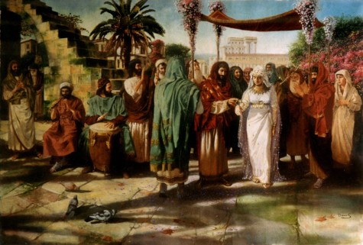
Jewish Marriage Customs
A betrothal period was more binding than our “engagement” periods today.
During the betrothal period, the husband would pay the dowry and make preparations for the wedding feast.
When the time came for the marriage to be consummated, the groom, arrayed in his best clothes, and joined by his friends, would make a procession to the home of his bride and take her to his home.
The festivities would last seven days or longer.

Slide 8
Christ and the Church
The church is the bride of Christ (Eph. 5:22-33).
We are in the betrothal period (2 Cor. 11:2).
Christ has paid the dowry – His blood.
The marriage will be consummated at the judgment.

Slide 9
Revelation chapter nineteen
Then he said to me, “Write: ‘Blessed are those who are called to the marriage supper of the Lamb!’” And he said to me, “These are the true sayings of God.”
And I fell at his feet to worship him. But he said to me, “See that you do not do that! I am your fellow servant, and of your brethren who have the testimony of Jesus. Worship God! For the testimony of Jesus is the spirit of prophecy.”

Slide 10
Revelation chapter nineteen
Now I saw heaven opened, and behold, a white horse. And He who sat on him was called Faithful and True, and in righteousness He judges and makes war.
His eyes were like a flame of fire, and on His head were many crowns. He had a name written that no one knew except Himself.

Slide 11
Revelation chapter nineteen
He was clothed with a robe dipped in blood, and His name is called The Word of God.
And the armies in heaven, clothed in fine linen, white and clean, followed Him on white horses.

Slide 12
Revelation chapter nineteen
Now out of His mouth goes a sharp sword, that with it He should strike the nations. And He Himself will rule them with a rod of iron. He Himself treads the winepress of the fierceness and wrath of Almighty God.
And He has on His robe and on His thigh a name written: KING OF KINGS AND LORD OF LORDS.

Slide 13
Revelation chapter nineteen
Then I saw an angel standing in the sun; and he cried with a loud voice, saying to all the birds that fly in the midst of heaven, “Come and gather together for the supper of the great God,
that you may eat the flesh of kings, the flesh of captains, the flesh of mighty men, the flesh of horses and of those who sit on them, and the flesh of all people, free and slave, both small and great.”

Slide 14
Revelation chapter nineteen
And I saw the beast, the kings of the earth, and their armies, gathered together to make war against Him who sat on the horse and against His army.

Slide 15
Revelation chapter nineteen
Then the beast was captured, and with him the false prophet who worked signs in his presence, by which he deceived those who received the mark of the beast and those who worshiped his image. These two were cast alive into the lake of fire burning with brimstone.
And the rest were killed with the sword which proceeded from the mouth of Him who sat on the horse. And all the birds were filled with their flesh.

Slide 16
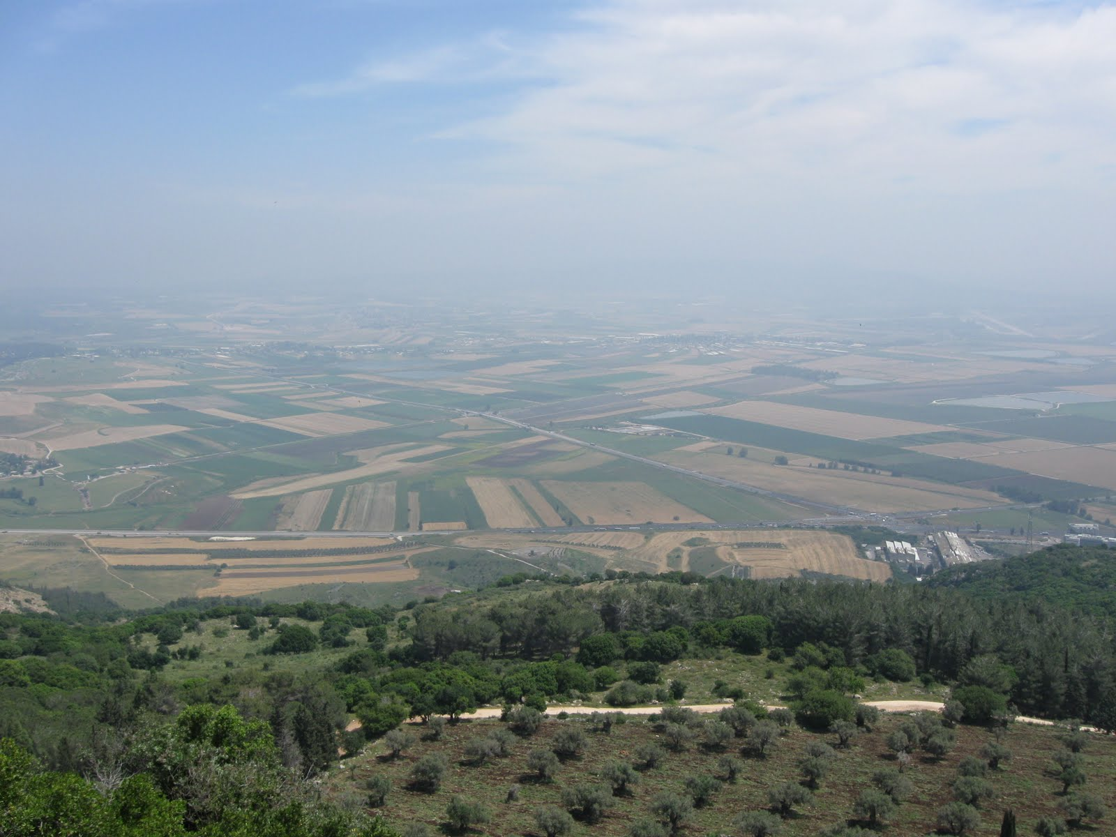
Three enemies have been destroyed: Babylon, the beast, and the false prophet.
There is one remaining – the dragon.

