Slide 1

“The Revelation of Jesus Christ, which God gave Him to show His servants - things which must shortly take place. And He sent and signified it by His angel to His servant John.”
Revelation 1:1

Slide 2
Things to remember as we study:
Revelation is a book of signs and symbols. It is the Bible’s “picture book” in that the message is found in the visions.
Revelation was written to help Christians in the First Century who were suffering for their faith.

Slide 3
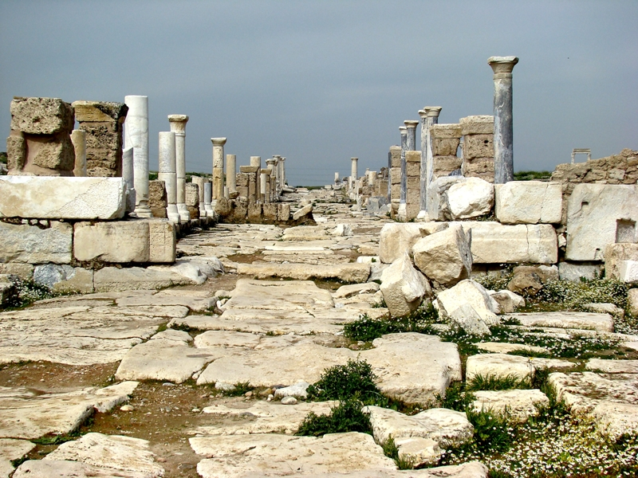
Laodicea Revelation 3:14-22

Slide 4
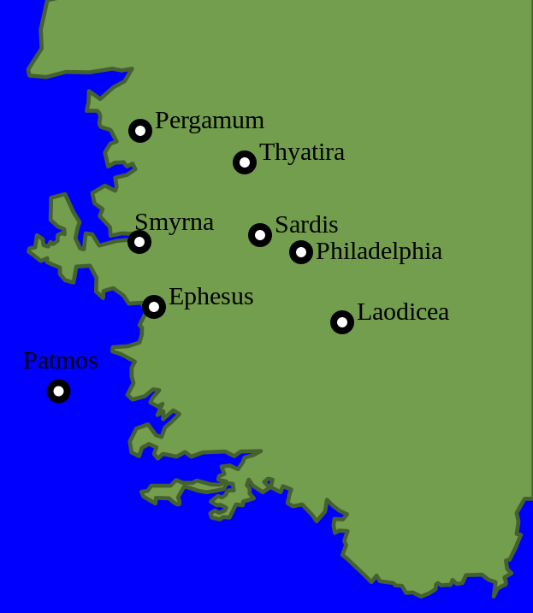
The City of Laodicea
Located 65 miles Southeast of Philadelphia

Slide 5
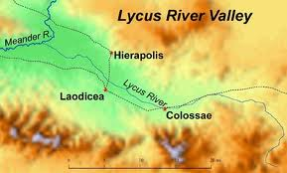
The City of Laodicea
Along with Colossae and Hierapolis, formed a tri-city triangle in the Lycus River valley.
The three cities were all within 10 to 12 miles of one another (Col. 4:12-13, 16).

Slide 6
The City of Laodicea
Very wealthy city
Located on trade route from Ephesus to the east
Three major businesses:
  banking
  black wool
  eye salve

Slide 7
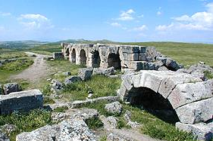
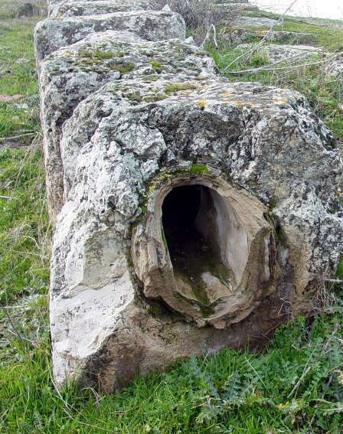
Bad Drinking Water
Despite its wealth, Laodicea was notorious for its terrible drinking water.
Because of heavy mineral deposits found in the aqueducts leading into the city, it is believed the water came from hot springs in the area.
By the time the water reached Laodicea, it would have been lukewarm.

Slide 8
Letters to the Seven Churches Follow a Pattern
Identification
Commendation
Complaint
Counsel
Promise

Slide 9
Identification
“These things says the Amen, the Faithful and True Witness, the Beginning of the creation of God” (v. 14).
Similar to statement in 1:5.
The judgments Jesus makes against this church are harsh - but true!
Jesus could bring them back to life.

Slide 10
Complaint
“I know your works, that you are neither cold nor hot. I could wish you were cold or hot. So then, because you are lukewarm, and neither cold nor hot, I will vomit you out of My mouth” (vs. 15-16).
They were indifferent.
Jesus is disgusted with them.

Slide 11
Complaint
“Because you say, ‘I am rich, have become wealthy, and have need of nothing’ - and do not know that you are wretched, miserable, poor, blind, and naked” (v. 15).
There is no hint of persecution or doctrinal error; this church was “suffering” because of their own prosperity.
Their material prosperity had blinded them to their true spiritual condition.

Slide 12
Counsel
“I counsel you to buy from Me gold refined in the fire, that you may be rich; and white garments, that you may be clothed, that the shame of your nakedness may not be revealed; and anoint your eyes with eye salve, that you may see” (v. 18).
Only the Lord can provide the spiritual remedies for this, or any other, church.

Slide 13
Counsel
“As many as I love, I rebuke and chasten. Therefore be zealous and repent” (v. 19).
The Lord’s chastening is evidence of His love for us (Heb. 12:5-6).
They needed to get “fired up” and turn themselves round.

Slide 14
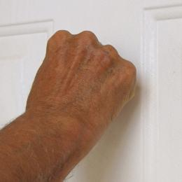
Promise
“Behold, I stand at the door and knock. If anyone hears My voice and opens the door, I will come in to him and dine with him, and he with Me” (v. 20).
They had shut the Lord out, but He still extended the offer of fellowship.
The door of our heart opens from the inside.

Slide 15
Promise
“To him who overcomes I will grant to sit with Me on My throne, as I also overcame and sat down with My Father on His throne” (v. 21).
Those who overcome with Christ will reign with Him (1:6).

Slide 16
Laodicea Revelation 3:14-22
The Lord is “disgusted” by indifference.
The danger of self-sufficiency and material prosperity.
We can be blind to our true spiritual condition.
The Lord rebukes those He loves.
The door of our heart opens from the inside.

