Slide 1

“The Revelation of Jesus Christ, which God gave Him to show His servants - things which must shortly take place. And He sent and signified it by His angel to His servant John.”
Revelation 1:1

Slide 2
Things to remember as we study:
Revelation is a book of signs and symbols. It is the Bible’s “picture book” in that the message is found in the visions.
Revelation was written to help Christians in the First Century who were suffering for their faith.

Slide 3
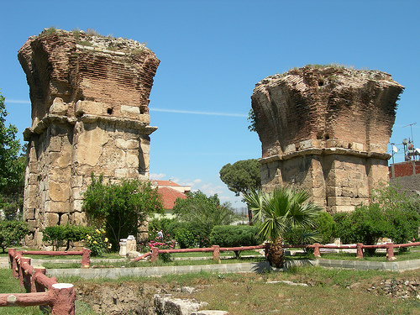
Philadelphia Revelation 3:7-13

Slide 4
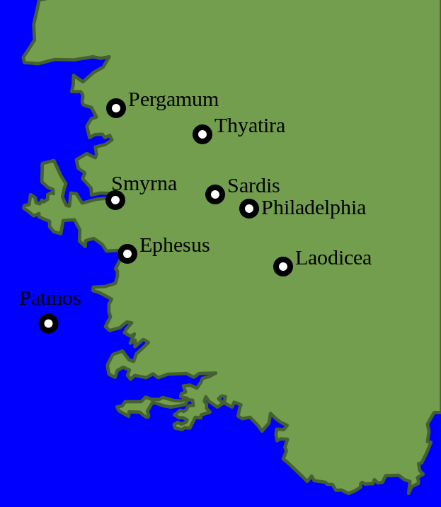
The City of Philadelphia
28 miles SE of Sardis
the youngest of the seven cities
strategically located on a major road leading to the east out of Europe
city had the title: “Gateway to the East”

Slide 5
The City of Philadelphia
built as a “missionary city” to carry Greek language and culture to the east
called “Little Athens” because of its numerous temples
known for its grapes and wine production

Slide 6
Philadelphia’s Fear
Earthquakes were common to the area.
Severe earthquake destroyed the city in AD 17, was rebuilt.
Citizens lived in constant fear, were routinely seen dwelling outside the city in tents.
Like Smyrna, the church suffered at the hands of Jews.
No information regarding establishment of church in Philadelphia.

Slide 7
Letters to the Seven Churches Follow a Pattern
Identification
Commendation
Complaint
Counsel
Promise

Slide 8
Identification
“These things says He who is holy, He who is true, ‘He who has the key of David, He who opens and no one shuts, and shuts and no one opens’” (v. 7).
Identifies Jesus as deity.
“Key of David” is messianic (Is. 22:22). Jesus rules over God’s house and alone has power to grant or refuse entrance.

Slide 9
Commendation
“I know your works. See, I have set before you an open door, and no one can shut it” (v. 8).
This was a missionary city. The “open door” was an evangelistic opportunity (Acts 14:27; 1 Cor. 16:8-9; 2 Cor. 2:12; Col. 4:3).
Could also mean an “open door” to fellowship with God which no man can close.

Slide 10
Commendation
“for you have a little strength, have kept My word, and have not denied My name… Because you have kept My command to persevere…” (v. 8, 10).
Despite their “little” strength, they were remaining faithful to the Lord; they were persevering in the face of trials.

Slide 11
Counsel
“Behold, I am coming quickly! Hold fast what you have, that no one may take your crown” (v. 11).
They had done good in the past, but were to hold fast and remain faithful so that no one would take their crown (2:10).

Slide 12
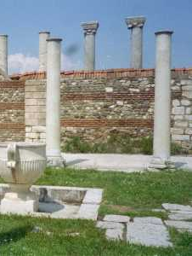
Promise
“Indeed I will make those of the synagogue of Satan, who say they are Jews and are not, but lie - indeed I will make them come and worship before your feet, and to know that I have loved you.” (v. 9).
Conversion of the Jews, or
Humiliation of the Jews

Slide 13
Promise
“Because you have kept My command to persevere, I also will keep you from the hour of trial which shall come upon the whole world, to test those who dwell on the earth” (v. 10).
Several ideas concerning the identity of the trial that is to come upon the whole earth.
Because they had persevered, Jesus will keep or protect them.

Slide 14
Promise
“He who overcomes, I will make him a pillar in the temple of My God, and he shall go out no more” (v. 12).
Because of earthquakes, the citizens of Philadelphia often had to flee for safety.
This is a figure of permanence. Faithful Christians will never be driven from their place of residence in God’s house.

Slide 15
Promise
“I will write on him the name of My God and the name of the city of My God, the New Jerusalem, which comes down out of heaven from My God. And I will write on him My new name” (v. 12).
A faithful Christian is a child of God, a citizen in the city of God, and enjoys fellowship with Christ.

Slide 16
Philadelphia Revelation 3:7-13
A church’s effectiveness does not depend upon physical numbers, status or strength.
Jesus has all authority.
Our enemies will not triumph over us.
The Lord gives us opportunities, but expects us to take them.
Eternal security is acquired through faithfulness and perseverance.

