Slide 1

“The Revelation of Jesus Christ, which God gave Him to show His servants - things which must shortly take place. And He sent and signified it by His angel to His servant John.”
Revelation 1:1

Slide 2
Things to remember as we study:
Revelation is a book of signs and symbols. It is the Bible’s “picture book” in that the message is found in the visions.
Revelation was written to help Christians in the First Century who were suffering for their faith.

Slide 3
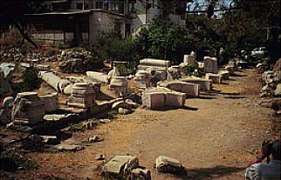
Thyatira Revelation 2:18-29

Slide 4
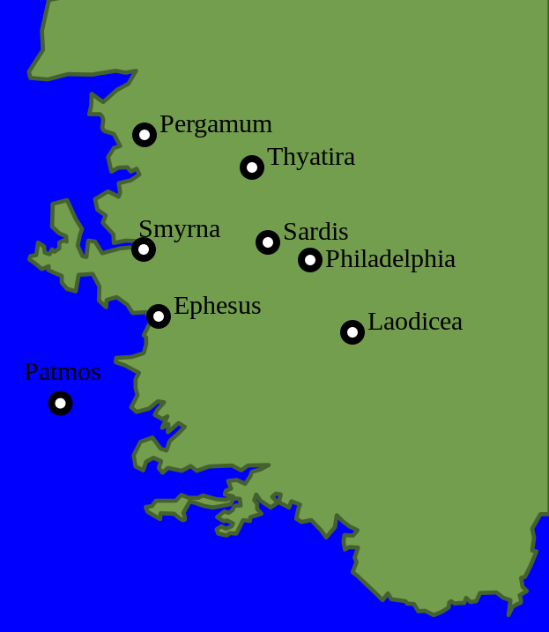
The City of Thyatira
40 miles SE of Pergamos
the “least known, least important, and least remarkable” of the seven cities
the city became famous for its rare and expensive purple dye
nothing known about the establishment of the church

Slide 5
Trade Guilds in Thyatira
Thyatira became a thriving manufacturing and commercial center under Roman rule.
Every trade had a guild or union. These trade guilds were associated with idols.
In order for one to “get ahead” in Thyatira, he had to belong to a trade guild.
Membership implied that he worshipped the trade’s god, and he was expected to attend the pagan feasts, in the idol’s temple, in honor of the god.

Slide 6
Trade Guilds in Thyatira
“At Thyatira, a Christian’s livelihood was affected by the issues involved in guild membership. Feasts sponsored by the guilds were held, at which meat consecrated to an idol was served, and where immoral fertility rites were common. Christians at Thyatira may have been pressured to conform to their environment… The power wielded by these trade guilds was to be feared because it was through them the citizens of Thyatira earned their daily sustenance” (Harkrider 40).

Slide 7
Letters to the Seven Churches Follow a Pattern
Identification
Commendation
Complaint
Counsel
Promise

Slide 8
Identification
“…the Son of God, who has eyes like a flame of fire, and His feet like fine brass” (v. 18).
The eyes of fire can penetrate the seductive arguments of the false teachers, and the feet of brass are ready and able to crush and destroy this sin and error.

Slide 9
Commendation
“I know your works, love, service, faith, and your patience; and as for your works, the last are more than the first” (v. 19).
They were displaying many good traits.
Their ability to work for the Lord was improving.

Slide 10
Complaint
“…you allow that woman Jezebel, who calls herself a prophetess, to teach and seduce My servants to commit sexual immorality and eat things sacrificed to idols” (v. 20).
A woman was teaching a doctrine of compromise with regard to participation in the sinful practices of the trade guilds.
The church “allowed” her to exert this influence unchallenged.

Slide 11
Counsel
“And I gave her time to repent of her sexual immorality, and she did not repent. Indeed I will cast her into a sickbed, and those who commit adultery with her into great tribulation, unless they repent of their deeds” (vs. 21-22).
God’s patience had come to an end.
Others still had an opportunity to repent, but if they didn’t they would suffer with her.

Slide 12
Counsel
“I will kill her children with death, and all the churches shall know that I am He who searches the minds and hearts. And I will give to each one of you according to your works” (vs. 23).
God used sickness and death as a means of removing sinful influences from local churches (Acts 5:1-11; 1 Cor. 11:30).
All the churches were to learn from what would happen in Thyatira.

Slide 13
Counsel
“Now to you I say, and to the rest in Thyatira, as many as do not have this doctrine, who have not known the depths of Satan, as they say, I will put on you no other burden. But hold fast what you have till I come” (vs. 24-25).
The “depths of Satan” is likely a reference to Gnosticism.
The faithful are to hold fast.

Slide 14
Promise
“And he who overcomes, and keeps My works until the end, to him I will give power over the nations. ‘He shall rule them with a rod of iron; they shall be dashed to pieces like the potter's vessels,’ as I also have received from My Father” (vs. 26-27).
They will rule over the nations with Christ in His kingdom which will endure forever.

Slide 15
Promise
“I will give him the morning star” (vs. 28).
Old Testament reference to the Messiah.
Jesus is the “Bright and Morning Star” (22:16).
As the morning star promises a new day, faithful saints are promised victory in Christ.

Slide 16
Thyatira Revelation 2:18-29
A church should not rest on past accomplishments, but continue to increase in their service to the Lord.
Christians are not to compromise their faith for social standing or economic prosperity.
Those who teach error and influence others to sin are not to be allowed, suffered, or tolerated. They are to be marked and withdrawn from.
Things that happen in local churches serve as examples to other churches.

