Slide 1

“The Revelation of Jesus Christ, which God gave Him to show His servants - things which must shortly take place. And He sent and signified it by His angel to His servant John.”
Revelation 1:1

Slide 2
Things to remember as we study:
Revelation is a book of signs and symbols. It is the Bible’s “picture book” in that the message is found in the visions.
Revelation was written to help Christians in the First Century who were suffering for their faith.

Slide 3
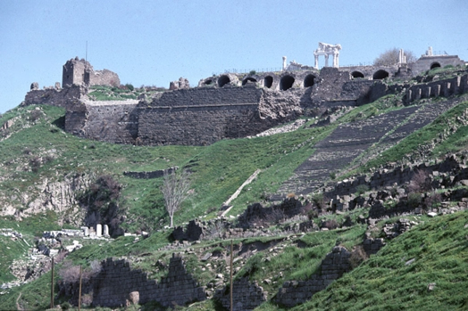
Pergamos Revelation 2:12-17

Slide 4
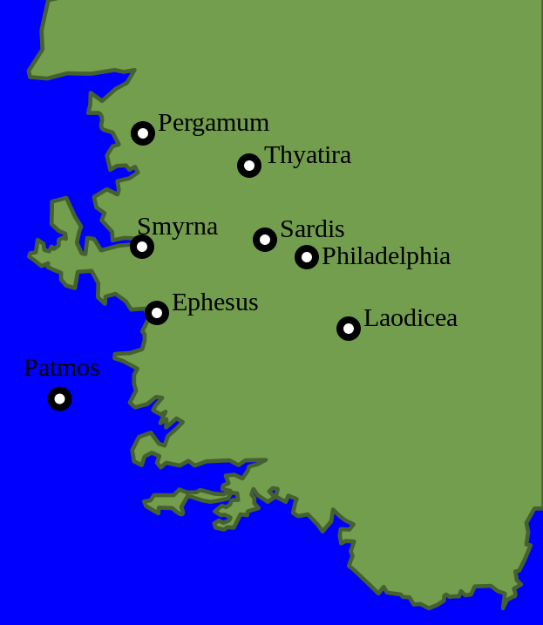
The City of Pergamos
50 miles N/NE. of Smyrna
the official capital of Asia Minor
“the most illustrious city in Asia”
housed a library and hospital
nothing known about the establishment of the church

Slide 5
Challenge To Christians in Pergamos
Religion was very important in Pergamos.
Known of as a city of temples devoted to sensuous worship.
Being the political capital, it was also the center of Emperor Worship.
The test of political loyalty (calling Caesar “Lord”) was felt more in Pergamos than in any other city in Asia.

Slide 6
Letters to the Seven Churches Follow a Pattern
Identification
Commendation
Complaint
Counsel
Promise

Slide 7
Identification
“…He who has the sharp two-edged sword” (v. 12).
Would have brought great hope and reassurance to Christians who were suffering for their faith.
“The troops have arrived!”

Slide 8
Commendation
“I know your works, and where you dwell, where Satan's throne is…” (v. 13).
Opposition to the church was so strong in Pergamos that the Lord referred to the city as the place where Satan (the enemy of God and His people) is enthroned and rules.

Slide 9
“At Smyrna, the persecution proceeded chiefly from fellow citizens, especially, the Jews. But the persecution at Pergamos was promulgated by State persecutors. Christians were tried in the local provincial court and were confronted with the choice of conforming to the State religion or receiving an immediate death sentence. Prisoners were brought from almost all parts of Asia to Pergamos for trial. Many martyrs were tried and condemned there who were not residents of the city.”
Robert Harkrider, pp. 36-37

Slide 10
Commendation
“…and you hold fast to My name, and did not deny My faith even in the days in which Antipas was My faithful martyr, who was killed among you, where Satan dwells” (v. 13).
They were living where the persecution was at its worse, but were remaining faithful to the Lord, and were doing His work.

Slide 11
Complaint
“…you have there those who hold the doctrine of Balaam, who taught Balak to put a stumbling block before the children of Israel, to eat things sacrificed to idols, and to commit sexual immorality” (v. 14).
There were some who held to a doctrine of compromise; they could participate in the worship of idols and still claim to be Christians.

Slide 12
Complaint
“Thus you also have those who hold the doctrine of the Nicolaitans, which thing I hate” (v. 15).
Doctrine is unknown, but it resulted in “deeds” that both the Lord and the church in Ephesus hated (v. 6), but the church in Pergamos allowed this error to be in their midst.

Slide 13
Counsel
“Repent, or else I will come to you quickly and will fight against them with the sword of My mouth” (v. 16).
The sword used against the enemy would be turned and used against them if they did not stop compromising with sin and error.

Slide 14
Promise
“To him who overcomes I will give some of the hidden manna to eat. And I will give him a white stone, and on the stone a new name written which no one knows except him who receives it” (v. 17).
They will be recognized as the Lord’s people and will receive His provision and fellowship.

Slide 15
Pergamos Revelation 2:12-17
It is possible to be faithful to the Lord, even in the worst environment and circumstances.
Compromise and sin can be found in churches withstanding external threats.
The church cannot compromise with sin and error.
Were the Lord to come to Knollwood, would He bring a sword of protection for us or a sword of judgment against us?

