Slide 1

“The Revelation of Jesus Christ, which God gave Him to show His servants - things which must shortly take place. And He sent and signified it by His angel to His servant John.”
Revelation 1:1

Slide 2
Things to remember as we study:
Revelation is a book of signs and symbols. It is the Bible’s “picture book” in that the message is found in the visions.
Revelation was written to help Christians in the First Century who were suffering for their faith.

Slide 3
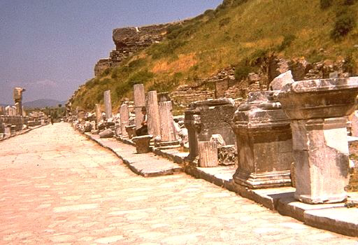
Ephesus Revelation 2:1-7

Slide 4
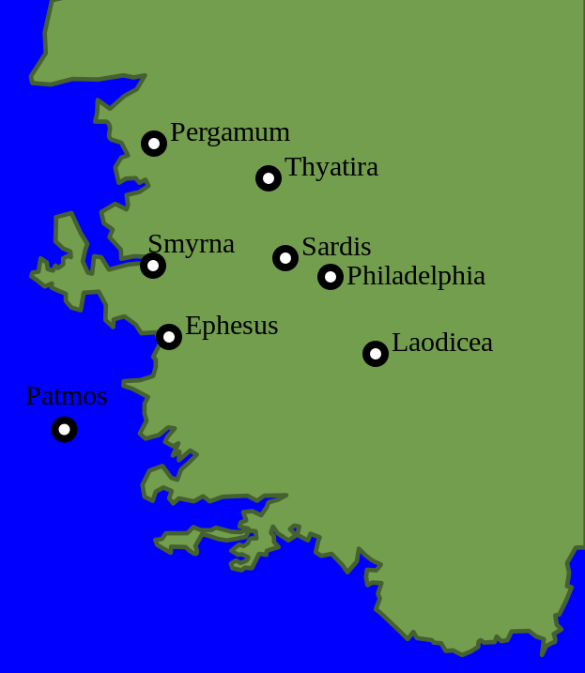
The City of Ephesus
Pop. 250,000
Asia Minor’s most important seaport
Three trade routes converged on the city
“Supreme Metropolis of Asia”
A free city

Slide 5
A Privileged Church
Paul spent over three years in Ephesus.
From Ephesus, the gospel was spread throughout all Asia Minor.
Paul warned the Ephesian elders.
Timothy was left there to serve as an evangelist.
John lived there in the latter years of his life.

Slide 6
Letters to the Seven Churches Follow a Pattern
Identification
Commendation
Complaint
Counsel
Promise

Slide 7
Identification
“He who holds the seven stars in His right hand, who walks in the midst of the seven golden lampstands” (v. 1).
Stresses the Lord’s firsthand knowledge, awareness, and concern for the church.

Slide 8
Commendation
They Worked and Labored (v. 2)
They Could Not Bear Evil Men (v. 2)
They Hated the Deeds of the Nicolatians (v. 6)
They Persevered in the Work and Had Not Grown Weary (v. 3)

Slide 9
Complaint
“Nevertheless I have this against you, that you have left your first love” (v. 4).
The Honeymoon was over.
They lacked the zeal and faith of the previous generation of the church.

Slide 10
Counsel
Remember
Repent
Do the First Works
Warning
  “I will come quickly and remove your lampstand” (v. 5)

Slide 11
Promise
“To him who overcomes I will give to eat from the tree of life, which is in the midst of the Paradise of God” (v. 7).
The promise of eternal life in the presence of God.

Slide 12
Ephesus Revelation 2:1-7
They were faithful - but lacking.
Their outward works were not complimented by an inward love for Christ.
It is good that a church is known for their faithfulness, but they also need to be known for their love.
Have we left our first love?

