Slide 1

“The Revelation of Jesus Christ, which God gave Him to show His servants - things which must shortly take place. And He sent and signified it by His angel to His servant John.”
Revelation 1:1

Slide 2
Things to remember as we study:
Revelation is a book of signs and symbols. It is the Bible’s “picture book” in that the message is found in the visions.
Revelation was written to help Christians in the First Century who were suffering for their faith.

Slide 3
Revelation chapter one
I, John, both your brother and companion in the tribulation and kingdom and patience of Jesus Christ, was on the island that is called Patmos for the word of God and for the testimony of Jesus Christ.
I was in the Spirit on the Lord’s Day, and I heard behind me a loud voice, as of a trumpet,
saying, “I am the Alpha and the Omega, the First and the Last…”

Slide 4
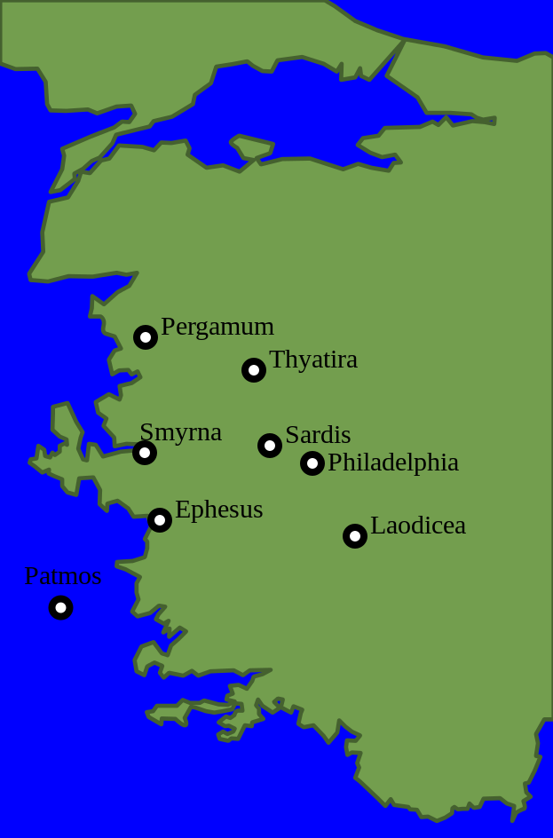
Revelation chapter one
…and, “What you see, write in a book and send it to the seven churches which are in Asia: to Ephesus, to Smyrna, to Pergamos, to Thyatira, to Sardis, to Philadelphia, and to Laodicea.”

Slide 5
The Glorified Christ vs. 10-16
Loud voice as of a trumpet
  authority, strength, demanding attention
Seven golden lampstands
  the churches (v. 20)
In the midst one like the Son of Man
  Jesus knows what is happening in and to these churches

Slide 6
The Glorified Christ vs. 10-16
Garment down to the feet
  priestly garment
Girded with a golden band
  one of a high and royal rank
Head and hair white like wool and snow
  holiness of Christ
Eyes like a flame of fire
  bright, sharp, penetrating, the all-seeing power of Christ

Slide 7
The Glorified Christ vs. 10-16
Feet like brass, bronze refined in furnace
  strength to tread down enemies
Voice as sound of many waters
  overpowering, demanding attention and respect
Seven stars in His right hand
  under His protection and control (v. 20)

Slide 8
The Glorified Christ vs. 10-16
Out of His mouth went sharp, two edged sword
  the word of God; symbol of judgment against His enemies (2:16; 19:15, 21)
Countenance was like the sun shining in its strength
  The unveiled glory of Christ (Matt. 17:2)

Slide 9
Revelation chapter one
And when I saw Him, I fell at His feet as dead. But He laid His right hand on me, saying to me, “Do not be afraid; I am the First and the Last.
I am He who lives, and was dead, and behold, I am alive forevermore. Amen. And I have the keys of Hades and of Death.

Slide 10
Revelation chapter one
Write the things which you have seen, and the things which are, and the things which will take place after this.
The mystery of the seven stars which you saw in My right hand, and the seven golden lampstands: The seven stars are the angels of the seven churches, and the seven lampstands which you saw are the seven churches.

