Slide 2
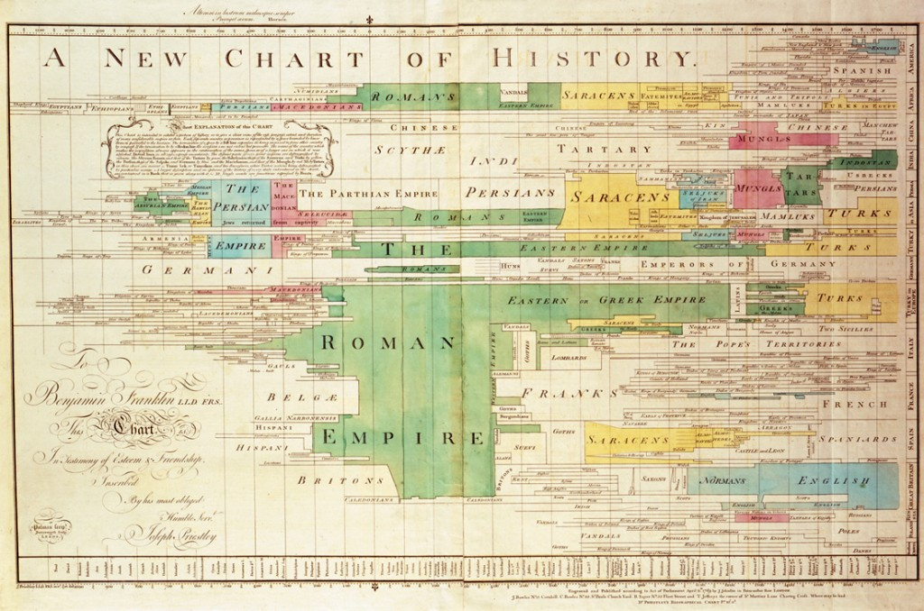
“The Fullness of the Time”
Galatians 4:4

Slide 3
and to make all see what is the fellowship of the mystery, which from the beginning of the ages has been hidden in God who created all things through Jesus Christ;
to the intent that now the manifold wisdom of God might be made known by the church to the principalities and powers in the heavenly places,
according to the eternal purpose which He accomplished in Christ Jesus our Lord,
Ephesians 3:9-11

Slide 4
I have made the earth, the man and the beast that are on the ground, by My great power and by My outstretched arm, and have given it to whom it seemed proper to Me.
And now I have given all these lands into the hand of Nebuchadnezzar the king of Babylon, My servant; and the beasts of the field I have also given him to serve him.
So all nations shall serve him and his son and his son’s son, until the time of his land comes; and then many nations and great kings shall make him serve them.
Jeremiah 27:5-7

Slide 5
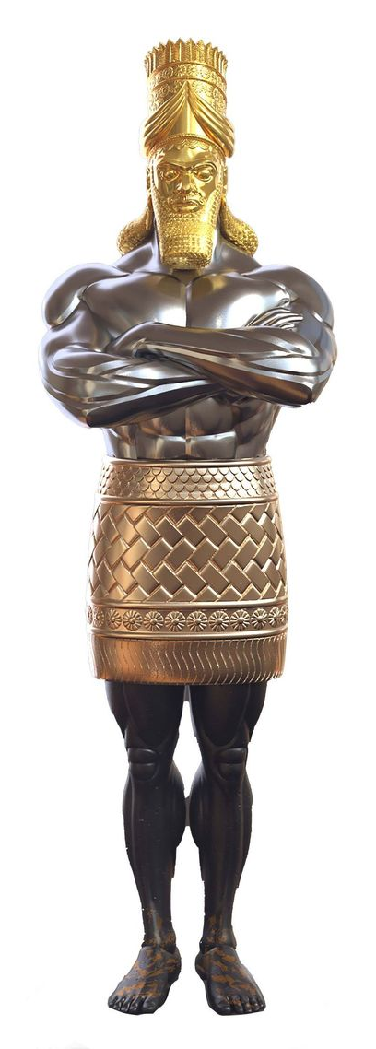
And in the days of these kings the God of heaven will set up a kingdom which shall never be destroyed; and the kingdom shall not be left to other people; it shall break in pieces and consume all these kingdoms, and it shall stand forever.
Daniel 2:44
And it came to pass in those days that a decree went out from Caesar Augustus that all the world should be registered.
Luke 2:1

Slide 6
Now after John was put in prison, Jesus came to Galilee, preaching the gospel of the kingdom of God,
and saying, “The time is fulfilled, and the kingdom of God is at hand. Repent, and believe in the gospel.”
Mark 1:14-15

Slide 7
God’s Promises to Abraham
Now the Lord had said to Abram: “Get out of your country, from your family and from your father’s house, to a land that I will show you.
I will make you a great nation; I will bless you and make your name great; and you shall be a blessing.
I will bless those who bless you, and I will curse him who curses you; and in you all the families of the earth shall be blessed.”
Genesis 12:1-3

Slide 8
The Synagogue
10 Jewish men could maintain a synagogue.
Preserved the Jewish way of life in foreign lands.
Attracted devout Gentiles to the true God and His word.
A place where God’s word was read and studied.
“For Moses has had throughout many generations those who preach him in every city, being read in the synagogues every Sabbath” (Acts 15:21).

Slide 9
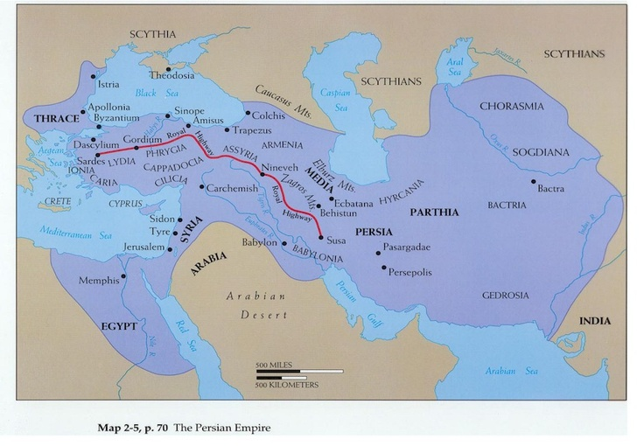
Medo-Persian Empire
Ezra 1:1-4; Esther 3:8; 8:5; 9:2

Slide 10
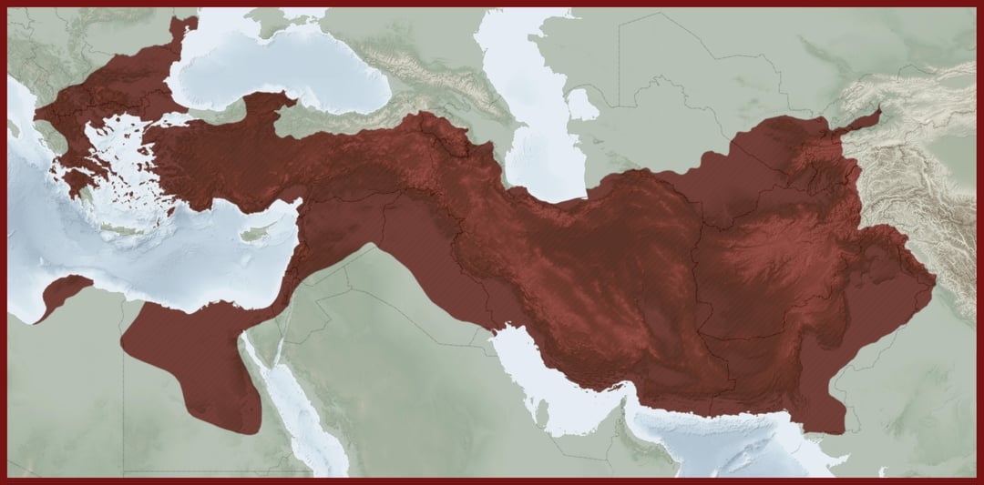
Macedonian Empire (Greece)

Slide 11
Roman Empire
Spread the Greek Language.
Pax Romana
Constructed Roads
Trade and Commerce
Roman Laws

Slide 12
A Time of Expectation
“And behold, there was a man in Jerusalem whose name was Simeon, and this man was just and devout, waiting for the Consolation of Israel, and the Holy Spirit was upon him”
(Luke 2:25).
“And coming in that instant she gave thanks to the Lord, and spoke of Him to all those who looked for redemption in Jerusalem” (v. 38).

Slide 13
“The Fullness of the Time”
Paganism and Judaism were not able to deliver mankind.
There was peace throughout the Roman Empire.
There was a universal language.
There was ease of travel throughout the Roman Empire.
The dispersion of the Jews made a ready audience in every foreign land.

