Slide 1

Water into Wine
John 2:1-11

Slide 2

On the third day there was a wedding in Cana of Galilee, and the mother of Jesus was there.
Now both Jesus and His disciples were invited to the wedding.
And when they ran out of wine, the mother of Jesus said to Him, “They have no wine.”

Slide 3
Jesus said to her, “Woman, what does your concern have to do with Me? My hour has not yet come.”
His mother said to the servants,
“Whatever He says to you, do it.”

Slide 4
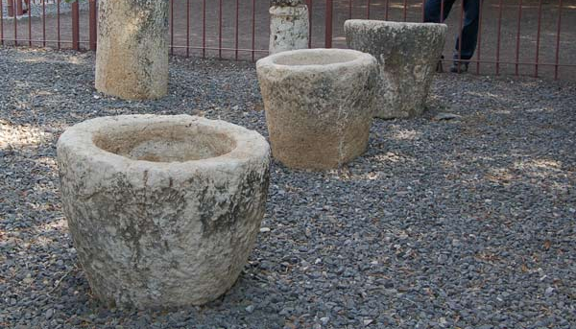
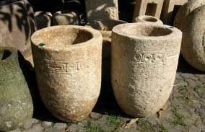
Now there were set there six waterpots of stone, according to the manner of purification of the Jews, containing twenty or thirty gallons apiece.
Jesus said to them, “Fill the waterpots with water.” And they filled them up to the brim.

Slide 5
And He said to them, “Draw some out now, and take it to the master of the feast.” And they took it.

Slide 6
When the master of the feast had tasted the water that was made wine, and did not know where it came from (but the servants who had drawn the water knew), the master of the feast called the bridegroom.
And he said to him, “Every man at the beginning sets out the good wine, and when the guests have well drunk, then the inferior. You have kept the good wine until now!”

Slide 7

Examining the Evidence
The master of the feast is an independent witness; his testimony is that wine was brought to him – the best wine of the entire feast.
There was no grape residue in the pots. They were ceremonial hand-washing water pots.
Nothing else was poured into the pots – they were filled to the brim with water.
The wedding guests weren’t in on a hoax – only the disciples and servants knew what was happening.

Slide 8
This beginning of signs Jesus did in Cana of Galilee, and manifested His glory; and His disciples believed in Him.

Slide 9
Additional Lessons
Jesus attended social gatherings and festive events - Matt. 5:13-16
Jesus sanctioned and honored marriage -
1 Tim. 4:3
Mary had no special influence or command over the Lord - 1 Tim. 2:5; John 14:13-14; 16:23-26

