Slide 1
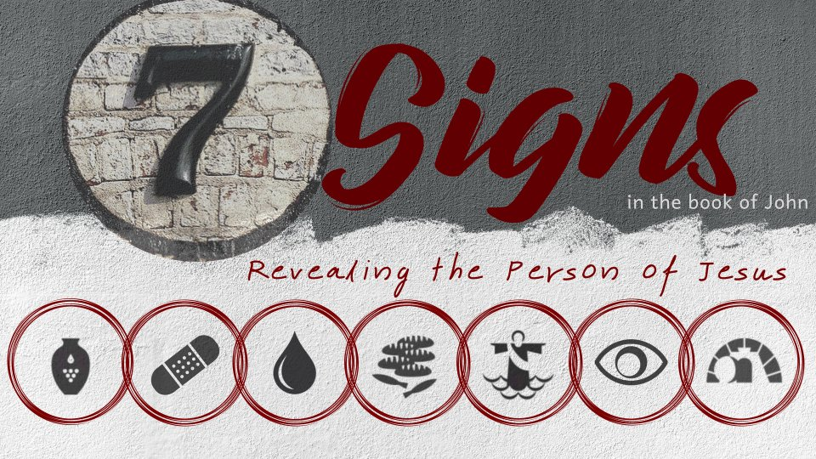
Introduction

Slide 2

And truly Jesus did many other signs in the presence of His disciples, which are not written in this book;
but these are written that you may believe that Jesus is the Christ, the Son of God, and that believing you may have life in His name.
John 20:30-31

Slide 3
And truly Jesus did many other signs in the presence of His disciples, which are not written in this book;
but these are written that you may believe that Jesus is the Christ, the Son of God, and that believing you may have life in His name.
John 20:30-31
Done in the presence of His disciples; verified by multiple eyewitnesses.
Presented to produce faith in the reader.
Point to Jesus as the Christ and the Son of God.
Will lead one to have life in His name.

Slide 4
Miracles, Wonders, Signs (Acts 2:22)
Men of Israel, hear these words: Jesus of Nazareth,
a Man attested by God to you by miracles, wonders, and signs which God did through Him in your midst, as you yourselves also know
Acts 2:22

Slide 5
Miracles, Wonders, Signs (Acts 2:22)
Miracles (dunamis) – an unusual display of power or might
Wonders (teras) – the excited response of those who witness the event
Signs (semeion) – an indication; pointing to a spiritual truth to be grasped and understood

Slide 6
How Jesus Used His Signs
John 5:36 – He was sent by the Father
John 9:3 – the works of God
John 10:24-25 – Jesus is the Christ
John 10:31-38 – Jesus is the Son of God

Slide 7
How Jesus’ Signs Were Received
“many believed in His name when they saw the signs which He did” (2:23).
“Rabbi, we know that You are a teacher come from God; for no one can do these signs that You do unless God is with him” (3:2).
“Then a great multitude followed Him, because they saw His signs which He performed on those who were diseased” (6:2).
“Then those men, when they had seen the sign that Jesus did, said, ‘This is truly the Prophet who is to come into the world’” (6:14).

Slide 8
How Jesus’ Signs Were Received
“And many of the people believed in Him, and said, ‘When the Christ comes, will He do more signs than these which this Man has done?’ (7:31).
“Therefore some of the Pharisees said, ‘This Man is not from God, because He does not keep the Sabbath.’ Others said, ‘How can a man who is a sinner do such signs?’ And there was a division among them” (9:16).
“Then the chief priests and the Pharisees gathered a council and said, ‘What shall we do? For this Man works many signs’” (11:47).

Slide 9
How Jesus’ Signs Were Received
However – not everyone believed!
“But although He had done so many signs before them, they did not believe in Him” (12:37).

Slide 10
Jesus said to him, “Thomas, because you have seen Me, you have believed. Blessed are those who have not seen and yet have believed.”
And truly Jesus did many other signs in the presence of His disciples, which are not written in this book;
but these are written that you may believe that Jesus is the Christ, the Son of God, and that believing you may have life in His name.
John 20:29-31

Slide 11
The Seven Signs of Jesus
Water into wine (2:1-11)
Heals nobleman’s son (4:46-54)
Heals lame man (5:1-9)
Feeds 5,000 (6:1-14)
Walks on water (6:15-21)
Heals man born blind (9:1-12)
Raises Lazarus (11:38-44)

Slide 12
The Seven Signs of Jesus
Power Over
Water into wine (2:1-11) Quality
Heals nobleman’s son (4:46-54) Distance
Heals lame man (5:1-9) Disease
Feeds 5,000 (6:1-14) Quantity
Walks on water (6:15-21) Nature
Heals man born blind (9:1-12) Misfortune
Raises Lazarus (11:38-44) Death

