Slide 2

The Requirements of Repentance
“Truly, these times of ignorance God overlooked, but now commands all men everywhere to repent.”
Acts 17:30

Slide 3
What is Repentance?
Feeling of sorrow or guilt?
  2 Corinthians 7:8-10
Godly sorrow leads to repentance.
Repentance is an action prompted by godly sorrow.

Slide 4
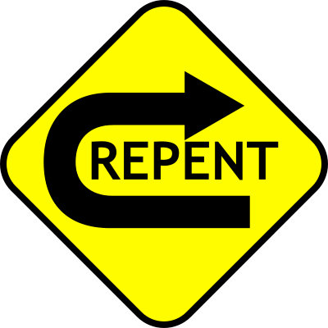
What is Repentance?
But declared first to those in Damascus and in Jerusalem, and throughout all the region of Judea, and then to the Gentiles, that they should repent, turn to God, and do works befitting repentance.
Acts 26:20

Slide 5
What is Repentance?
The men of Nineveh will rise up in the judgment with this generation and condemn it, because they repented at the preaching of Jonah; and indeed a greater than Jonah is here.
Matthew 12:41

Slide 6
What is Repentance?
Then God saw their works, that they turned from their evil way; and God relented from the disaster that He had said He would bring upon them, and He did not do it.
Jonah 3:10

Slide 7
What True Repentance Requires
A Desire to Repent
  Acts 2:36-38; Joel 2:12-13; Ezek. 18:28
An Acknowledgement of Our Sin
  2 Sam. 12:13; Acts 19:18-19
A Reform of Our Thinking and Conduct
  Prov. 4:23; 1 Thess. 1:9; Luke 3:10-14;
A Restitution of Wrong
  Luke 19:8; Lev. 5:14-19

