Slide 2
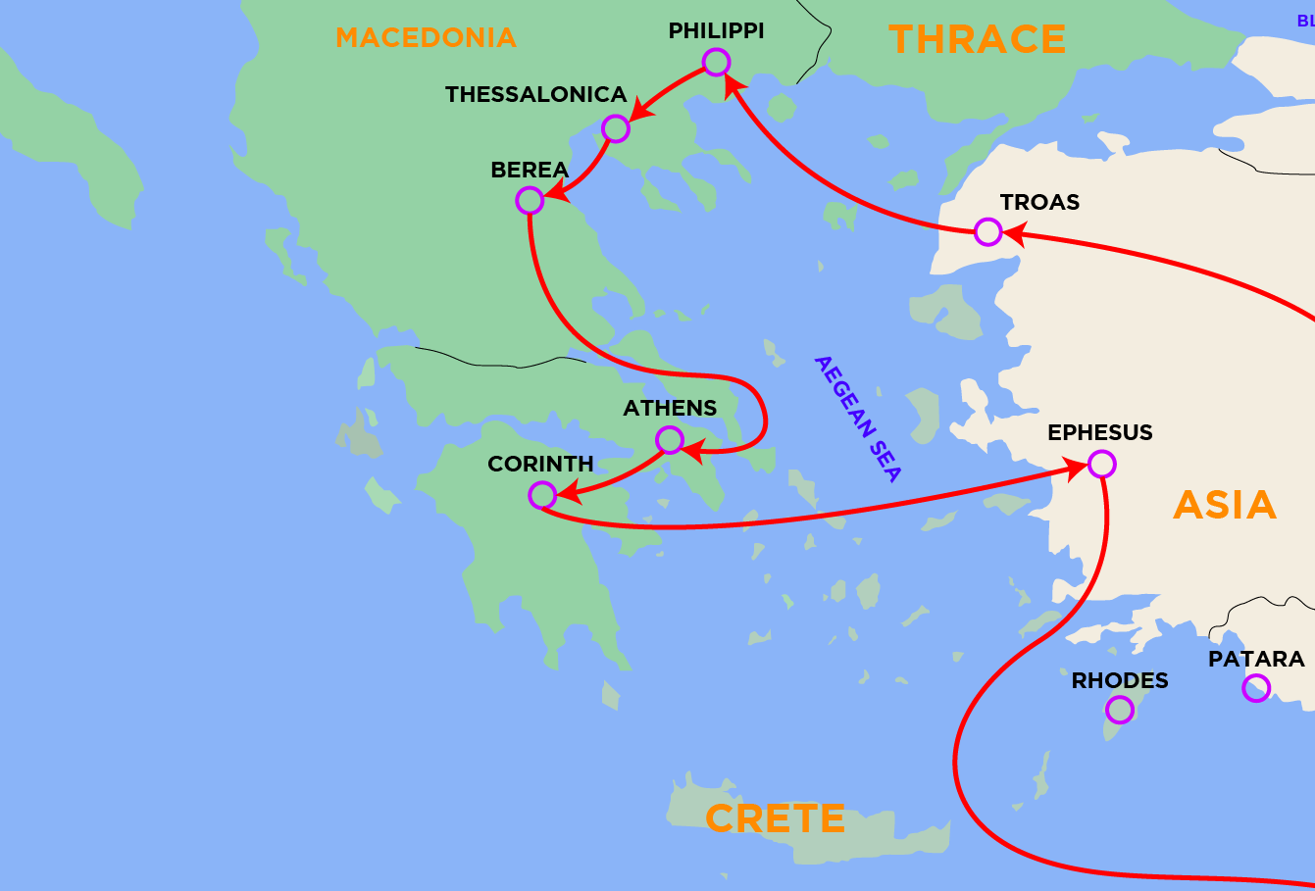
Those in Thessalonica
“These were more fair-minded than those in Thessalonica, in that they received the word with all readiness, and searched the Scriptures daily to find out whether these things were so” (Acts 17:11).

Slide 3
Those in Thessalonica
Receiving the gospel - 1 Thess. 1:6-10
Enduring persecution - 1 Thess. 1:6; 2:14-16
Showing great love - 1 Thess. 4:9-10
Comforting and edifying one another -
1 Thess. 5:11
Sounding forth the word - 1 Thess. 1:8
Earning Paul’s confidence - 2 Thess. 3:4

