Slide 2


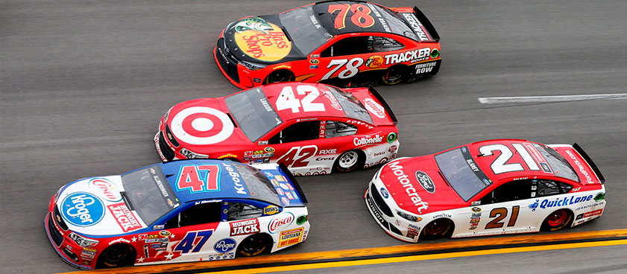
Endeavoring with
All Diligence

Slide 3
σπουδάζω - spoudazó
“to use speed, i.e. to make effort, to be prompt or earnest” (Strong)
“to hasten, make haste; to exert oneself, endeavor, give difference” (Thayer)
“to hasten to do a thing, to exert oneself, endeavor, give diligence” (Vine)
“be especially conscientious in discharging an obligation, be zealous/eager, take pains, make every effort” (Bauer)

Slide 4

σπουδάζω - spoudazó
endeavor
diligence
labor
strive
work hard
eager
make every effort
do your best

Slide 5
σπουδάζω - spoudazó
“be diligent to come to be quickly” (2 Tim. 4:9)
“do your utmost to come before winter” (2 Tim. 4:21)
“be diligent to come to me at Nicopolis” (Titus 3:12)

Slide 6
Five Spoudazo Admonitions
Keeping the Unity of the Spirit - Eph. 4:3
Studying to Show Ourselves Approved -
2 Tim. 2:15
Entering Our Rest - Heb. 4:11
Making Our Call and Election Sure - 2 Pet. 1:10
Being Found in Christ without Spot or Blemish - 2 Pet. 3:14

