Slide 2
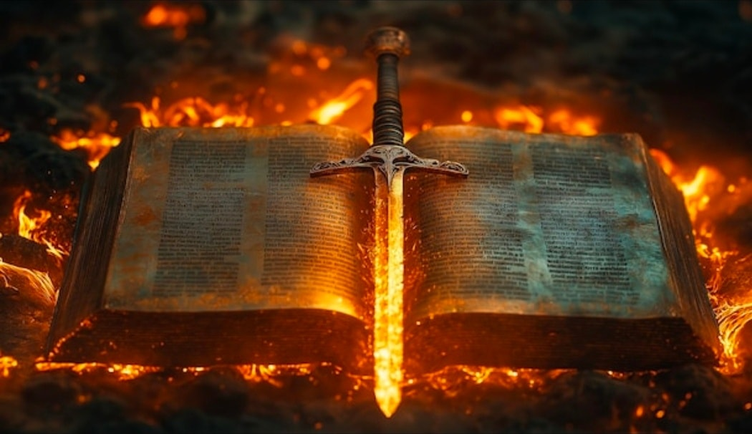
The Bible’s Inspiration
“All Scripture is given by inspiration of God, and is profitable for doctrine, for reproof, for correction, for instruction in righteousness” (2 Tim. 3:16).

Slide 3
1. The Bible’s Unity
66 books
3 languages
40 writers
3 continents
1,600 years
with one perfectly unified message!

Slide 4
2. Historical and Geographical Accuracy
Hundreds of incidents recorded in the Bible that can be checked against secular history and archeology for their accuracy.
The Bible passes this test every time.

Slide 5
3. Fulfilled Prophecy
Remember the former things of old, for I am God, and there is no other; I am God, and there is none like Me,
Declaring the end from the beginning, and from ancient times things that are not yet done, saying, “My counsel shall stand, and I will do all My pleasure.”
Isaiah 46:9-10

Slide 6
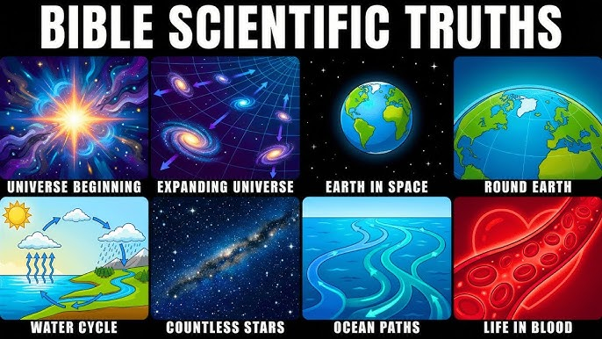
4. Scientific Foreknowledge

Slide 7
5. The Bible’s Brevity
In contrast to the writings of men and women, the Bible is amazingly brief when it addresses important people and topics.
The fact that the Bible contains many “unanswered questions” is evidence of its divine origin.

Slide 8
6. The Bible’s Impartiality
Noah
Abraham
Moses
David
Peter

Slide 9

Evidence for the Bible’s Inspiration
Unity
Historical and Geographical Accuracy
Fulfilled Prophecy
Scientific Foreknowledge
Brevity
Impartiality

