Slide 2
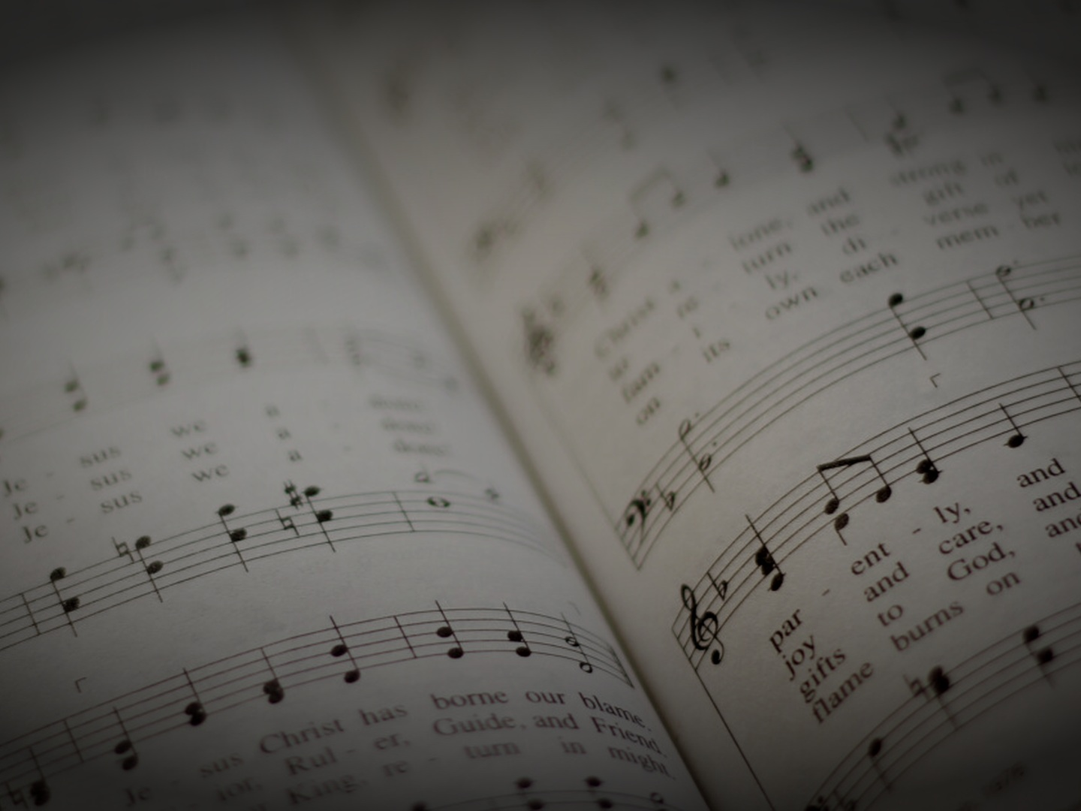
A Sacrifice of Praise
Hebrews 13:10-16
Knollwood Church of Christ • 5/31/26

Slide 3
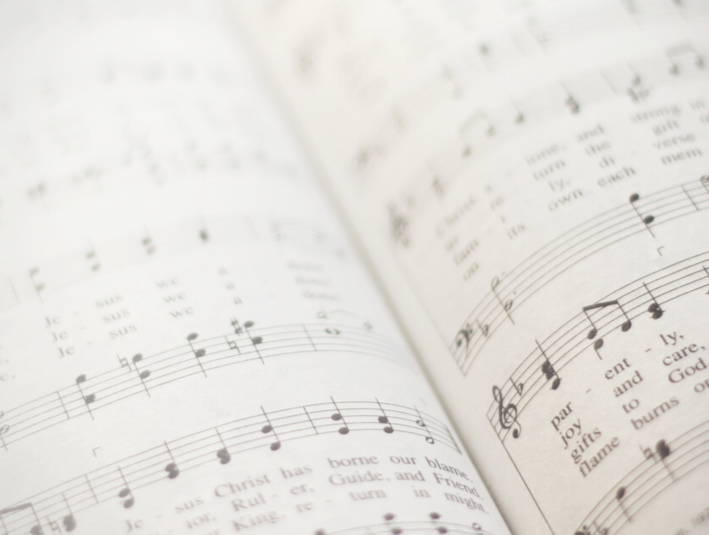
A Sacrifice of Praise
01
Singing is a Form of Sacrifice
02
03

Slide 4
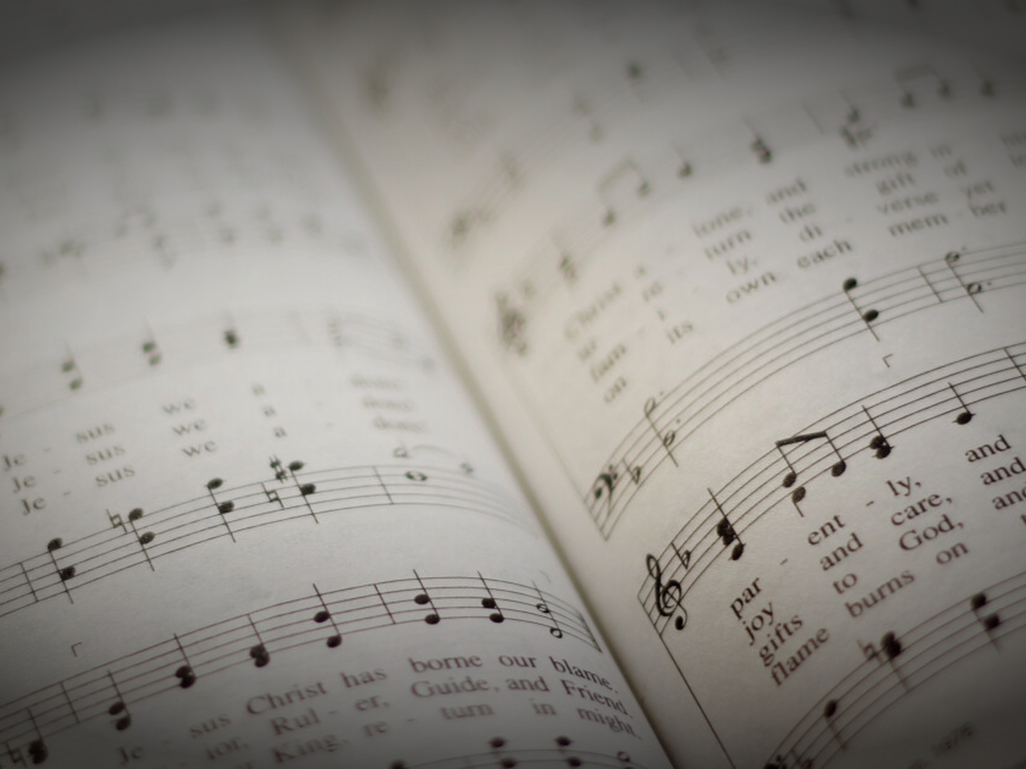
“We have an altar from which those who serve the tent have no right to eat. For the bodies of those animals whose blood is brought into the holy places by the high priest as a sacrifice for sin are burned outside the camp. So Jesus also suffered outside the gate in order to sanctify the people through his own blood. Therefore let us go to him outside the camp and bear the reproach he endured. For here we have no lasting city, but we seek the city that is to come. Through him then let us continually offer up a sacrifice of praise to God, that is, the fruit of lips that acknowledge his name. Do not neglect to do good and to share what you have, for such sacrifices are pleasing to God.”
Hebrews 13:10-16 (ESV)

Slide 5
“By faith Abel offered to God a more acceptable sacrifice than Cain, through which he was commended as righteous, God commending him by accepting his gifts. And through his faith, though he died, he still speaks.”
Hebrews 11:4 (ESV)

Slide 6
A Sacrifice of Praise
01
Singing is a Form of Sacrifice
02
What Makes a Good Sacrifice?
03

Slide 7
“Look carefully then how you walk, not as unwise but as wise, making the best use of the time, because the days are evil. Therefore do not be foolish, but understand what the will of the Lord is. And do not get drunk with wine, for that is debauchery, but be filled with the Spirit, addressing one another in psalms and hymns and spiritual songs, singing and making melody to the Lord with your heart, giving thanks always and for everything to God the Father in the name of our Lord Jesus Christ, submitting to one another out of reverence for Christ.”
Ephesians 5:15-21 (ESV)

Slide 8
“Let the word of Christ dwell in you richly, teaching and admonishing one another in all wisdom, singing psalms and hymns and spiritual songs, with thankfulness in your hearts to God. And whatever you do, in word or deed, do everything in the name of the Lord Jesus, giving thanks to God the Father through him.”
Colossians 3:16-17 (ESV)

Slide 9
“What then, brothers? When you come together, each one has a hymn, a lesson, a revelation, a tongue, or an interpretation. Let all things be done for building up.”
1 Corinthians 14:26 (ESV)

Slide 10
A Sacrifice of Praise
01
Singing is a Form of Sacrifice
02
What Makes a Good Sacrifice?
03
Singing is a Skill to be Improved

Slide 11
A Sacrifice of Praise
Hebrews 13:10-16
Knollwood Church of Christ • 5/31/26

