Slide 2
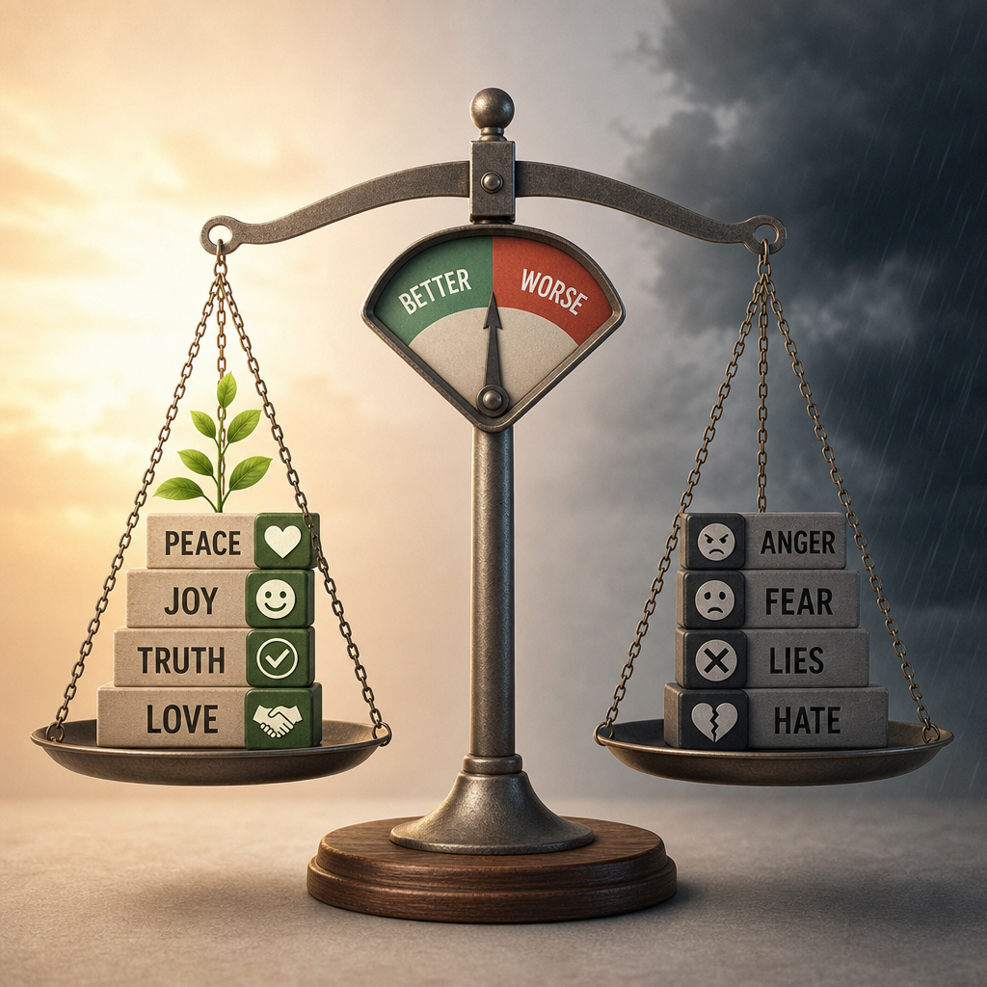

The power of Comparison
How do we Determine Value?

Slide 3
How do we determine whether something is “better or “worse”
In some cases, it depends on your individual values (opinion)
Some things are inherently better than other things – depending on the standard
We can be deceived
  Isaiah 5:20

Slide 4
Moral comparisons
Little possessed with reverence for God surpasses great wealth accompanied by trouble (Prov 15:16–17)
Self-control surpasses physical strength, and mastering one’s emotions exceeds conquering a city (Prov 16:32)
Integrity in poverty transcends dishonesty or wealth gained through corruption (Prov 19:1; 28:6)
A good reputation and favor exceed great riches, silver, or gold (Prov 22:1)

Slide 5
How can we tell if something is “better” or “worse” than something else?
We explain to children in terms they understand
God explains spiritual things to us in terms that we can understand

Slide 6
How bad is Hell?
Today, people look at it as little more than a curse word, and with language becoming coarser every day, even that has lost much of its effect.
Bible description
  Eternal fire prepared for the devil and his angels – Matt. 25:41-46
  The smoke of their torment goes up forever and ever, and they have no rest, day or night.” – Rev. 14:9-11
  Blackness of darkness or Gloom of utter darkness Jude 13
  Eternal destruction, away from the presence of the Lord and from the glory of his might, II Thess. 1:8-9

Slide 7
Comparison of Hell with what we can understand
And if your hand or your foot causes you to sin, cut it off and throw it away. It is better for you to enter life crippled or lame than with two hands or two feet to be thrown into the eternal fire. And if your eye causes you to sin, tear it out and throw it away. It is better for you to enter life with one eye than with two eyes to be thrown into the hell of fire Mt 18:8–9.

Slide 8
How great will heaven be?
Description of the city in Rev 21-22 – City of gold and precious stones
All suffering vanishes: death ceases, mourning ends, crying stops, and pain disappears entirely (Rev 21:1–7).
The redeemed serve God perpetually in His temple, sheltered by His presence, experiencing neither hunger nor thirst, protected from harm, while the Lamb shepherds them to springs of living water and wipes away every tear (Rev 7:9–17)

Slide 9
Comparisons which help us understand
What no eye has seen, nor ear heard, nor the heart of man imagined, what God has prepared for those who love him” 1 Cor. 2:9.
For I consider that the sufferings of this present time are not worth comparing with the glory that is to be revealed to us. Rom 8:18
Paul’s sufferings? II Cor. 11:23-28

