Slide 1


Slide 2
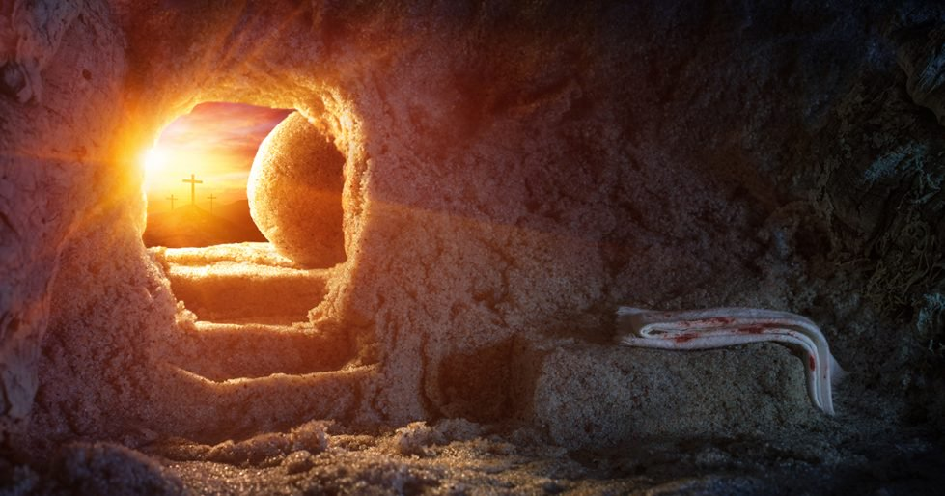
THE RESURRECTION

Slide 3
RESURRECTION
Vital Feature Of The Gospel (1 Cor. 15:14-19, 3-4; 2 Tim. 2:8).
Necessary To Our Salvation (1 Cor. 15:17; Rom. 10:9).
Necessary To Our Justification (Rom. 4:24-25).

Slide 4
GOSPEL ACCOUNTS
Mt. 28:1-17
  The Women (1).
  Earthquake and Angel (2-5).
  He Is Not Here, He Is Risen (6).
  Jesus Met Them (11-17).
Lk. 24:4-8
  Why Seek The Living Among The Dead (5).
  Crucified, Rise Third Day (7).
  What Did Peter See? (12).

Slide 5
IMPLICATIONS
If Jesus Has Not Been Raised (1 Cor. 15:14-19)
  Gospel Preaching Is In Vain.
  Our Faith Is In Vain.
  Apostles Were False Witnesses.
  We Are Still In our Sins
  Believers Have Perished At Death.
  Christians Are To Be Pitied.

Slide 6
IMPLICATIONS
If Jesus has been raised
  Verifies Our Justification (Rom. 4:24-25).
  Hope For Our Resurrection (1 Pet. 1:3,21).
  Demands Our Complete Loyalty To Him (Rom. 14:9).

