Slide 2
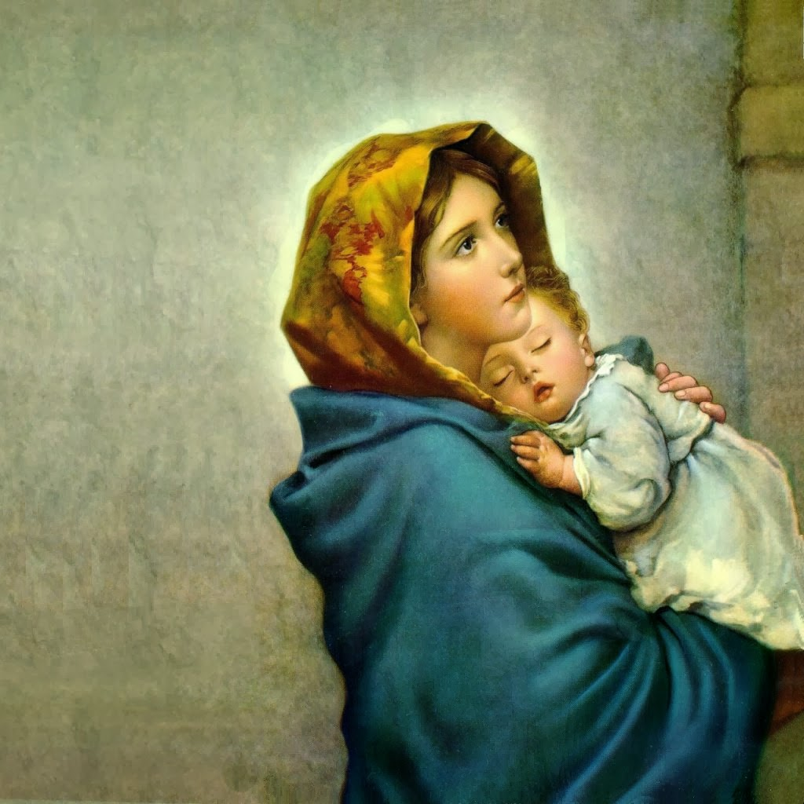
THE VIRGIN BIRTH

Slide 3
THE VIRGIN BIRTH (OT)
First Prophecy (Gen. 3:15).
Promise To David (2 Sam. 7:12-16).
Isaiah’s Prophecy (Is. 7:14).
Jeremiah’s Prophecy (Jer. 31:22).

Slide 4
THE VIRGIN BIRTH (NT)
Matthew Is Very Clear (Mt. 1:20-21).
Luke Is Clear (Lk. 1:27-28).
Luke Follows Up (Lk. 1:30-32).
The Connection To 2 Sam. 7.
Mary Questions This (Lk. 1:34).
The Angel Answers (Lk. 1:35).
Paul Said Jesus Was Born Of A Woman (Gal. 4:4-5).

