Slide 2
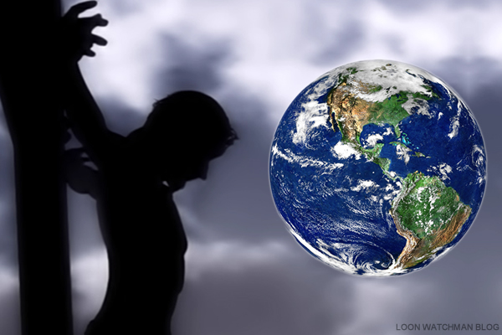
HOW THE ACTIONS OF JESUS CHANGED THE WORLD

Slide 3
CHANGING THE WORLD
Establishment Of The Church (Mt. 16:18; Acts 2:1-6, 16-21, 22-24, 36-38).
Faith (Heb. 11:6, 1-2; Rom. 5:1-2; Eph. 2:8; Jas. 2:14-24).
Preaching The Gospel (Jer. 31:31-34; Mt. 28:19-20; Mk. 16:15-16; 1 Cor. 1:23; 2 Tim. 4:2).
Forgiveness (Eph. 1:7; Acts 13:38).
Showed The Love of God (1 Jn. 4:8, 16).
Traded A Crown For A Cross (Heb. 12:2; Col. 1:20; Phil. 2:8; Rev. 12:3; 13:1; 19:11-16).
The Resurrection (Phil. 3:8-11).
He Died So We Could Live (1 Thess. 5:9-10).

