Slide 2


Slide 3
Job was an upright, God-fearing man.
Blessed with 10 children and abundant livestock.
“the greatest of all the people of the east” (vs. 1-3).
He lost everything in a single day (1:13-19).
Then he lost his health (2:7-8).
His wife told him to “curse God and die” (v. 9).
His three friends came to comfort him (vs. 11-13), but when Job spoke, they accused him of sin.
Job maintained his innocence, and the friends doubled down (chapters 3-31).

Slide 4
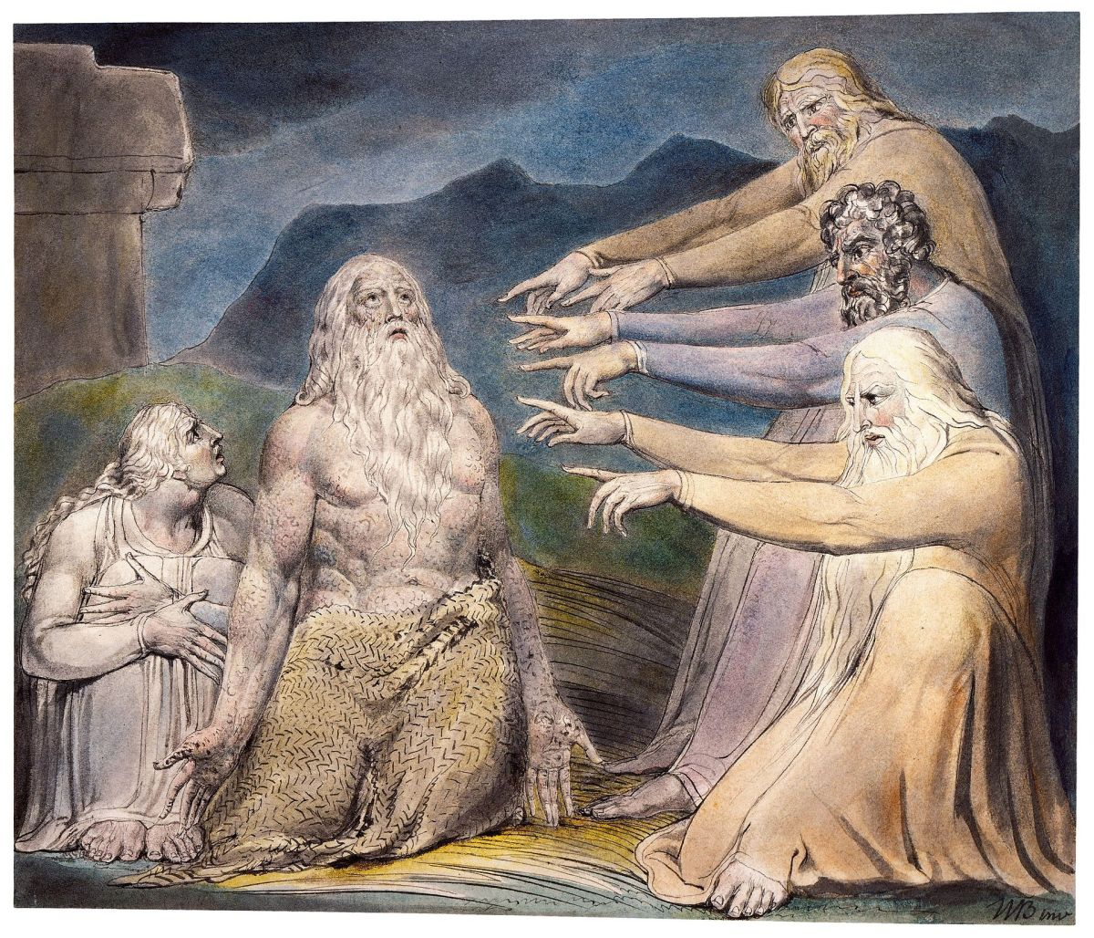
“Have pity on me, have pity on me, o you my friends, for the hand of God has struck me!
Why do you persecute me as God does, and are not satisfied with my flesh?”
Job 19:21-22

Slide 5
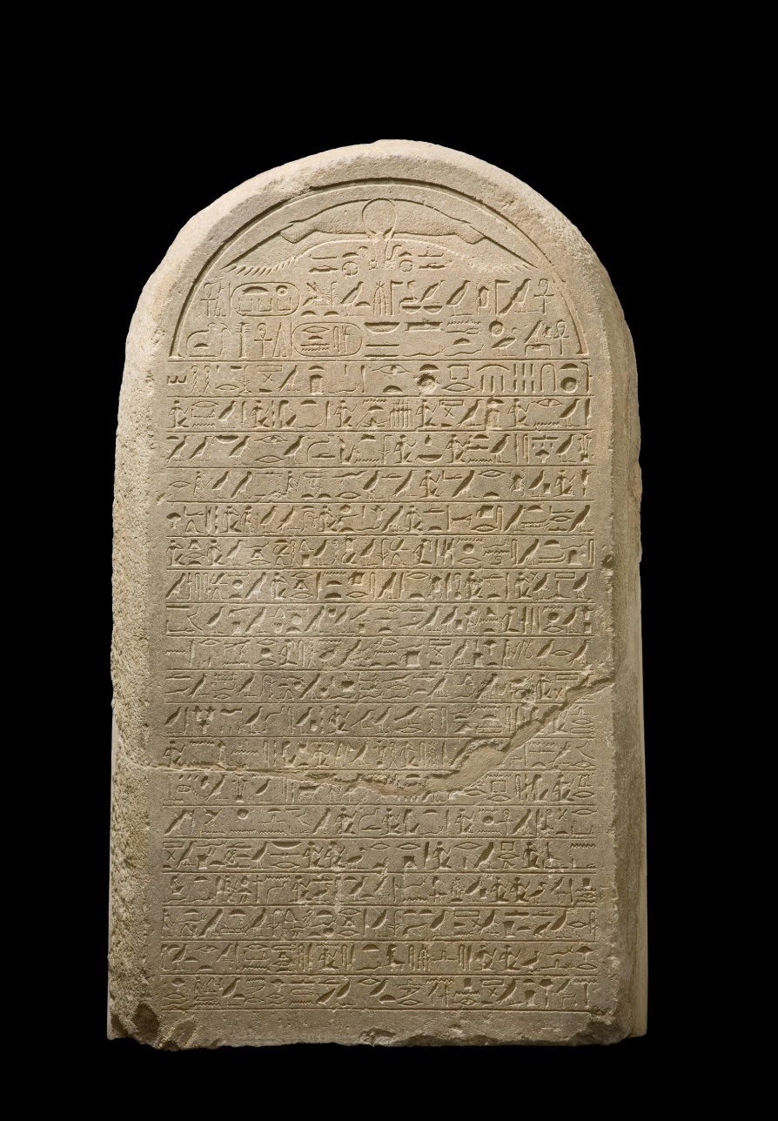
“Oh, that my words were written! Oh, that they were inscribed in a book!
That they were engraved on a rock with an iron pen and lead, forever!”
Job 19:23-24

Slide 6
Job’s Confidence
“I Know”
“My Redeemer”
“Lives”
“For I know that my Redeemer lives, and He shall stand at last on the earth.”
Job 19:25

Slide 7
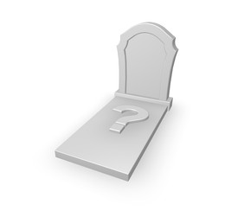
How Much Did Job Understand?
And after my skin is destroyed, this I know, that in my flesh I shall see God,
Whom I shall see for myself, and my eyes shall behold, and not another. How my heart yearns within me!
Job 19:26-27

Slide 8
“I Know My Redeemer Lives!”
Doubts are common, even to men and women of great faith.
Wrestling with our doubts can be unsettling.
We must cling to what we know to be true!

