Slide 2

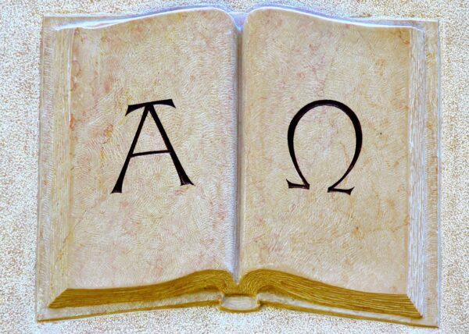
“I am the Alpha and the Omega, the Beginning and the End,” says the Lord, “who is and who was and who is to come, the Almighty.”
Revelation 1:8

Slide 3
“I am the Alpha and the Omega, the Beginning and the End,” says the Lord, “who is and who was and who is to come, the Almighty.”
Revelation 1:8
The first and last letters in the Greek alphabet.
Represents the beginning and the end; the first and the last.
Repeated in Revelation - 1:11, 17-18; 2:8; 21:6; 22:13

Slide 4
The Alpha and Omega
Jesus is Eternal
  Heb. 13:8
Jesus is Sovereign
  Matt. 28:18; John 1:1-3; Heb. 1:1-3
Jesus is the Only Lord
  Is. 44:6; 48:12; Eph. 4:5
Jesus is Victorious Over Death
  Rev. 2:8

