Slide 2
SUBMISSION
What does it mean to subject ourselves to another?

Slide 3
submit
“to yield to the action, control, power, etc. of another or others” (Webster’s).

Slide 4
hupotasso
“to arrange under, to subordinate; to subject, put in subjection” (Thayer).
“primarily a military term, ‘to rank under’ (hupo, ‘under,’ tasso, ‘to arrange’), denotes…
  (a) ‘to put in subjection, to subject,’
  ‘to put under,’ ‘be subdued’
  (b) in the middle or passive voice, to subject oneself, to obey, be subject to” (Vine’s)

Slide 5
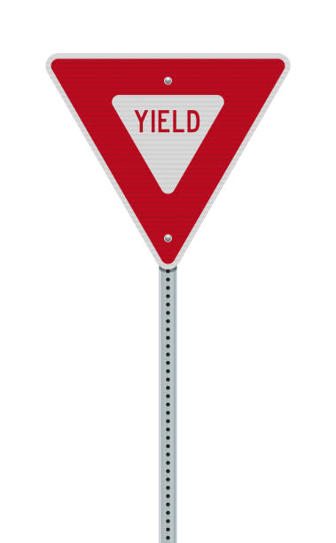
yield
“to give place; lose precedence, leadership, etc. a) to let another have the right of way,
b) to give up willingly a right, position, privilege, etc.” (Webster’s)

Slide 6
1. In Society
Government
  1 Pet. 2:13-15; Rom. 13:1-5, Titus 3:1
Workplace
  1 Pet. 2:18-19

Slide 7
2. In the Home
1 Peter 3:1-6
Colossians 3:18
1 Corinthians 11:3
Ephesians 6:1
1 Timothy 3:4

Slide 8
3. In the Church
Christ as the Head
  Ephesians 1:21-22
One Another
  Ephesians 5:21
The Elders
  1 Pet. 5:1-5; 1 Thess. 5:12-13; Heb. 13:17

Slide 9
4. In the Heart
“But sanctify Christ as Lord in your hearts, always being ready to make a defense to everyone who asks you to give an account for the hope that is in you, yet with gentleness and reverence.”
1 Peter 3:15, NASB

Slide 10
Jesus is Our Example
To His earthly parents - Luke 2:51
To His Heavenly Father - Heb. 5:8-9
To His Father’s will - 1 Pet. 2:18-25

Slide 11
Jesus is Our Example
Let this mind be in you which was also in Christ Jesus,
who, being in the form of God, did not consider it robbery to be equal with God,
but made Himself of no reputation, taking the form of a bondservant, and coming in the likeness of men.
And being found in appearance as a man, He humbled Himself and became obedient to the point of death, even the death of the cross.
Philippians 2:5-8

Slide 12
Submission
Likewise you younger people, submit yourselves to your elders. Yes, all of you be submissive to one another, and be clothed with humility, for “God resists the proud, But gives grace to the humble.”
Therefore humble yourselves under the mighty hand of God, that He may exalt you in due time.
1 Peter 5:5-6

