Slide 2
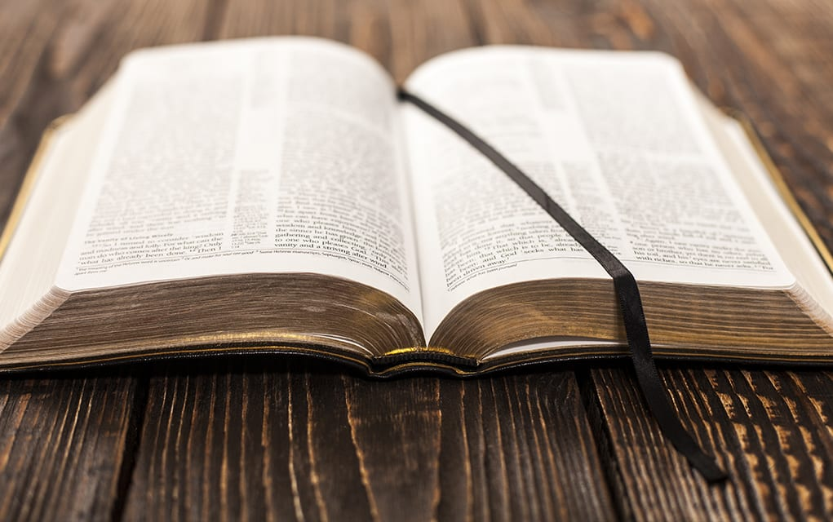
Why Obedience Pleases God

Slide 3
Finally then, brethren, we urge and exhort in the Lord Jesus that you should abound more and more, just as you received from us how you ought to walk and to please God;
for you know what commandments we gave you through the Lord Jesus.
1 Thessalonians 4:1-2

Slide 4
“And suddenly a voice came from heaven, saying, ‘This is My beloved Son, in whom
I am well pleased’” (Matt. 3:17).
“This is My beloved Son, in whom I am
well pleased. Hear Him!” (Matt. 17:5).

Slide 5
And He who sent Me is with Me.
The Father has not left Me alone,
for I always do those things that
please Him.
John 8:29

Slide 6
1. Shows Our Respect for God’s Love
“But that the world may know that I love the Father, and as the Father gave Me commandment, so I do. Arise, let us go from here” (John 14:31).
“If you love Me, keep My commandments” (John 14:15).

Slide 7
1. Shows Our Respect for God’s Love
Children, obey your parents in the Lord, for this is right.
“Honor your father and mother,” which is the first commandment with promise:
Ephesians 6:1-2

Slide 8
1. Shows Our Respect for God’s Love
And the Lord commanded us to observe all these statutes, to fear the Lord our God, for our good always, that He might preserve us alive, as it is this day.
Then it will be righteousness for us, if we are careful to observe all these commandments before the Lord our God, as He has commanded us.
Deuteronomy 6:24-25

Slide 9
1. Shows Our Respect for God’s Love
And the Lord commanded us to observe all these statutes, to fear the Lord our God, for our good always, that He might preserve us alive, as it is this day.
Then it will be righteousness for us, if we are careful to observe all these commandments before the Lord our God, as He has commanded us.
Deuteronomy 6:24-25
Obedience to God has always been joined to love:
Ex. 20:6
Deut. 7:10
Deut. 10:12-13
Daniel 9:4
John 15:10
2 John 6

Slide 10
2. Shows Our Trust in God’s Grace
For the grace of God that brings salvation has appeared to all men,
teaching us that, denying ungodliness and worldly lusts, we should live soberly, righteously, and godly in the present age.
Titus 2:11-12

Slide 11
3. Shows Our Faith in God’s Promises
But without faith it is impossible to please Him, for he who comes to God must believe that He is, and that He is a rewarder of those who diligently seek Him.
Hebrews 11:6

Slide 12
3. Shows Our Faith in God’s Promises
Abraham pleased God
with great faith in His promises!
He left his home to live in a land God would show him (vs. 8-10).
He stayed in that land when he could have gone back home (vs. 13-16).
He offered his son Isaac (vs. 17-19).

Slide 13
Why Obedience Pleases God
It shows our respect for His love
It shows our trust in His grace
It shows our faith in His promises

