Slide 1
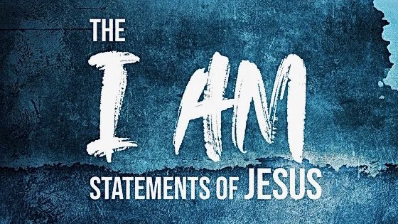

John 14:1-6

Slide 2
In the upper room...
One of them would betray Him - John 13:21
He was leaving, they could not follow - v. 33
Peter would deny Him three times - vs. 36-38

Slide 3
In the upper room...
“Let not your heart be troubled; you believe in God, believe also in Me.
In My Father's house are many mansions; if it were not so, I would have told you. I go to prepare a place for you.
And if I go and prepare a place for you, I will come again and receive you to Myself; that where I am, there you may be also.”
John 14

Slide 4
In the upper room...
“And where I go you know, and the way you know.”
Thomas said to Him, “Lord, we do not know where You are going, and how can we know the way?”
Jesus said to him, “I am the way, the truth, and the life. No one comes to the Father except through Me.”
John 14

Slide 5
“I Am the Way”
“Way” indicates a road or path connecting two points.
When man sinned, he was separated from the presence of God and the Tree of Life with no instruction of how to get back (Gen. 3:24).
Jesus made the way by His blood (Heb. 10:19-20).
He keeps the way open by serving as our High Priest (vs. 21-22).

Slide 6
“I Am the Truth”
Jesus is “the light of the world” (John 8:12).
“Pilate therefore said to Him, ‘Are You a king then?’ Jesus answered, ‘You say rightly that I am a king. For this cause I was born, and for this cause I have come into the world, that I should bear witness to the truth. Everyone who is of the truth hears My voice’” (John 18:37).

Slide 7
“I Am the Truth”
Jesus is the embodiment of God’s ultimate revelation of Himself and His will to this world (John 1:14; 17-18).
“And you shall know the truth, and the truth shall make you free… Therefore if the Son makes you free, you shall be free indeed” (John 8:32, 36).

Slide 8
“I Am the Life”
Deity is the source of all life - physical and spiritual.
The words of Jesus are the words of eternal life (John 6:63, 68).
Eternal life is only found in Jesus (1 John 5:11-12).

Slide 9
Exclusive Nature of This Statement
“The” indicates a singular or exclusive object.
Jesus is the ONLY Way to the Father, the ONLY source of Truth, and the ONLY means of having eternal Life.
These blessings can’t be found in any other person or thing.

Slide 10
Jesus said to him, “I am the way, the truth, and the life. No one comes to the Father except through Me.”
John 14:6

