Slide 2
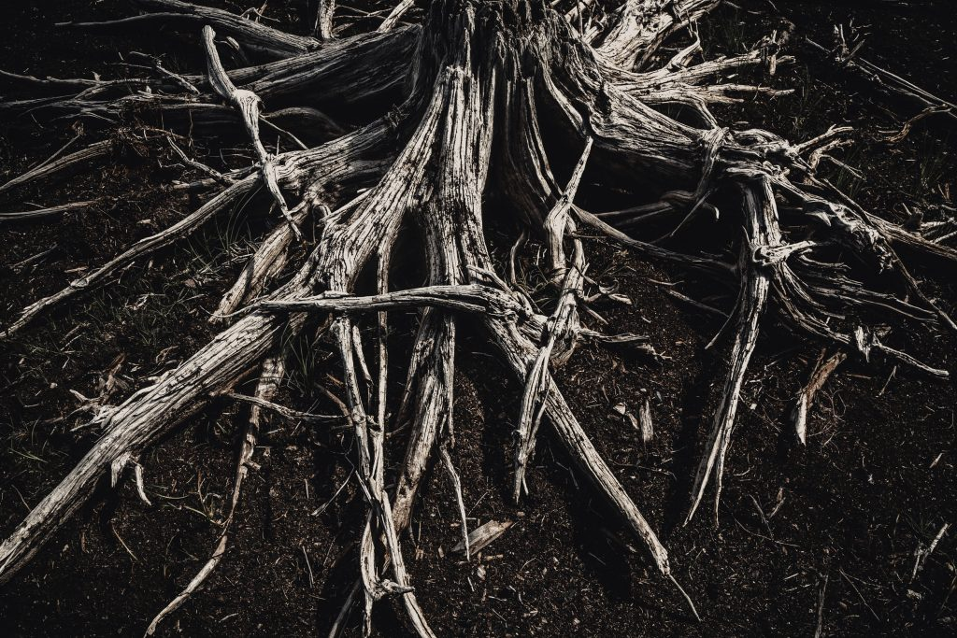
The Root of Bitterness

Slide 3
bitter
causing or showing sorrow, discomfort, or pain; grievous
characterized by strong feelings of hatred, resentment, cynicism, etc.
Webster’s Dictionary

Slide 4

Root of Bitterness
“…that there may not be among you a root bearing bitterness or wormwood” (Deut. 29:18).
“looking carefully lest anyone fall short of the grace of God; lest any root of bitterness springing up cause trouble, and by this many become defiled” (Heb. 12:15).

Slide 5
What Causes Bitterness?
Suffering
Being Cheated or Defrauded
Mishandling Our Anger

Slide 6
The Danger of Bitterness
Keeps bad company - Eph. 4:31
Defiles the heart - Heb. 12:15; Prov. 4:23
Spreads to others - Heb. 12:15
Distorts our view of God - Ruth 1:20-21; James 5:11
Robs us of peace and joy - Prov. 14:10
Damages relationships - Col. 3:19

Slide 7
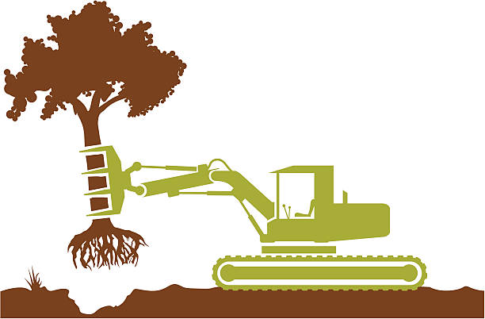
Overcoming Bitterness
Dig it out and replace it - Eph. 4:31-23
Follow wisdom from above - James 3:13-18
Learn to rejoice with those who rejoice - Rom. 12:15
STOP nursing grudges - Phil. 4:8
Pray - 1 Sam. 1:10; 1 Pet. 5:7

Slide 8
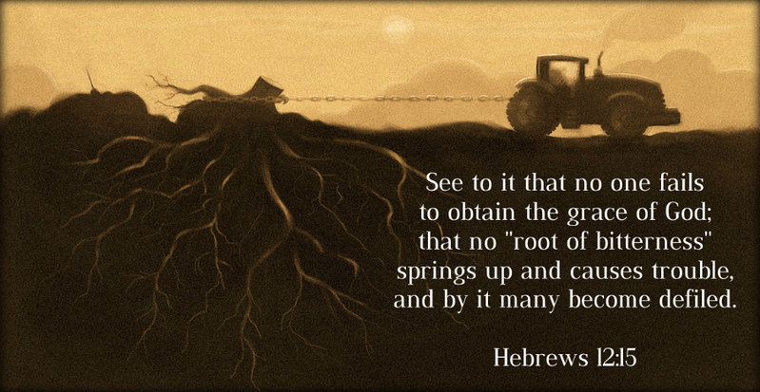
The Root of Bitterness

