Slide 2
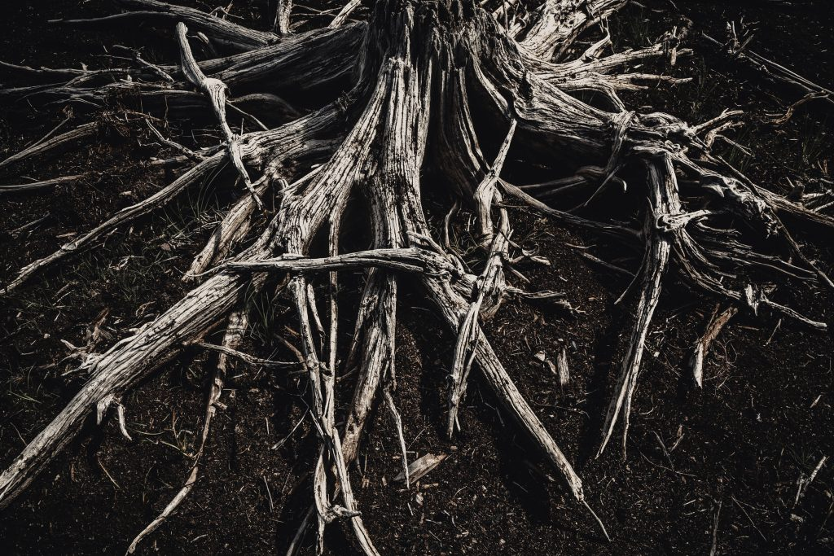
The Root of Bitterness

Slide 3
bitter
designating or having a sharp, often unpleasant taste
causing or showing sorrow, discomfort, or pain; grievous
characterized by strong feelings of hatred, resentment, cynicism, etc.
Webster’s Dictionary

Slide 4
bitter
marah - “bitterly, angry, chafed, discontented, heavy”
“Now when they came to Marah, they could not drink the waters of Marah, for they were bitter. Therefore the name of it was called Marah”
(Ex. 15:23).
“But she said to them, ‘Do not call me Naomi; call me Mara, for the Almighty has dealt very bitterly with me’” (Ruth 1:20).

Slide 5
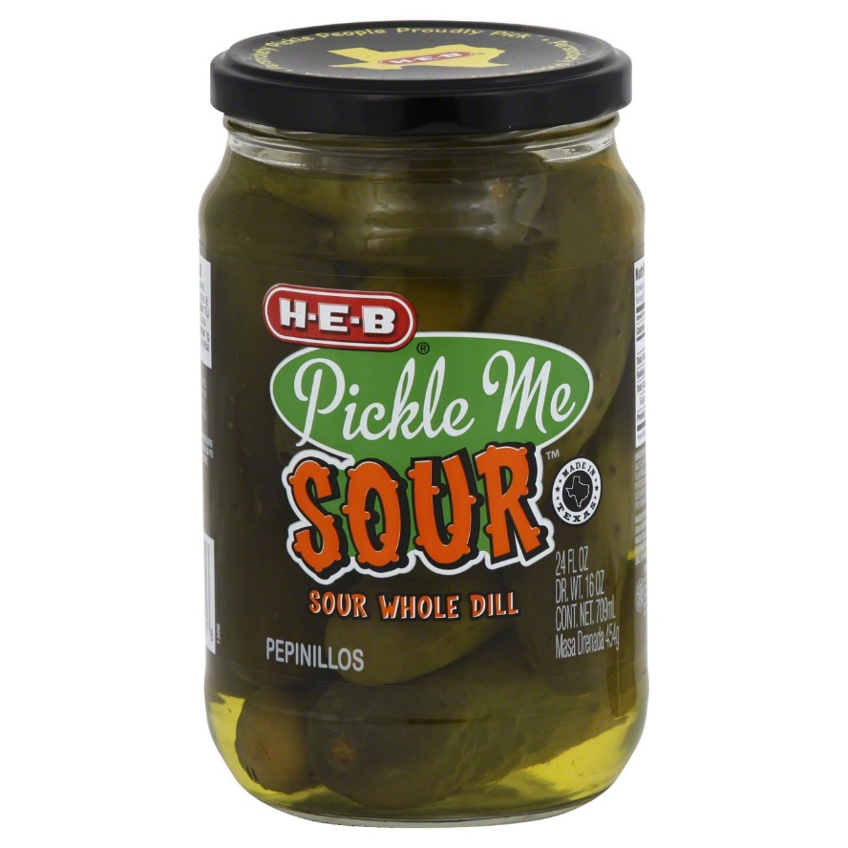
bitter
pikraino – verb, “to embitter”
pikros – adjective, “bitter”
pikria – noun, “bitterness”

Slide 6
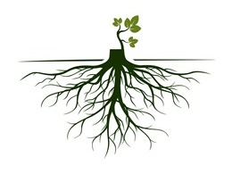
Root of Bitterness
“…that there may not be among you a root bearing bitterness or wormwood” (Deut. 29:18).
“looking carefully lest anyone fall short of the grace of God; lest any root of bitterness springing up cause trouble, and by this many become defiled” (Heb. 12:15).

Slide 7
What Causes Bitterness?
1. Suffering
Israelites were bitter in Egypt - Ex. 1:14
Job said, “I will complain in the bitterness of my soul” - Job 7:11
Foolish child is bitterness to parents - Prov. 17:25
After denying the Lord,
Peter went out and wept
bitterly - Matt. 26:75

Slide 8
What Causes Bitterness?
2. Being Cheated or Defrauded
Esau - Gen. 27:34
Hannah - 1 Sam. 1:4-10

Slide 9
What Causes Bitterness?
3. Mishandling Our Anger
Bitterness is unresolved anger, anger pointed inward, or anger gone to seed - Eph. 4:26-27
“You are poisoned by bitterness” - Acts 8:23

Slide 10
What Causes Bitterness?
Suffering
Being Cheated or Defrauded
Mishandling Our Anger

