Slide 2

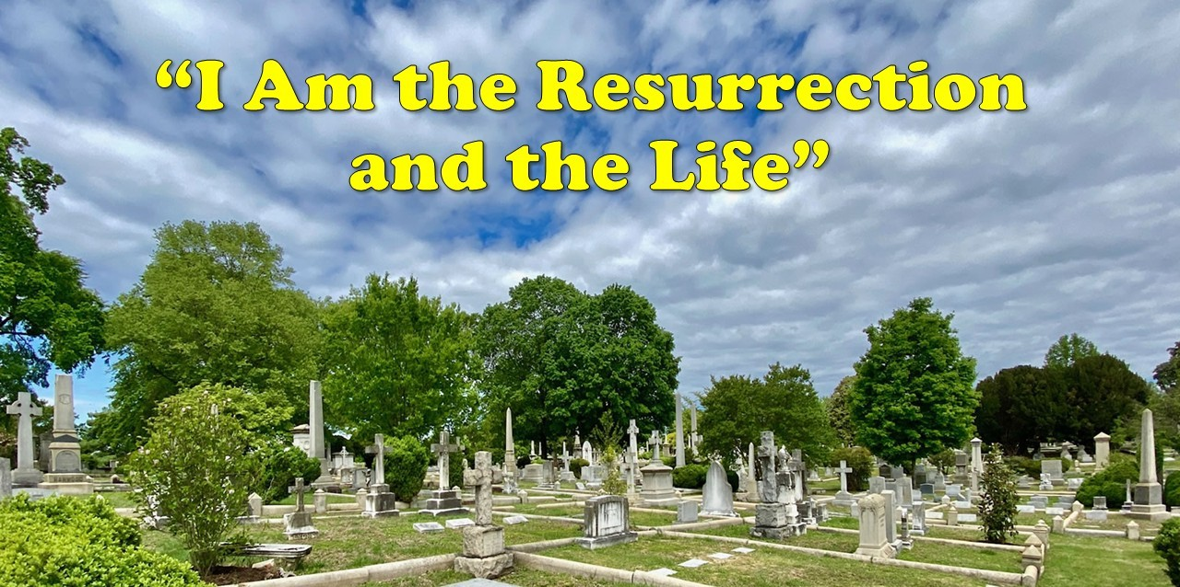

Slide 3
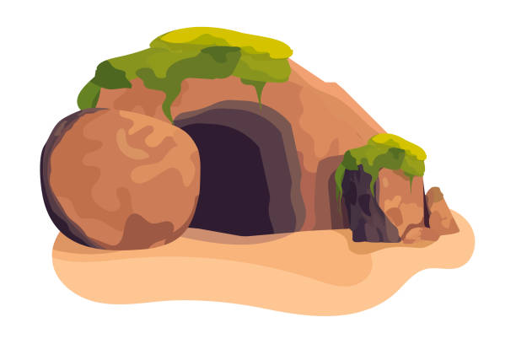
The Death of Lazarus - John 11
Martha and Mary call for Jesus - vs. 1-16
Jesus challenges Martha - vs. 17-27
They take Jesus to the tomb - vs. 28-37
Jesus raises Lazarus - vs. 38-44

Slide 4
“I Am the Resurrection”
Anastasia - “a standing up again” (Strong’s)
Was taught in the OT, more clearly in the NT
Subject of controversy between Sadducees and Pharisees - Acts 23:8
Martha believed in the resurrection - vs. 23-24
Jesus presents Himself as the power behind this resurrection

Slide 5
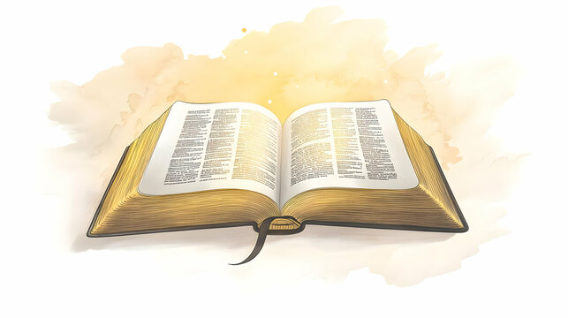
“I Am the Life”
Deity is the source of all life
John 1:4
John 4:10-14
John 6:33-35
John 8:12
John 10:10
John 14:6

Slide 6
Victory Over Death
Jesus said to her, “I am the resurrection and the life. He who believes in Me, though he may die, he shall live.
And whoever lives and believes in Me shall never die. Do you believe this?”
John 11:25-26

Slide 7
Victory Over Death
Physical Death - James 2:26
Spiritual Death - Eph. 2:1; Rom. 6:3-4
The “Second Death” - Rev. 20:14-15

Slide 8
Do You Believe?
Jesus said to her, “I am the resurrection and the life. He who believes in Me, though he may die, he shall live.
And whoever lives and believes in Me shall never die. Do you believe this?”
She said to Him, “Yes, Lord, I believe that You are the Christ, the Son of God, who is to come into the world.”
John 11:25-26

Slide 9
