Slide 2
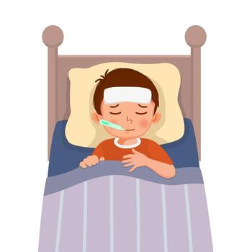
Did Jesus Ever Get Sick?
A Study of
the Humanity of Jesus

Slide 3

Did Jesus Ever Get Sick?
Where does it say He did?
Where does it say He didn’t?

Slide 4

The Humanity of Jesus
John 1:14
Galatians 4:4
Colossians 2:9
1 Timothy 3:16
Hebrews 2:14; 10:4-10
1 John 1:1; 4:1-3
2 John 7

Slide 5
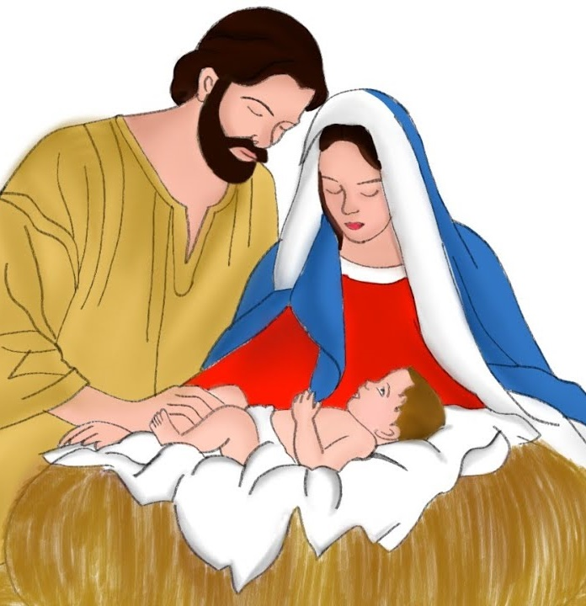
The Incarnation of Jesus
Incarnate literally means “in flesh.”
“God was manifested in the flesh” (1 Tim. 3:16).
“God sent forth His Son, born of a woman”
(Gal. 4:4).

Slide 6
The Incarnation of Jesus

Slide 7

The Incarnation of Jesus
Grew as a normal child.
  Luke 2:40, 52

Slide 8
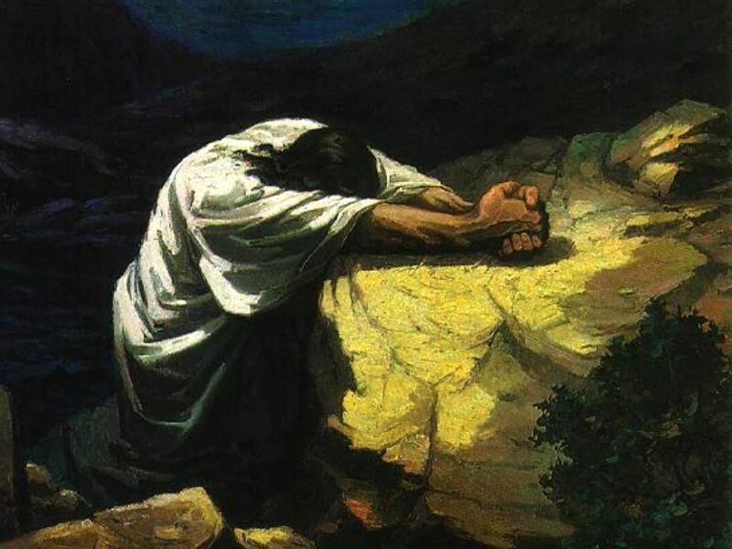
The Incarnation of Jesus
Grew as a normal child.
  Luke 2:40, 52
Became hungry - Luke 4:2.
Fell asleep - Luke 8:23.
Was in agony and sweat
like great drops of blood -
Luke 22:44.

Slide 9

Jesus’ Suffering and Death
They struck Him, crown of thorns, scourged Him.
Simon carried His cross - Luke 23:26.
Psalm 22:14-17
Isaiah 53:5
“I thirst” - John 19:28.

Slide 10
John Emphasized the Lord’s Humanity
John 1:14
1 John 1:1
1 John 4:1-3
2 John 7
“For many deceivers have gone out into the world who do not confess Jesus Christ as coming in the flesh. This is a deceiver and an antichrist” (2 John 7).

Slide 11
Significance of Jesus’ Humanity
Gives us unsatisfiable awe and wonder!
  2 Tim. 3:16; Col. 2:9
Gives us a real blood sacrifice for our sins!
  Heb. 2:9; 9:22
Gives us victory over death!
  Heb. 2:14
Gives us a sympathetic High Priest!
  Heb. 2:17-18; 5:15
Gives us hope to share with Christ in something greater than we know now!
  1 John 3:1-3

