Slide 2
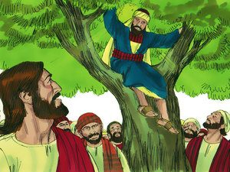
Zacchaeus the Publican

Slide 3
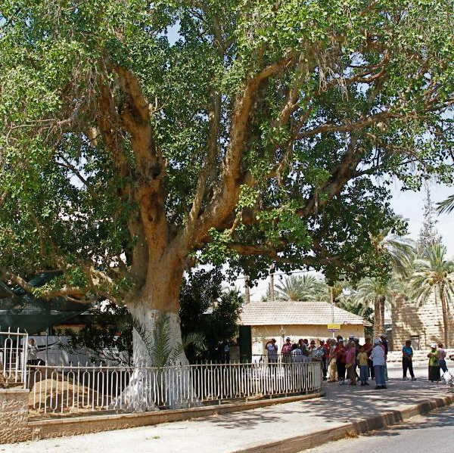
Sycamore tree
Large, common tree during NT times in the lowlands like Jericho
Also called the fig-mulberry tree because of its large leaves and fig-like fruit.

Slide 4
Background- Luke 19:1-10
Luke is the only one to record the story
Events take place the week before Jesus’ crucifixion
Crowd was excited because they thought he was going to establish the kingdom (v11)
Tax collectors in New Testament times
  Rome allowed people to be tax collectors by buying the position
  A certain amount of taxes were required, but the tax collector could keep anything above that level for himself
  Their work required contact with Gentiles which made them ritually unclean much of the time

Slide 5

Some New Testament statements regarding tax collectors
Attracted to the message of John – Luke 3:12-13 told not to take more than what was owed
They are often mentioned in conjunction with undesirable people–
Mark 2:15 ff – Associated with sinners
Matt 21:31 – Chief priests and elders told that publicans and harlots would enter into the kingdom of God before they would
Hated by the people because they worked for the occupying Romans
Matthew was formerly a tax collector
Zacchaeus was a “chief” publican

Slide 6
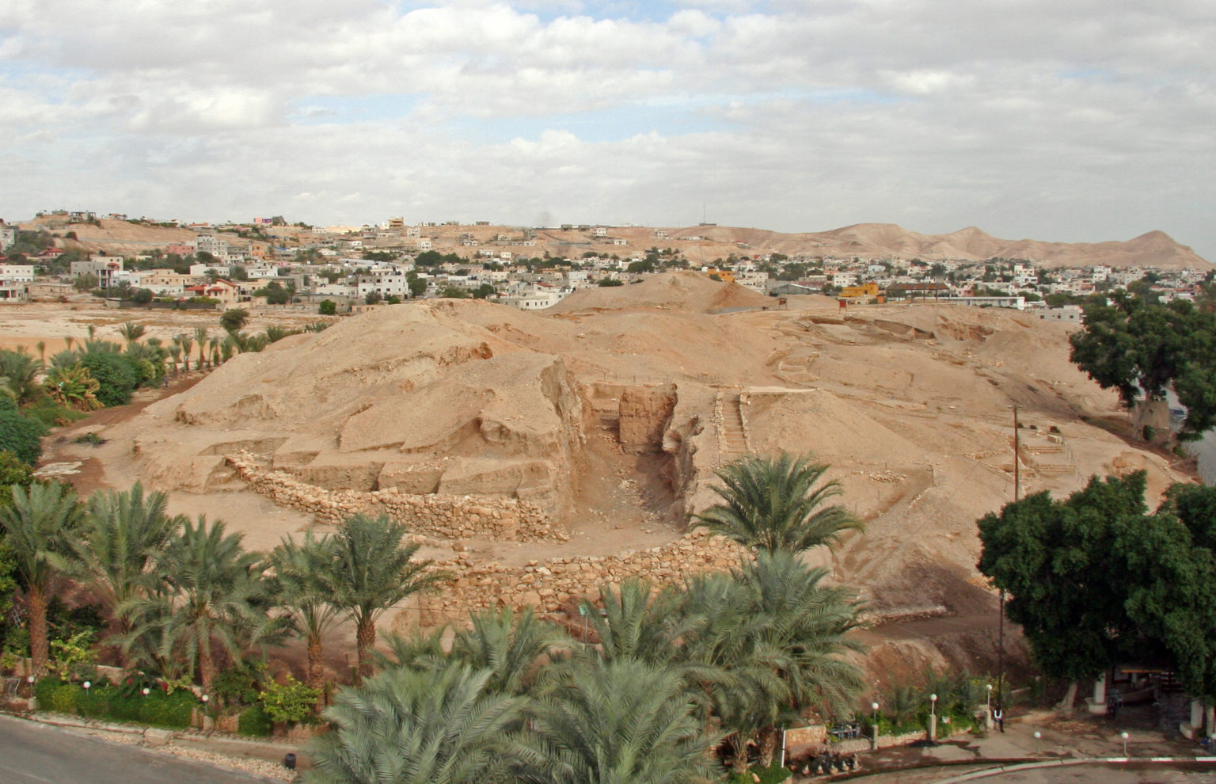
Jericho
One of the oldest cities – Some sources say 9,000 years old
A wealthy city at the time – known for trae in balsam – a resin from which balm, and fragrances were made. The rose gardens could be smelled for miles
Antony gave Cleopatra date plantations there

Slide 7
What can we learn from this story?
Money and power are not the most important things in life
  What would you do for $10,000,000
Seeing the Lord was important to him
  He had a need that his wealth and importance could not meet
  It was not easy for him to see Jesus
  It cost him to see Jesus and to repent
The Lord knew his name and his character – as He does ours
The importance of repentance

