Slide 2
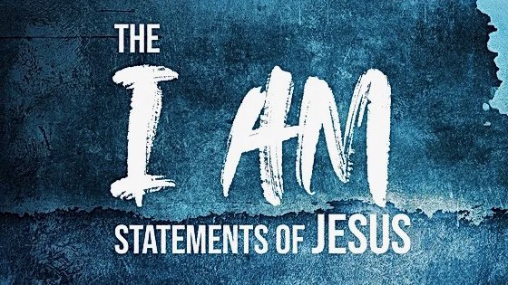
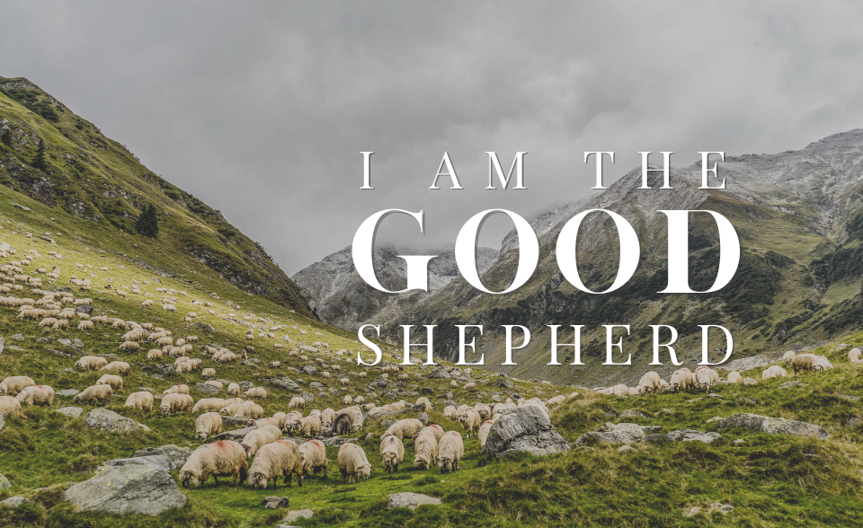

Slide 3
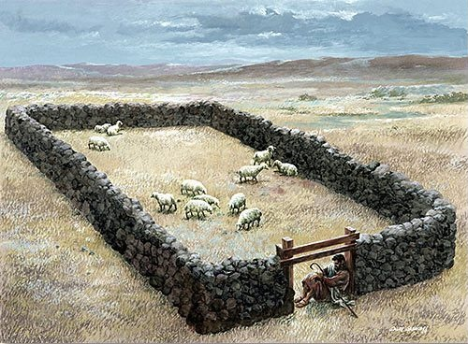
“I Am the Door”
Access
Protection

Slide 4
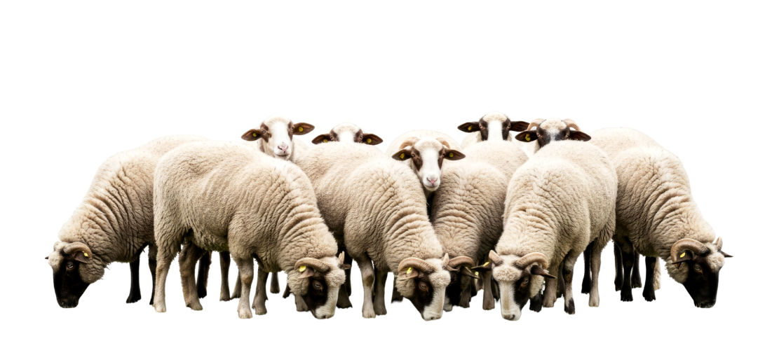
1. Jesus Owns the Sheep
The Father gave them to Him - John 10:29
Jesus purchased them with His own blood -
Acts 20:28

Slide 5
2. Jesus Cares for the Sheep
“The hireling flees because he is a hireling and does not care about the sheep” (v. 13).

Slide 6
2. Jesus Cares for the Sheep
Psalm 23
Provides green pastures and still waters - v. 2
Leads the sheep in the right path - v. 3
Protects the sheep - vs. 4-5

Slide 7
2. Jesus Cares for the Sheep
“I am the good shepherd. The good shepherd gives His life for the sheep” (v. 11).
“I lay down My life for the sheep” (v. 15).

Slide 8
3. Jesus Knows the Sheep
“I am the good shepherd; and I know My sheep, and am known by My own” (v. 14).

Slide 9
4. Jesus Unites the Sheep
“And other sheep I have which are not of this fold; them also I must bring, and they will hear My voice; and there will be one flock and one shepherd” (v. 16).

