Slide 2
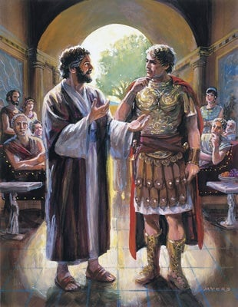
What Cornelius Teaches Us About Worshiping God
Acts 10

Slide 3
Not all worship is acceptable to God!
Worship can be hated by God - Isaiah 1:14
Worship can be in vain - Matt. 15:9
Sincere worship can be rejected - Matt. 7:21-23

Slide 4
God is looking for a specific kind of worship offered by a specific kind of worshiper!
But the hour is coming, and now is, when the true worshipers will worship the Father in spirit and truth; for the Father is seeking such to worship Him.
God is Spirit, and those who worship Him must worship in spirit and truth.
John 4:23-24

Slide 5
1. He Feared God
There was a certain man in Caesarea called Cornelius, a centurion of what was called the Italian Regiment,
a devout man and one who feared God with all his household, who gave alms generously to the people, and prayed to God always.

Slide 6
1. He Feared God
There was a certain man in Caesarea called Cornelius, a centurion of what was called the Italian Regiment,
a devout man and one who feared God with all his household, who gave alms generously to the people, and prayed to God always.
For thus says the High and Lofty One Who inhabits eternity, whose name is Holy: “I dwell in the high and holy place, with him who has a contrite and humble spirit, to revive the spirit of the humble, and to revive the heart of the contrite ones.”
Isaiah 57:15

Slide 7
2. He Was a Person of Prayer
There was a certain man in Caesarea called Cornelius, a centurion of what was called the Italian Regiment,
a devout man and one who feared God with all his household, who gave alms generously to the people, and prayed to God always.

Slide 8
3. He Was a Generous Person
There was a certain man in Caesarea called Cornelius, a centurion of what was called the Italian Regiment,
a devout man and one who feared God with all his household, who gave alms generously to the people, and prayed to God always.

Slide 9
4. He Was Willing to Be Corrected
As Peter was coming in, Cornelius met him and fell down at his feet and worshiped him.
But Peter lifted him up, saying, “Stand up;
I myself am also a man.”

Slide 10
5. He Had a Sense of Urgency About Hearing God’s Word
So I sent to you immediately, and you have done well to come. Now therefore, we are all present before God, to hear all the things commanded you by God.

Slide 11
6. He Appreciated Those Who Lead in Worship
So I sent to you immediately, and you have done well to come. Now therefore, we are all present before God, to hear all the things commanded you by God.

Slide 12
7. He Invited Others to
Worship God
So I sent to you immediately, and you have done well to come. Now therefore, we are all present before God, to hear all the things commanded you by God.

Slide 13
8. He Realized He Was in
God’s Presence
So I sent to you immediately, and you have done well to come. Now therefore, we are all present before God, to hear all the things commanded you by God.

Slide 14
9. He Was Ready to
Hear God’s Word
So I sent to you immediately, and you have done well to come. Now therefore, we are all present before God, to hear all the things commanded you by God.

Slide 15
9. He Was Ready to
Hear God’s Word
So I sent to you immediately, and you have done well to come. Now therefore, we are all present before God, to hear all the things commanded you by God.
“Keep thy foot when thou goest to the house of God, and be more ready to hear, than to give the sacrifice of fools: for they consider not that
they do evil.”
Ecclesiastes 5:1

Slide 16
10. He Was Quick to Obey and Wanted More
“Can anyone forbid water, that these should not be baptized who have received the Holy Spirit just as we have?”
And he commanded them to be baptized in the name of the Lord. Then they asked him to stay a few days.

Slide 17
Cornelius was a worshiper, but he was not saved!
And he told us how he had seen an angel standing in his house, who said to him, “Send men to Joppa, and call for Simon whose surname is Peter,
who will tell you words by which you and all your household will be saved.”
Acts 11:13-14

Slide 18
Will you be saved today?
Believe in Jesus - John 8:24
Repent of your sins - Luke 13:3
Confess your faith - Rom. 10:9-10
Be baptized - Mark 16:16
Serve the Lord faithfully - Heb. 10:36

