Slide 2
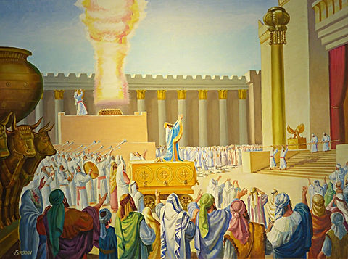
Solomon Dedicates the Temple
First Kings 8

Slide 3
Reasons to Worship God
First Kings 8
He Keeps His Promises
He Fills the Entirety of Creation
He Hears Our Prayers
He Forgives Our Sins
He Knows Our Hearts
He Wants Everyone to Be Saved

