Slide 1



Slide 2
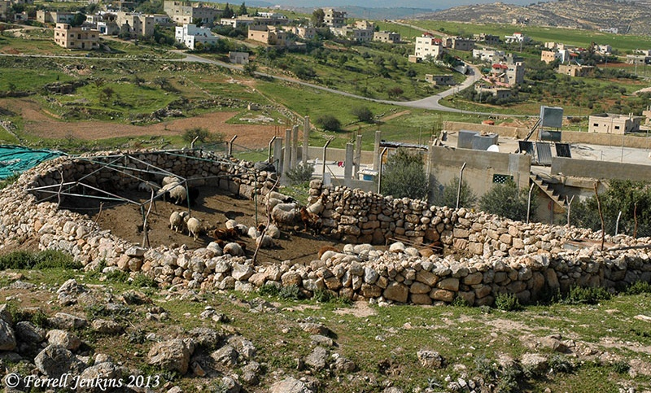
John 10:1-6

Slide 3
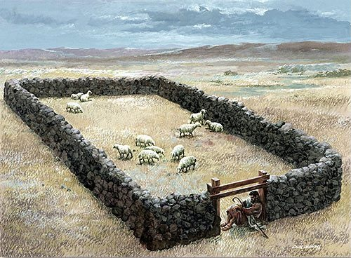
John 10:7-10

Slide 4
“I Am the Door”
Access
  Salvation - v. 9
  Good Pasture - v. 9
  Abundant Life - v. 10
Protection

