Slide 2
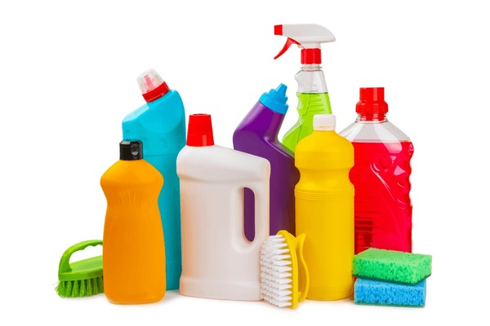
Things That Can’t Wash Away Our Sins

Slide 3
Things That Can’t Wash Away Our Sins
“Although you wash yourself with lye and use much soap, the stain of your iniquity is before Me,” declares the Lord God.
Jeremiah 2:22 NASB

Slide 4

1. Good Works
Not by works of righteousness which we have done, but according to His mercy He saved us, through the washing of regeneration and renewing of the Holy Spirit.
Titus 3:5

Slide 5

2. Prayer
Cornelius was a praying man, but he was not saved - Acts 10:2, 4
Saul was a praying man, but he was not saved - Acts 9:10-12; 22:16
Prayer for forgiveness is a
privilege given to
Christians - Acts 8:22

Slide 6

3. The Blame Game
Genesis 3:12-13
Exodus 32:21-24
1 Samuel 15:15, 21

Slide 7
3. The Blame Game
For we must all appear before the judgment seat of Christ, that each one may receive the things done in the body, according to what he has done, whether
good or bad.
2 Corinthians 5:10

Slide 8

4. Running Away

Slide 9

4. Running Away
Psalm 90:8
Psalm 139:7-12
Numbers 32:23

Slide 10

5. Time
But, beloved, do not forget this one thing, that with the Lord one day is as a thousand years, and a thousand years as one day.
2 Peter 3:8

Slide 11
The Blood of Jesus Washes Away Our Sins
“The next day John saw Jesus coming toward him, and said, ‘Behold! The Lamb of God who takes away the sin of the world!’”
John 1:29

Slide 12
The Blood of Jesus Washes Away Our Sins
Believe in Jesus - John 8:24
Repent of our sins - Luke 13:3
Confess our belief in Jesus - Romans 10:9-10
Be Baptized - Mark 16:16
Remain faithful - 1 John 1:7

