Slide 1
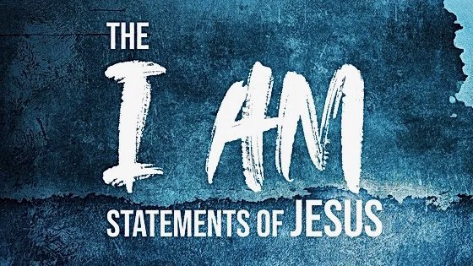
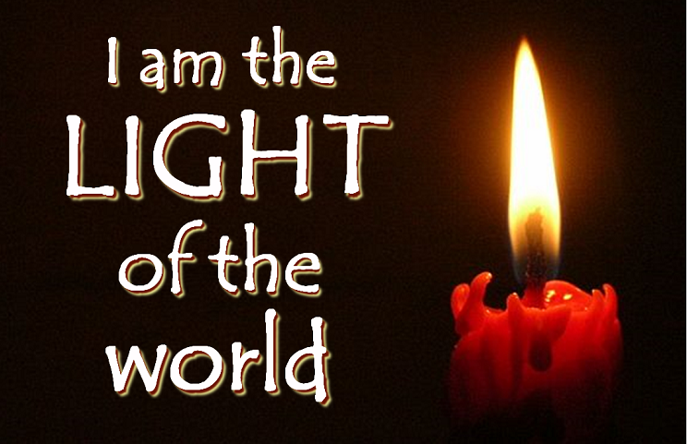

Slide 2
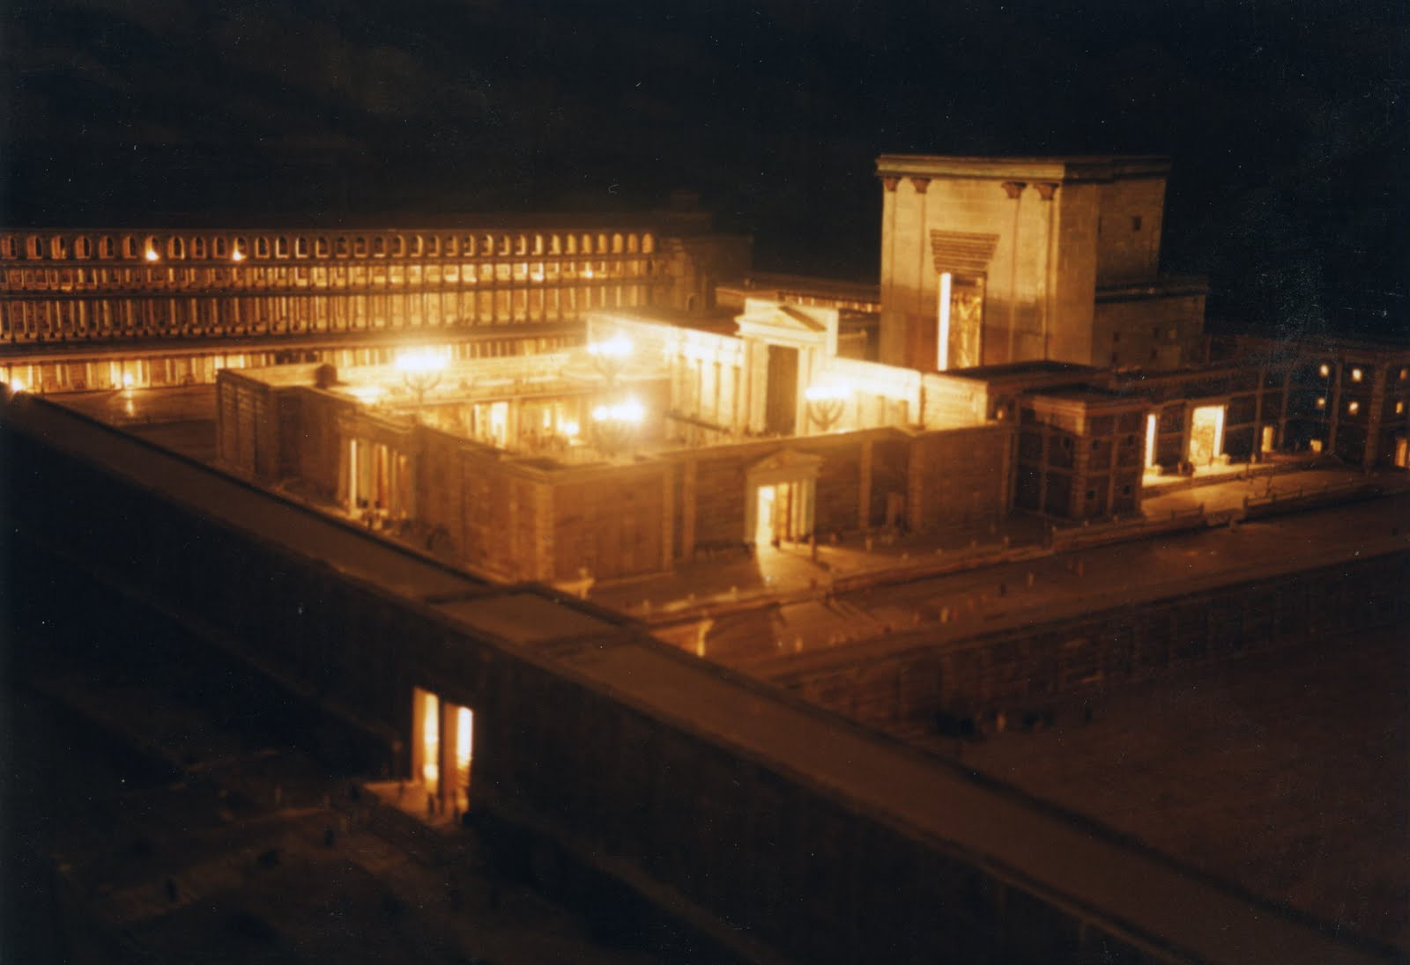
The Feast of Tabernacles
John 7:2

Slide 3
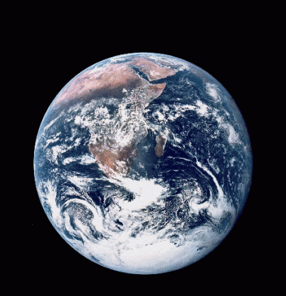
Jesus is the Light of the World
Deliverance from Darkness
Guidance
Revelation from God
Draws Us to God
Gives and Sustains
Spiritual Life

