Slide 1
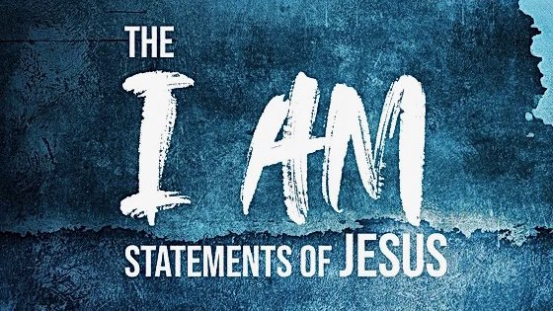
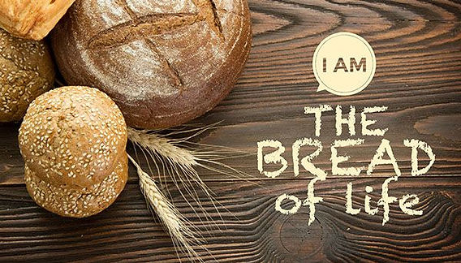

Slide 2
John 6
Jesus fed the 5,000.
They believed He was the Prophet and wanted to take Him by force and make Him king (vs. 14-15).
The next day they looked for Jesus.
“Most assuredly, I say to you, you seek Me, not because you saw the signs, but because you ate of the loaves and were filled” (v. 26).
Contrast between physical and spiritual.

Slide 3
John 6
Jesus speaks of “the food which endures to everlasting life” (v. 27).
They asked Jesus to perform a sign, suggesting He repeat the miracle Moses performed in sending manna (vs. 30-31).
They want to be fed again!
Jesus offers them the bread from heaven that gives life to the world. Then reveals that He is “the bread of life” (vs. 32-35).

Slide 4
Bread in the Bible
Literally – food baked from flour
Generically – representing all food
Figuratively – representing something of which we partake
  adversity, sorrows, wickedness, affliction, idleness.

Slide 5
Jesus is the Bread of Life
Physical bread satisfies our hunger, supplies fuel, and provides nutrients to replenish our body’s cells.
We are spiritual beings (Gen. 1:26-27;
Eccl. 3:11); desiring that which satisfies, fuels, and replenishes our spirits.
Only Jesus can satisfy this hunger!

Slide 6
Physical and Spiritual Bread
Physical bread perishes, spiritual endures to everlasting life (v. 27).
Physical bread does not satisfy, spiritual completely satisfies (v. 35).
Those who eat physical bread will eventually die, those who eat spiritual bread will live forever
(vs. 49-50, 58).

Slide 7
What is the Bread of Life?
Jesus made it clear that He was talking about His words.
“It is the Spirit who gives life; the flesh profits nothing. The words that I speak to you are spirit, and they are life” (v. 63).

