Slide 2
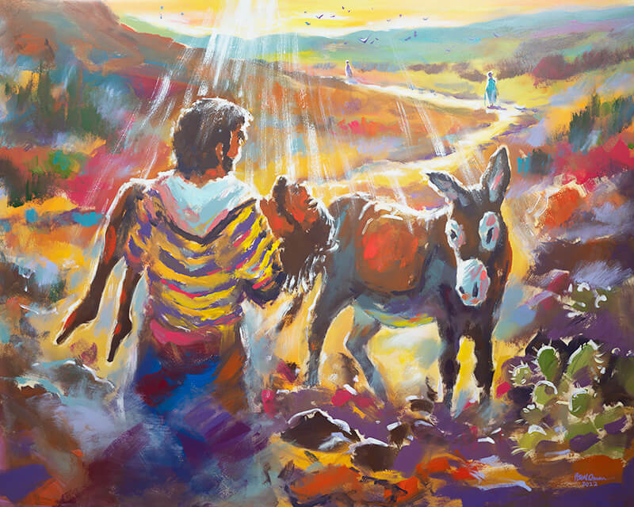
The Compassion of the Good Samaritan
Luke 10:25-37

Slide 3
And behold, a certain lawyer stood up and tested Him, saying, “Teacher, what shall I do to inherit eternal life?”
He said to him, “What is written in the law? What is your reading of it?”
So he answered and said, “‘You shall love the Lord your God with all your heart, with all your soul, with all your strength, and with all your mind,’ and ‘your neighbor as yourself.’”
And He said to him, “You have answered rightly; do this and you will live.”
Luke 10:25-28

Slide 4

But he, wanting to justify himself, said to Jesus, “And who is my neighbor?”

Slide 5
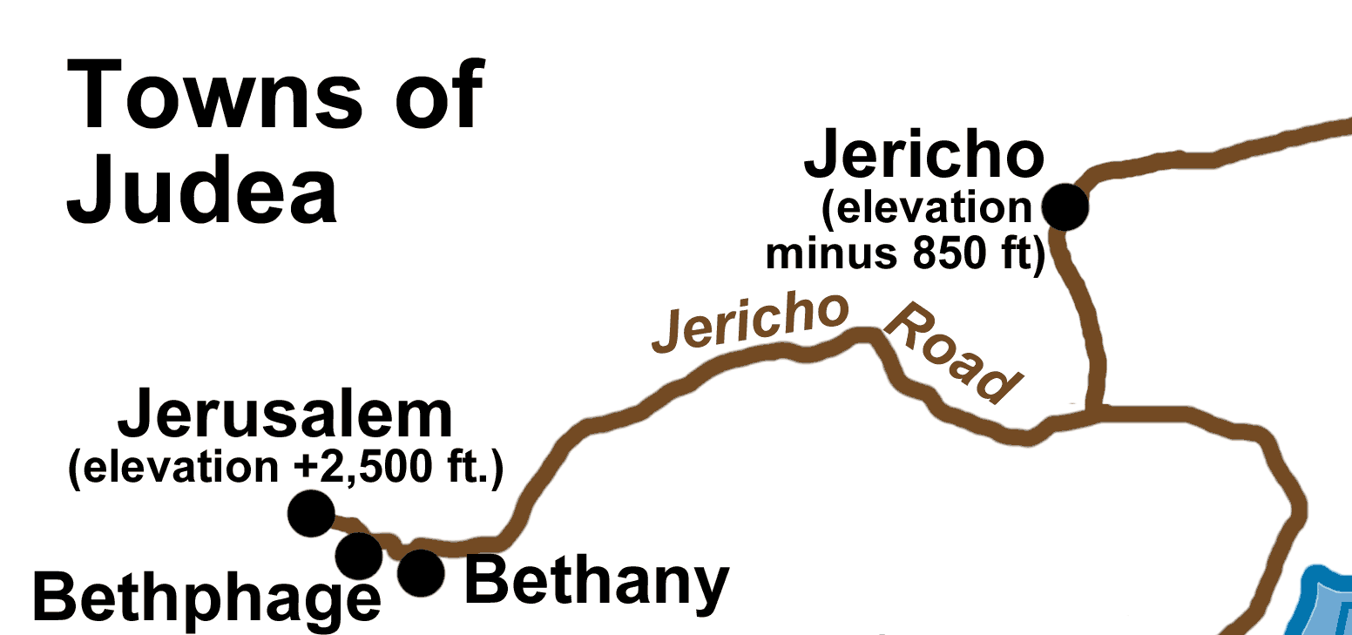
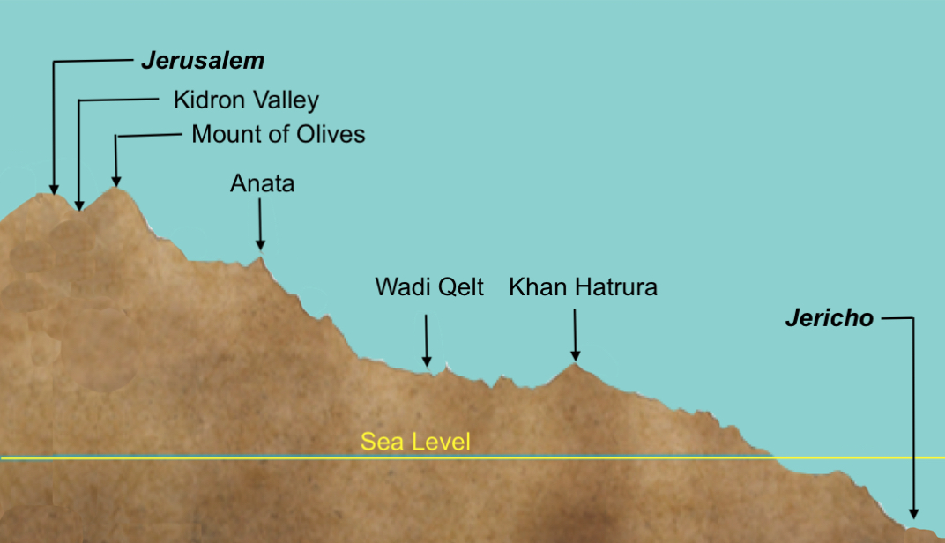
“went down from Jerusalem to Jericho”

Slide 6
Now by chance a certain priest came down that road. And when he saw him, he passed by on the other side.
Likewise a Levite, when he arrived at the place, came and looked, and passed by on the other side.
But a certain Samaritan, as he journeyed, came where he was. And when he saw him, he had compassion.
Luke 10:31-33

Slide 7
What the Samaritan Did
He Saw
He Had Compassion
He Went
He Got Involved

Slide 8
“So which of these three do you think was neighbor to him who fell among the thieves?”
And he said, “He who showed mercy on him.” Then Jesus said to him, “Go and do likewise.”
Luke 10:36-37

Slide 9
Jesus had compassion on…
Those struggling under poor leadership - Matt. 9:36
Those who were hungry - Matt. 15:32
Two blind men - Matt. 20:34
A leper - Mark 1:41
A demon-possessed man - Mark 5:19
A grieving widow - Luke 7:13

