Slide 1

Doctrine
That Makes Us
Different
Why We Oppose
Premillennialism

Slide 2



What is Premillennialism?
The Antichrist
The Rapture
Seven Year Tribulation
Thousand Year Reign of Christ
Battle of Armageddon

Slide 3
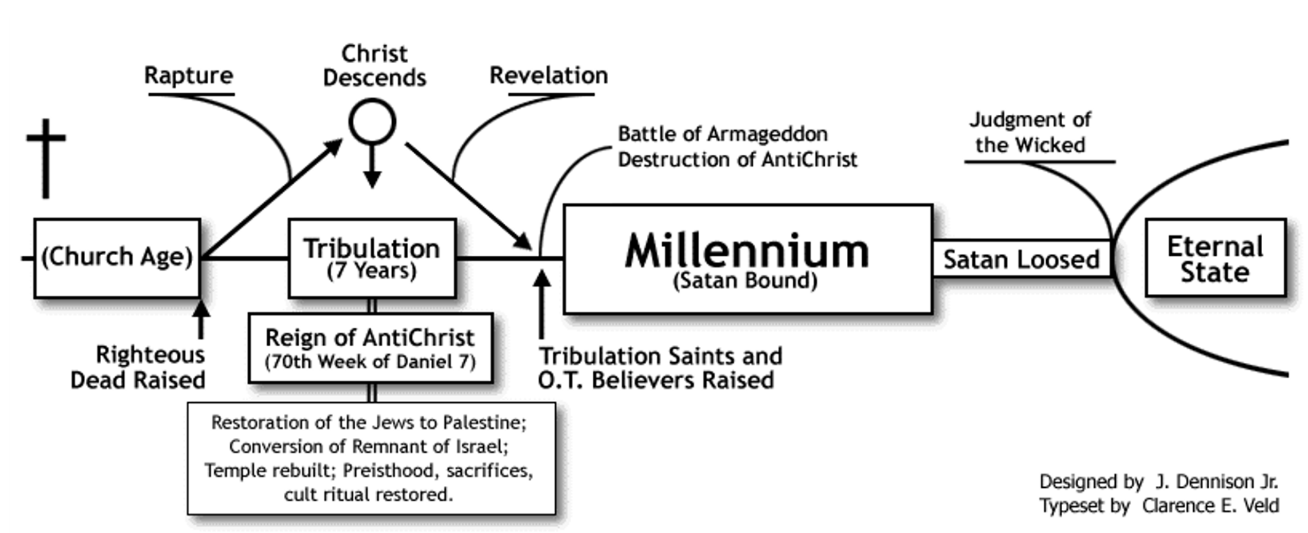

Slide 4
Problems with Premillennialism
Makes Jesus a Failure
  Job 42:2; Psalm 2
Makes Jesus a False Prophet
  Mark 9:1; Deut. 18:15-22
Minimizes the Lord’s Church
  Eph. 3:8-11
Calls for a Return to the Law of Moses
  Heb. 10:1-10; Matt. 5:17; Col. 2:14

Slide 5

Starting in January
new series for our 9:30 am service

