Slide 2

How Our Ears Test Words
Does not the ear test words
as the palate tastes food?
Job 12:11 ESV

Slide 3
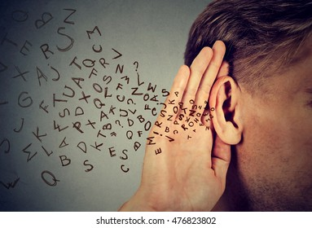
1. Take time to think and process what we hear
“The heart of the righteous studies how to answer, but the mouth of the wicked pours forth evil”
(Prov. 15:28).
“He who answers a matter before he hears it, it is folly and shame to him” (Prov. 18:13).

Slide 4
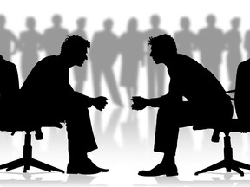
2. Get all the facts
“The first one to plead his cause seems right,
until his neighbor comes and examines him”
(Prov. 18:17).

Slide 5
2. Get all the facts
“One witness shall not rise against a man concerning any iniquity or any sin that he commits; by the mouth of two or three witnesses the matter shall be established” (Deut. 19:15).
John 8:17
Matthew 18:16
1 Timothy 5:19

Slide 6
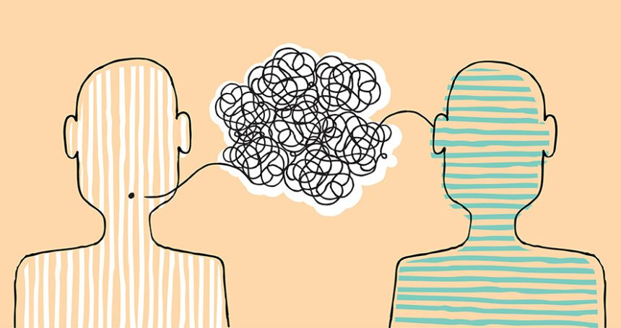
3. Guard against deception
“Now this I say lest anyone should deceive you with persuasive words” (Col. 2:4).

Slide 7
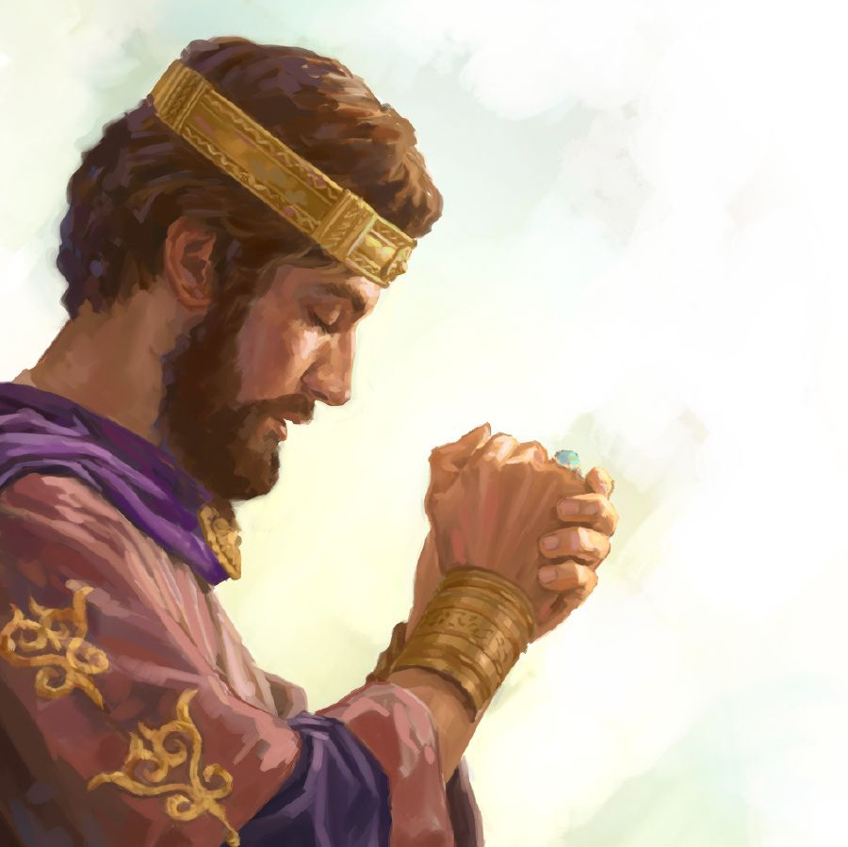
4. Pray for wisdom
“Therefore give to Your servant an understanding heart to judge Your people, that I may discern between good and evil. For who is able to judge this great people of Yours?”
1 Kings 3:9

Slide 8
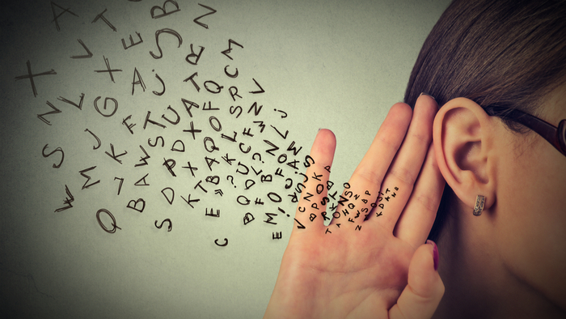
How Our Ears Test Words
Think and Process What We Hear
Get All the Facts
Guard Against Deception
Pray for Wisdom

