Slide 1


Please take this time to prepare yourself for the worship service.

Slide 2

1134 - Thy Word Is A Treasure - Title

Slide 3
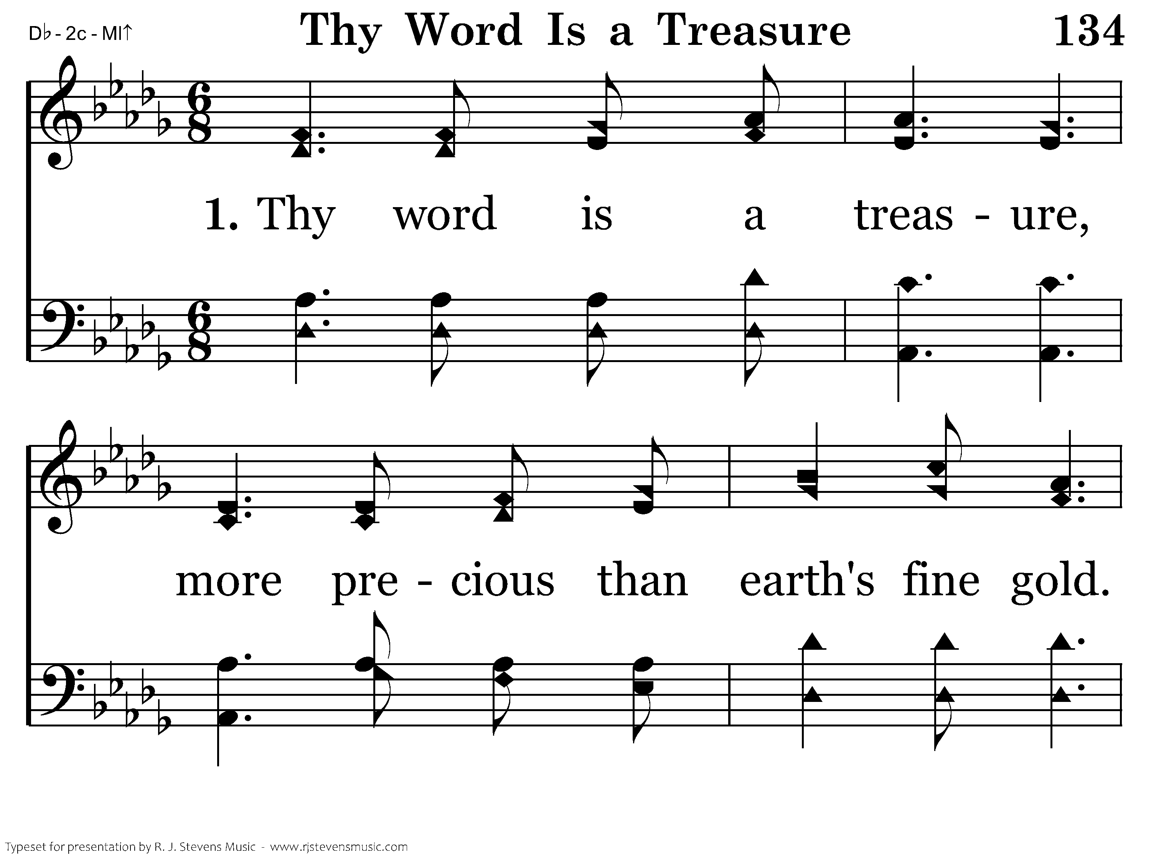
1134 - Thy Word Is A Treasure - 1.1

Slide 4
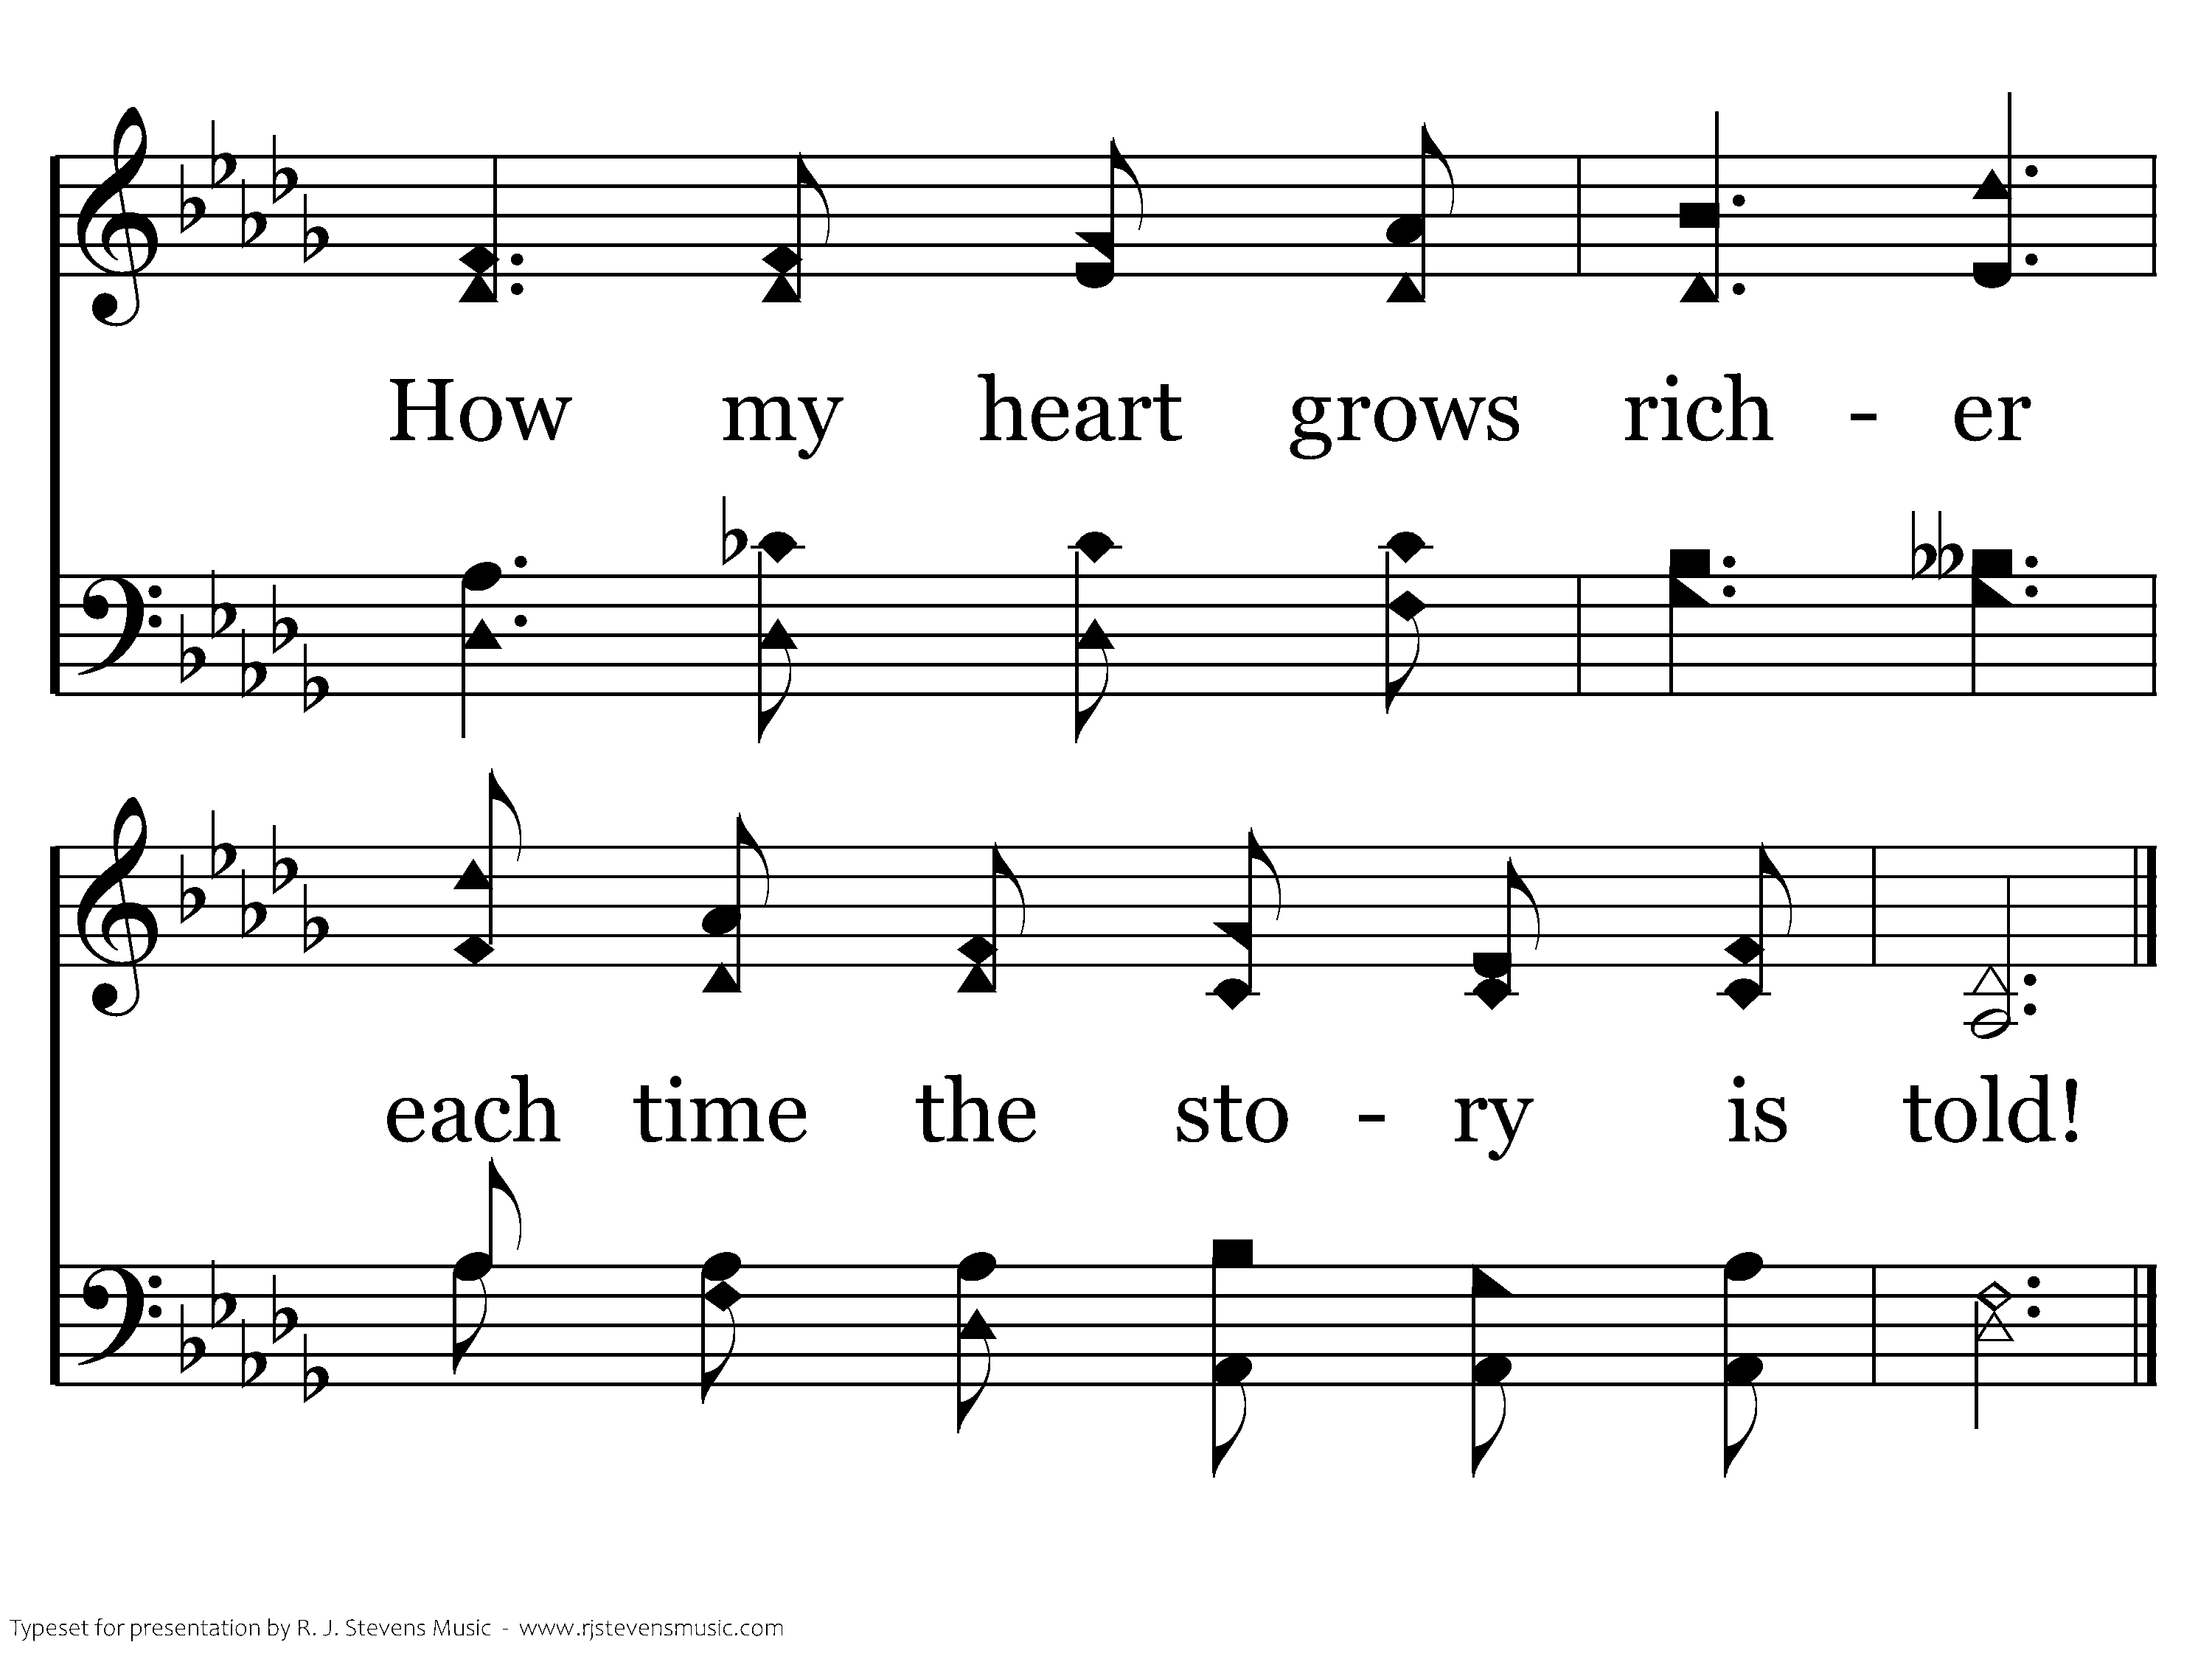
1134 - Thy Word Is A Treasure - 1.2
End of Verse 1

Slide 5
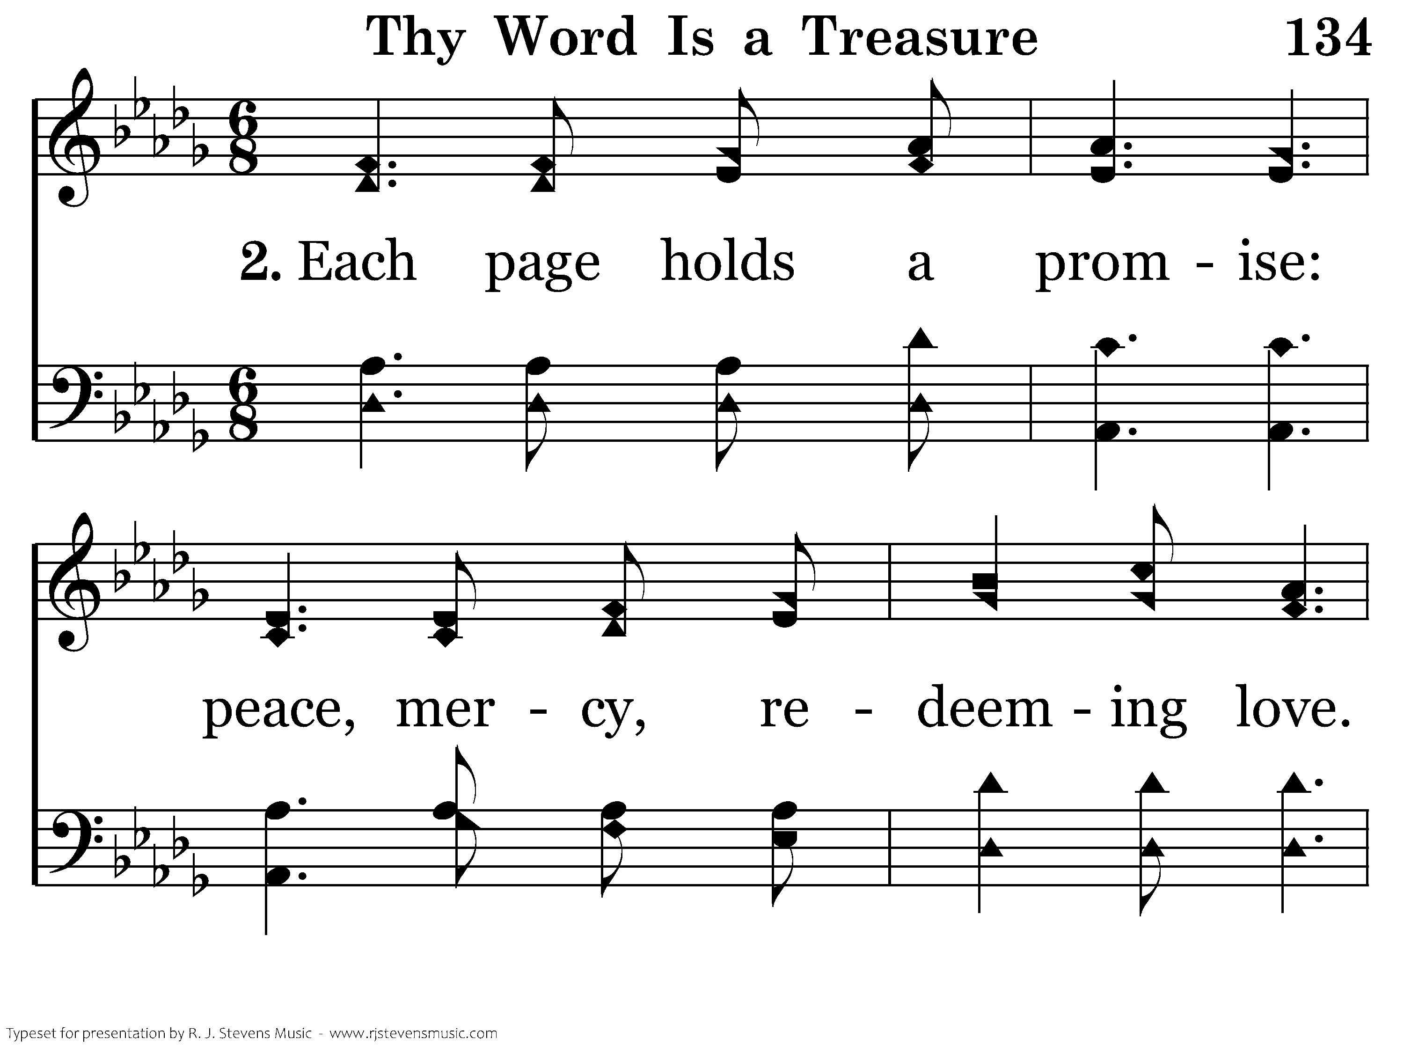
1134 - Thy Word Is A Treasure - 2.1

Slide 6
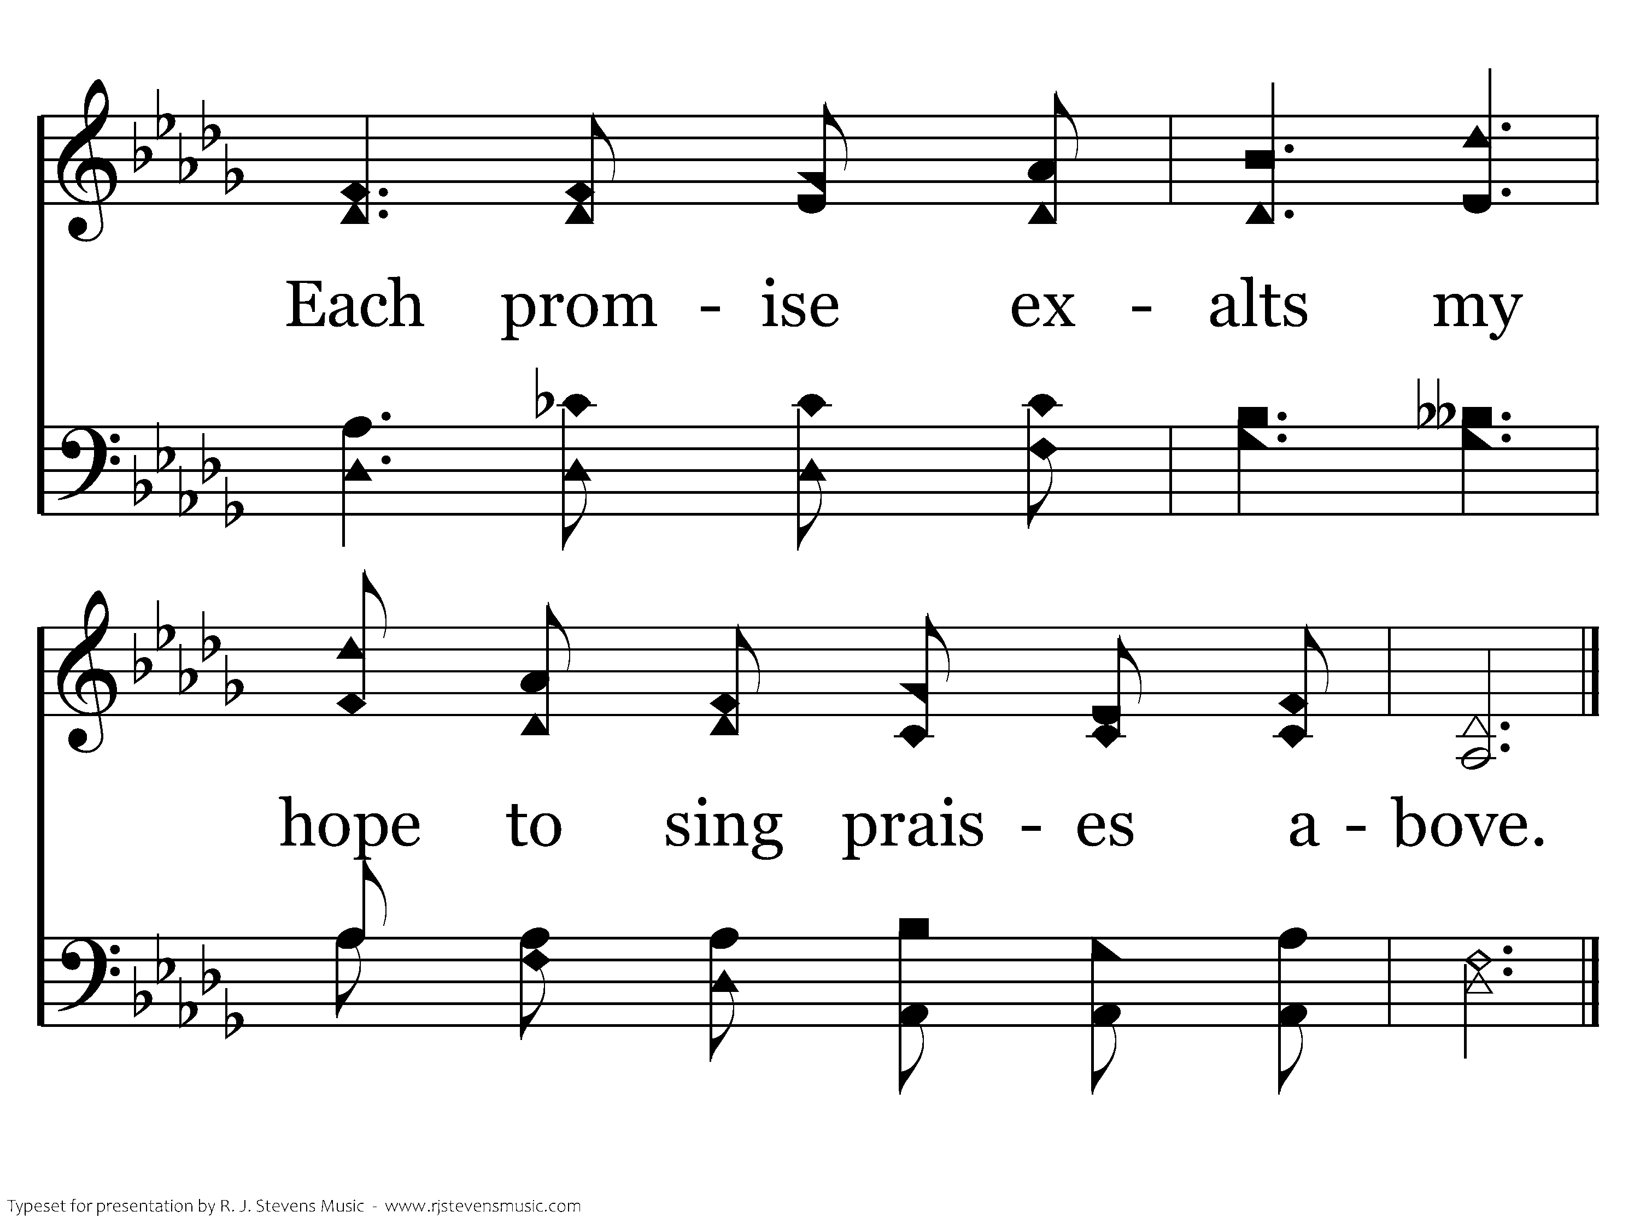
1134 - Thy Word Is A Treasure - 2.2
End of Verse 2

Slide 7
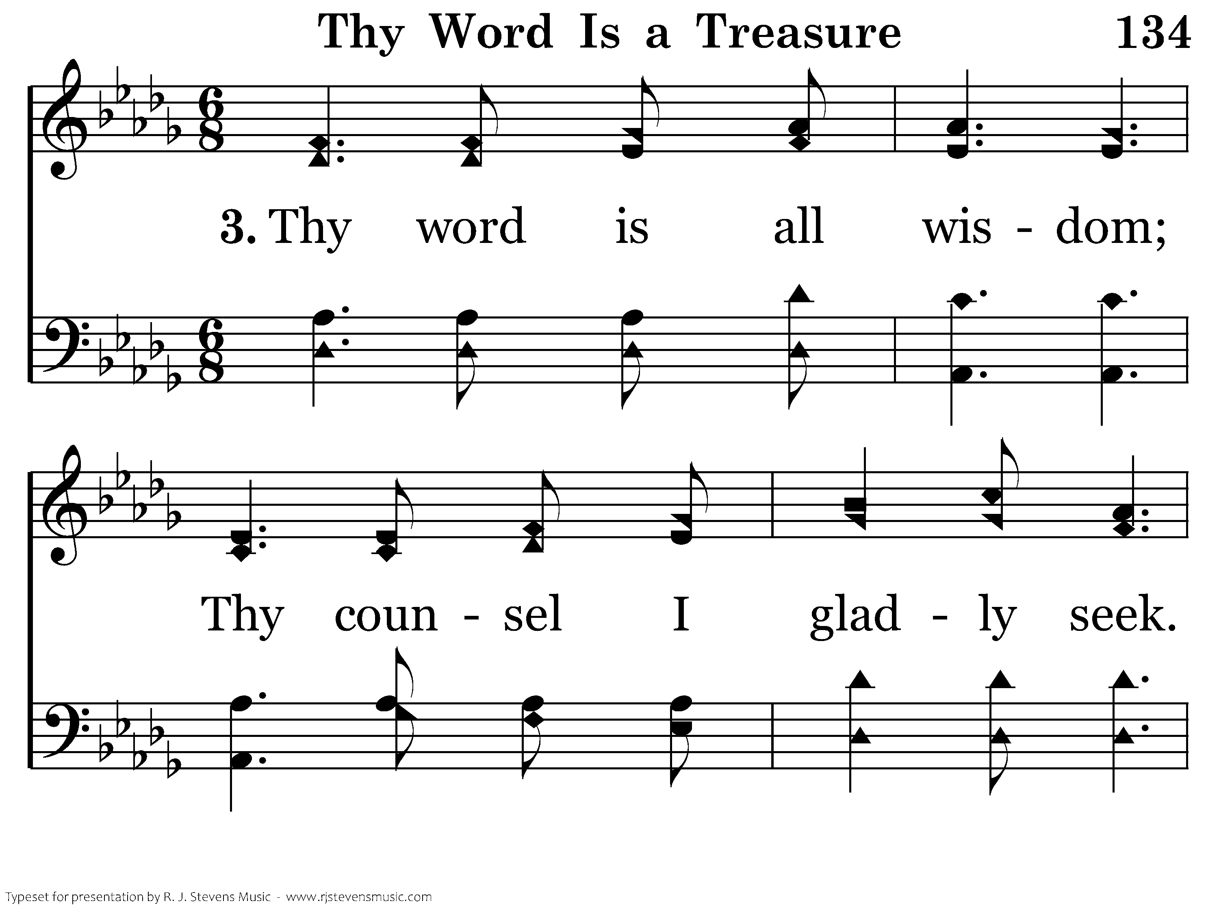
1134 - Thy Word Is A Treasure - 3.1

Slide 8
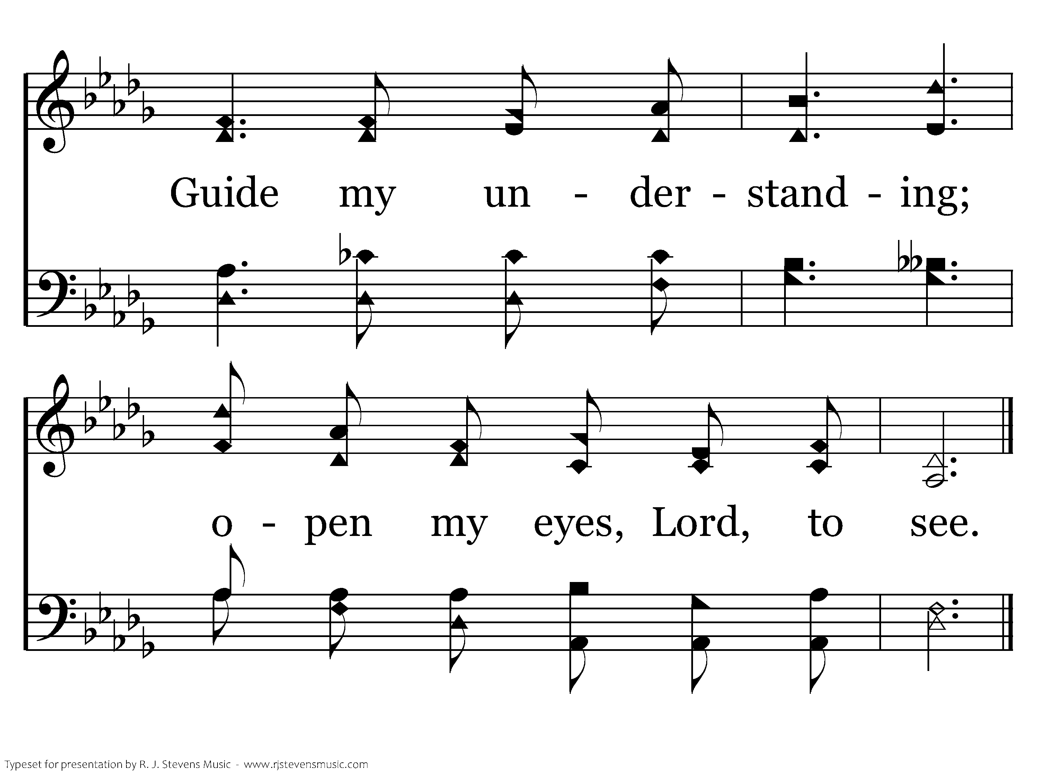
1134 - Thy Word Is A Treasure - 3.2
End of Verse 3

Slide 9
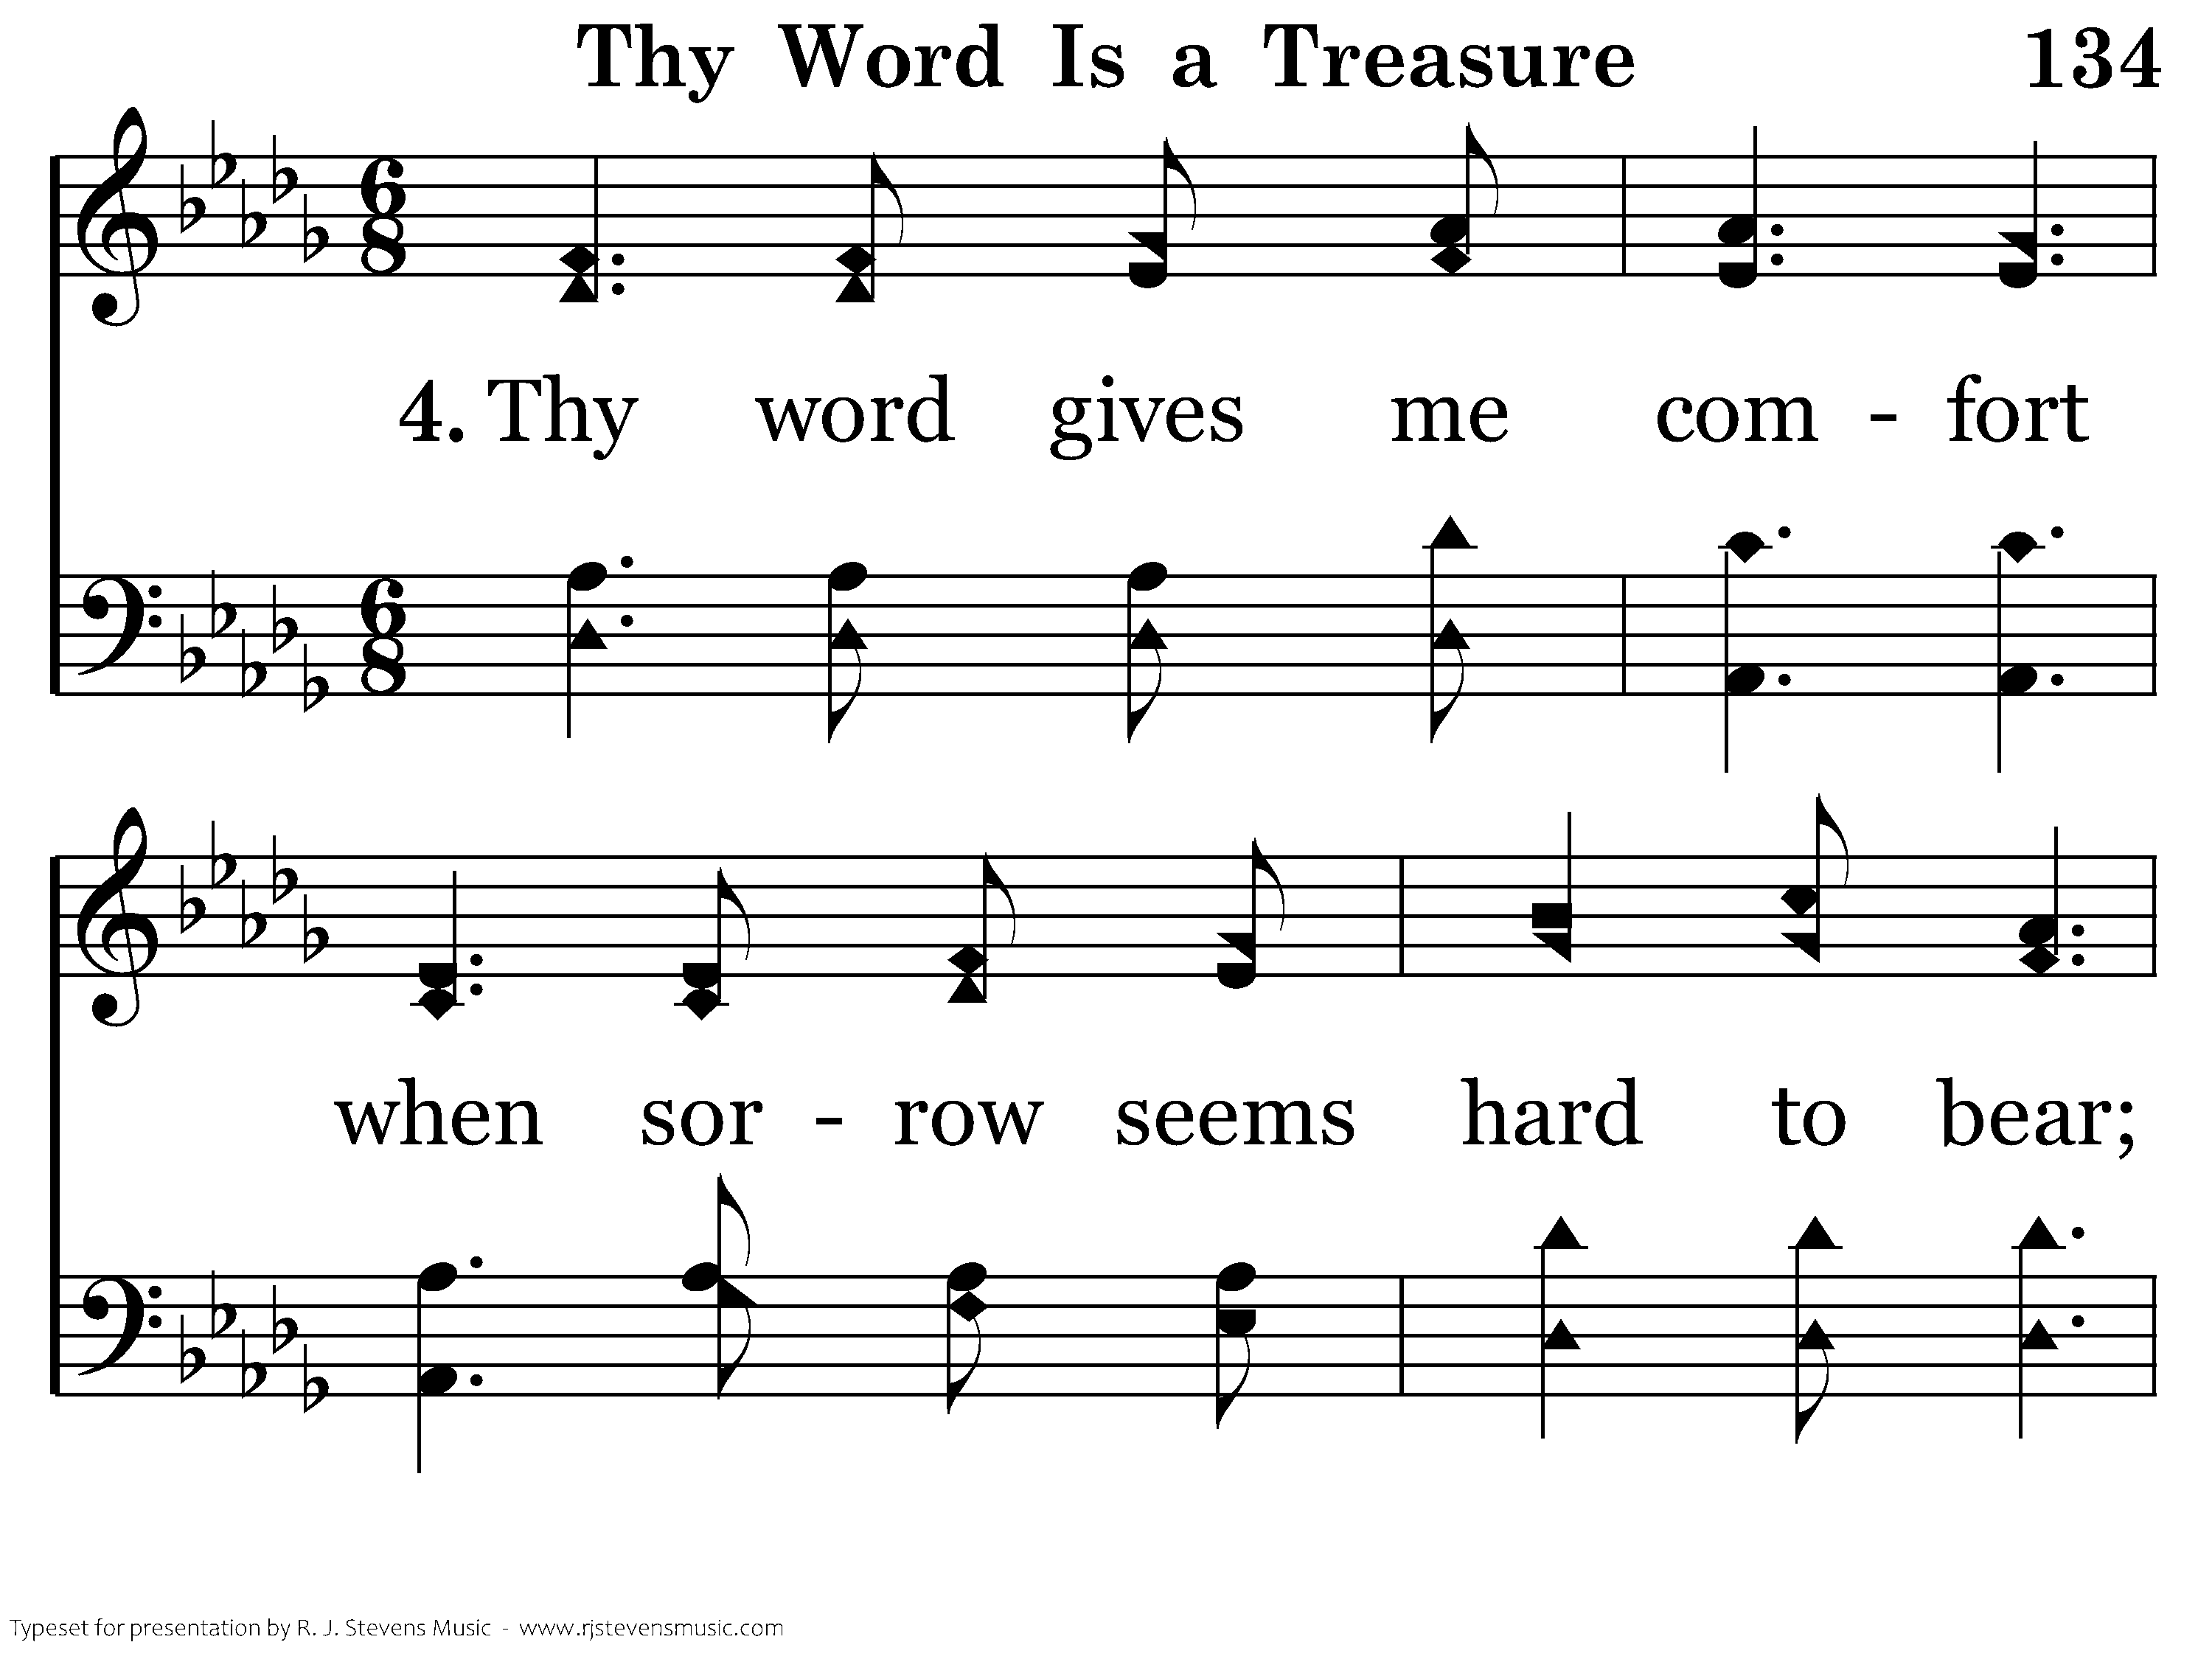
1134 - Thy Word Is A Treasure - 4.1

Slide 10
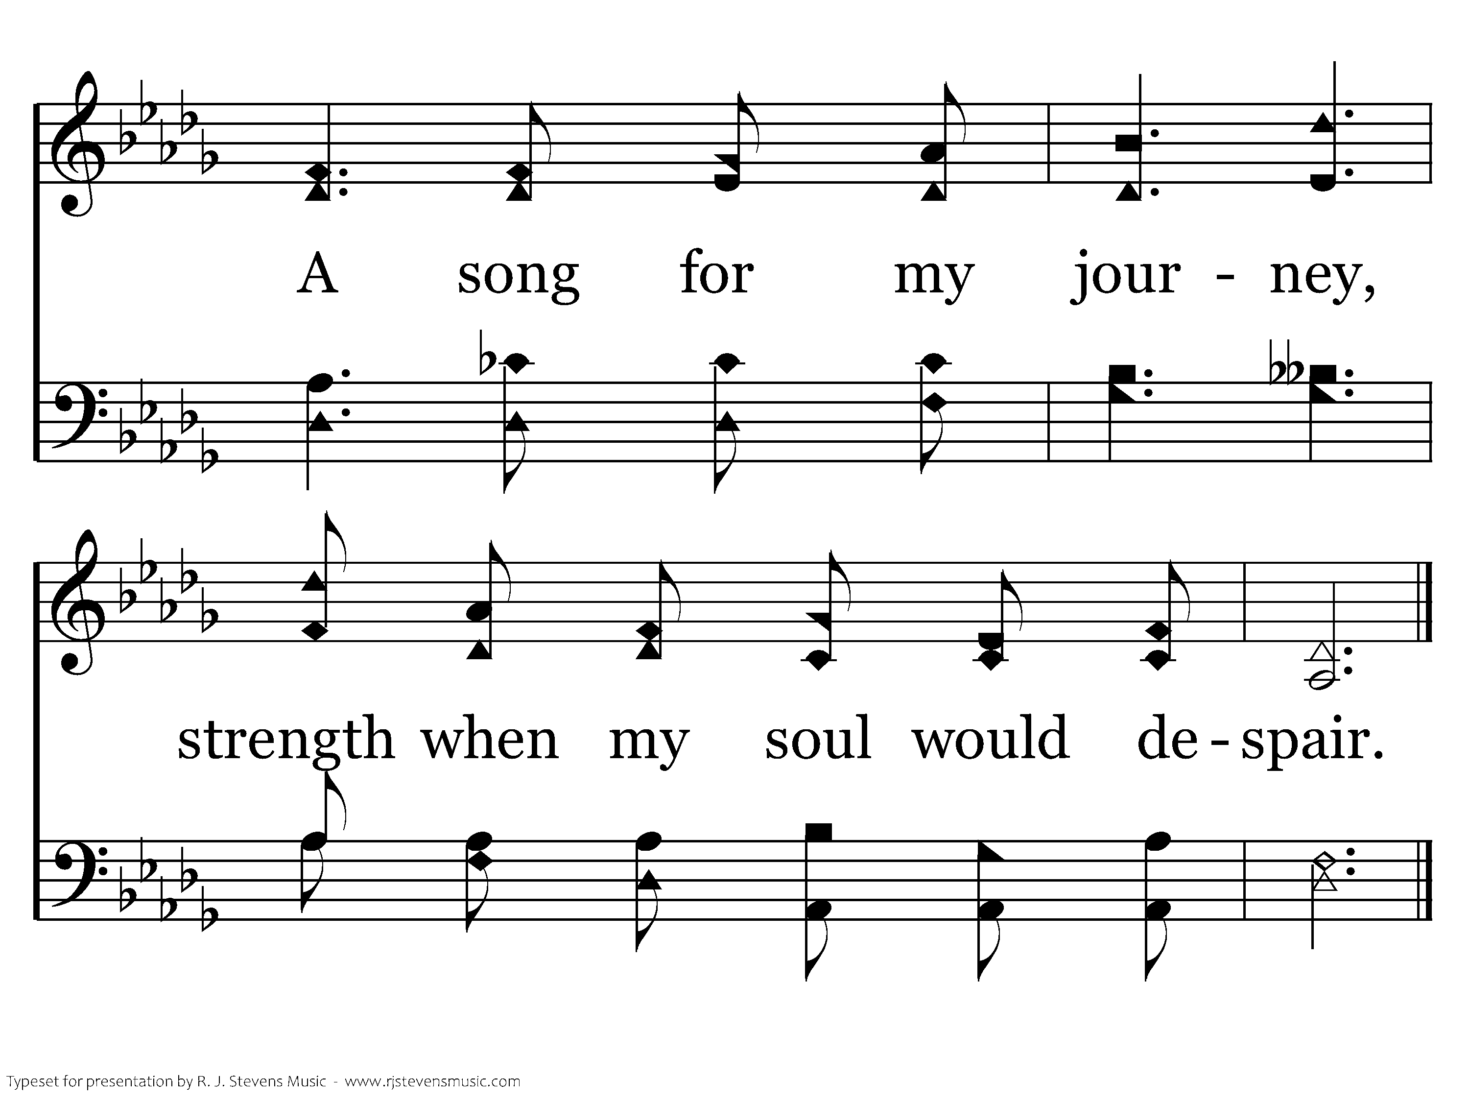
1134 - Thy Word Is A Treasure - 4.2
End of Verse 4

Slide 11
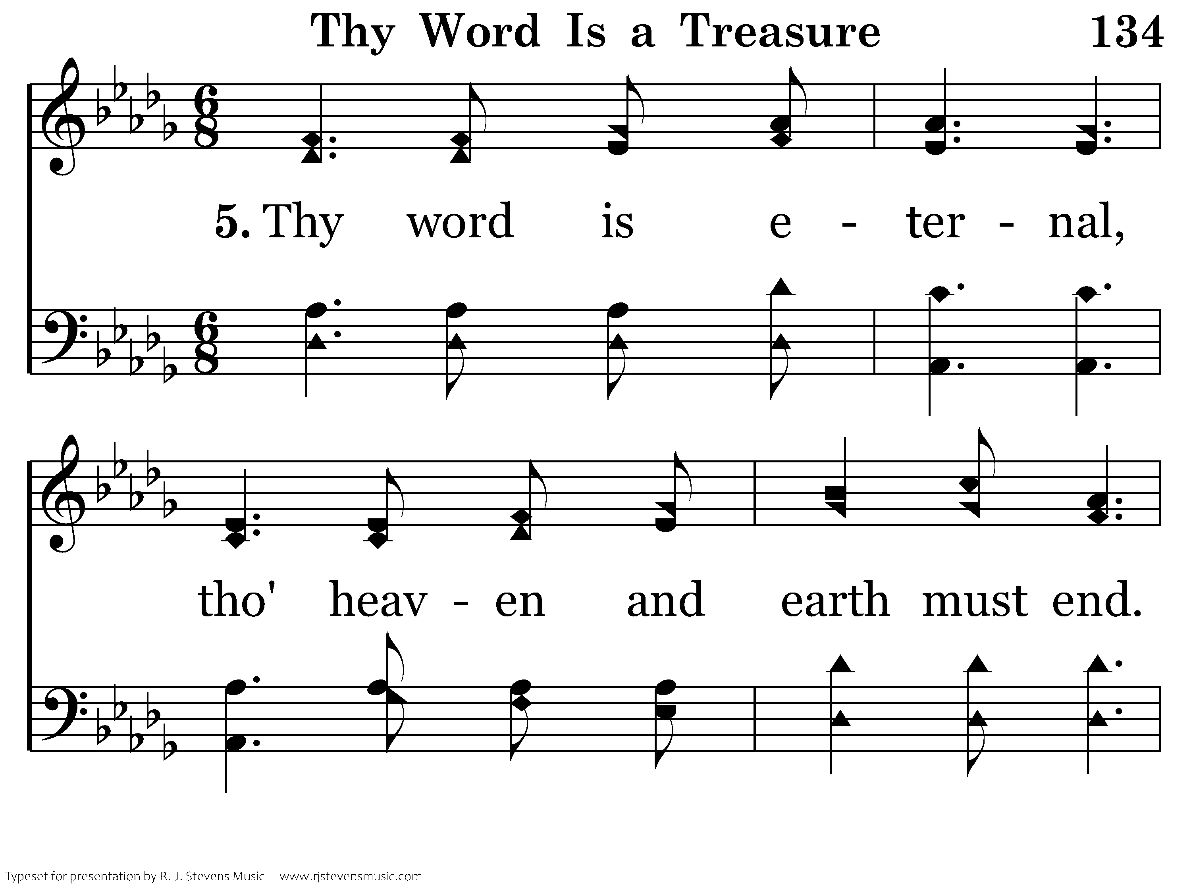
1134 - Thy Word Is A Treasure - 5.1

Slide 12
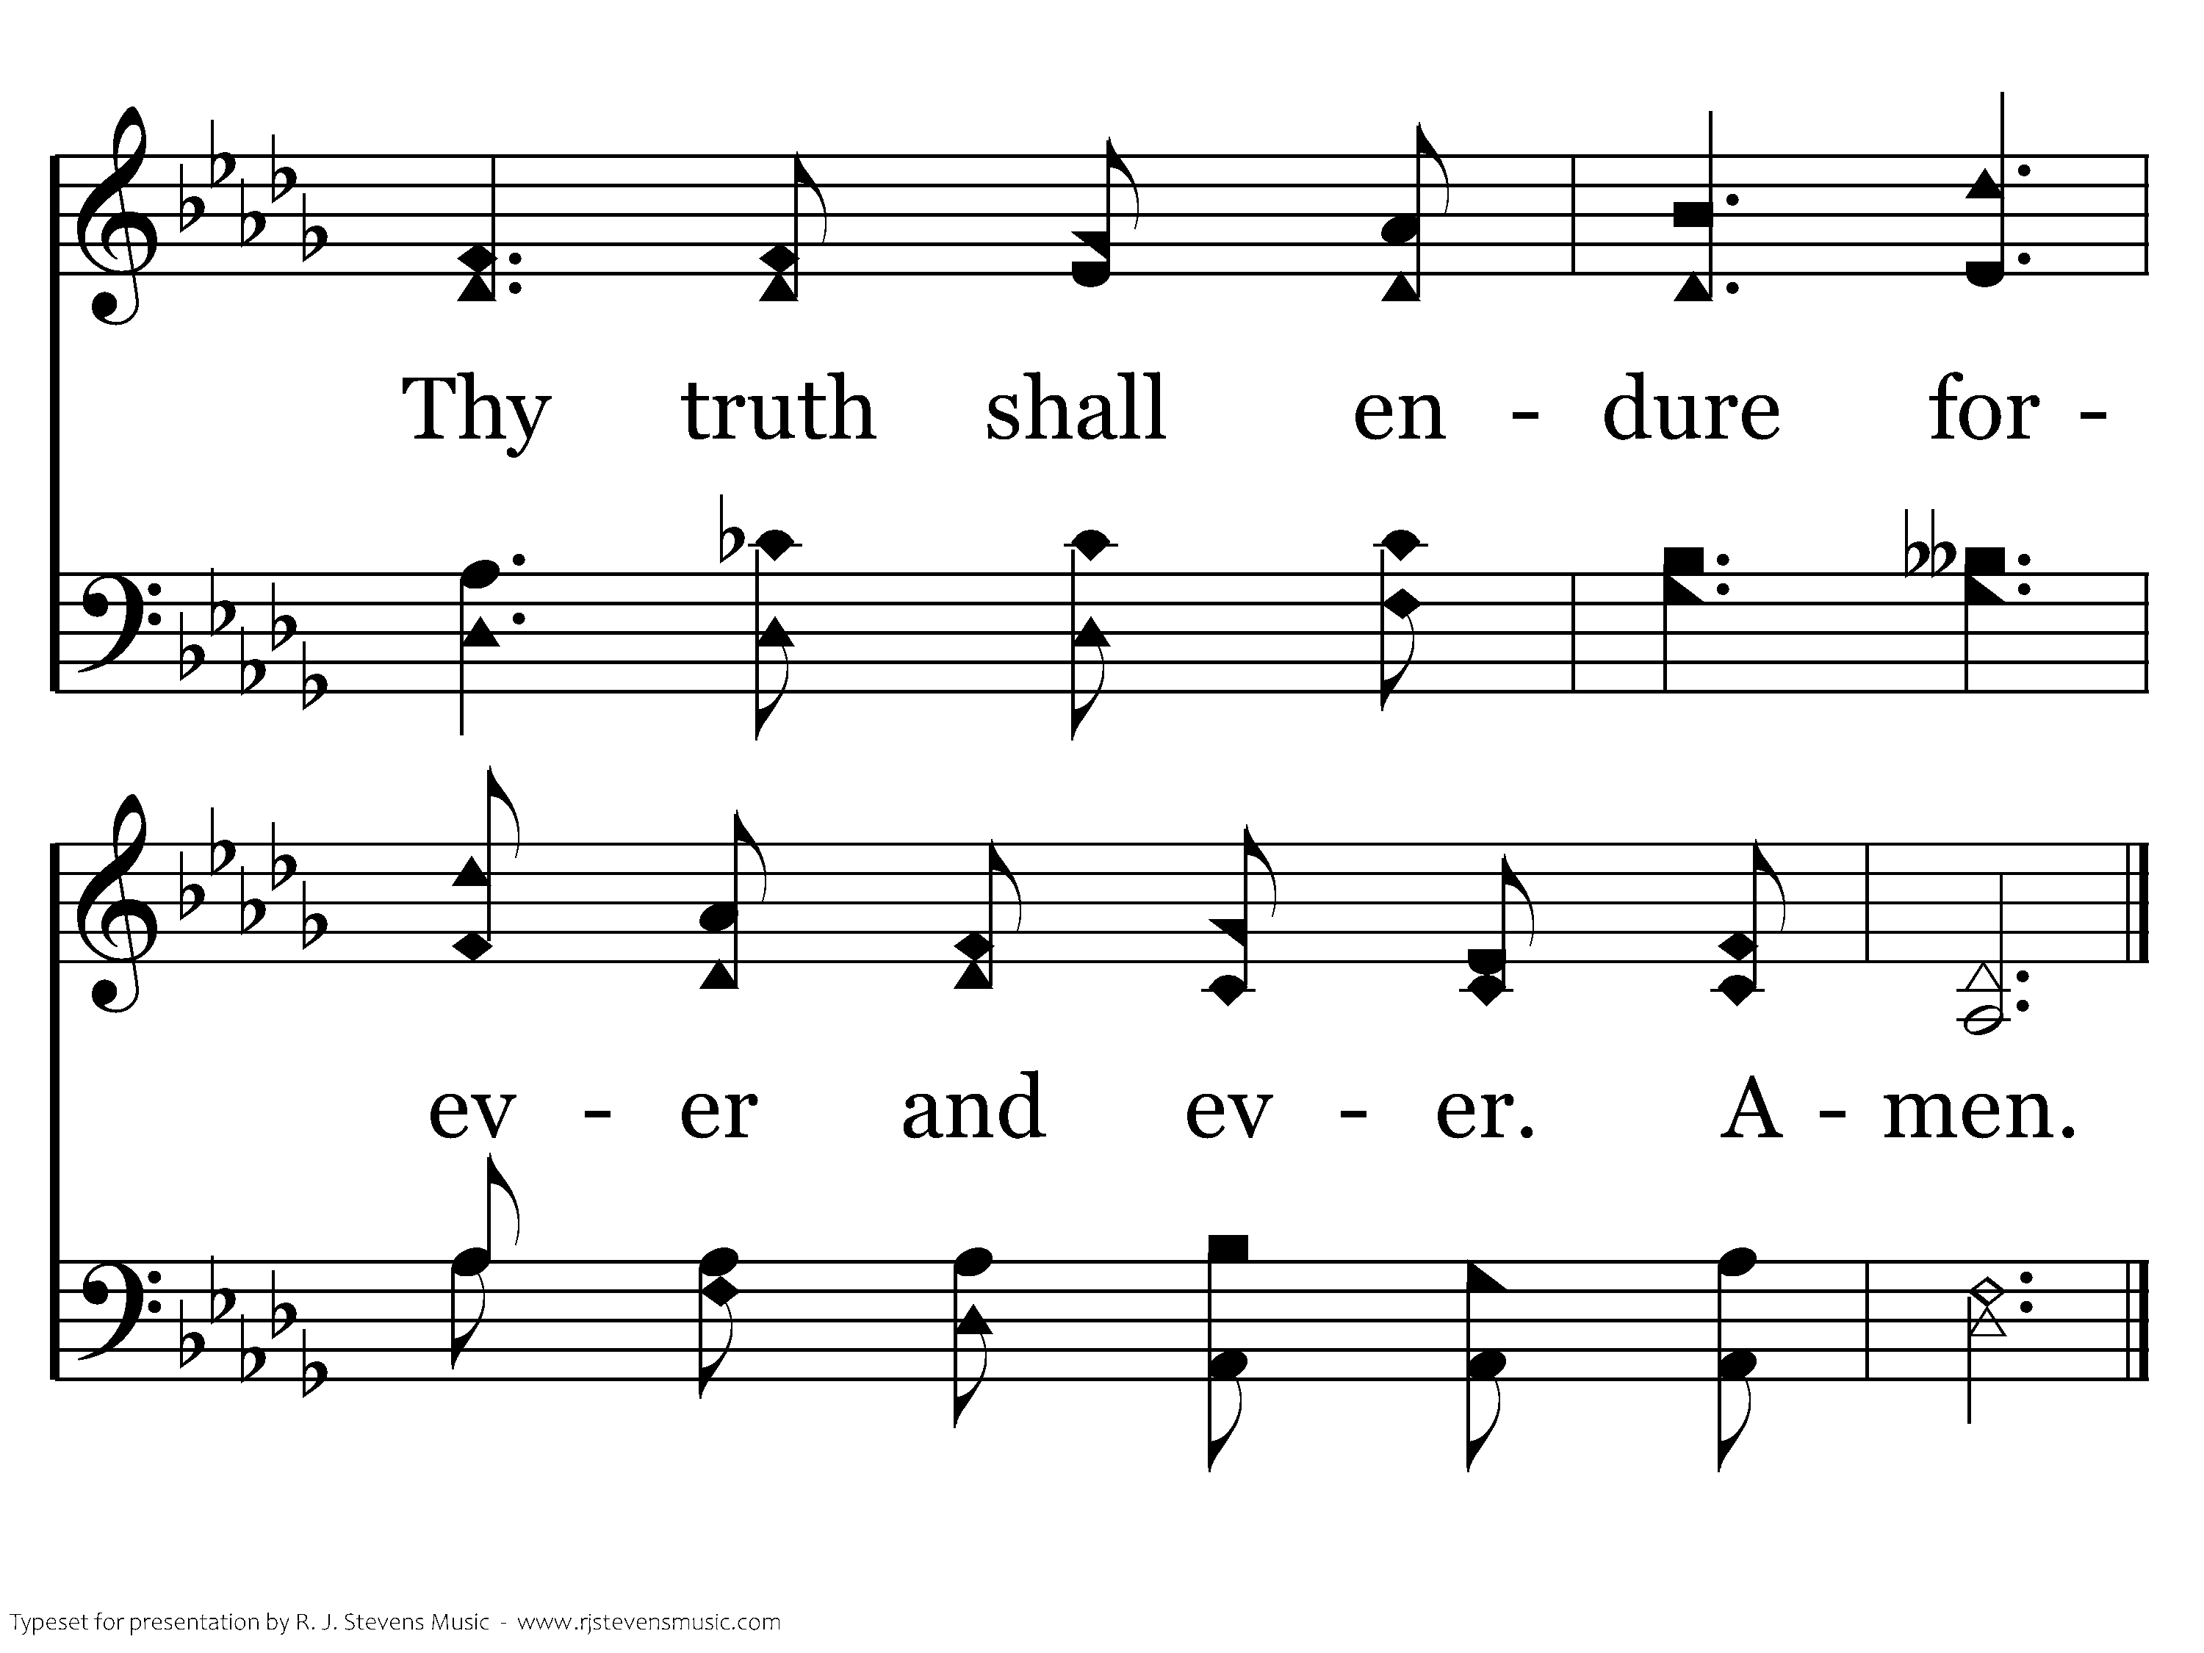
1134 - Thy Word Is A Treasure - 5.2
End of Song

Slide 13
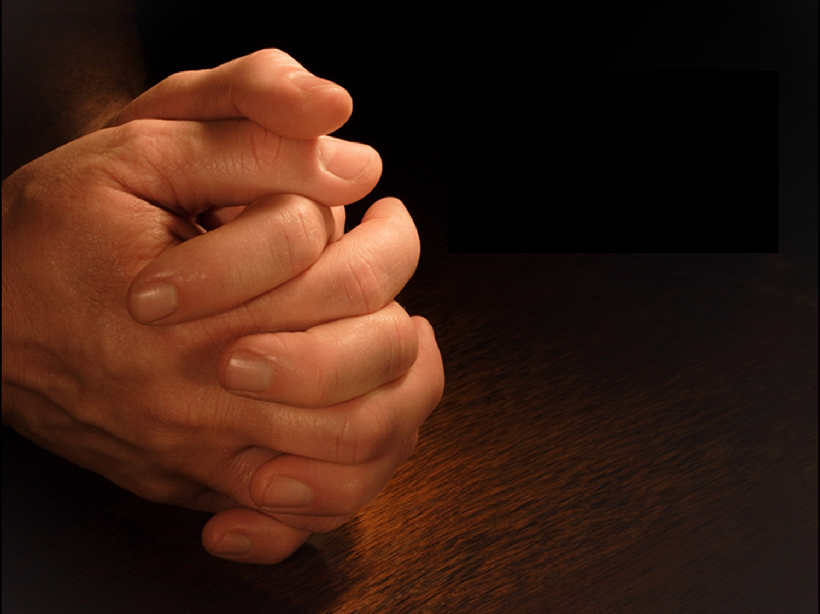
Opening Prayer

Slide 14

1 Timothy 2:1-4
Scripture Reading
Mark 14:3-9

Slide 15
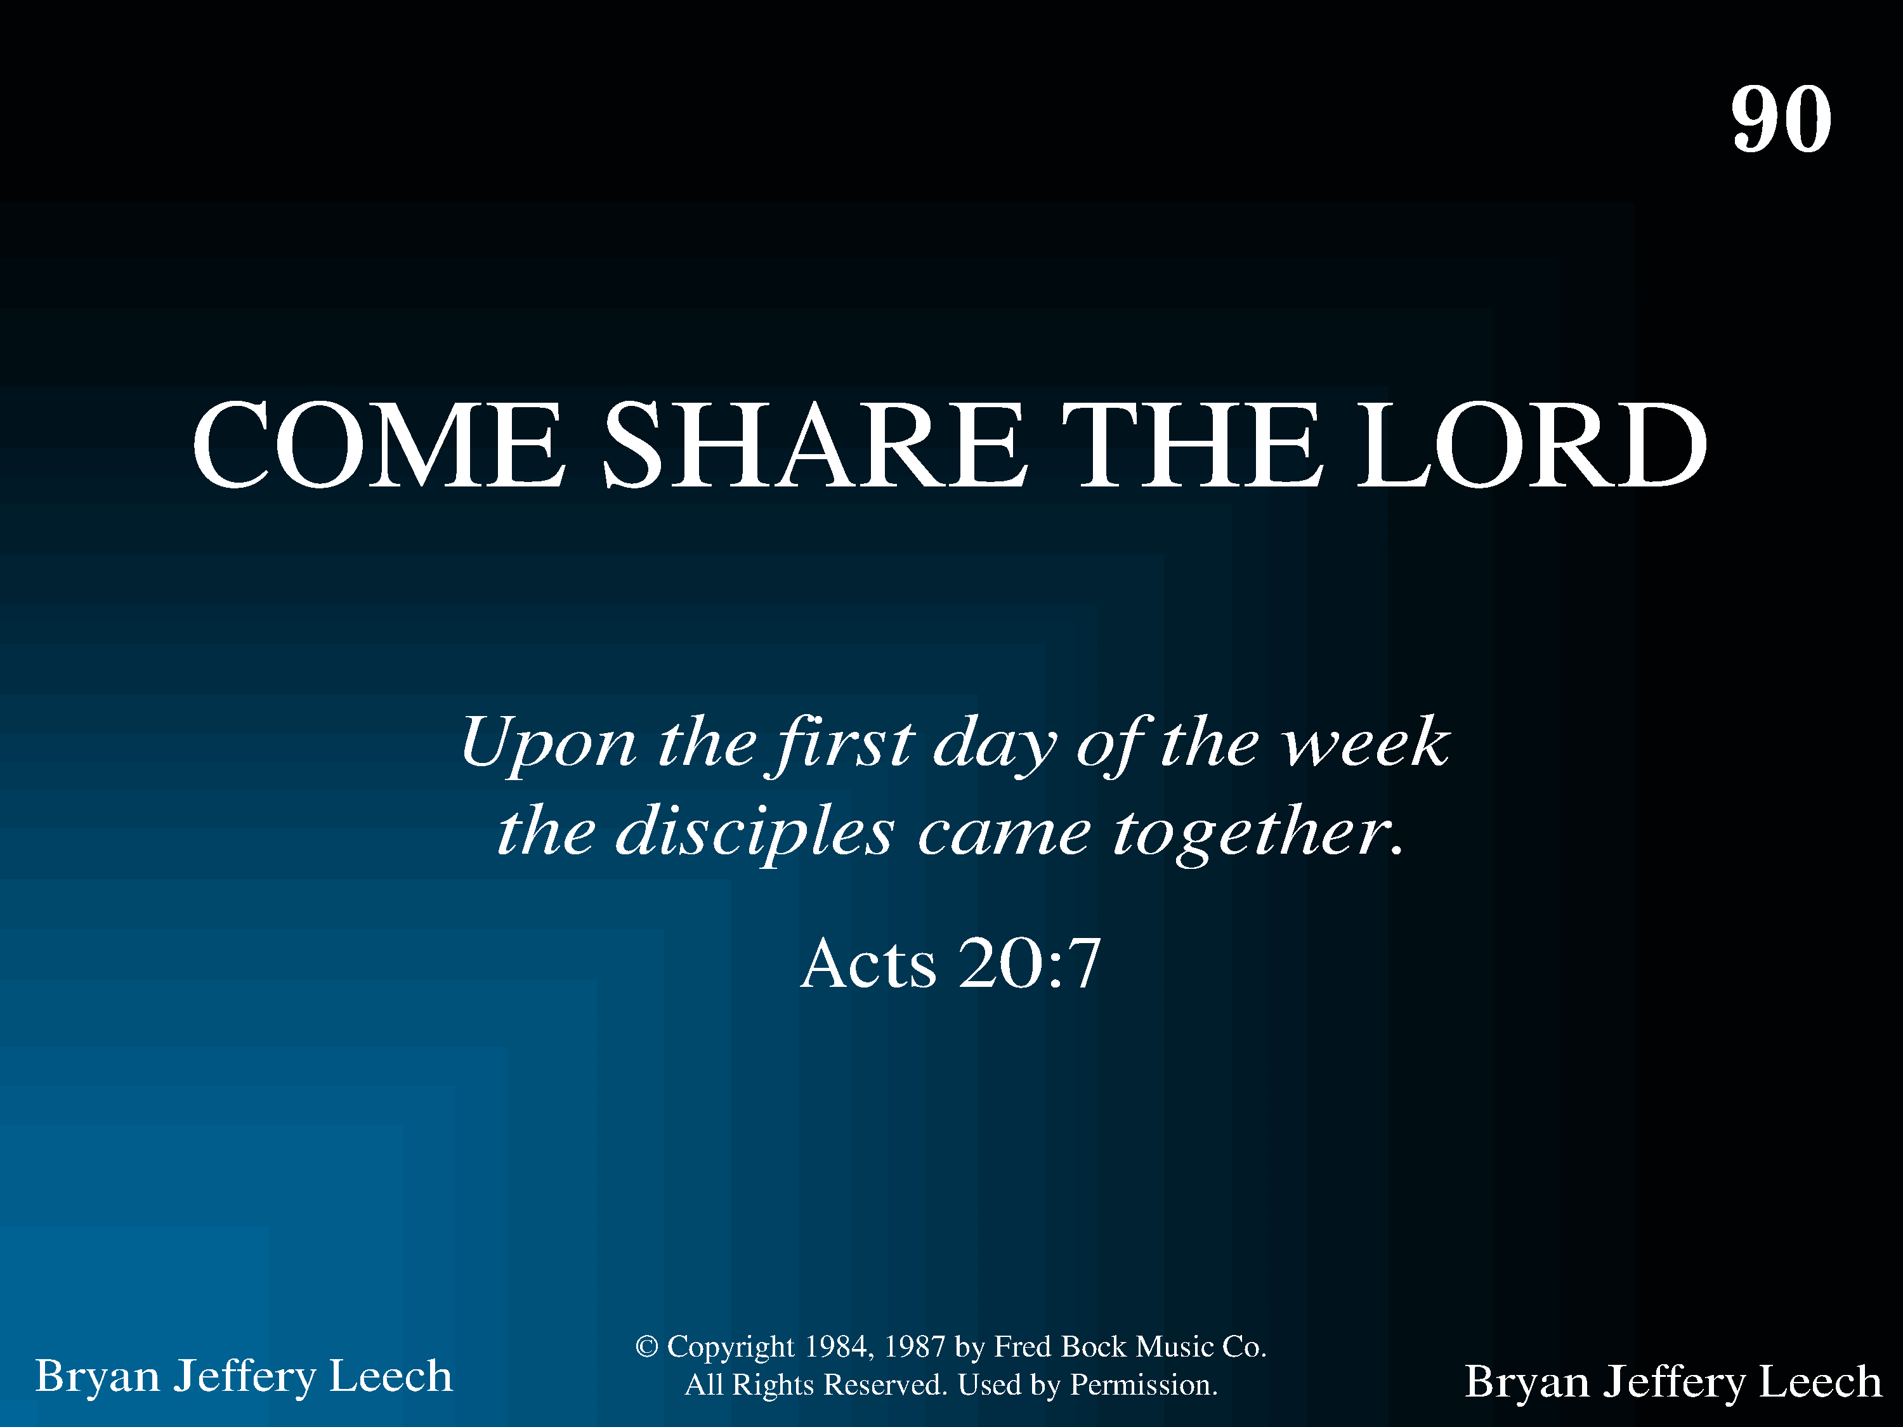
1090 - Come, Share The Lord - Title

Slide 16
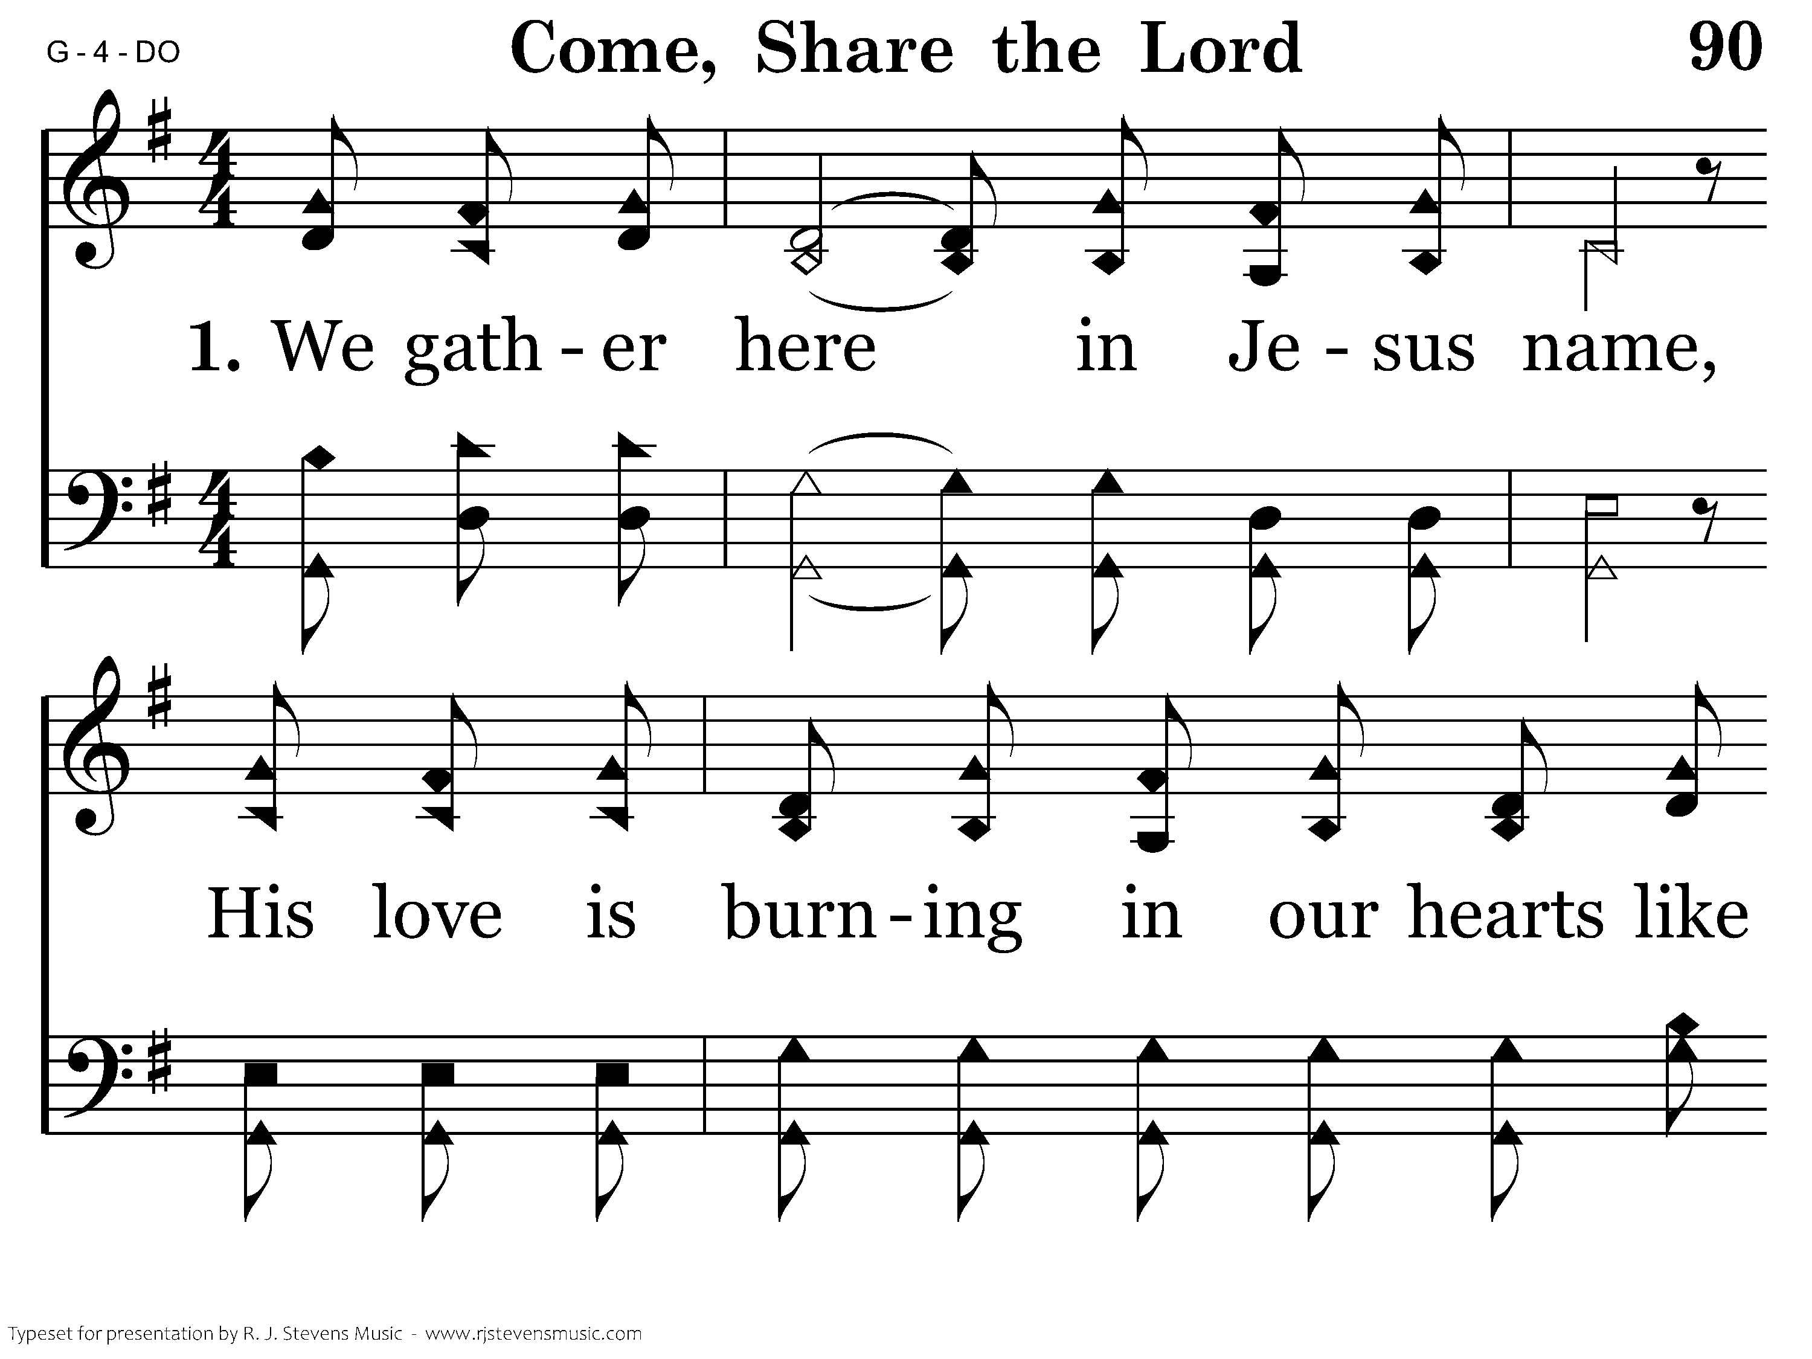
1090 - Come, Share The Lord - 1.1

Slide 17
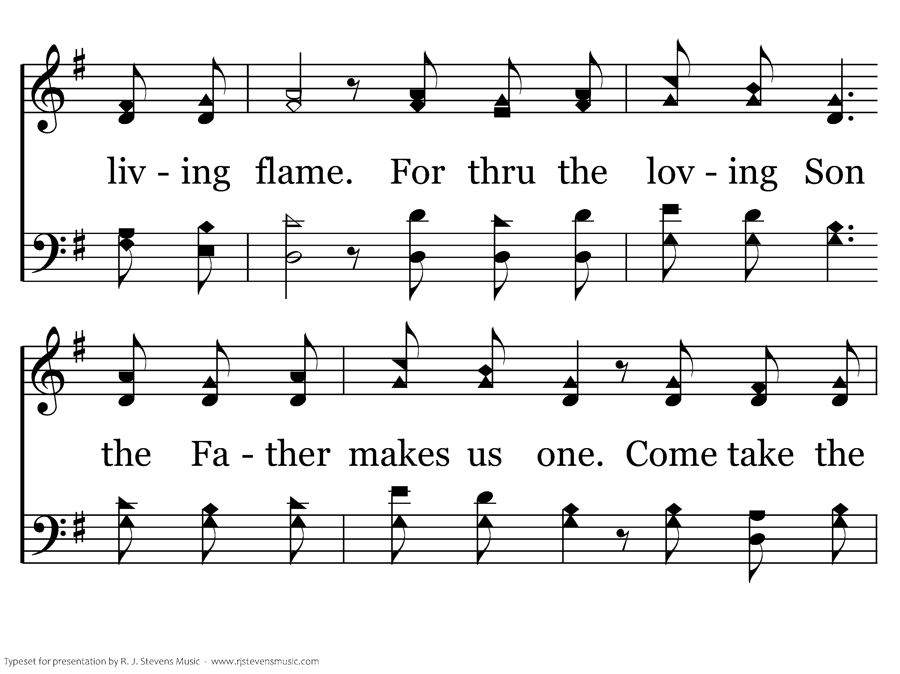
1090 - Come, Share The Lord - 1.2

Slide 18
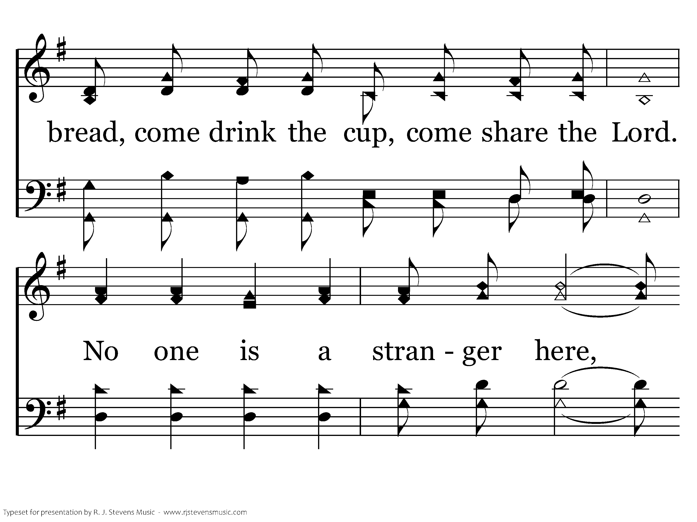
1090 - Come, Share The Lord - 1.3

Slide 19
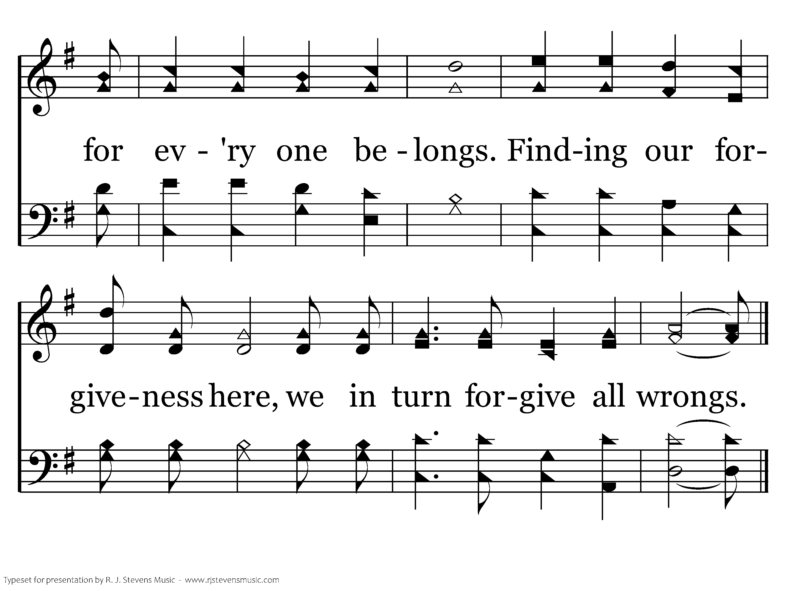
1090 - Come, Share The Lord - 1.4
End of Verse 1

Slide 20
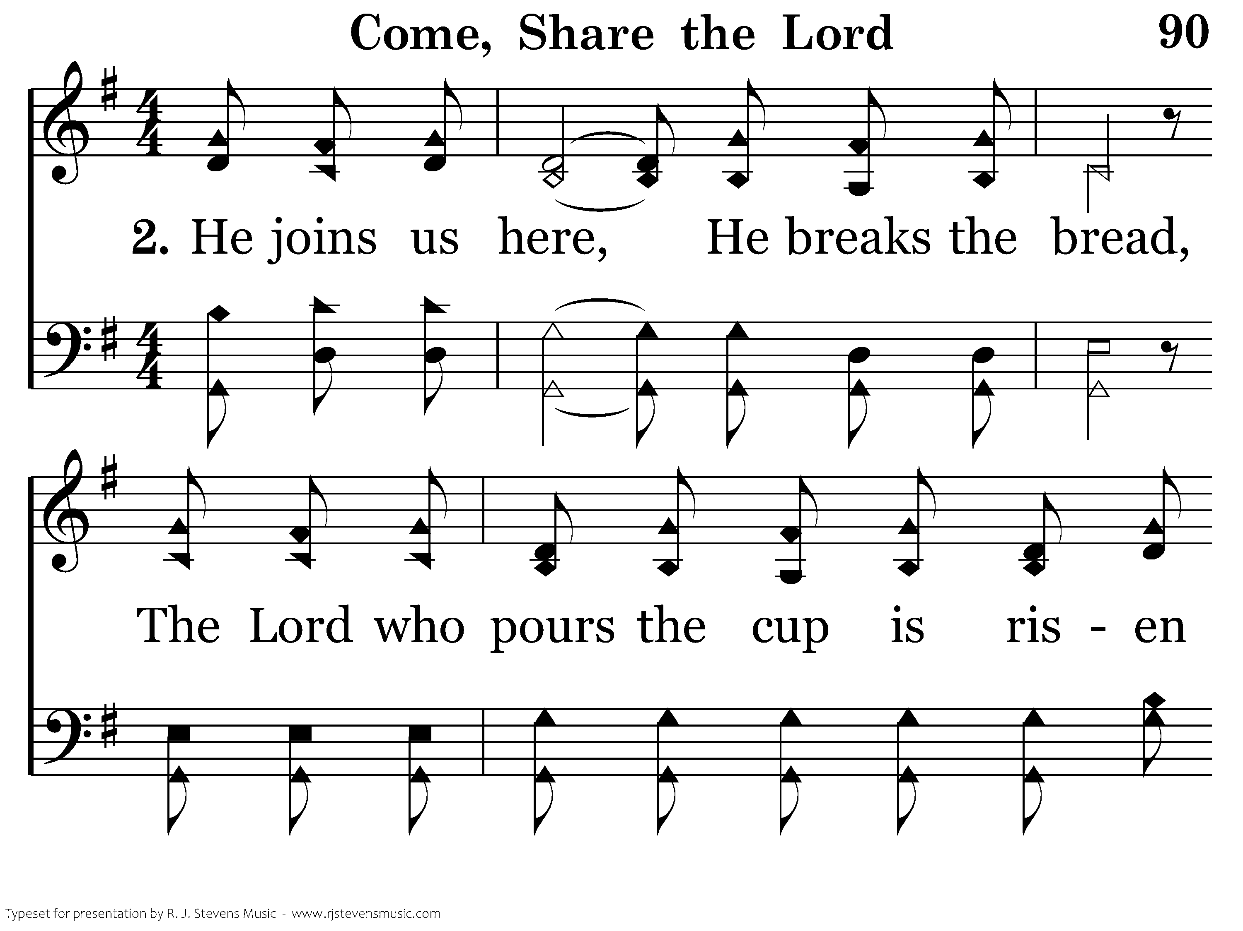
1090 - Come, Share The Lord - 2.1

Slide 21
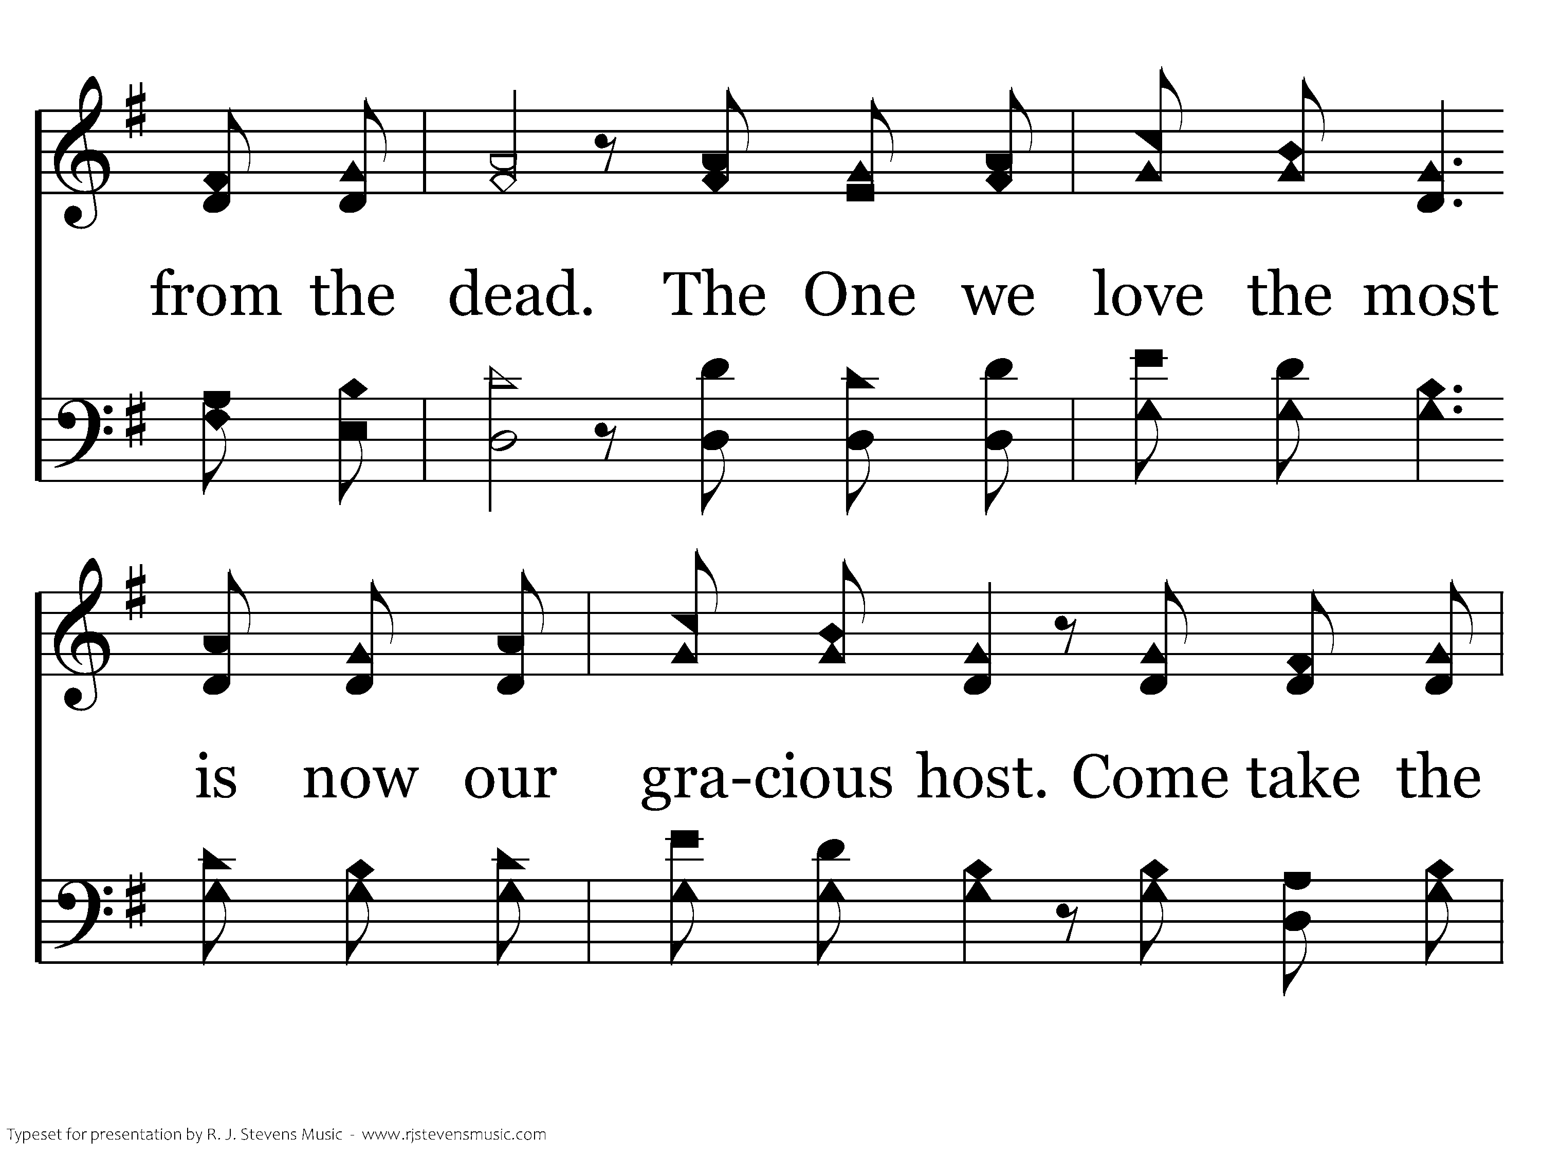
1090 - Come, Share The Lord - 2.2

Slide 22
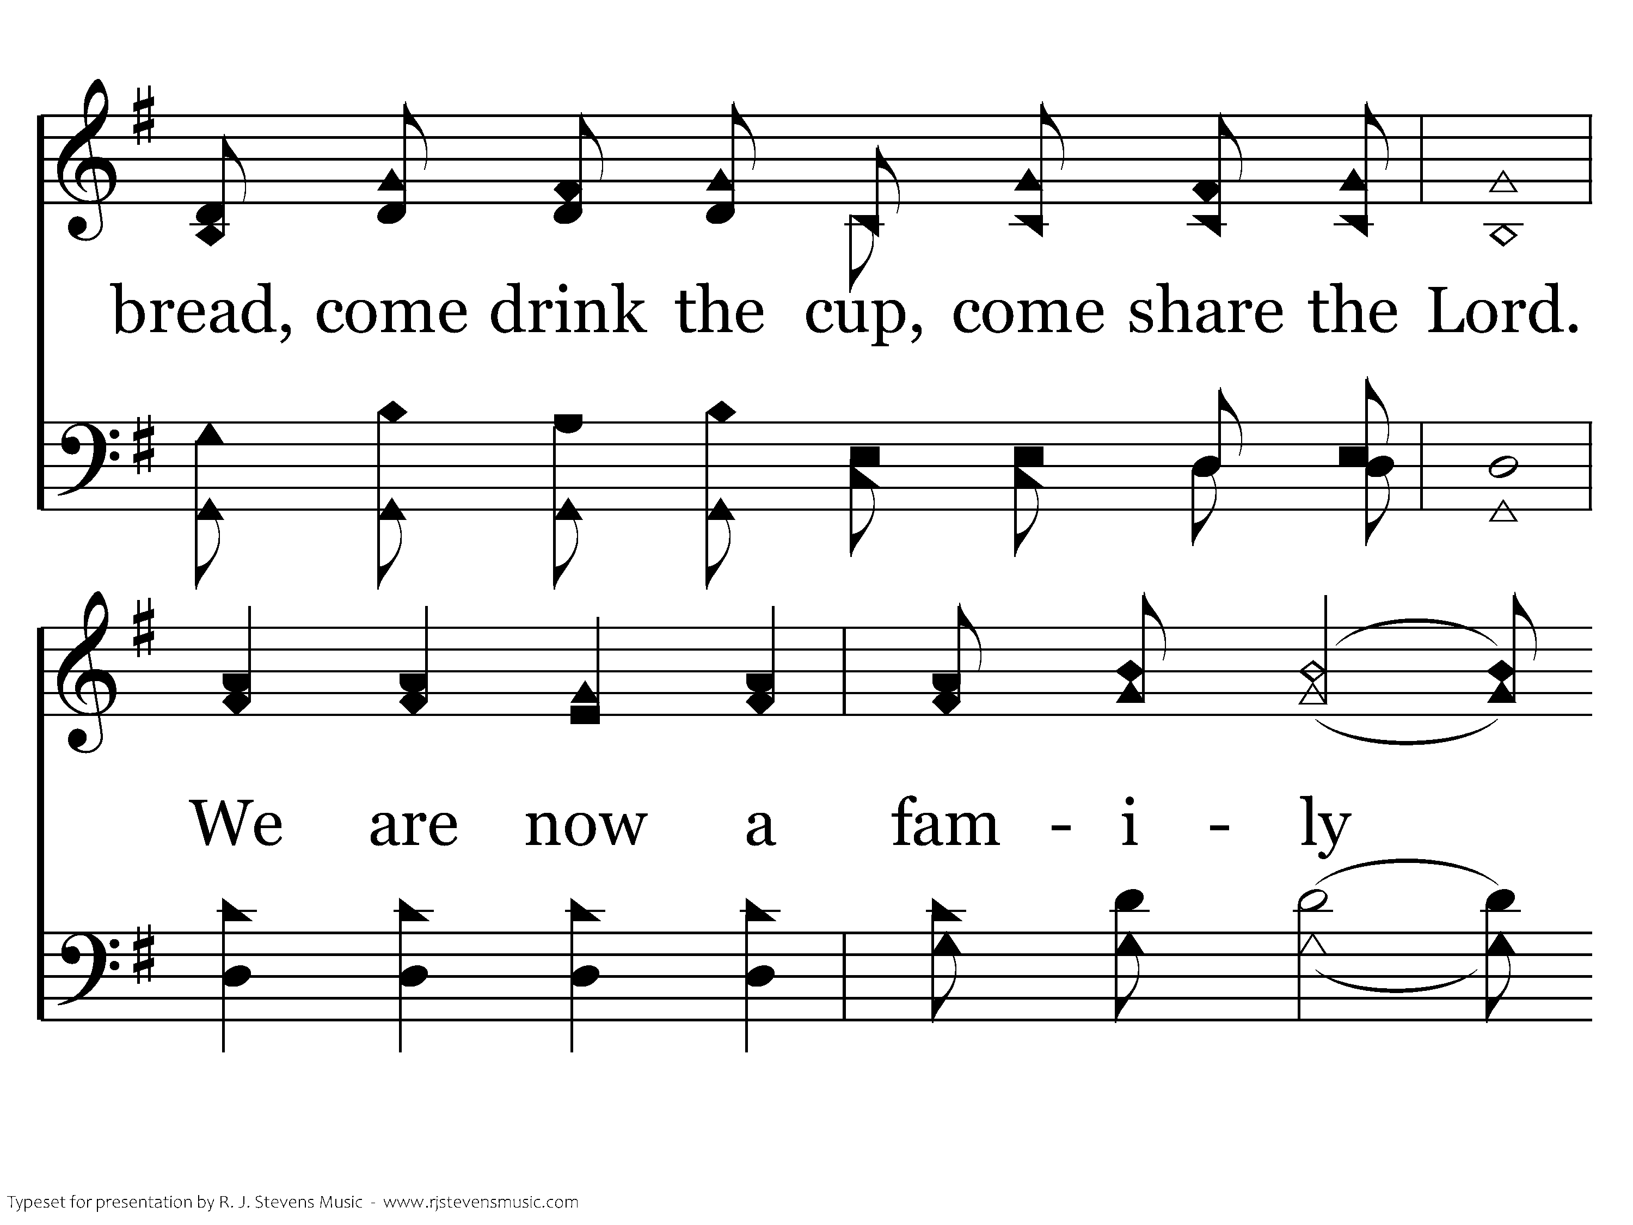
1090 - Come, Share The Lord - 2.3

Slide 23
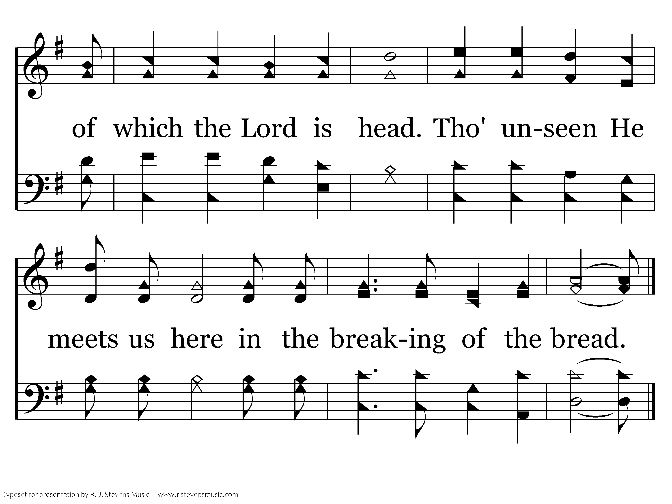
1090 - Come, Share The Lord - 2.4
End of Verse 2

Slide 24
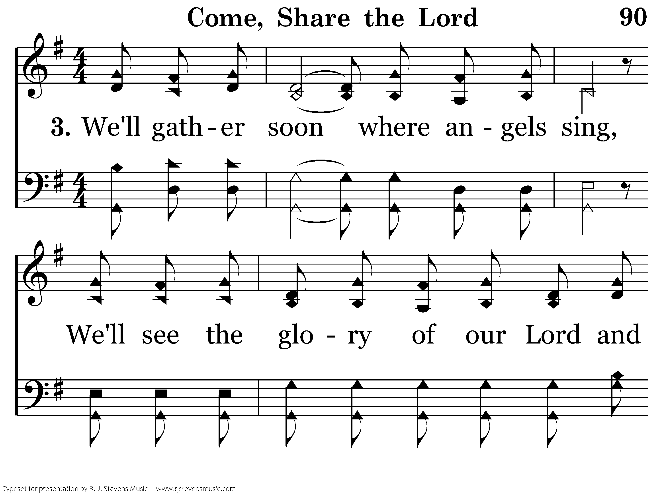
1090 - Come, Share The Lord - 3.1

Slide 25
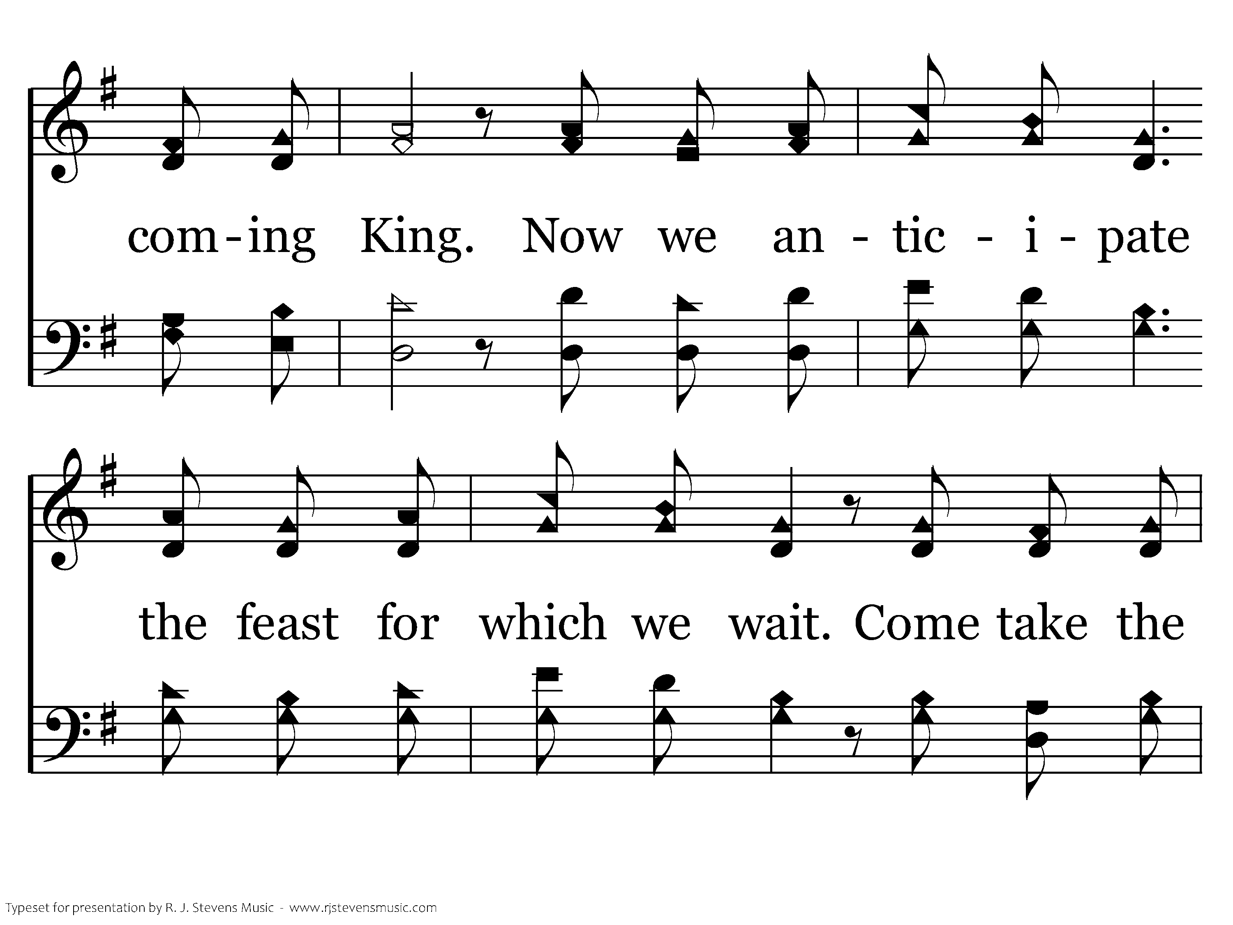
1090 - Come, Share The Lord - 3.2

Slide 26
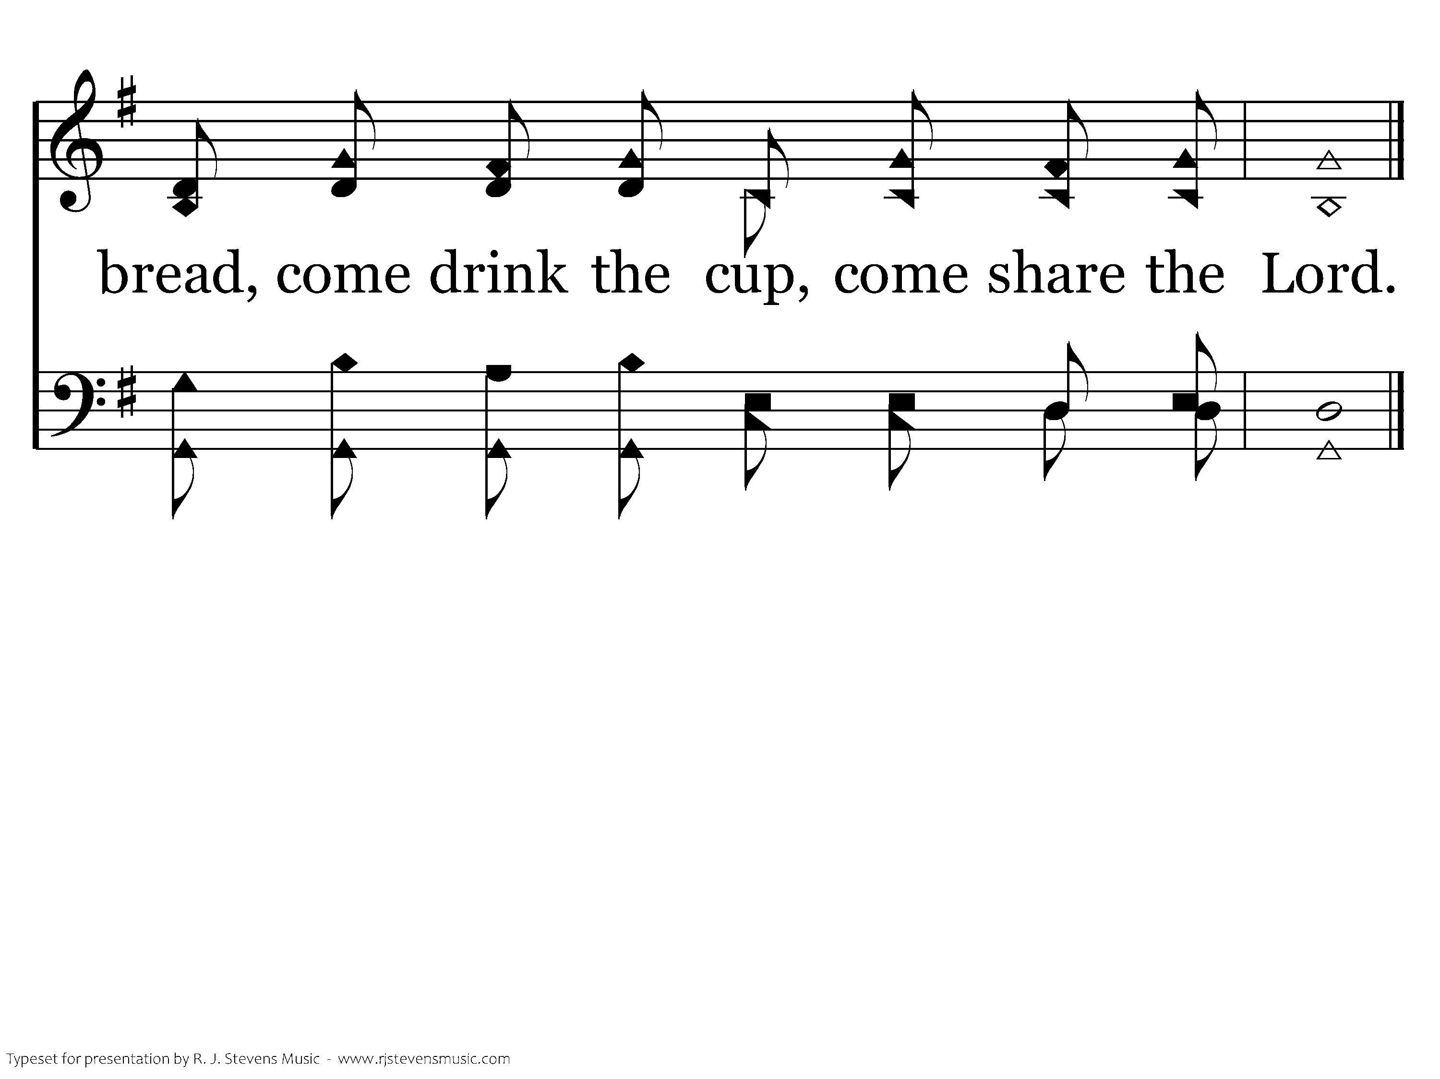
1090 - Come, Share The Lord - 3.3
End of Song

Slide 27

“DO THIS IN REMEMBRANCE OF ME”

Slide 29
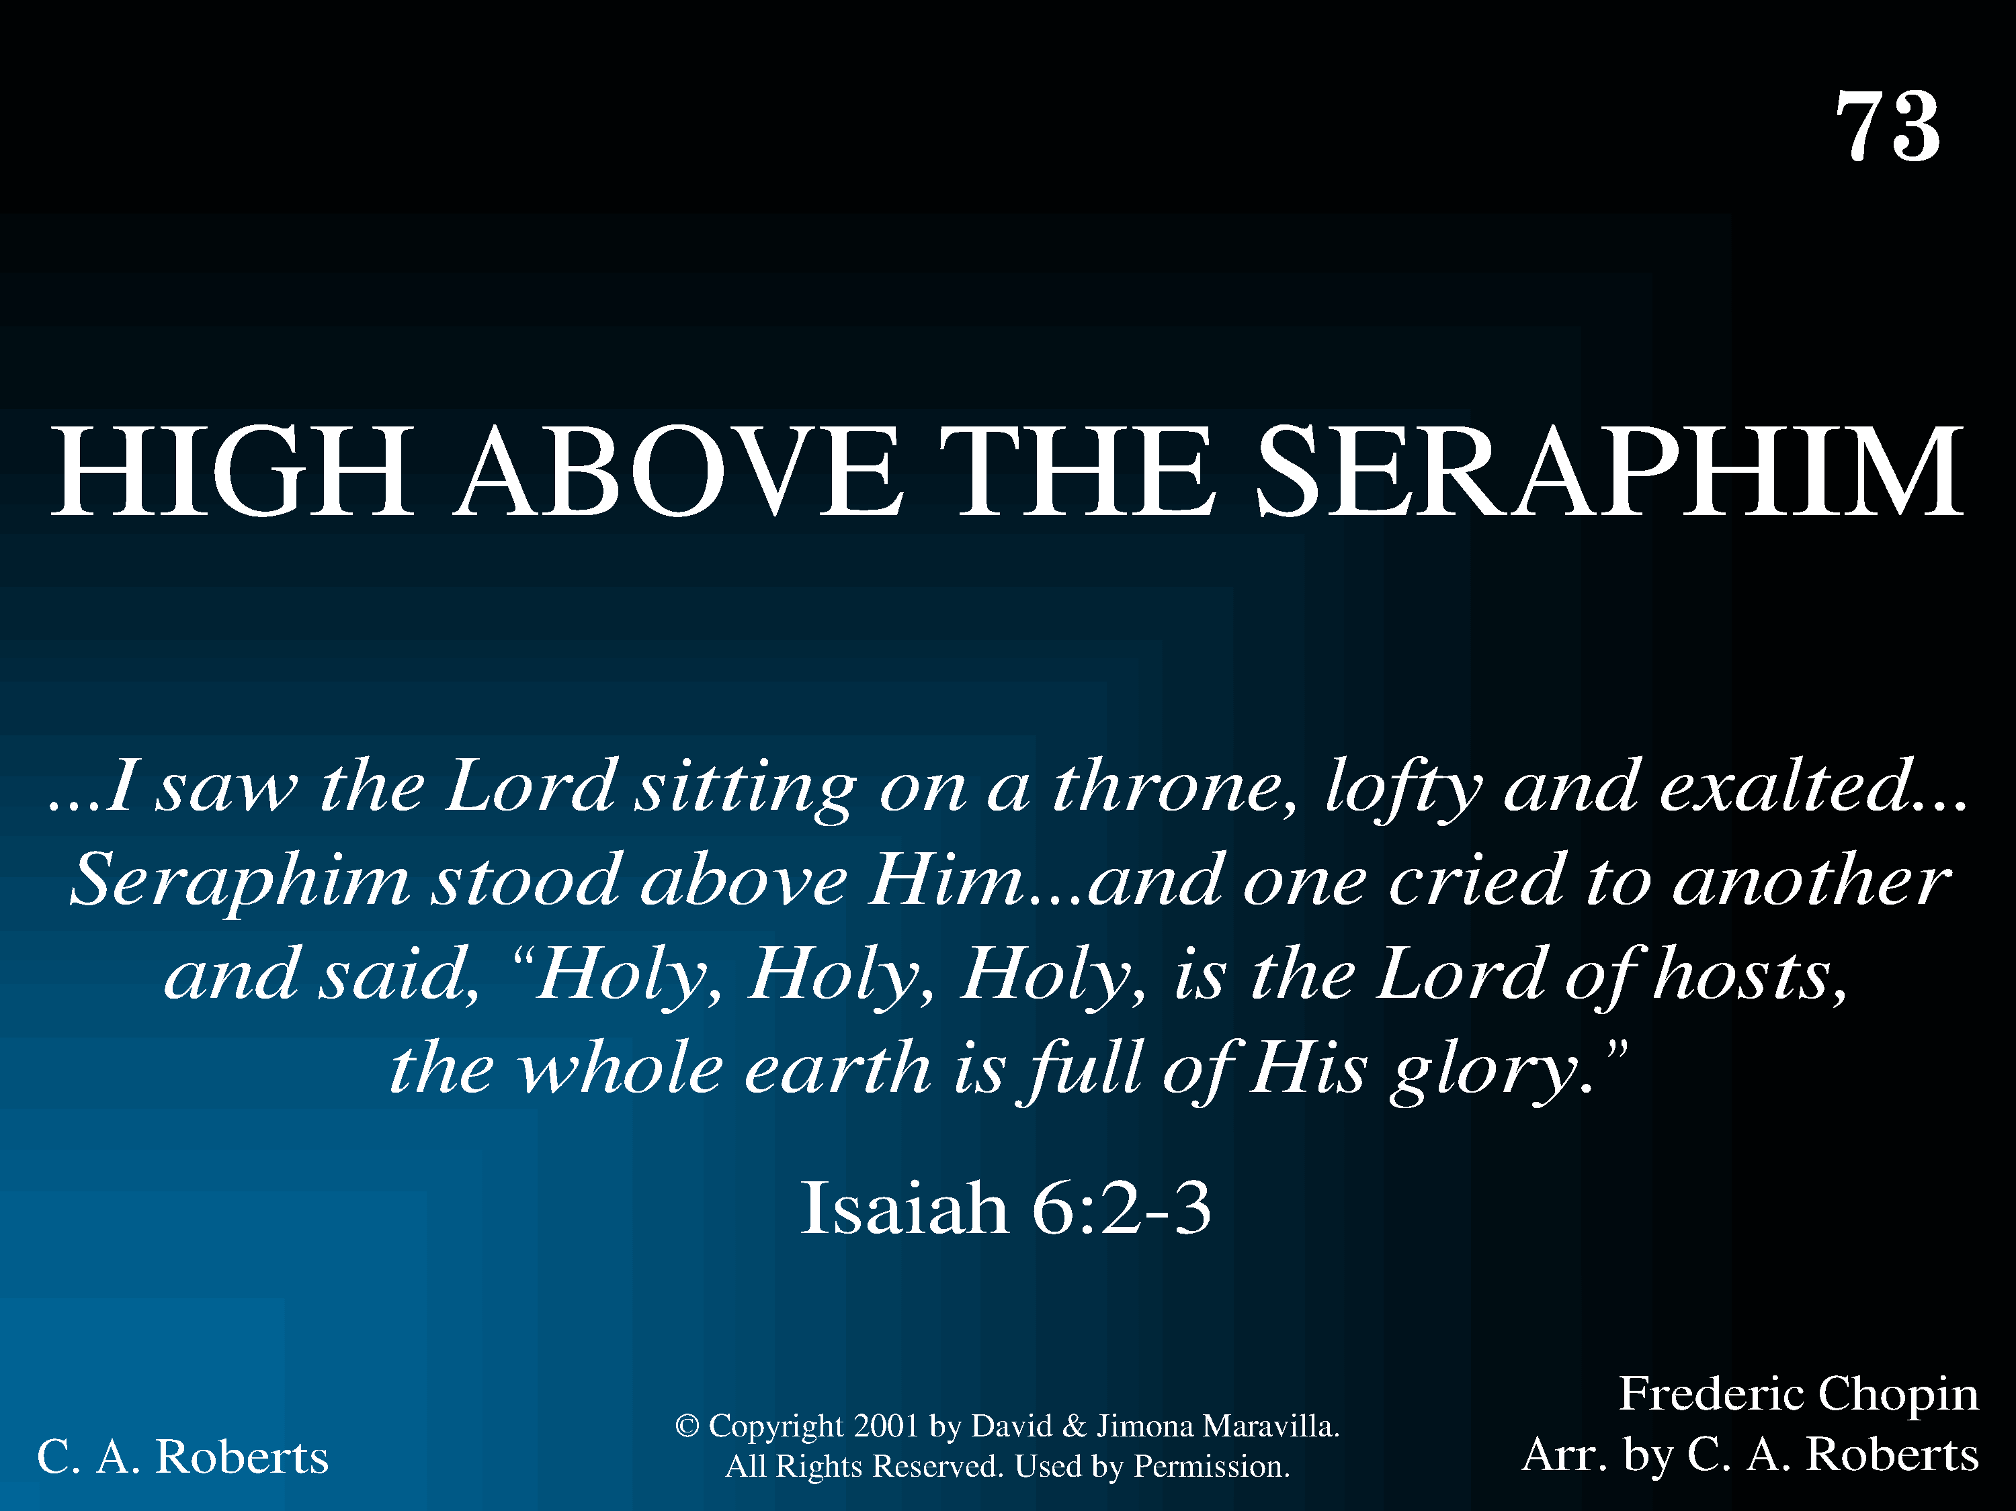
1073 - High Above The Seraphim - Title

Slide 30
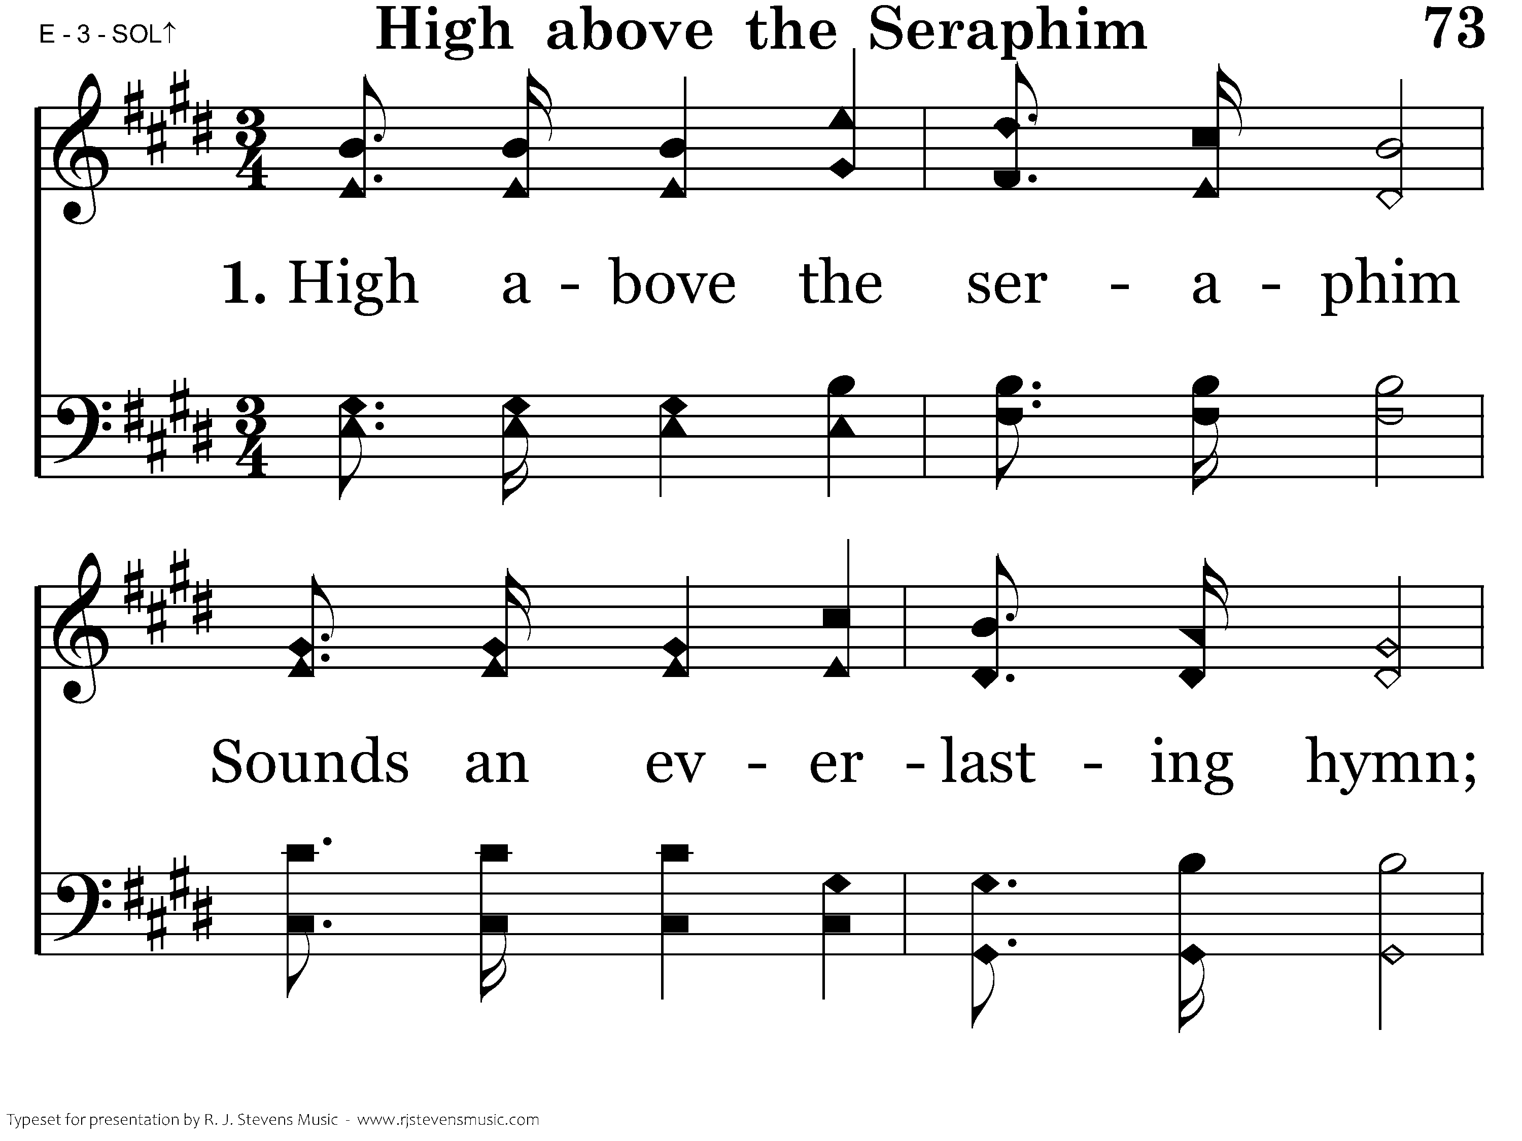
1073 - High Above The Seraphim - 1.1

Slide 31
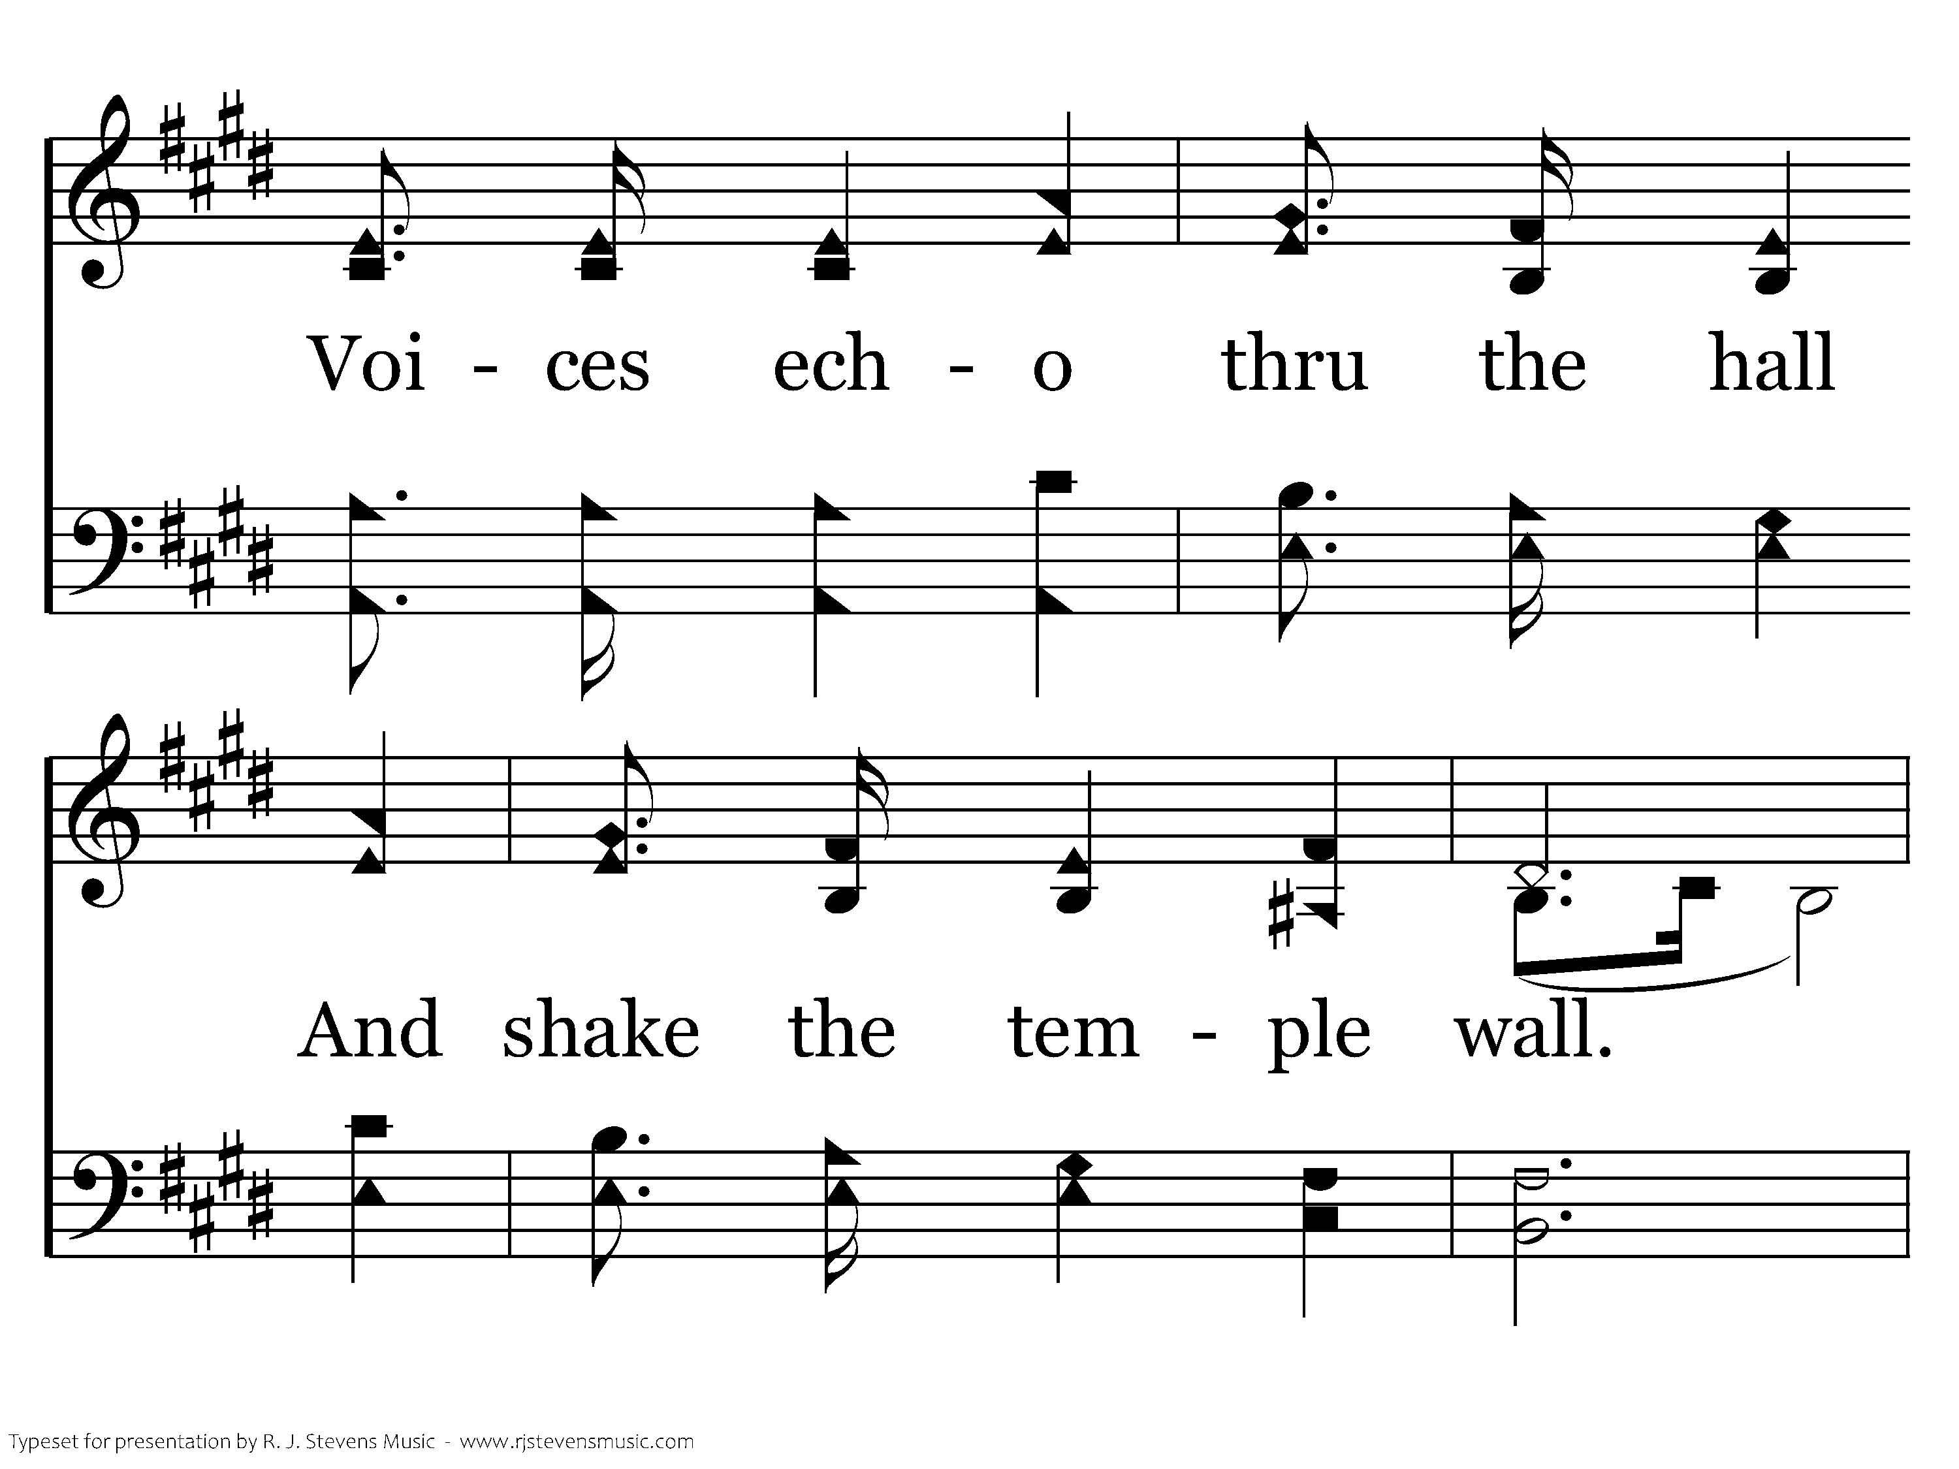
1073 - High Above The Seraphim - 1.2

Slide 32
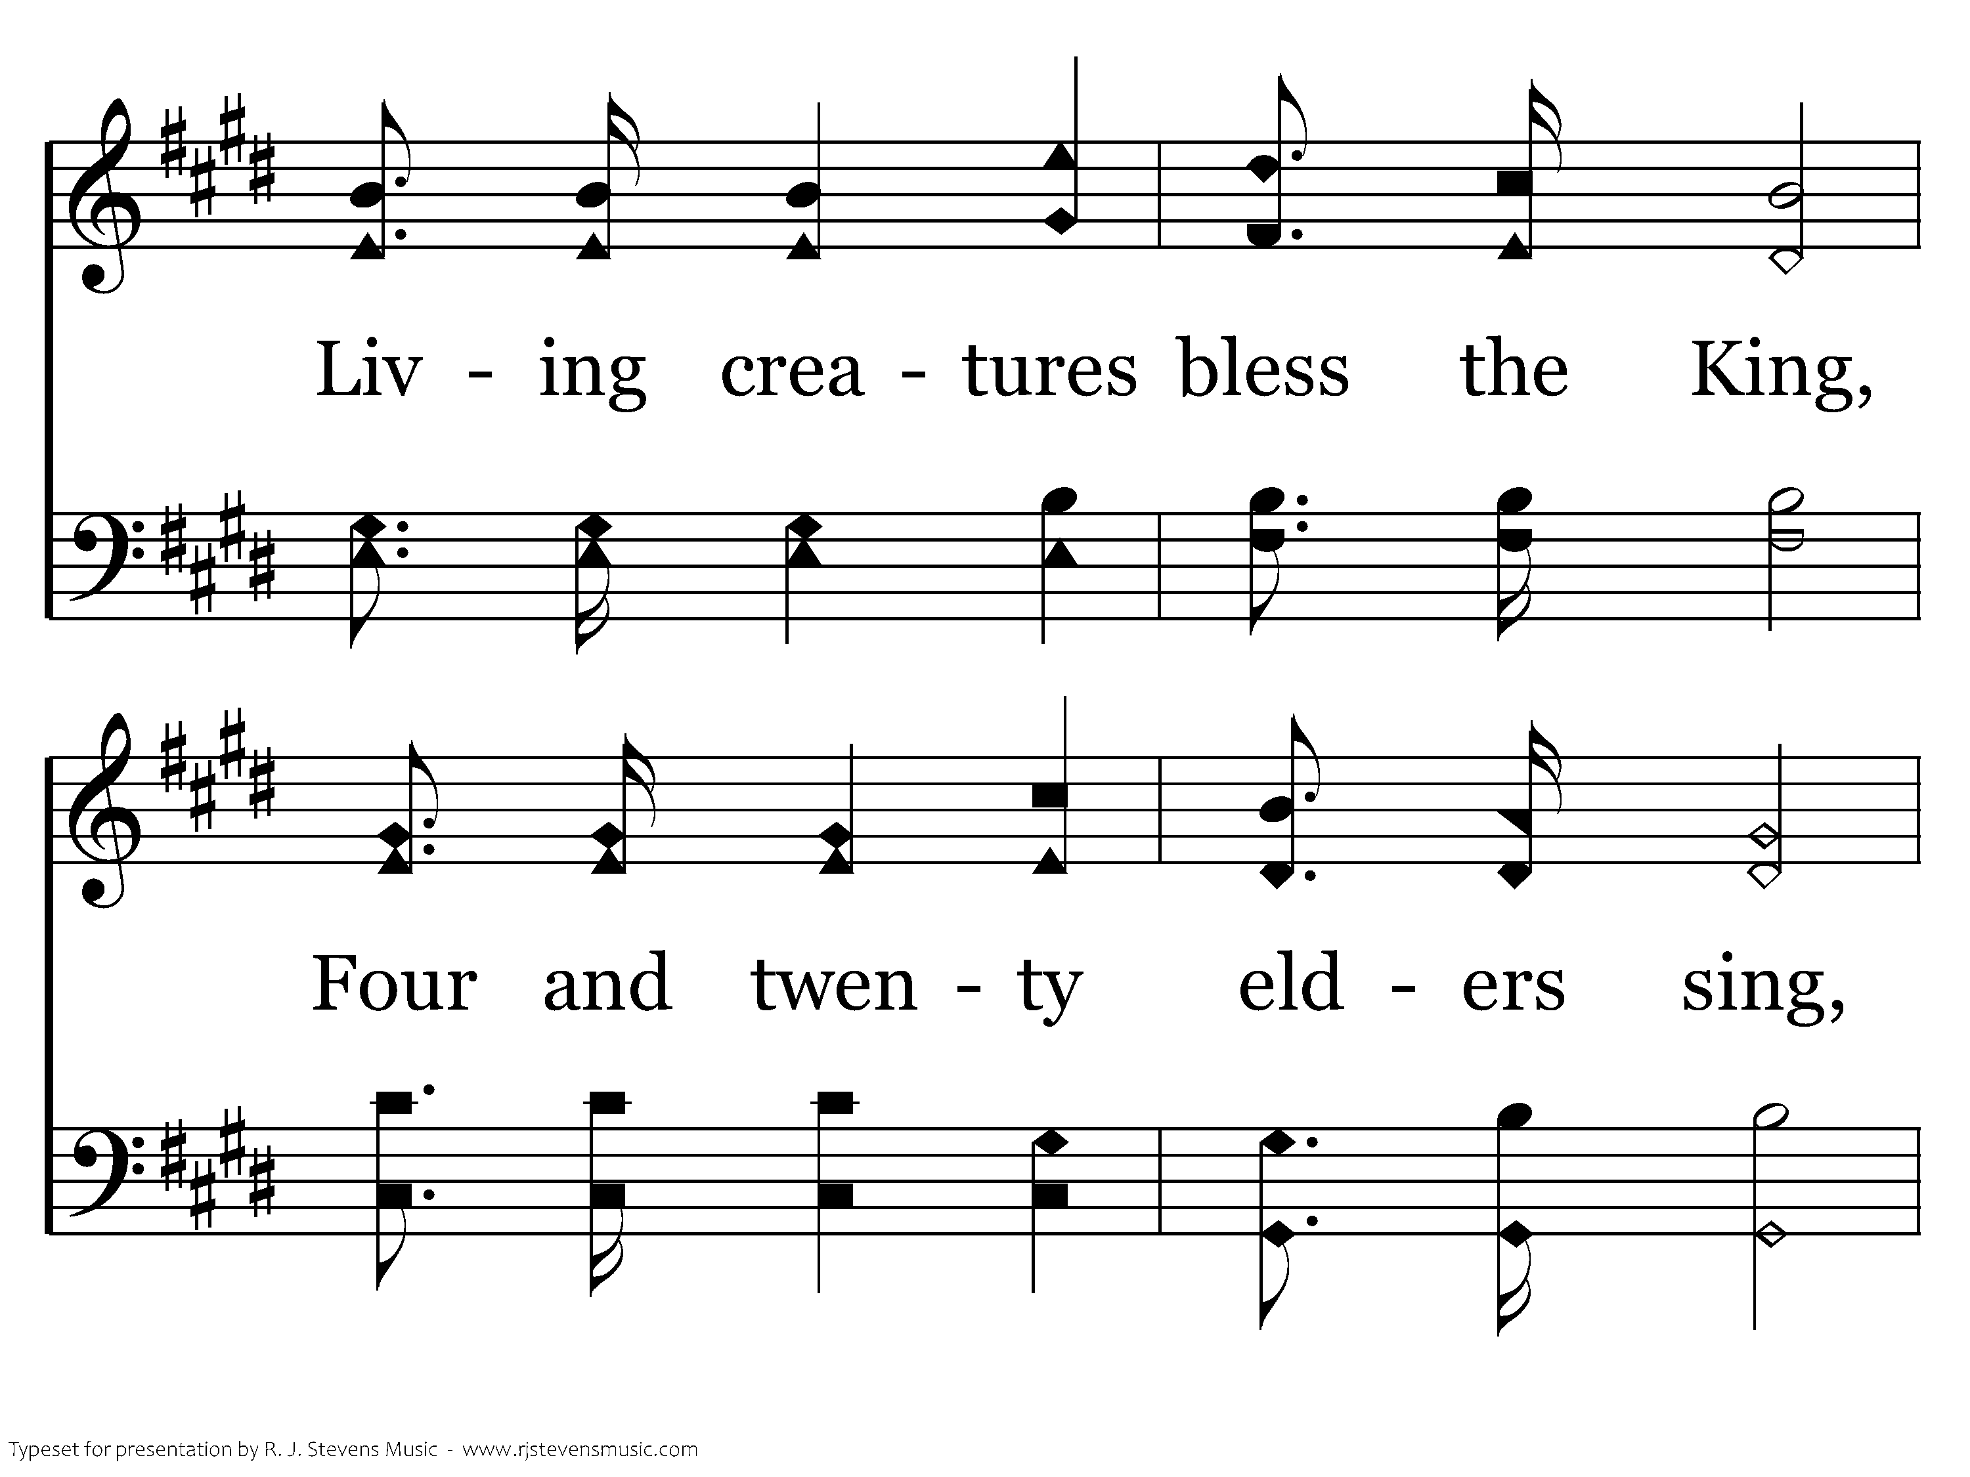
1073 - High Above The Seraphim - 1.3

Slide 33
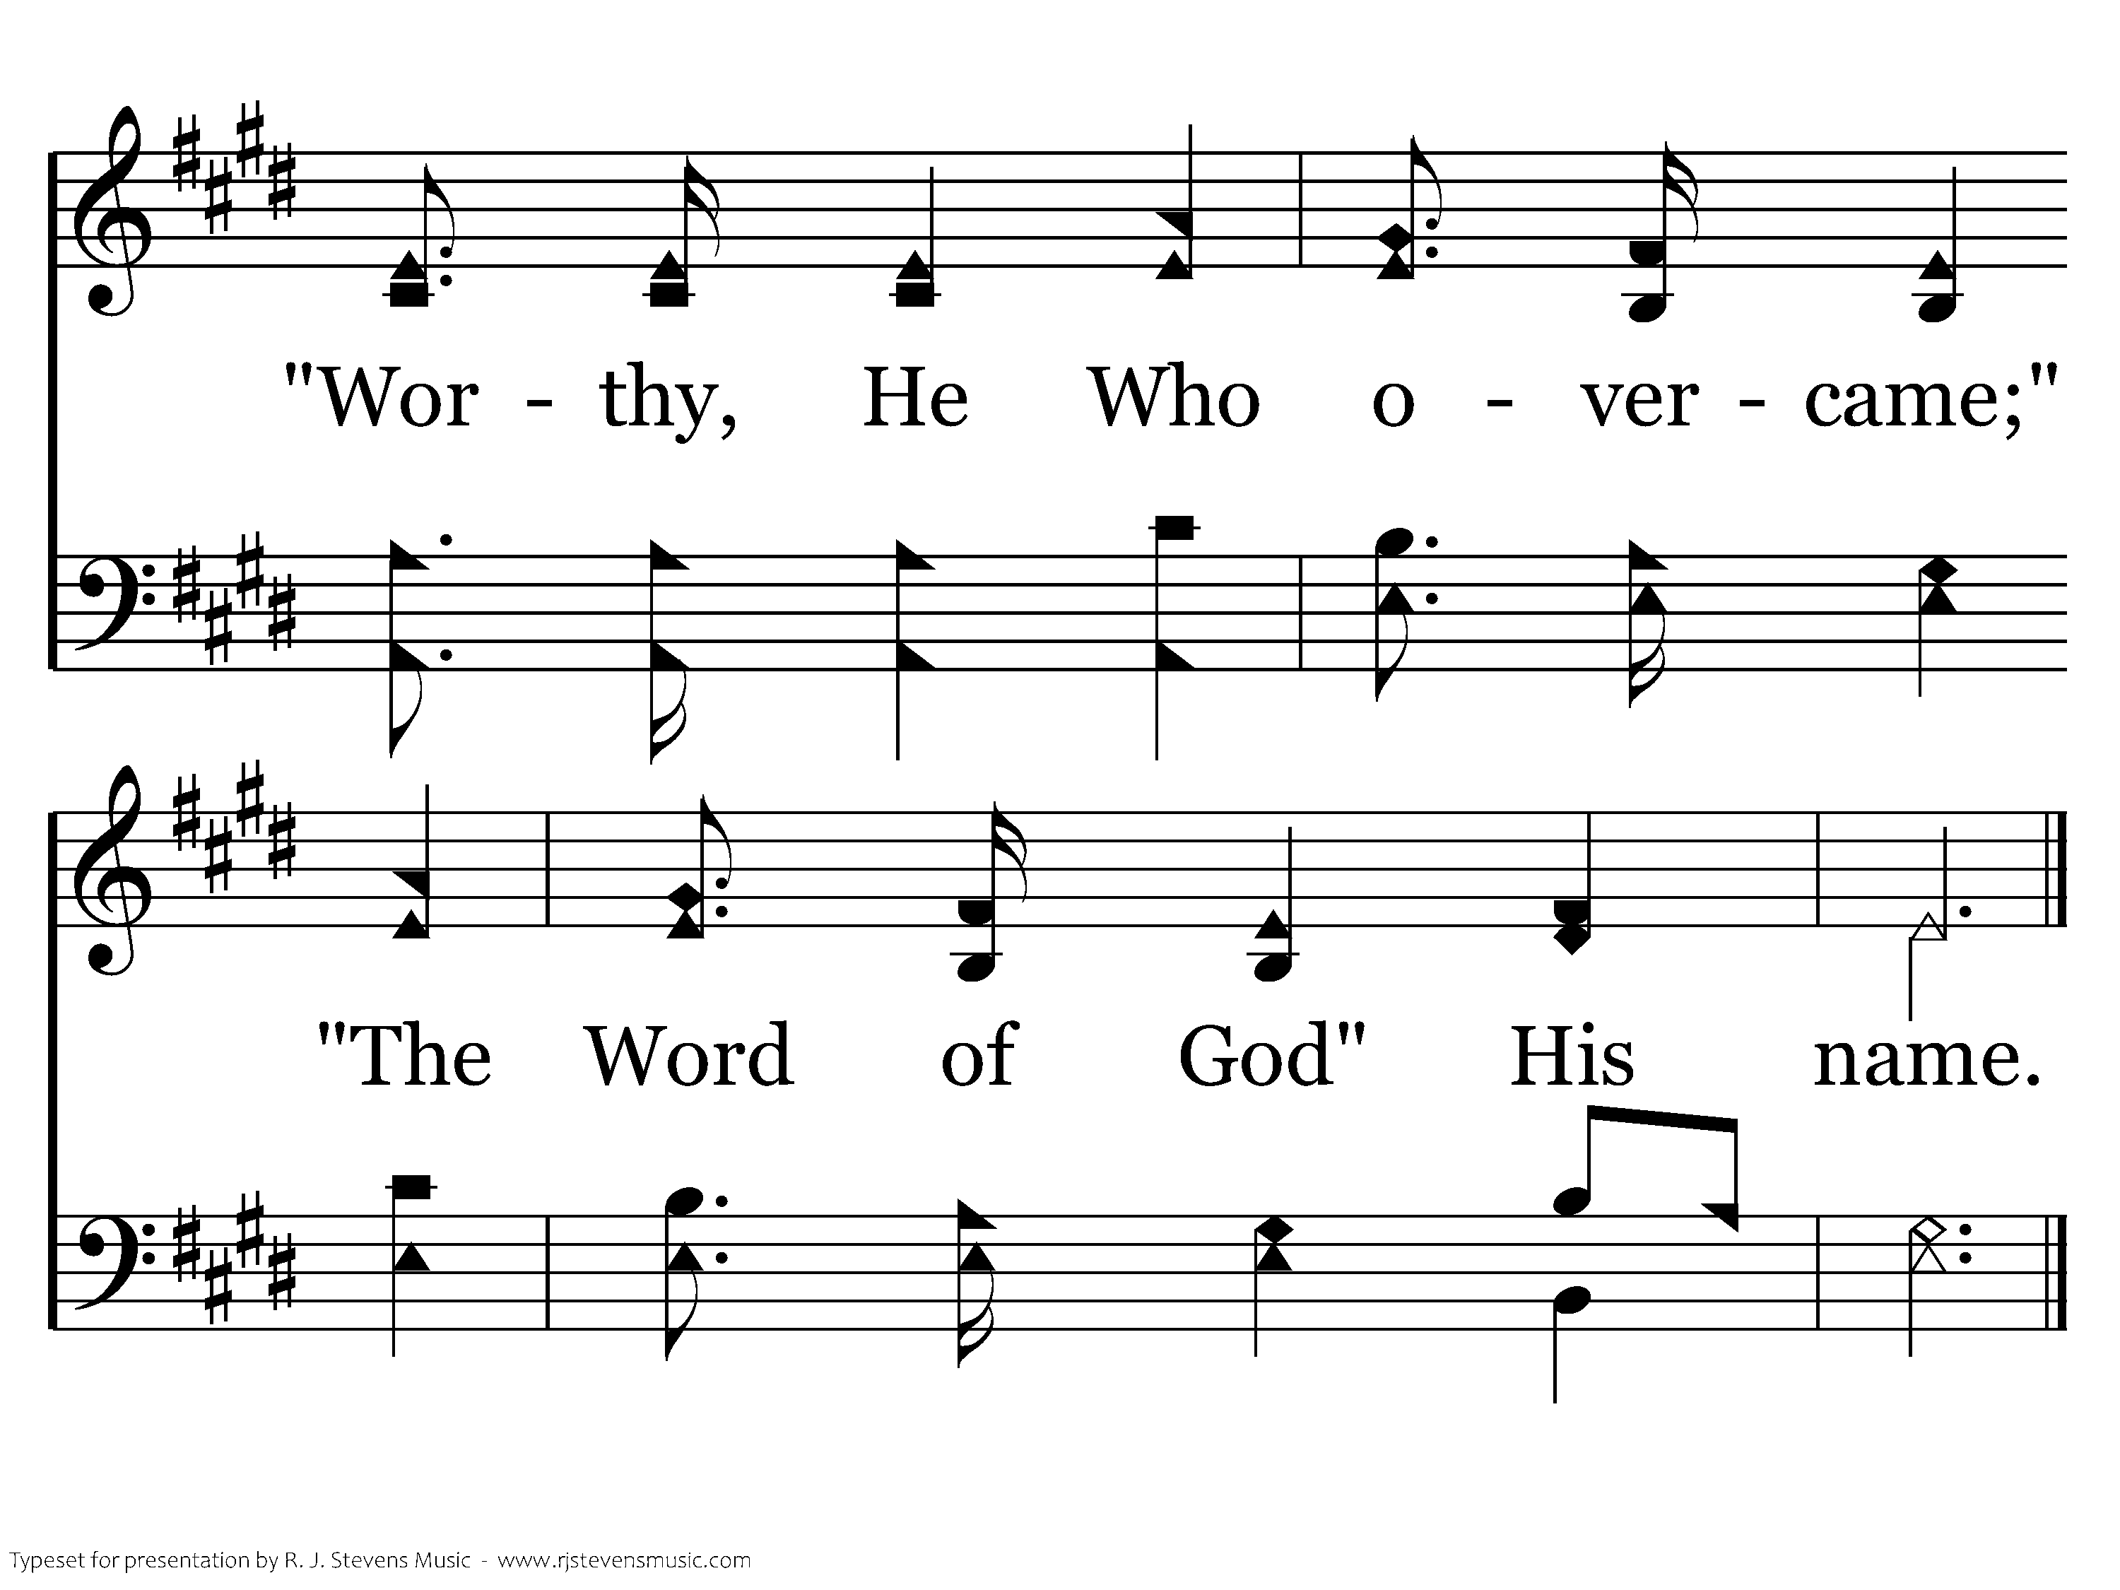
1073 - High Above The Seraphim - 1.4
End of Verse 1

Slide 34
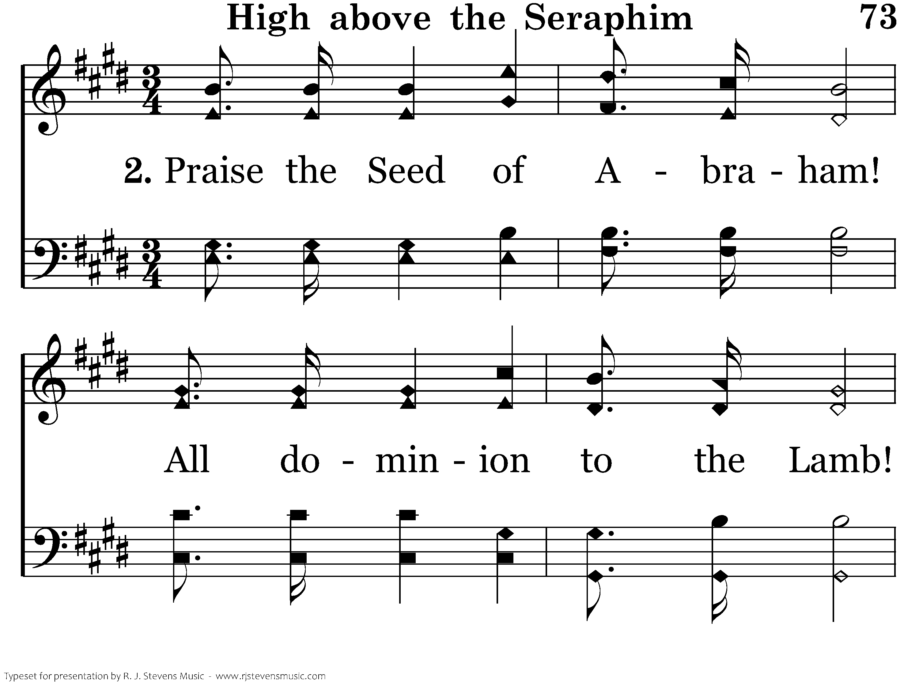
1073 - High Above The Seraphim - 2.1

Slide 35
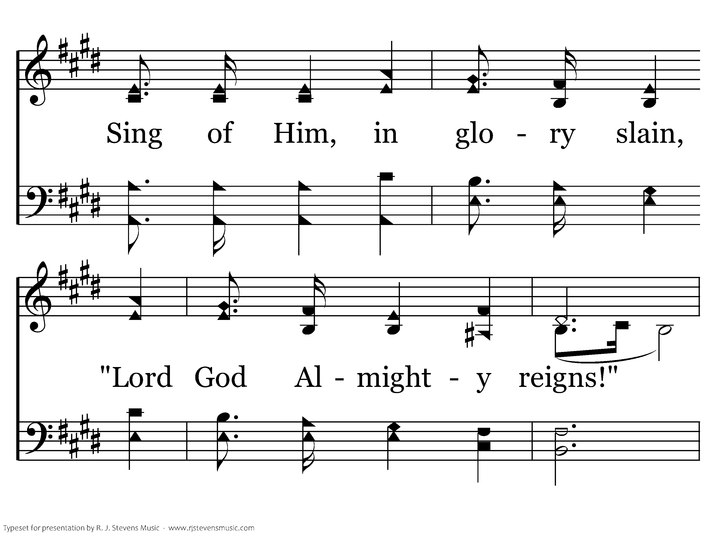
1073 - High Above The Seraphim - 2.2

Slide 36
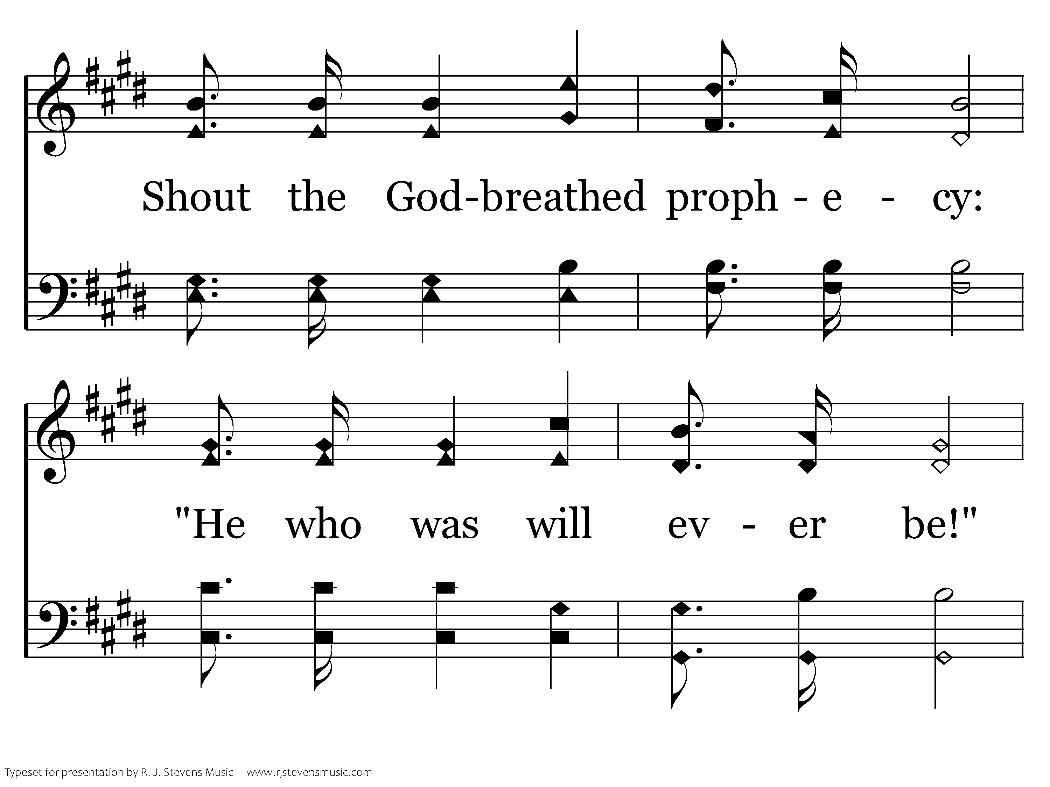
1073 - High Above The Seraphim - 2.3

Slide 37
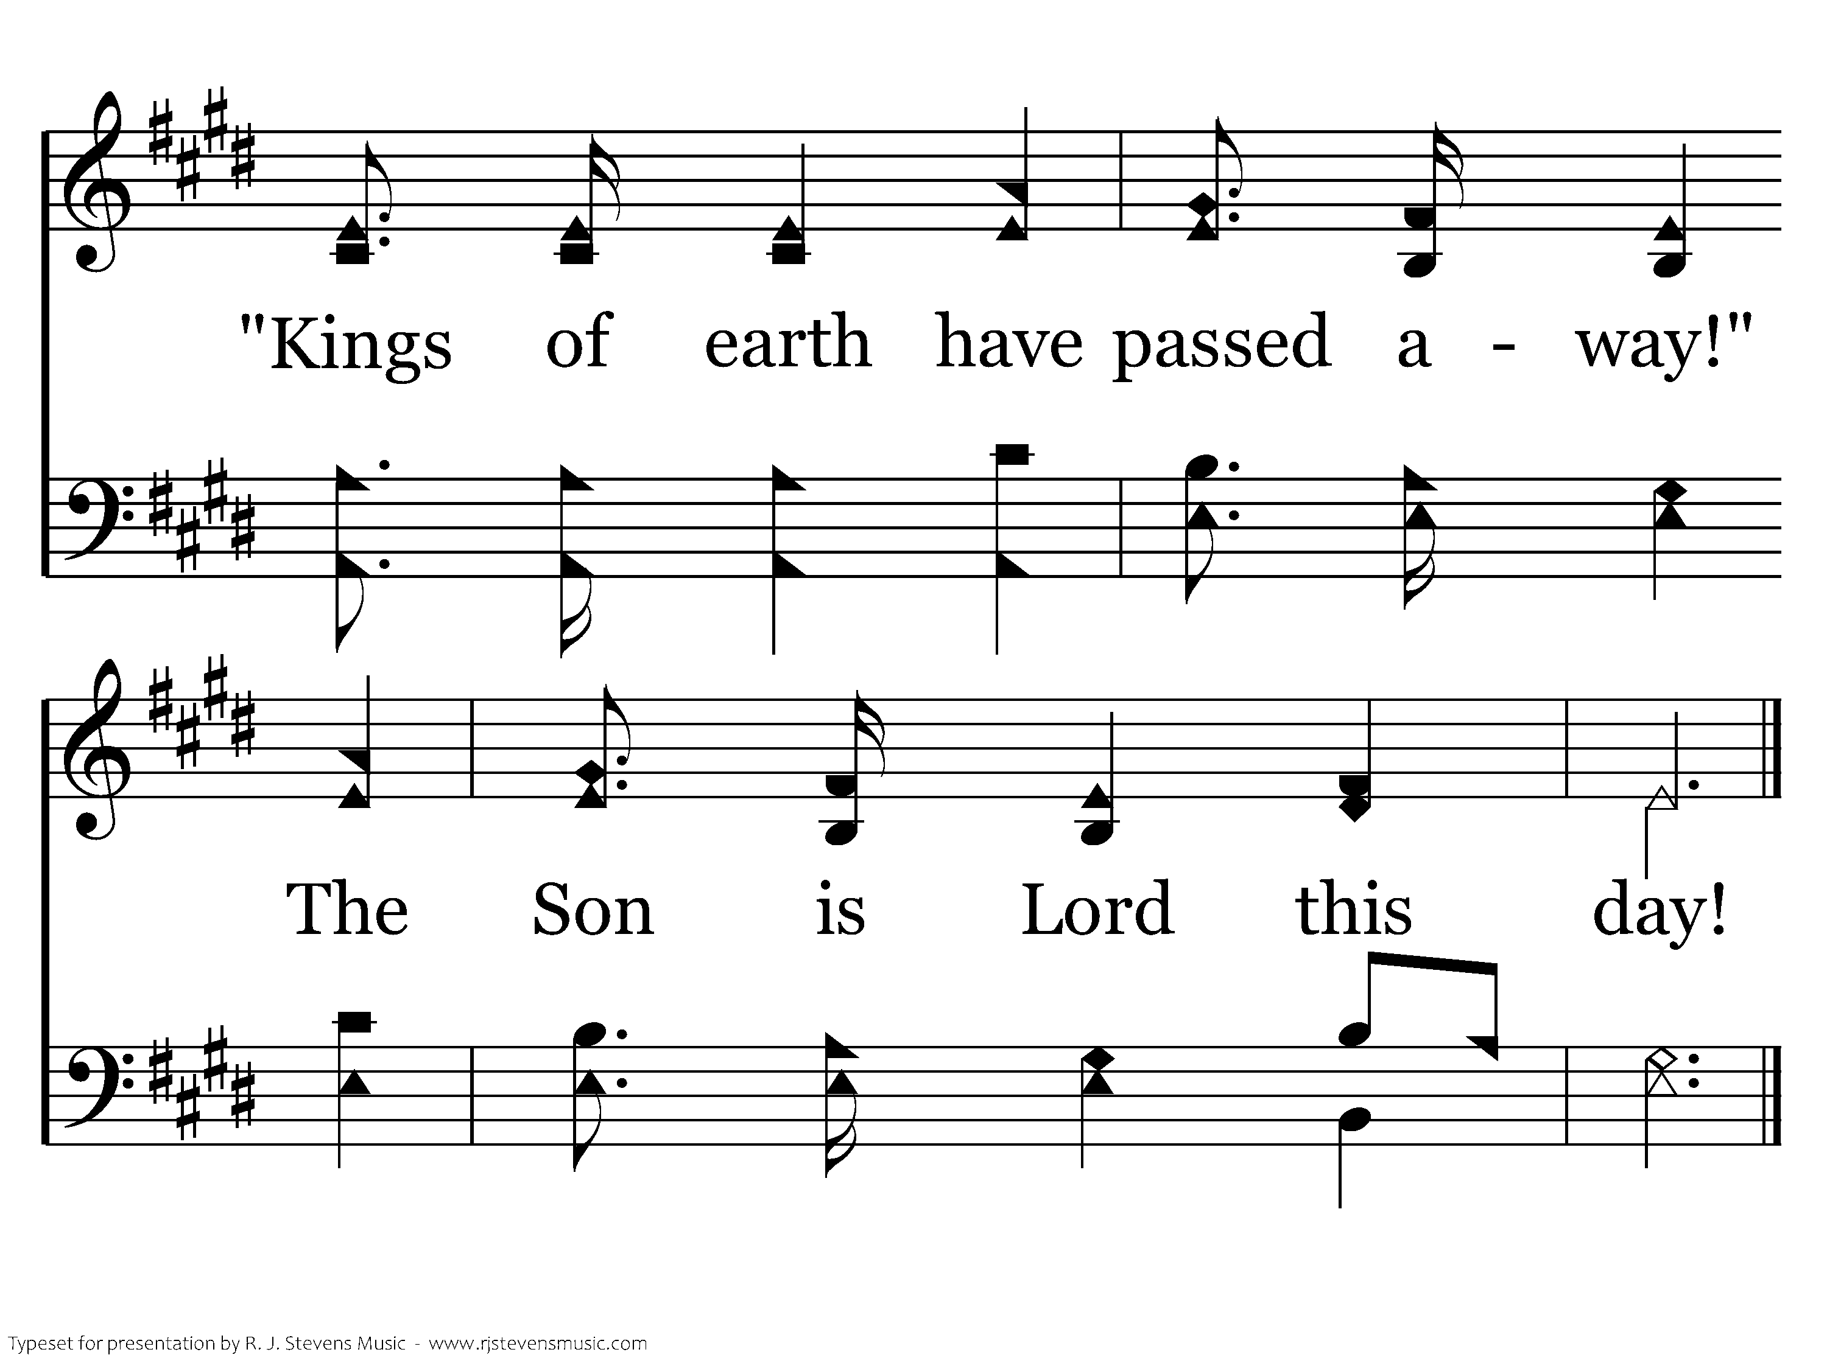
1073 - High Above The Seraphim - 2.4
End of Verse 2

Slide 38
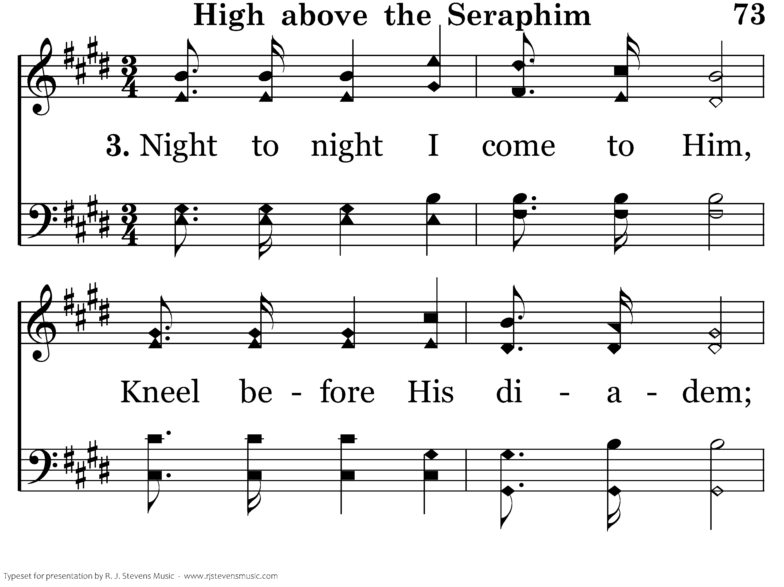
1073 - High Above The Seraphim - 3.1

Slide 39
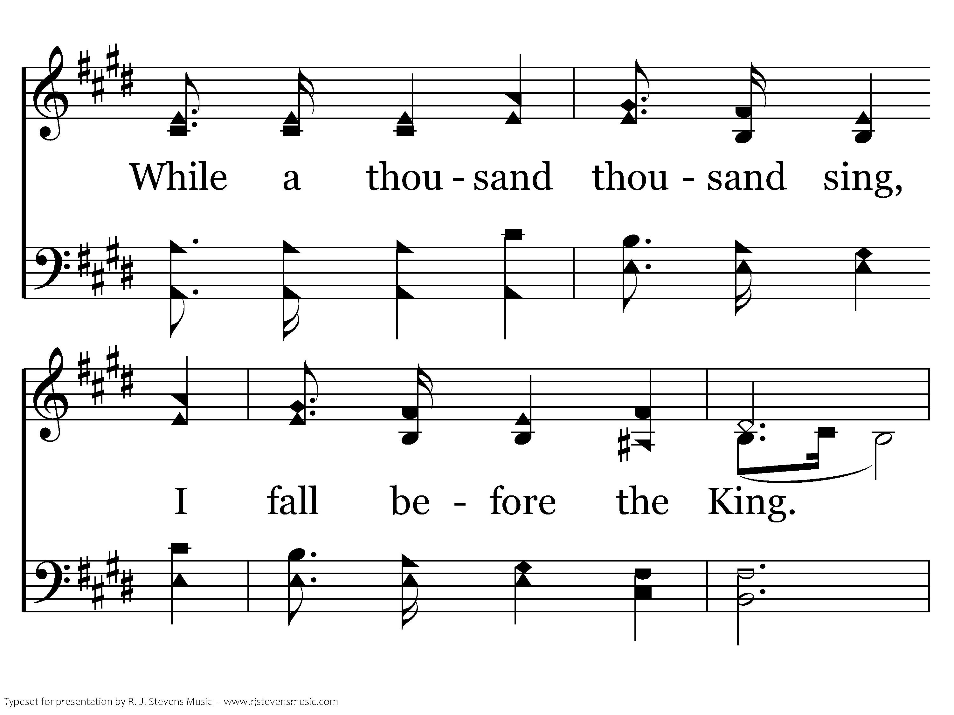
1073 - High Above The Seraphim - 3.2

Slide 40
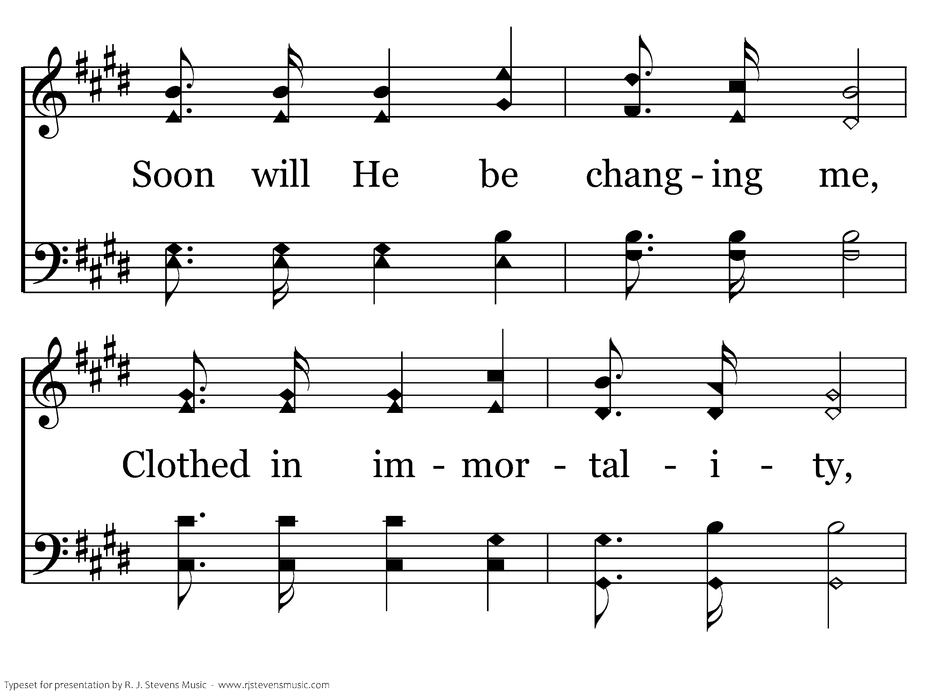
1073 - High Above The Seraphim - 3.3

Slide 41
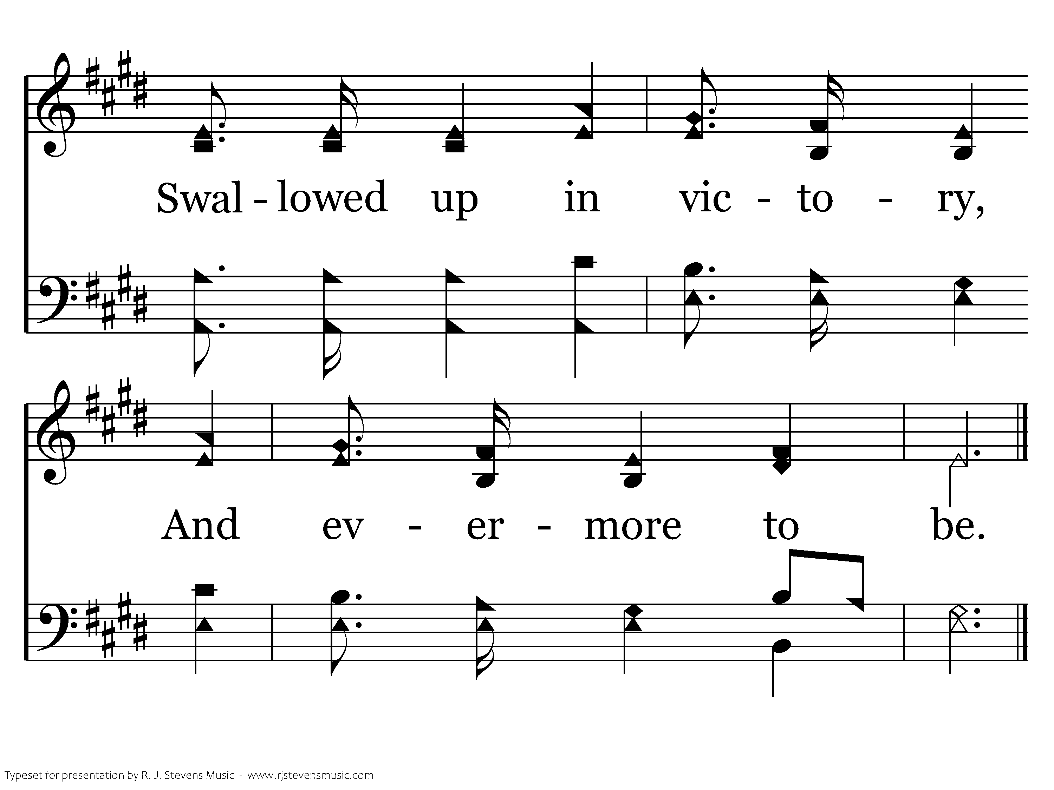
1073 - High Above The Seraphim - 3.4
End of Song

Slide 43
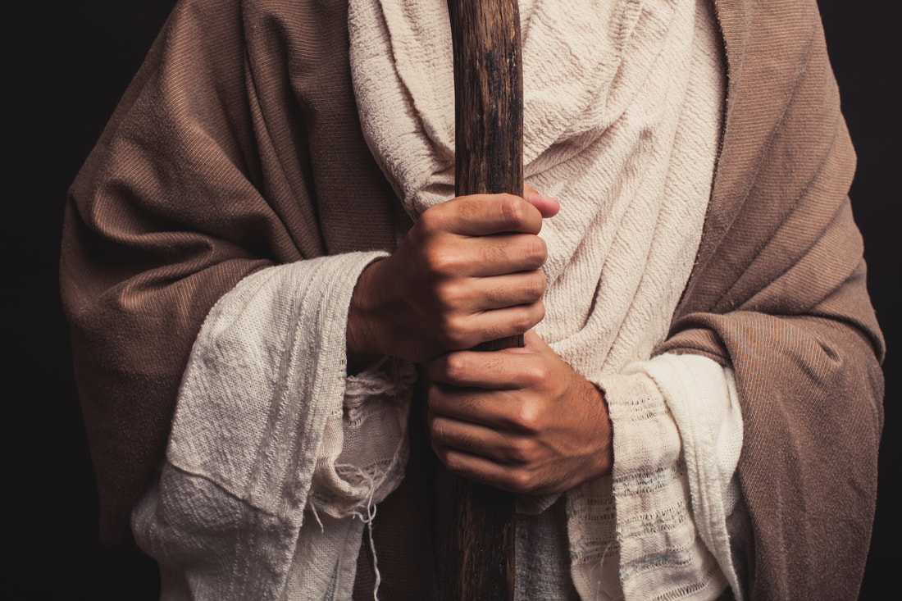
What is That in Your Hand?

Slide 44
God’s Use of “Little” Things
Gideon’s army of 300 - Judges 7:4-7
David’s sling - 1 Samuel 17
Bethlehem - Micah 5:2
Widow’s two mites - Luke 21:1-4
Lad’s loaves and fishes - John 6:9
“Who has despised the day of small things?” Zechariah 4:10

Slide 45

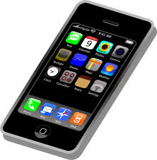


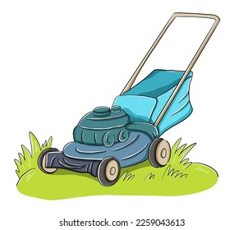
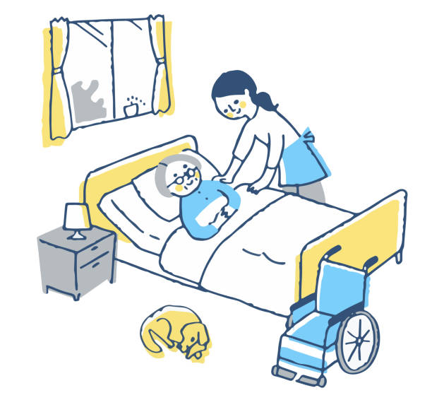
What is in YOUR hand?

Slide 46
Why We Should Do Good
The Example of Jesus
  Acts 10:38
The Reason We Are Saved
  Titus 2:14; Eph. 2:8-10
There is a Great Need
  Titus 3:14; Mark 14:7; Gal. 6:10

Slide 47
Principles to Follow
With God’s Authority
  Col. 3:17
Heartily
  Col. 3:23; Eccl. 9:10
Contribute to Peace and Edification
  Rom. 14:19
To God’s Glory
  1 Cor. 10:31

Slide 49
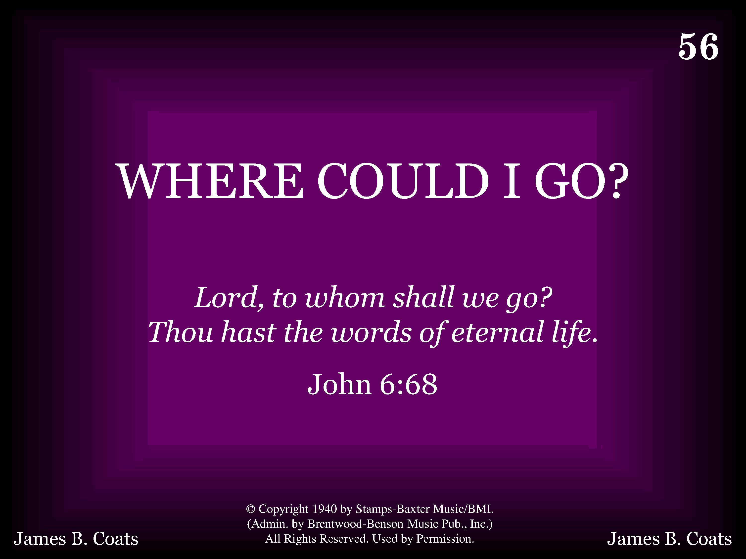
1056 - Where Could I Go - Title

Slide 50
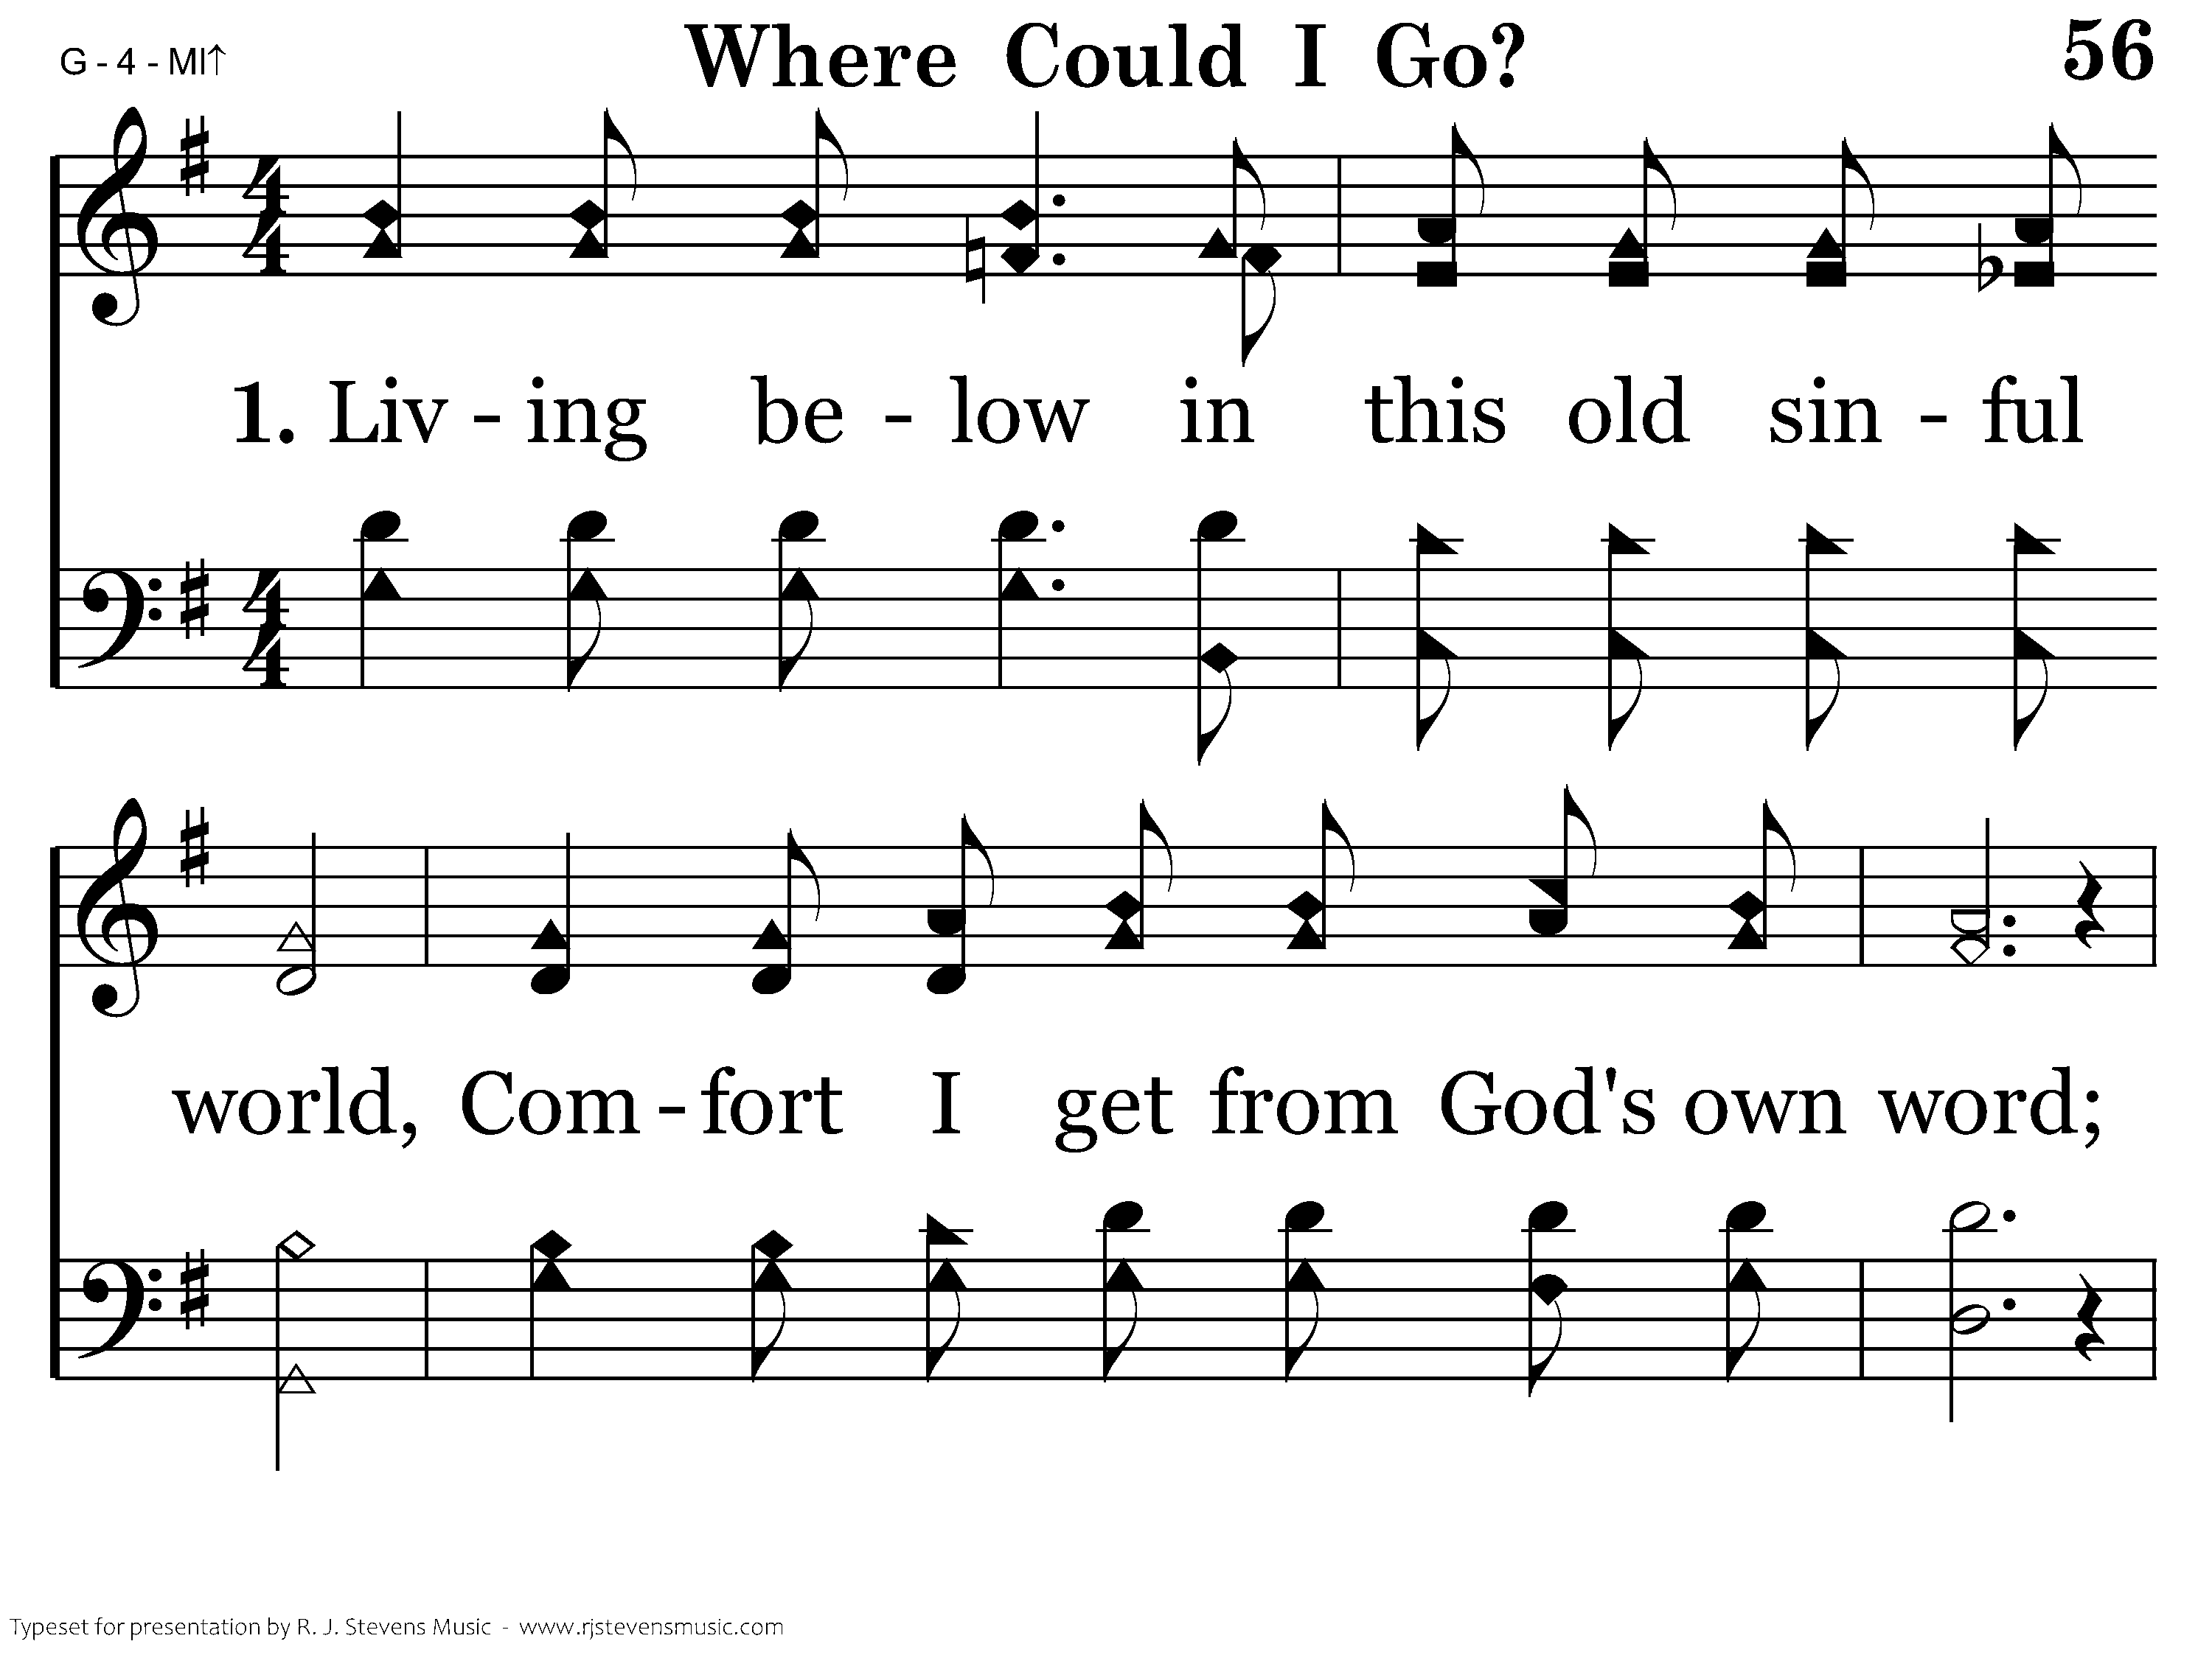
1056 - Where Could I Go - 1.1

Slide 51
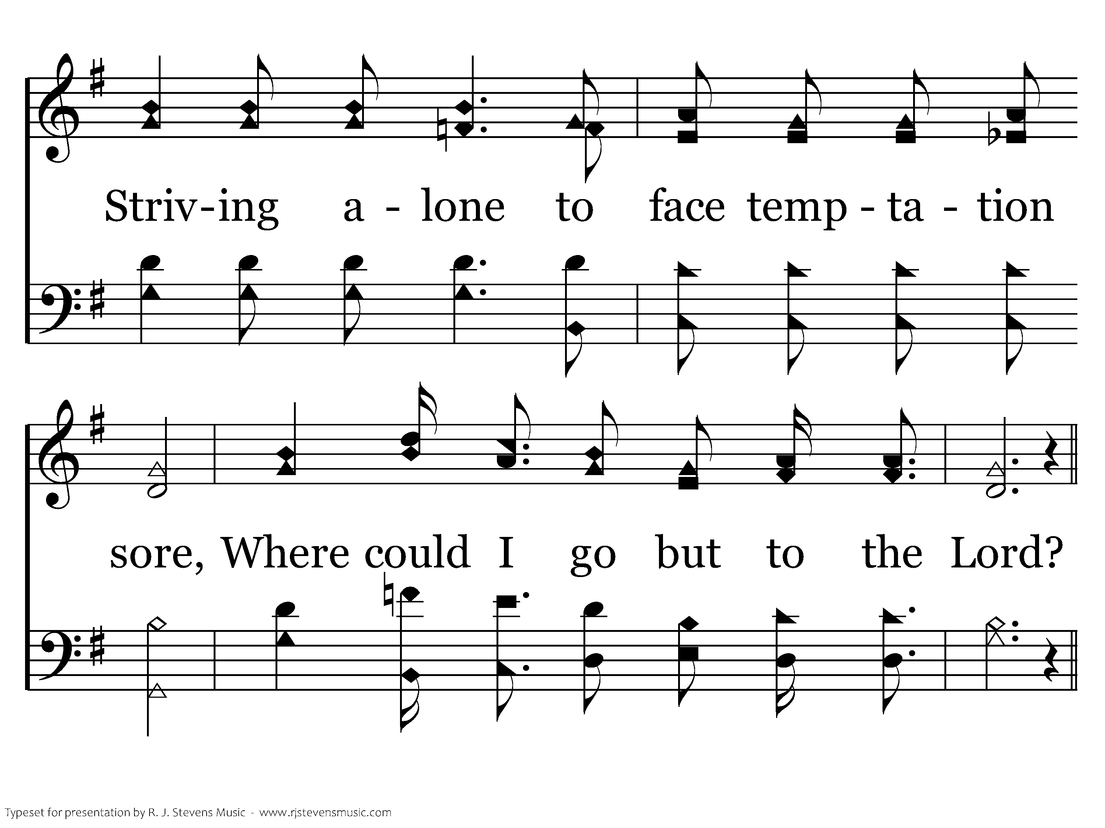
1056 - Where Could I Go - 1.2

Slide 52
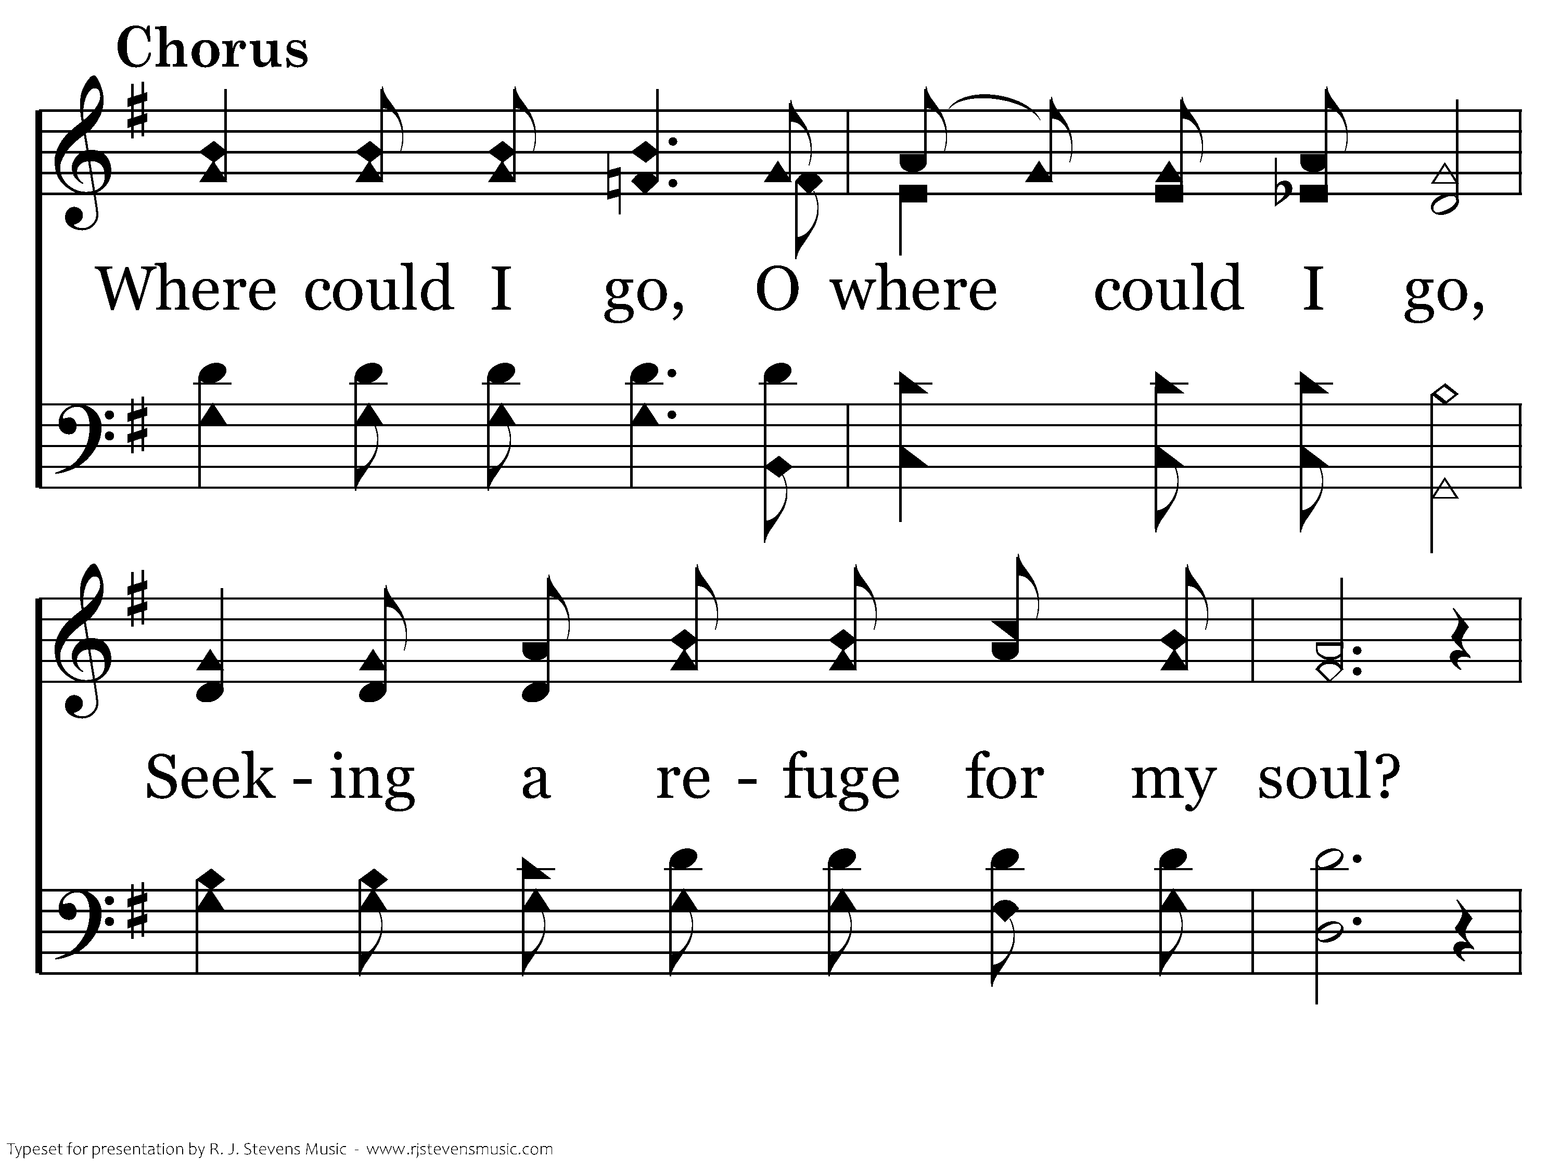
1056 - Where Could I Go - C.1

Slide 53
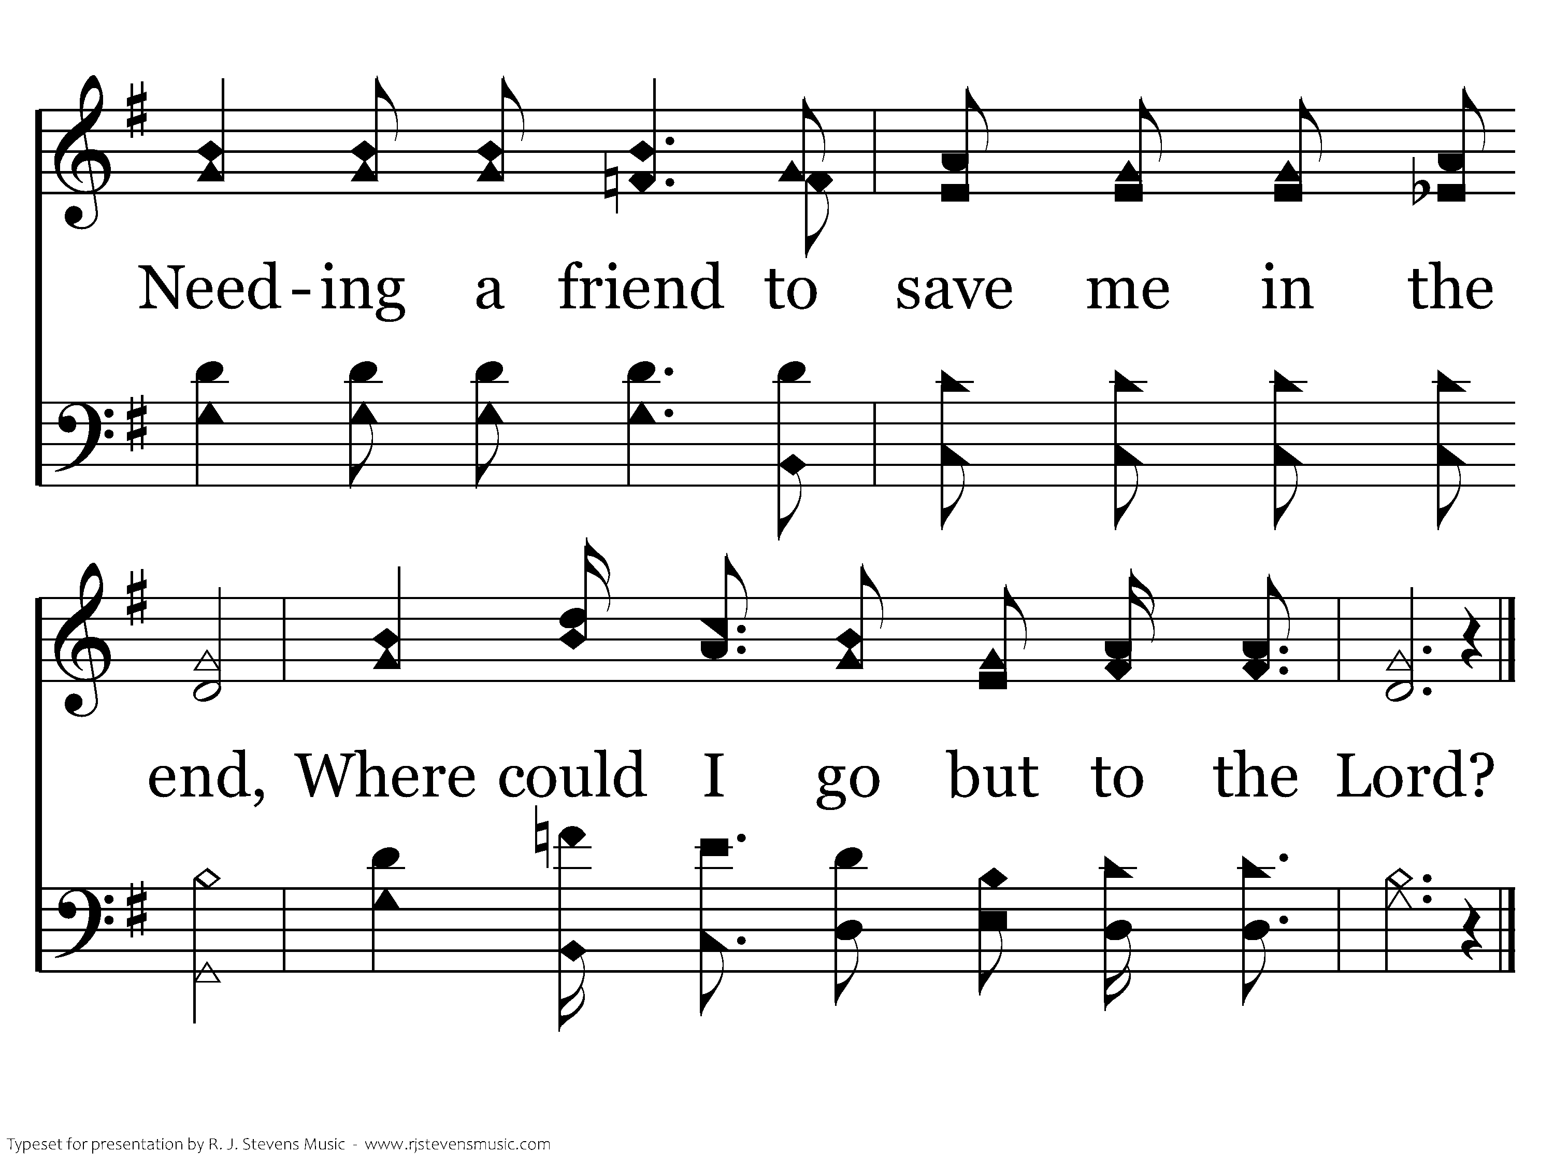
1056 - Where Could I Go - C.2
End of Verse 1

Slide 54
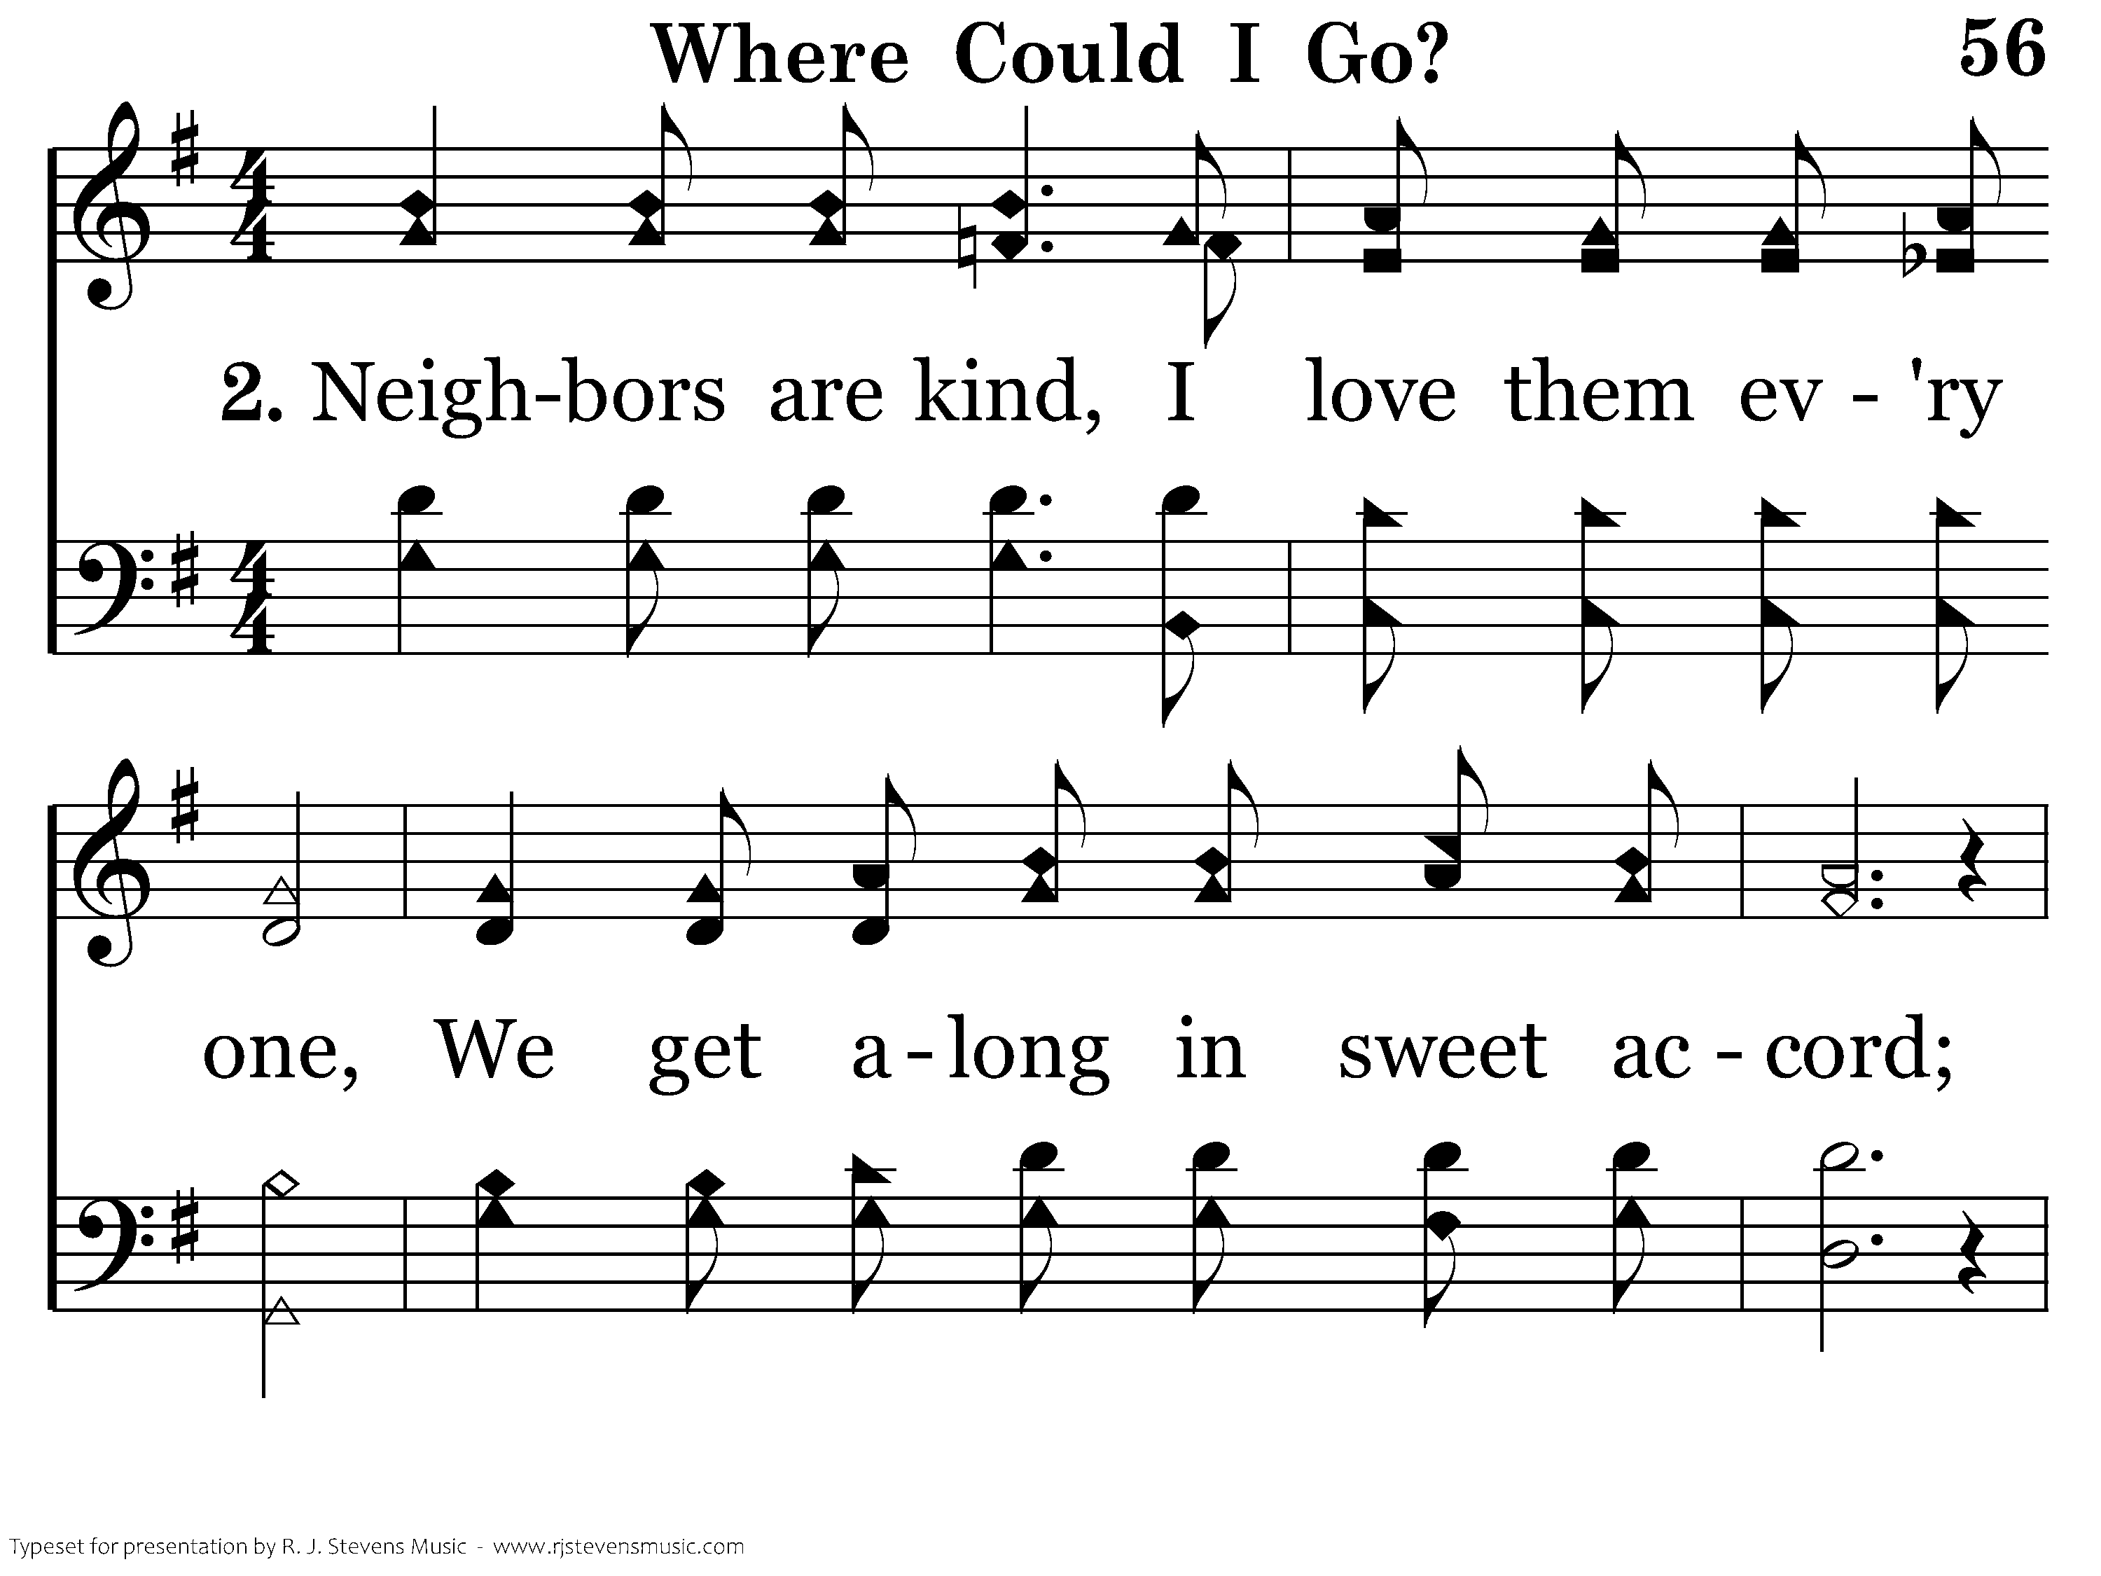
1056 - Where Could I Go - 2.1

Slide 55
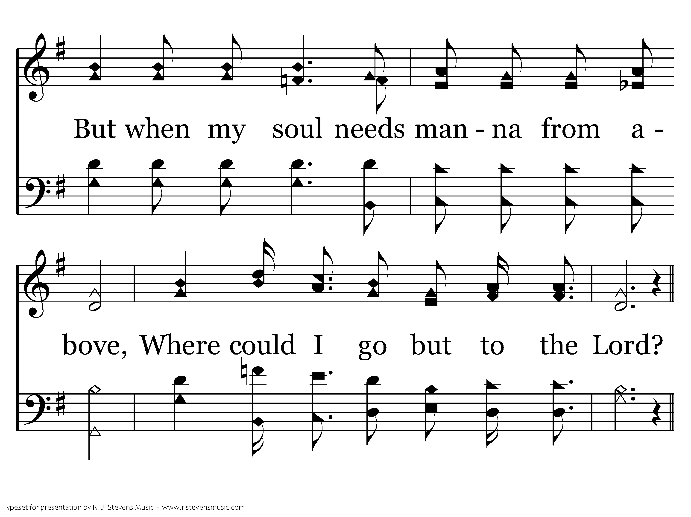
1056 - Where Could I Go - 2.2

Slide 56
1056 - Where Could I Go - C.1

Slide 57
1056 - Where Could I Go - C.2
End of Verse 2

Slide 58
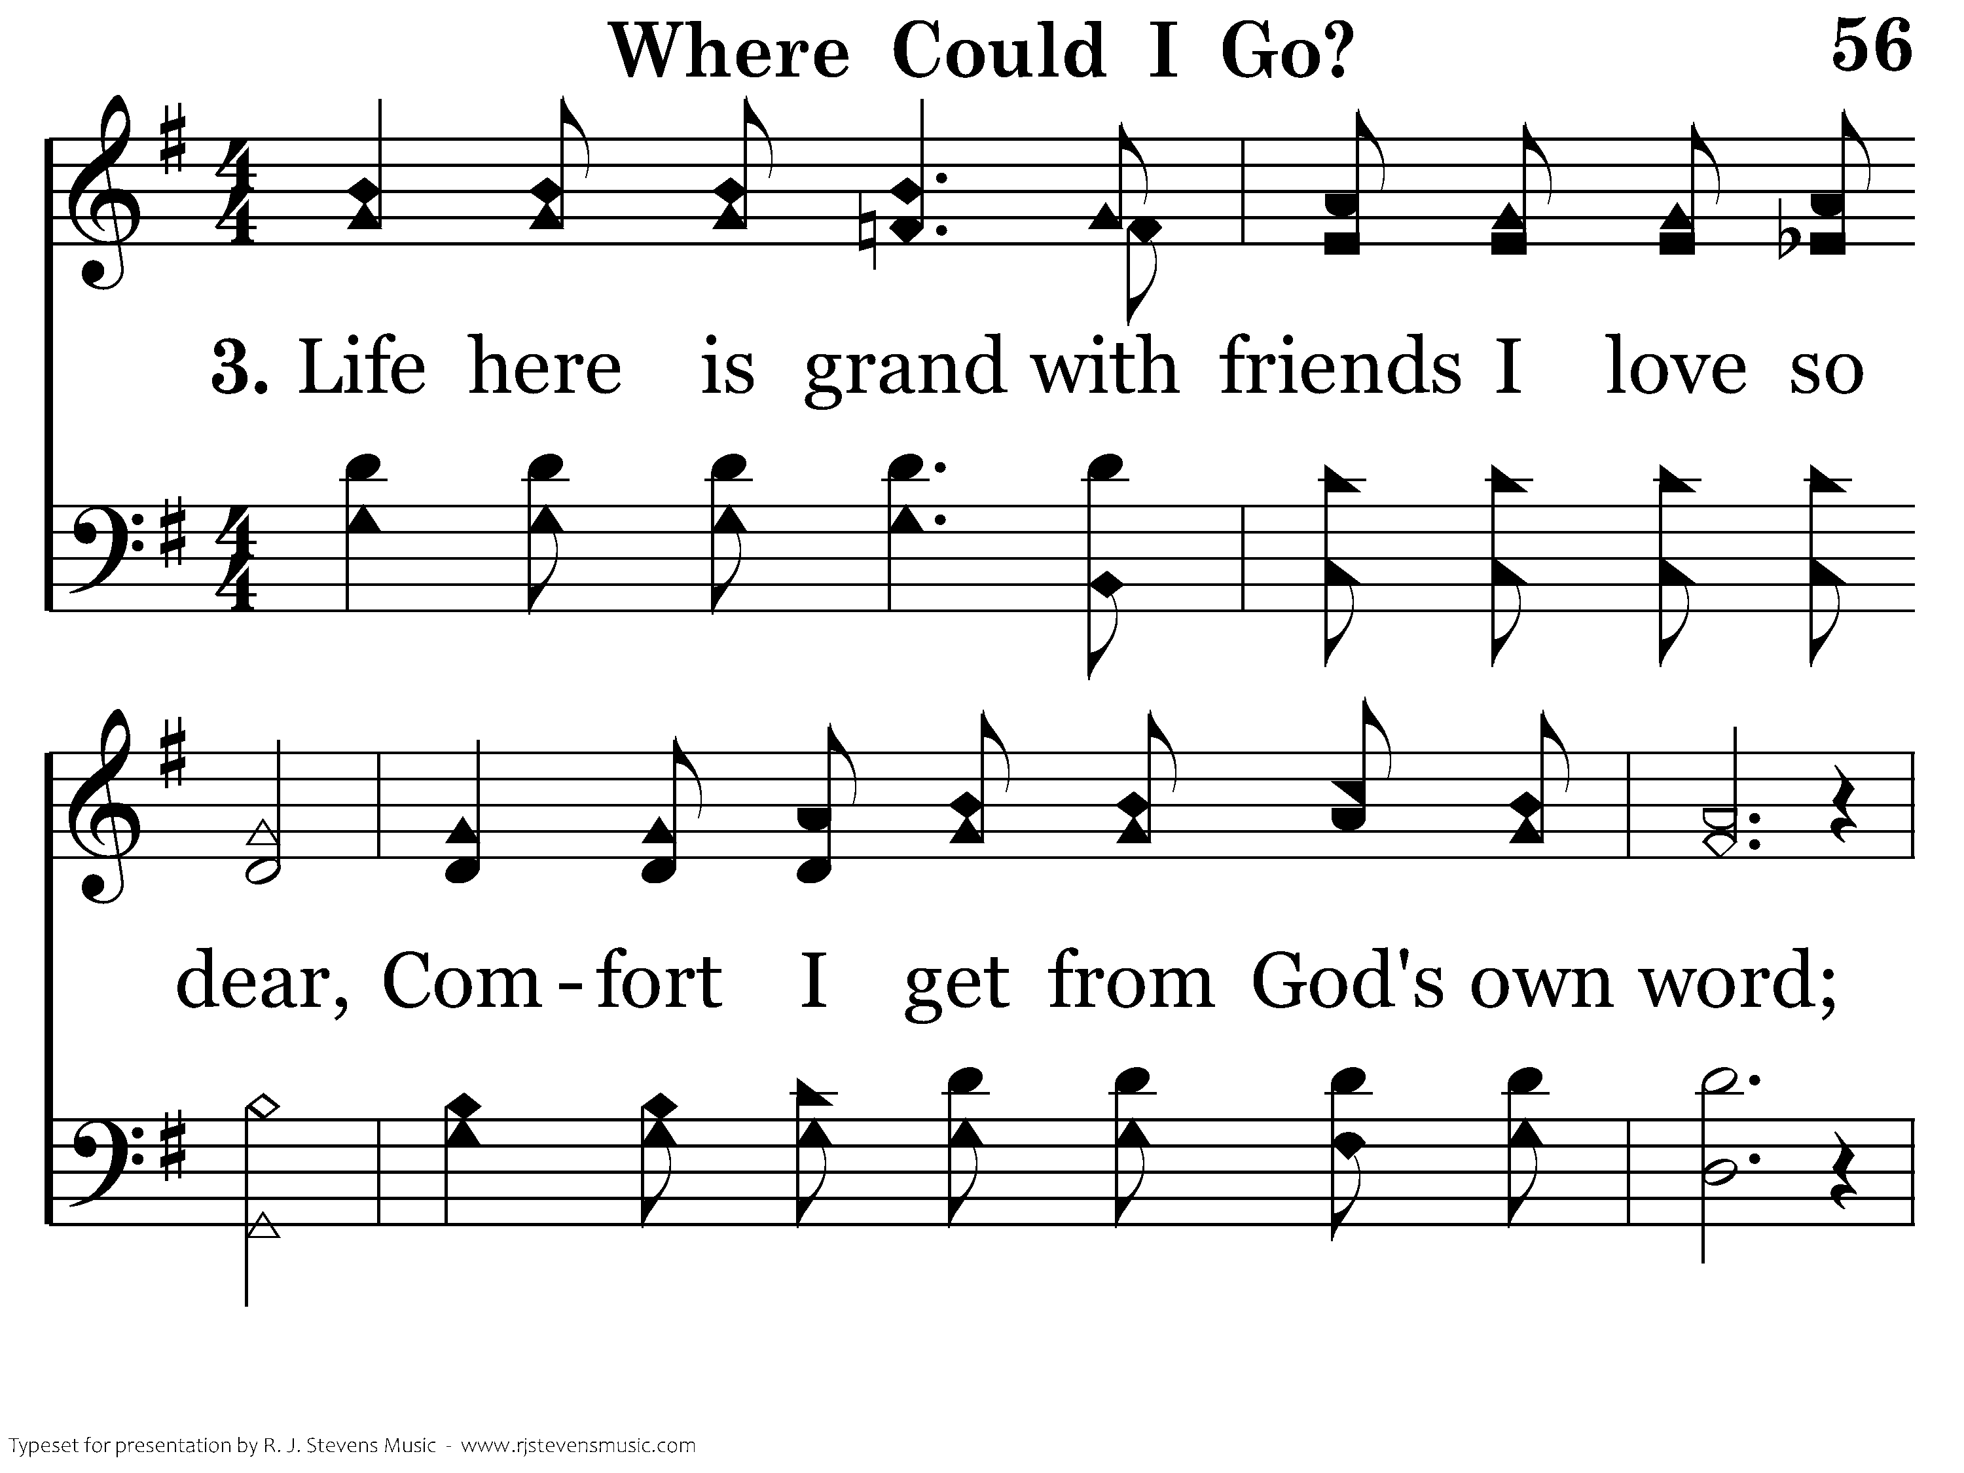
1056 - Where Could I Go - 3.1

Slide 59
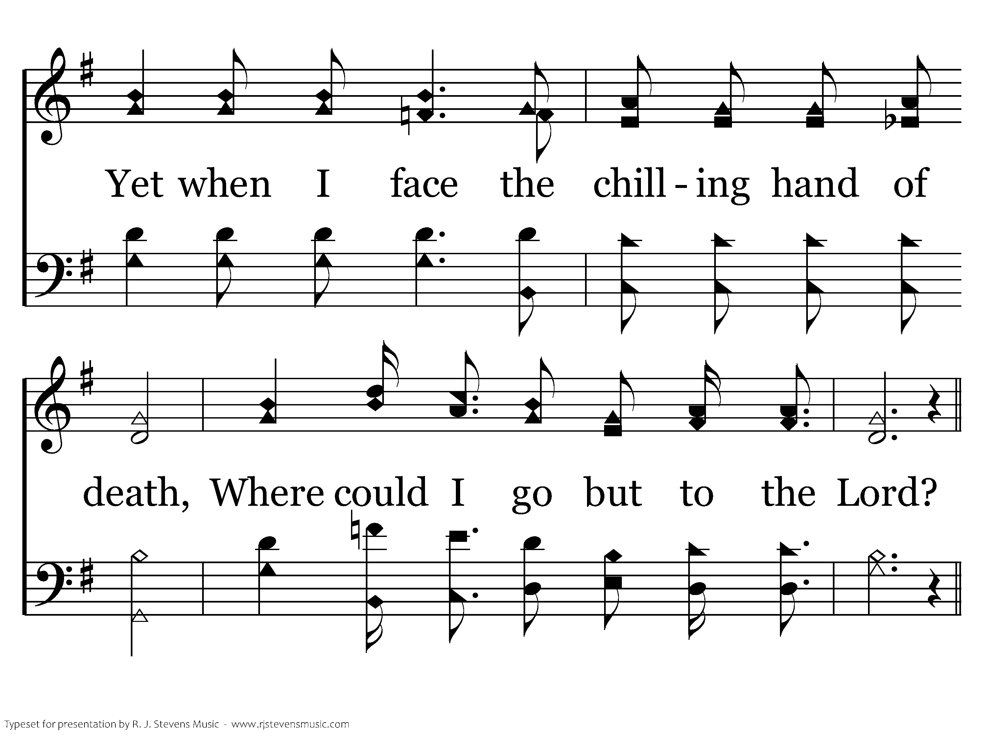
1056 - Where Could I Go - 3.2

Slide 60
1056 - Where Could I Go - C.1

Slide 61
1056 - Where Could I Go - C.2
End of Song

