Slide 2
The Imputation of Righteousness
How Are We Saved?

Slide 3

Five Points of Calvinism
Total Inherited Depravity
Unconditional Election
Limited Atonement
Irresistible Grace
Perseverance of the Saints

Slide 4
Imputation of Righteousness
Romans 4:6-8, 22-24
LOGIZOMAI
  Used 11 times in Romans 4
  Used 40 times in the New Testament

Slide 5
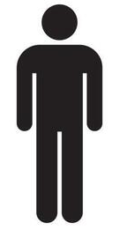
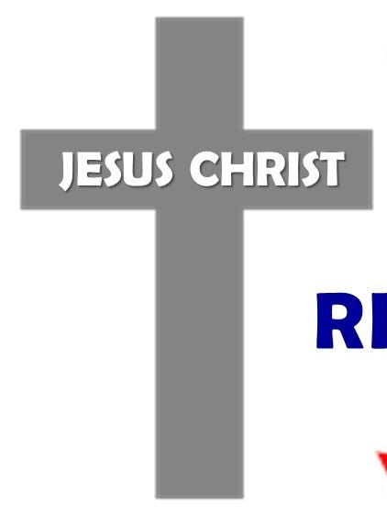
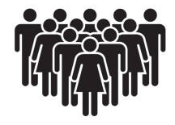
According to Calvinism
Imputation = Transference
Adam’s sin to man
Man’s sin to Christ
Christ’s righteousness to man

Slide 6
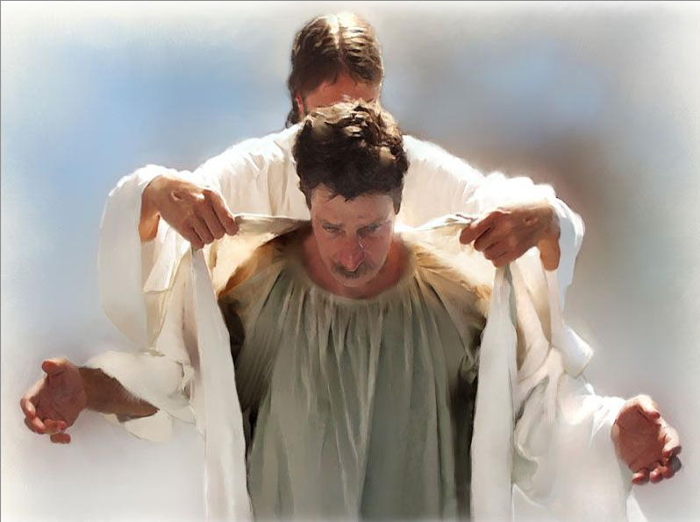
According to Calvinism
Imputation = Transference

Slide 7
According to some brethren
Imputation = Transference
“When God looks at those embracing His grace, He sees Jesus’ righteousness…”
“He has taken our sins, and it was credited to the Son and taken the Son’s righteousness and credited to us…”

Slide 8
According to some brethren
Imputation = Transference
“The essence of grace is a profound exchange… it’s as if Jesus swapped places and identifies with us. On the cross, God saw our sins in Jesus and inflicted our deserved punishment on Him. Consequently, when God looks at those embracing His grace, He sees Jesus’ righteousness.”

Slide 9
Scriptural View of Imputation
LOGIZOMAI is never used to mean transfer or transference.
It was an accounting or bookkeeping term.
  “to make account of” (Thayer)
  “to take an inventory, i.e., estimate” (Strong’s)
  “reckon, attribute, credit, account, count”

Slide 10


Scriptural View of Imputation

Slide 11
God forgives and removes our sins.

Slide 12
God forgives and removes our sins.
Wash me thoroughly from my iniquity, and cleanse me from my sin.
Purge me with hyssop, and I shall be clean; wash me, and I shall be whiter than snow.
Psalm 51:2, 7

Slide 13
God forgives and removes our sins.
As far as the east is from the west, so far has He removed our transgressions from us.
Psalm 103:12

Slide 14
God forgives and removes our sins.
“Come now, and let us reason together,” says the Lord, “Though your sins are like scarlet, they shall be as white as snow; though they are red like crimson, they shall be as wool.”
Isaiah 1:18

Slide 15
God forgives and removes our sins.
Who is a God like You, pardoning iniquity and passing over the transgression of the remnant of His heritage? He does not retain His anger forever, because He delights in mercy.
He will again have compassion on us, and will subdue our iniquities. You will cast all our sins into the depths of the sea.
Micah 7:18-19

Slide 16
God forgives and removes our sins.
And now why are you waiting? Arise and be baptized, and wash away your sins, calling on the name of the Lord.
Acts 22:16

Slide 17
God forgives and removes our sins.
And such were some of you. But you were washed, but you were sanctified, but you were justified in the name of the Lord Jesus and by the Spirit of our God.
1 Corinthians 6:11

Slide 18
God forgives and removes our sins.
But if we walk in the light as He is in the light, we have fellowship with one another, and the blood of Jesus Christ His Son cleanses us from all sin.
1 John 1:7

Slide 19
God forgives and removes our sins.
And from Jesus Christ, the faithful witness, the firstborn from the dead, and the ruler over the kings of the earth. To Him who loved us and washed us from our sins in His own blood.
Revelation 1:5

Slide 20
Problems with Brethren Advocating Calvinistic Imputation
Neither sin nor righteousness can be transferred (Ezek. 18:20).
Minimizes (eliminates) obedience.
Removes personal accountability.
Leads to more errors.

Slide 21
The Imputation of Righteousness
Why does this matter?

