Slide 2
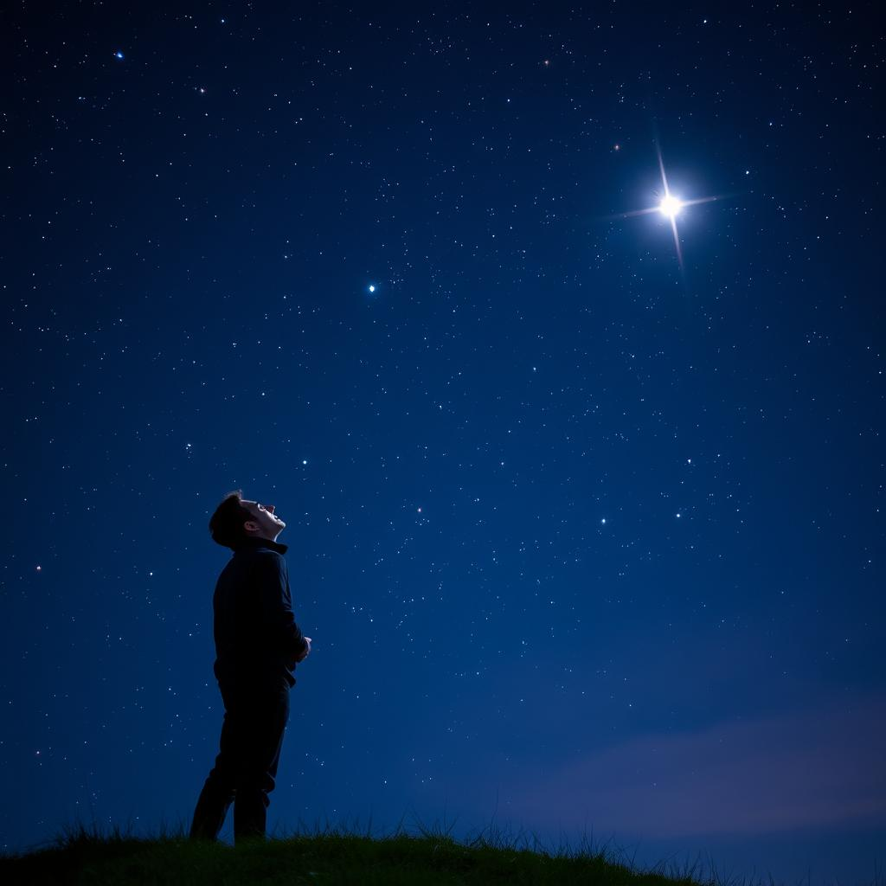
Created for a Purpose

Slide 3
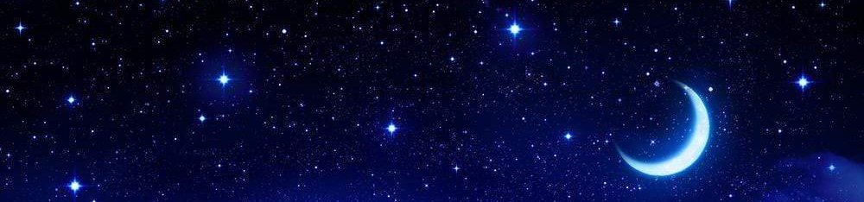
When I consider Your heavens, the work of Your fingers, the moon and the stars, which You have ordained,
What is man that You are mindful of him, and the son of man that You visit him?
Psalm 8

Slide 4
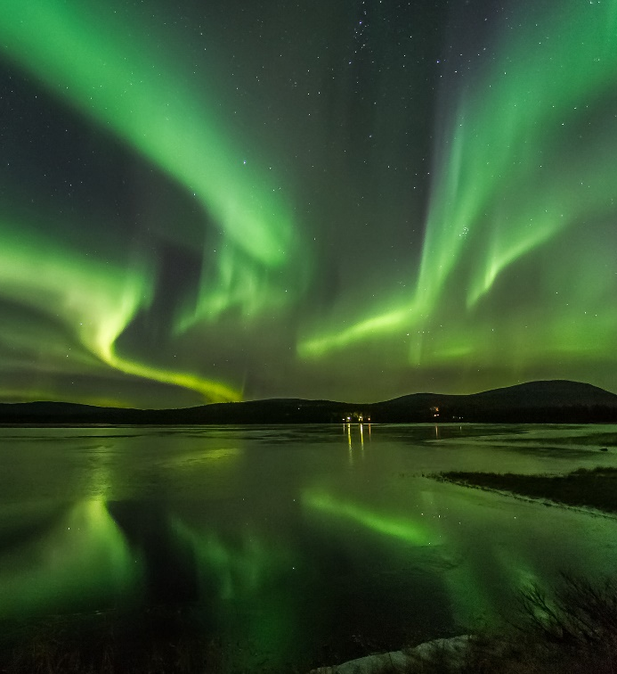
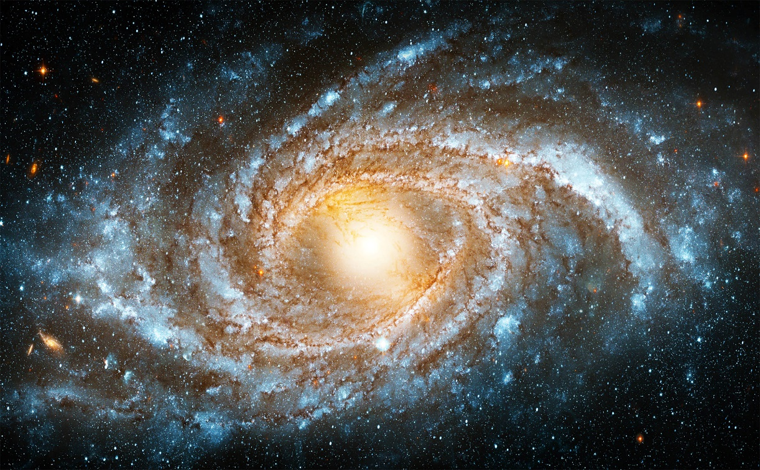
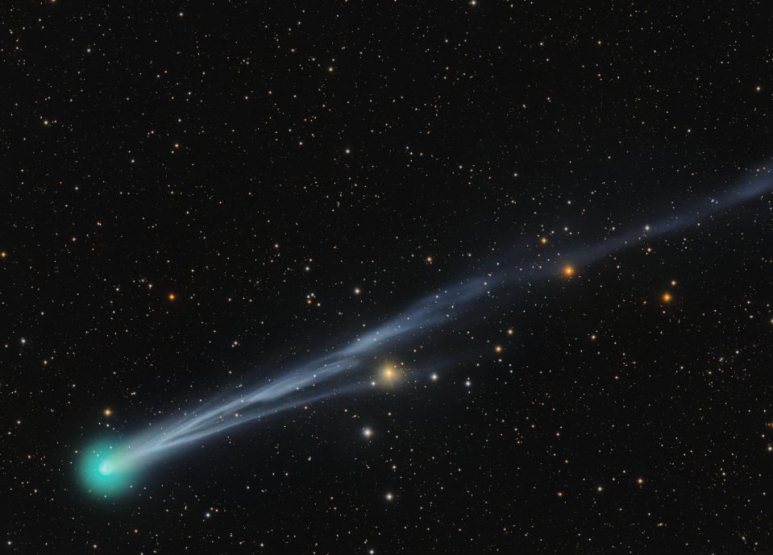
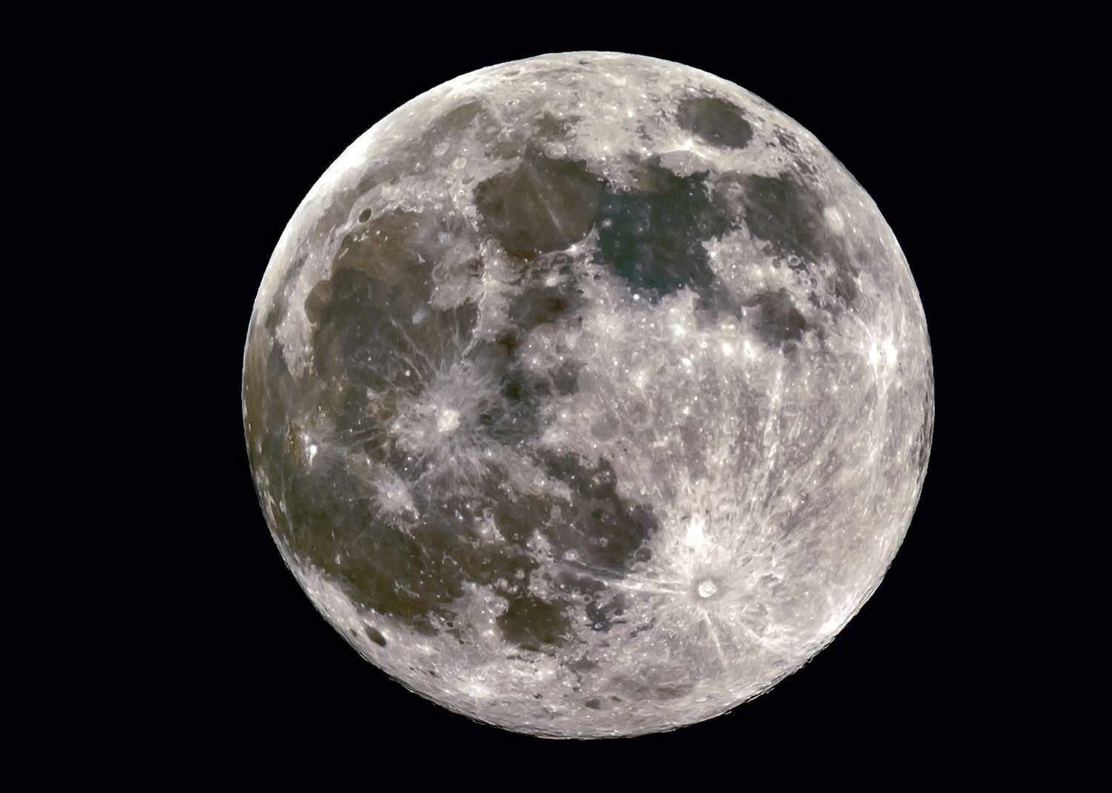

Slide 5


Slide 6
1. We Were Created by God
Genesis 2:7; Psalm 100:3
The pinnacle of God’s creation (Gen. 1:26-28).
We are “fearfully and wonderfully made”
(Psalm 139:13-16).

Slide 7
2. We Were Created in God’s Image
Then God said, “Let Us make man in Our image, according to Our likeness; let them have dominion over the fish of the sea, over the birds of the air, and over the cattle, over all the earth and over every creeping thing that creeps on the earth.”
So God created man in His own image; in the image of God He created him; male and female He created them.
Genesis 1:26-27

Slide 8
3. We Were Created to Have Fellowship with God
God has “put eternity into man’s heart” (Eccl. 3:11).
God calls for us to know and understand Him
(Jer. 9:23-24).
“So that they should seek the Lord, in the hope that they might grope for Him and find Him, though He is not far from each one of us” (Acts 17:27).

Slide 9
Created for a Purpose

