Slide 1

Doctrine
That Makes Us
Different

Slide 2

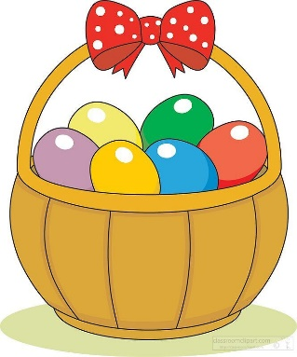

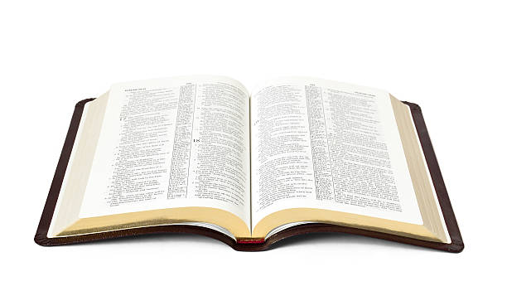
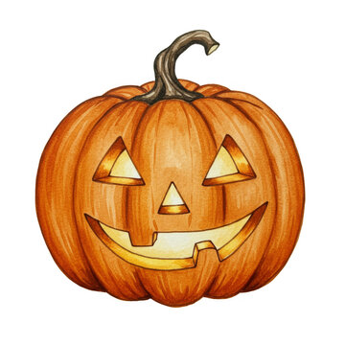
Celebrating Holidays

Slide 3
“Christian” Holidays
Advent
Christmas
Epiphany
Lent
  Ash Wednesday
  Palm Sunday
  Good Friday
  Easter
Saint Patrick’s Day
All Saints Day
All Souls Day

Slide 4
No Authority for These Holidays
There is NO command, example, or inference that the church observed these holidays.
“And in vain they worship Me, teaching as doctrines the commandments of men” (Matt. 15:9).

Slide 5
No Authority for These Holidays
“They had special days and feasts in the Old Testament.”
  Gal. 4:9-11; Col. 2:16-17
“The Lord’s birth and resurrection are important Bible events.”
  Not celebrated by the church in the NT.
“Easter is mentioned in the Bible.”
  Acts 12:4, King James Version

Slide 6
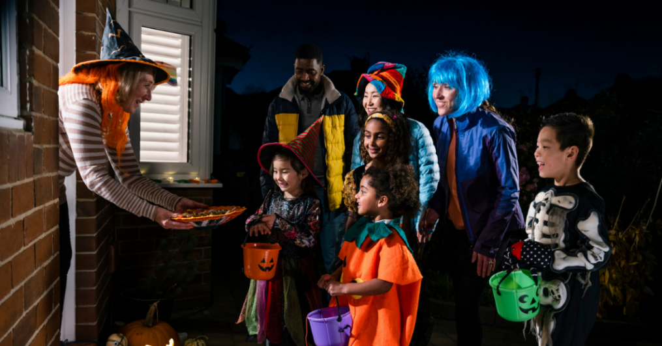
The Christian and Halloween
Pagan Origins
Glorification of Darkness, Death,
and the Devil
Serious Spiritual
Concerns

Slide 7



Customs Rooted in Paganism
Christmas - Norse Yule, Roman Saturnalia
Easter - Germanic festival honoring the spring goddess Eostre
Days of the Week
Months of the Year
Wedding Rings
Brides Maids

Slide 8
Christians Celebrating These as Non-Religious Holidays
“One person esteems one day above another; another esteems every day alike. Let each be fully convinced
in his own mind” (Rom. 14:5).
It’s a matter of personal conscience/conviction.
We can’t do what is sinful, we can’t bind our choices on others, nor can we judge and condemn others for making different choices.

