Slide 1

5 Enemies of greatness

Slide 2
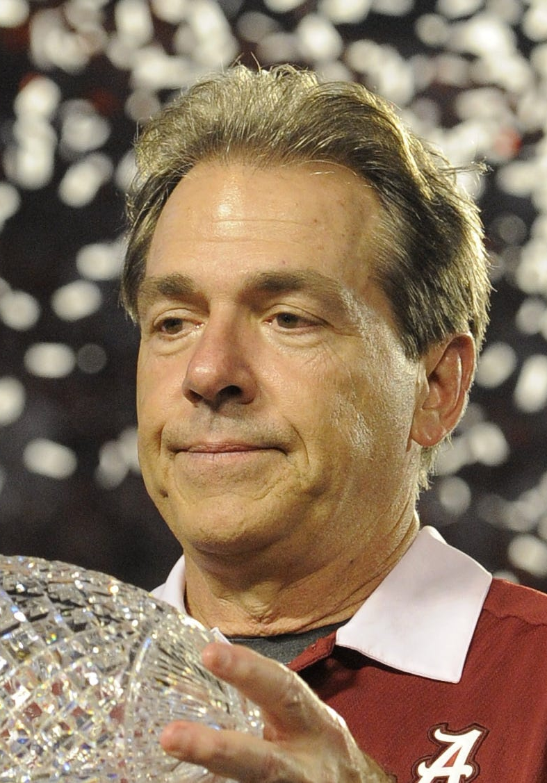
Nick Saban
7 National Championships
292-71 Record as a head coach
206-29 Record at Alabama

Slide 3
Entitlement
“You get up every day, you’re entitled to nothing. So nothing is acceptable but your best.”
Prodigal Son
  Luke 15:11-12
Jesus’s Example
  John 13:12-16

Slide 4
Lack of Discipline
“Run hard when it gets hard to run. Everything starts with discipline. Practice until you can't get it wrong – not just until you get it right. If you don’t respect it enough to do it right – when it’s the right way to do it, how can you be trusted in a game?”
Samson
  Judges 14
  Gives in to his wife and reveals the answer to his riddle
  Judges 16
  Trusts his own strength instead of God and reveals the secret to his strength.
Nehemiah 4:15-23
  Also gets the rest of Isreal to work in a disciplined manner

Slide 5
Circumstances Over Vision
Joseph
Sold by his brothers
Slave
Sent to jail wrongly accused
Forgotten about
Parable of the Rich Fool
Luke 12:16-21
“If you want to be good, you really don’t have a lot of choices, because it takes what it takes.”

Slide 6
Self Pity
Elijah
  1 Kings 19
Paul
  2 Corinthians 12:9-10
“There are two pains in life. There is the pain of discipline and the pain of disappointment. If you handle the pain of discipline, then you’ll never have to deal with the pain of disappointment.”

Slide 7
Complacency
“Complacency creates a blatant disregard for doing what is right.”
Daniel 6:4-5
  Could find nothing wrong with him unless they used his religion against him
Moses
  Numbers 20:11-12

