Slide 1
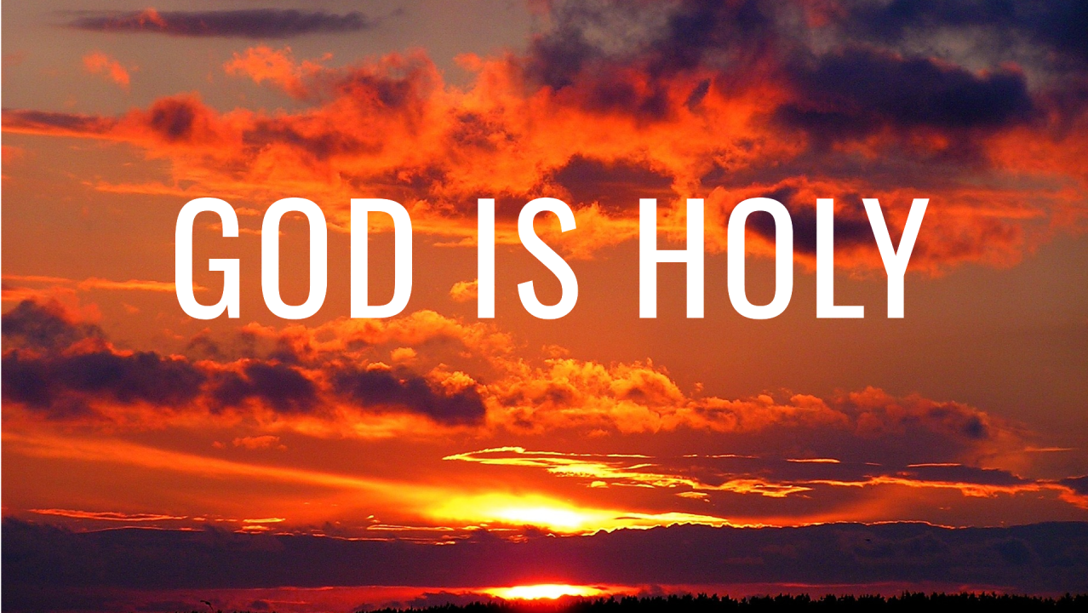

Slide 2
Holy - Qadowsh
Primary idea is “cutting off” or “separation”
  See Lev. 20:26
“sacred, holy, set apart”
“that which belongs to the sphere of the sacred, distinct from the common or profane”

Slide 3
God is Holy
God is distinct and separate from His physical creation.
God’s moral character is distinct and separate from any and all defilement.

Slide 4
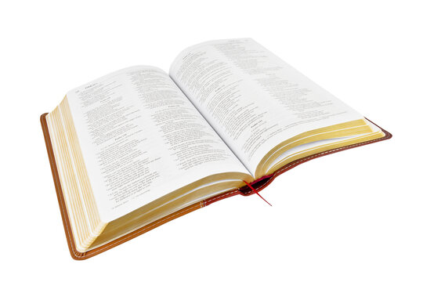
God is Holy
“Who is like You, O Lord, among the gods? Who is like You, glorious in holiness,
fearful in praises, doing wonders?”
Exodus 15:11

Slide 5
God is Holy
“No one is holy like the Lord,
for there is none besides You,
nor is there any rock like our God.”
1 Samuel 2:2

Slide 6
God is Holy
“Who shall not fear You, O Lord, and glorify Your name? For You alone are holy.
For all nations shall come and worship
before You, for Your judgments have
been manifested.”
Revelation 15:4

Slide 7
God is Holy
Above it stood seraphim; each one had six wings: with two he covered his face, with two he covered his feet, and with two he flew.
And one cried to another and said:
“Holy, holy, holy is the Lord of hosts;
the whole earth is full of His glory!”
Isaiah 6:2-3

Slide 8
God is Holy
God’s holiness is so overwhelming
and powerful that it will destroy every impurity in God’s presence!
Moses was stopped when approaching God’s presence at the burning bush (Ex. 3:5-6).
Isaiah cried, “Woe is me, for I am undone”
(Is. 6:5) when he witnessed God’s holiness.

Slide 9
The Demands of God’s Holiness
View God in the Proper Way
  Psalm 99:1-3
View Ourselves in the Proper Way
  Isaiah 6:5; 64:6
Approach God in the Proper Way
  Leviticus 10:1-3
Live in the Proper Way
  Matt. 5:8; 1 Pet. 1:15-16; Rom. 12:9

