Slide 2
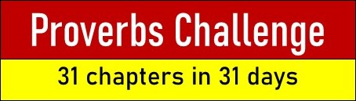
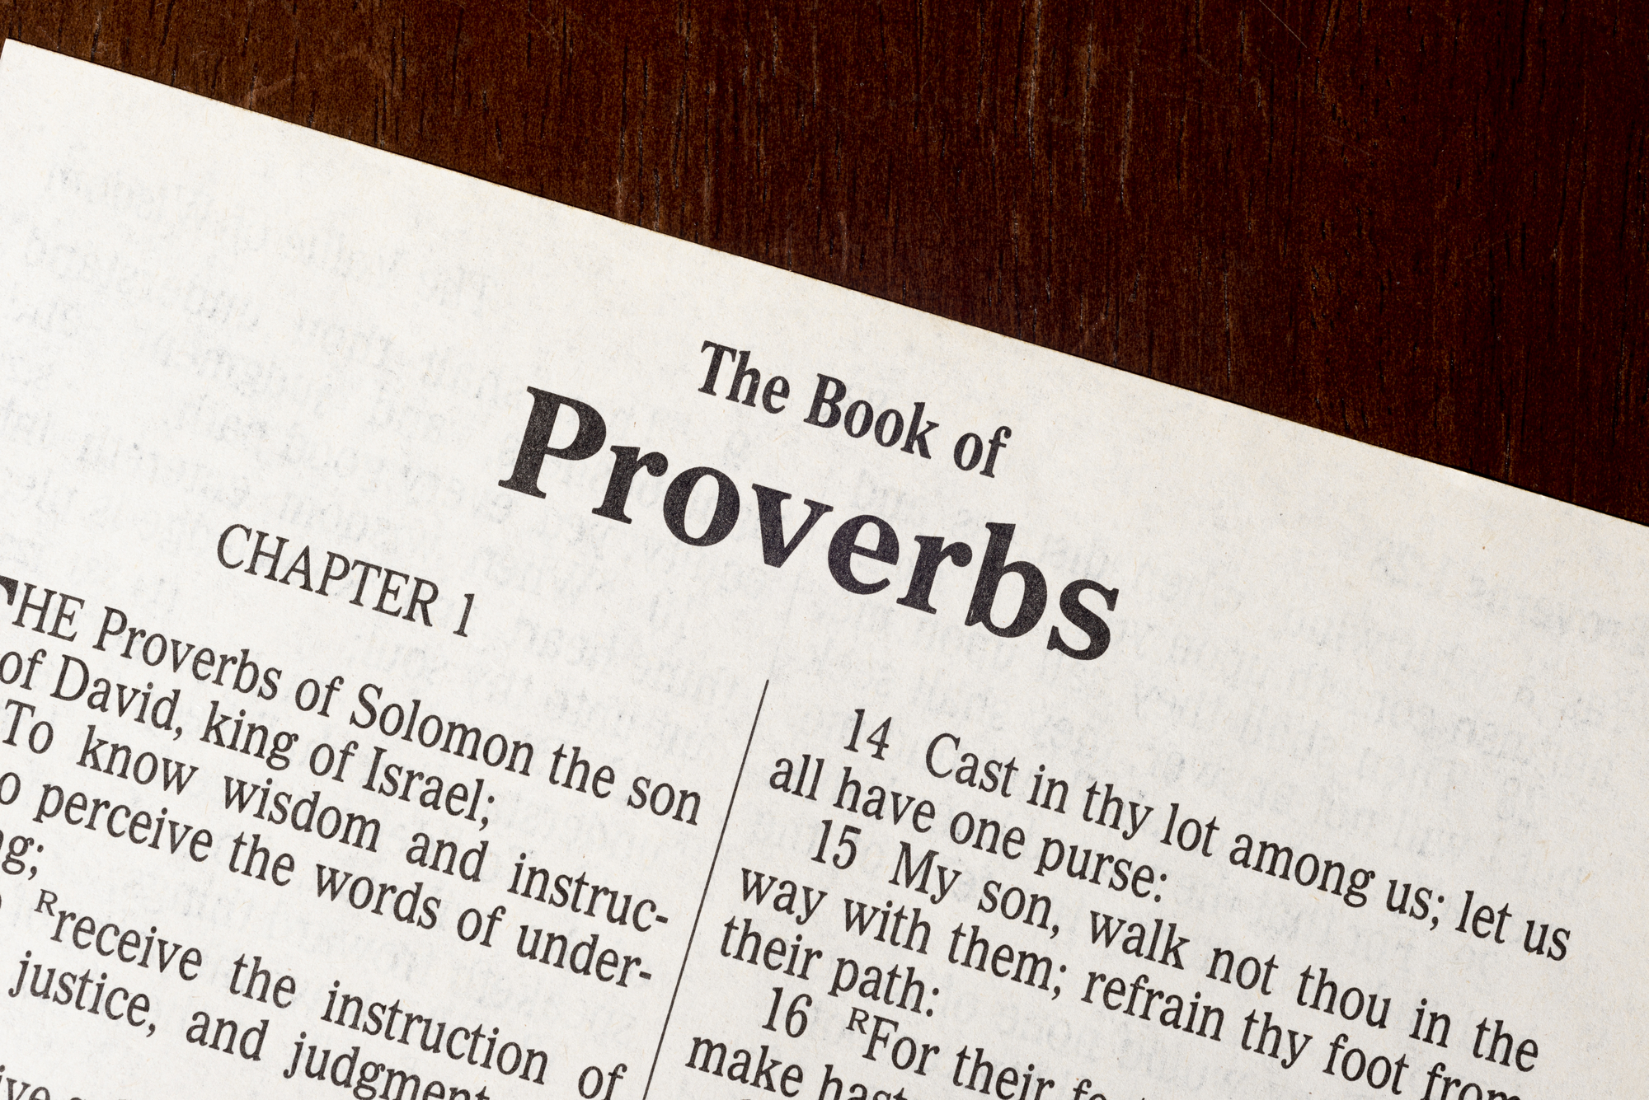
knollwoodchurch.org
Follow our Facebook page during the 31 days of October, as together we will read the 31 chapters of the book of Proverbs, one chapter a day.

Slide 3
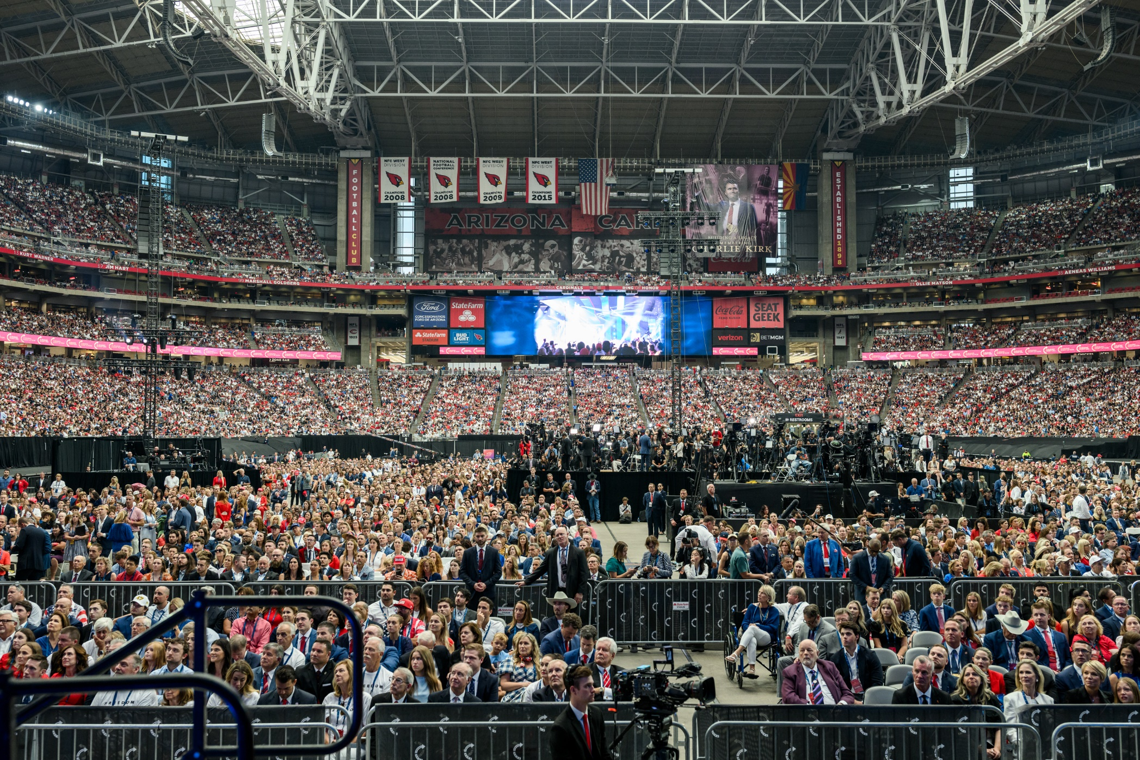
Who is a Christian?

Slide 4
One is not a Christian because…
They are religious - James 1:26-27
They believe in Jesus - John 8:24
They live moral lives - Acts 10:1-2, 22; 11:14
They are sincere - Acts 23:1; 26:9
They “identify” as a Christian - Matt. 7:21-23

Slide 5
Who is a Christian?
A Disciple of Jesus - Acts 11:26
  A baptized believer - Matt. 28:18-19
  Following Jesus’ teachings - v. 20, John 8:31
  Identifying with other disciples - Acts 11:26
Persuades Others to Be Disciples -
Acts 26:27-29
Willing to Suffer for Christ -
1 Peter 4:15-16

Slide 6
Are You a Christian?
Following the Teachings of Jesus
Persuading Others to Be a Disciple
Willing to Suffer for Christ

