Slide 2

Doctrine
That Makes Us
Different

Slide 3


Slide 4
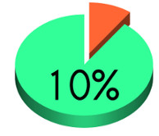
What is Tithing?
Giving a tenth of one’s income or property as an offering to God.
The custom dates to ancient times, practiced by many nations.
Among Israelites, its practice predates
the Law of Moses (Gen. 14:17-20).

Slide 5
What is Tithing?
The Law of Moses commanded tithes.
  Lev. 27:30-32; Num. 18:21-32
Mentioned 8 times in the New Testament, but all referring to Old Testament practice.
Law of Moses done away with (Col. 2:14).

Slide 6






Slide 7
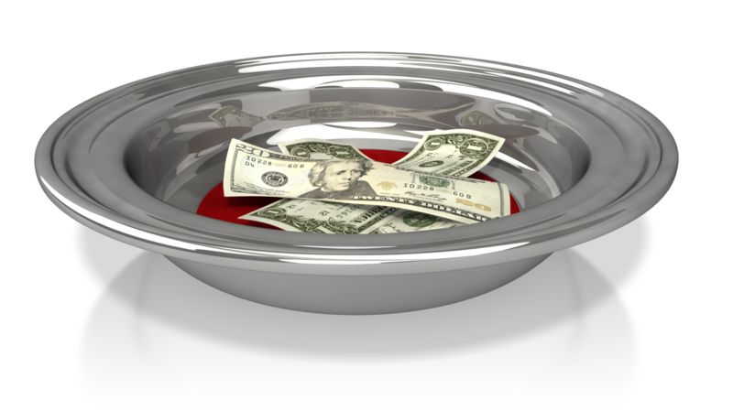
How the Church Raises Funds
Members laid freewill offerings at the feet of the apostles (Acts 4:34-5:4).
Members were to “lay by in store” every first day of the week (1 Cor. 16:1-2).

Slide 8
Biblical Principles for Giving
As We Prosper - 1 Cor. 16:2
Bountifully - 2 Cor. 9:6
Purpose in Our Heart - 2 Cor. 9:7
Cheerfully - 2 Cor. 9:7

