Slide 2

A study of Matthew 19:3-12

Slide 3
Matthew 19:3-12
Pharisees come to Jesus v. 3
The Lord’s response vs. 4-6
The certificate of divorce v. 7
Jesus corrects their misunderstanding v. 8
Divorce results in adultery v. 9

Slide 4

Why the 2nd marriage is adultery.

Slide 5
Why the 2nd marriage is adultery.

Slide 6
Why the 2nd marriage is adultery.
This first marriage bond is still intact.

Slide 7
Matthew 19:3-12
Pharisees come to Jesus v. 3
The Lord’s response vs. 4-6
The certificate of divorce v. 7
Jesus corrects their misunderstanding v. 8
Divorce results in adultery v. 9

Slide 8
Matthew 19:3-12
Pharisees come to Jesus v. 3
The Lord’s response vs. 4-6
The certificate of divorce v. 7
Jesus corrects their misunderstanding v. 8
Divorce results in adultery v. 9
The disciples’ response v. 10

Slide 9
Matthew 19:3-12
Pharisees come to Jesus v. 3
The Lord’s response vs. 4-6
The certificate of divorce v. 7
Jesus corrects their misunderstanding v. 8
Divorce results in adultery v. 9
The disciples’ response v. 10
“He who is able to accept it” vs. 11-12

Slide 10
Who has a right by God to get married?
One who has never been married
One who’s spouse has died (Rom. 7:2-3)
One who divorced their unfaithful spouse
for the cause of sexual immorality
(Matt. 5:32; 19:9)

Slide 12
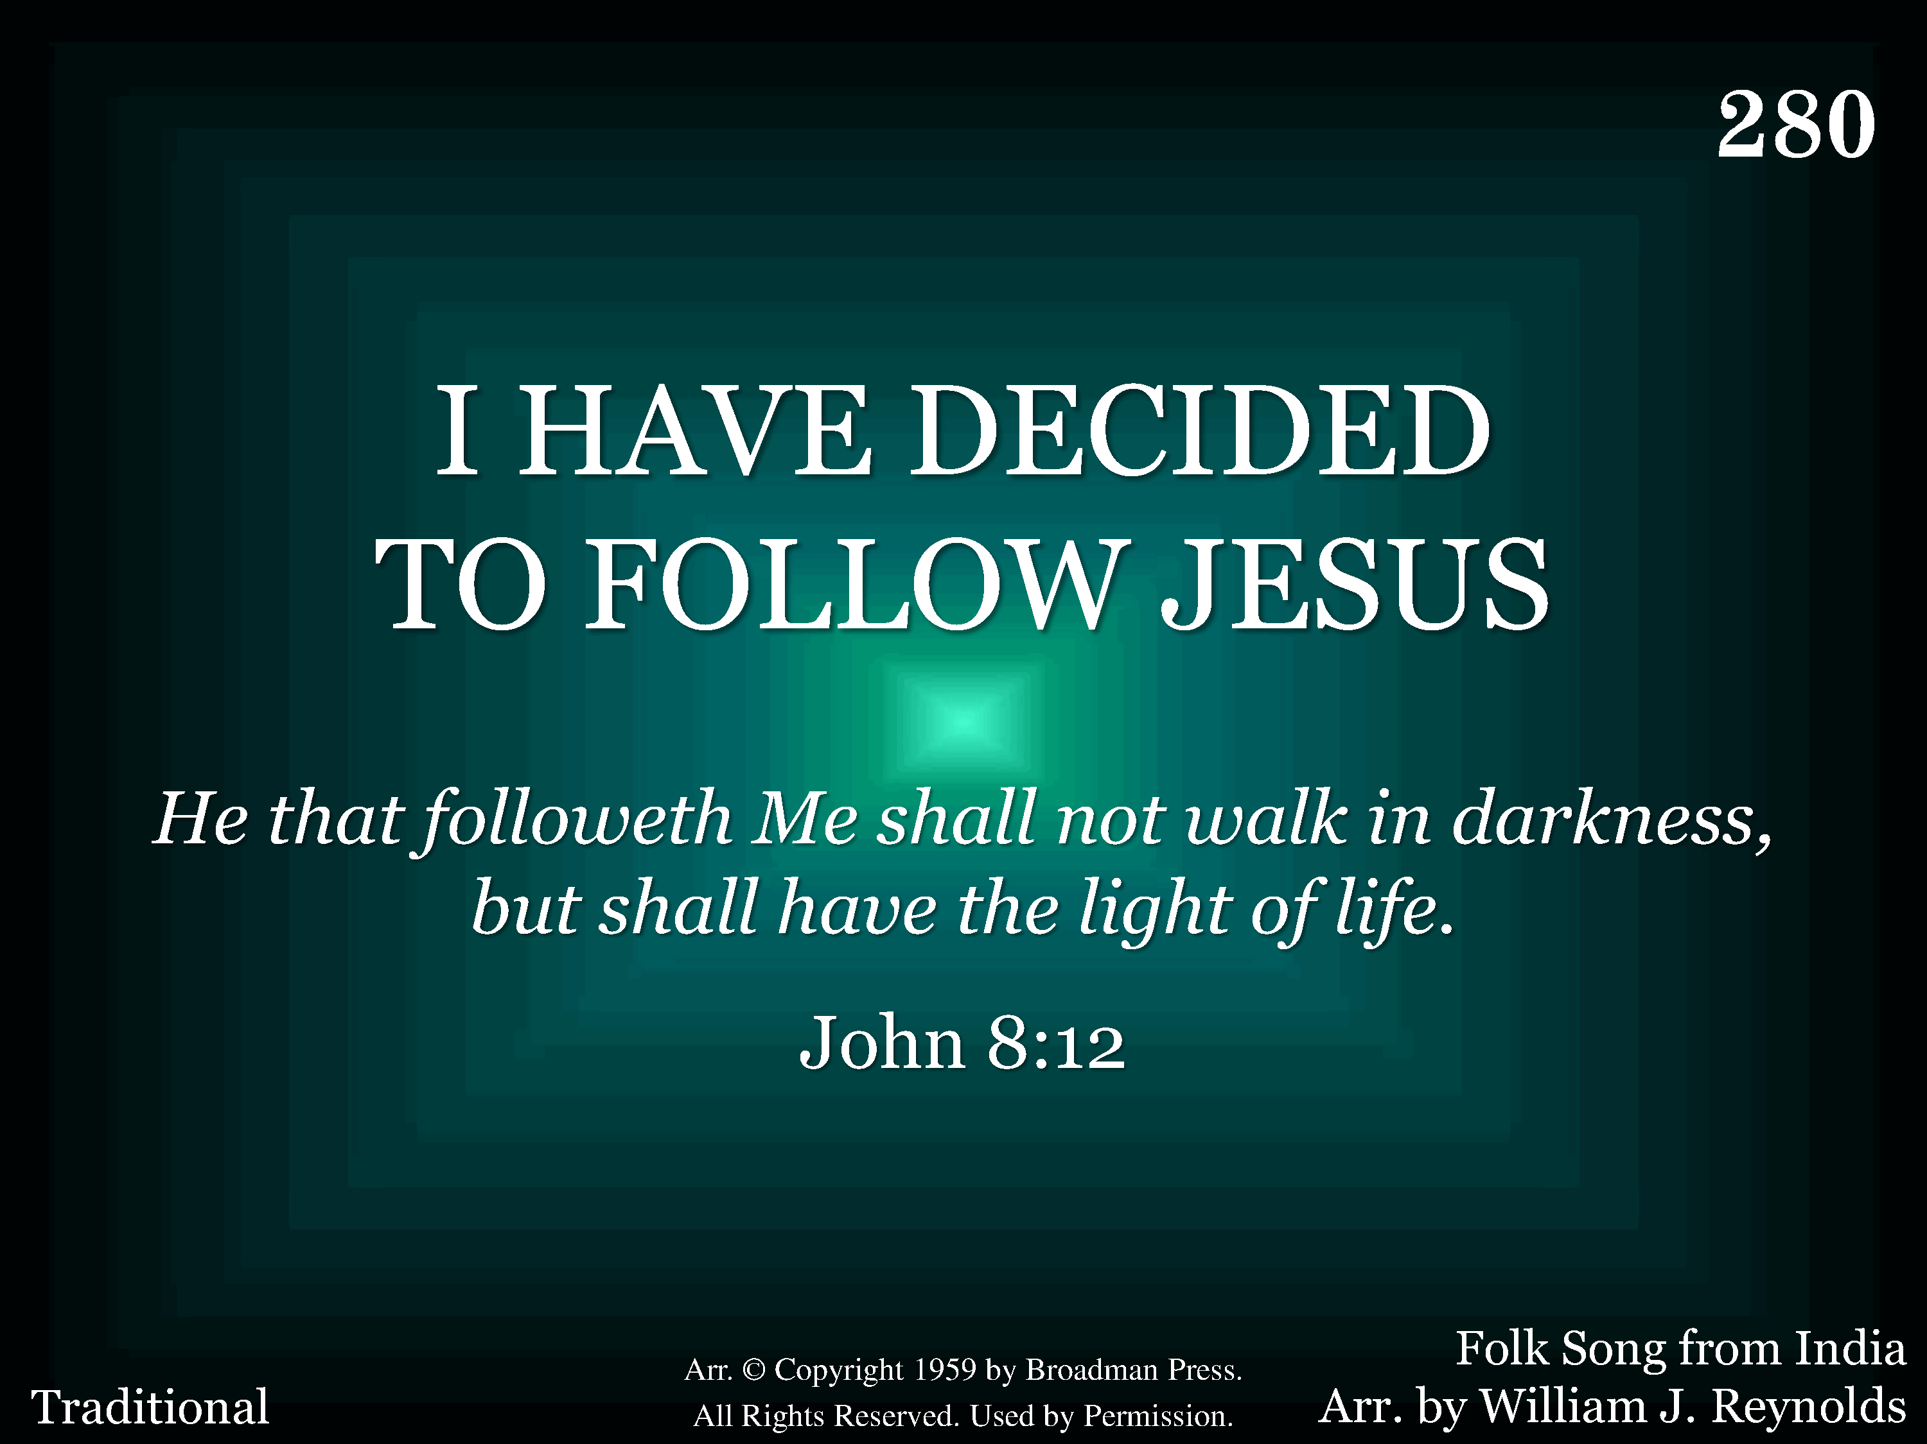
280 - I Have Decided To Follow Jesus - Title

Slide 13
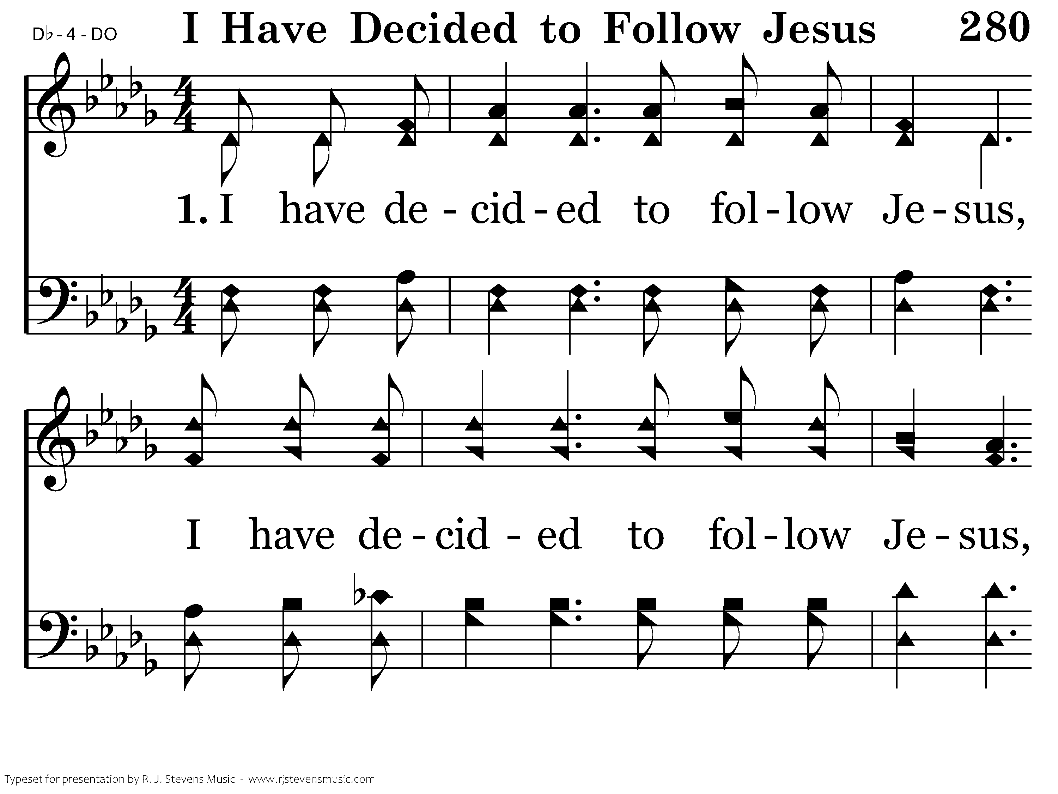
280 - I Have Decided To Follow Jesus - 1.1

Slide 14
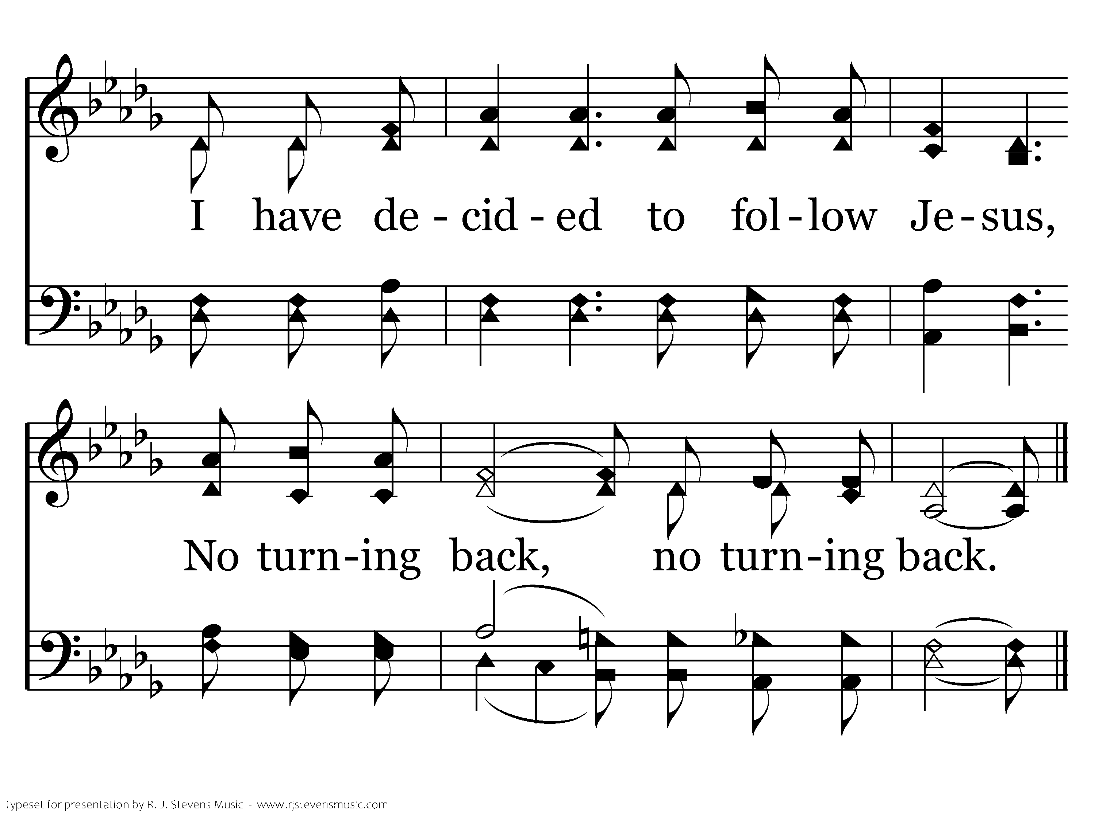
280 - I Have Decided To Follow Jesus - 1.2
End of Verse 1

Slide 15
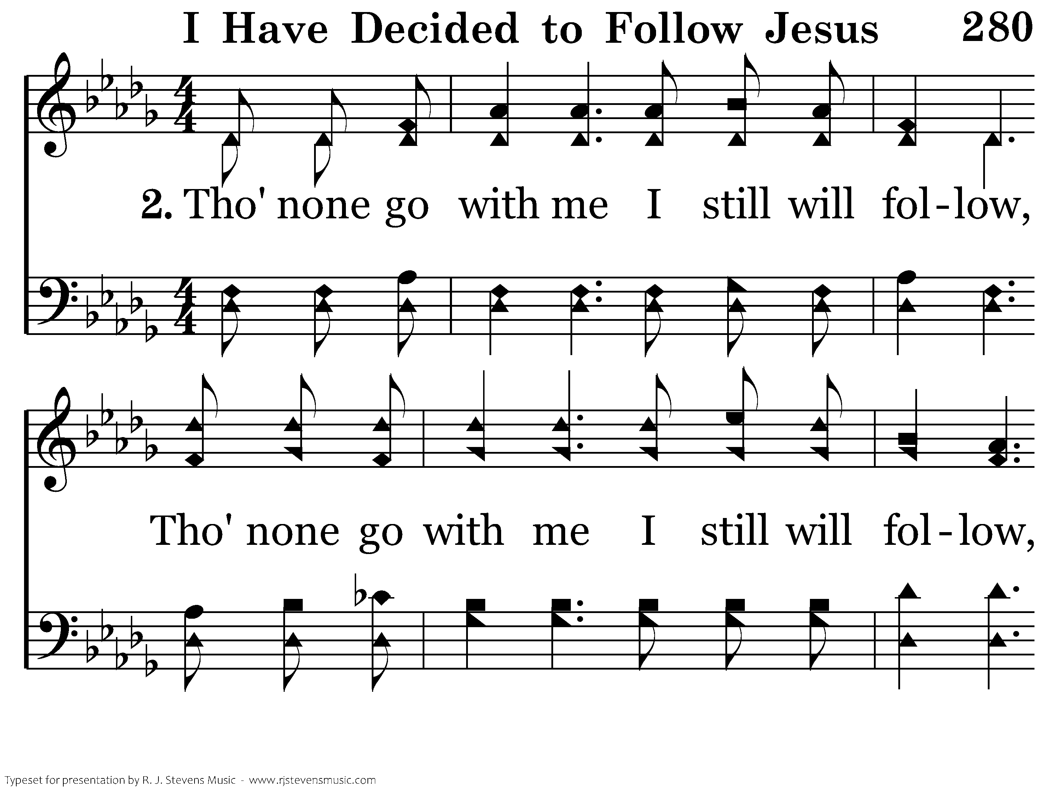
280 - I Have Decided To Follow Jesus - 2.1

Slide 16
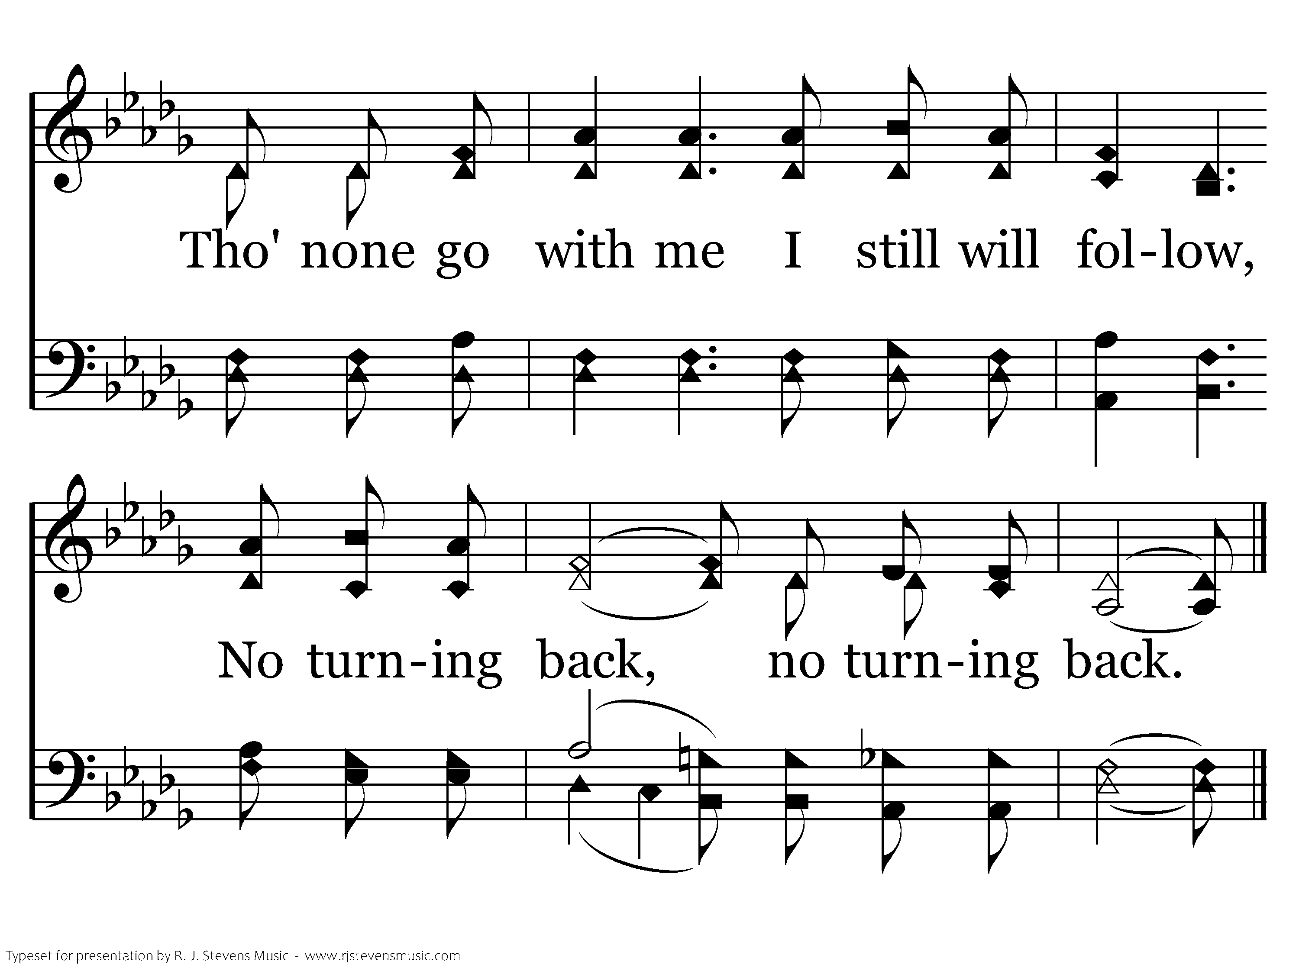
280 - I Have Decided To Follow Jesus - 2.2
End of Verse 2

Slide 17
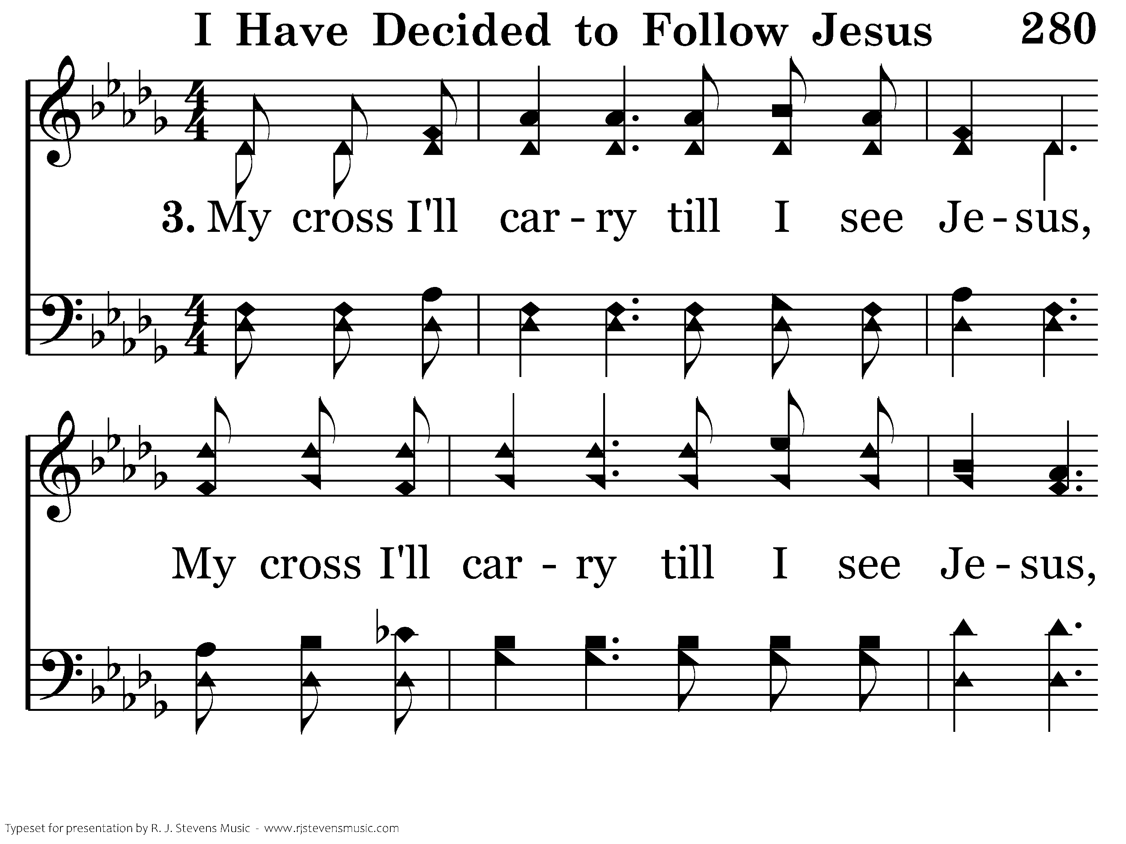
280 - I Have Decided To Follow Jesus - 3.1

Slide 18
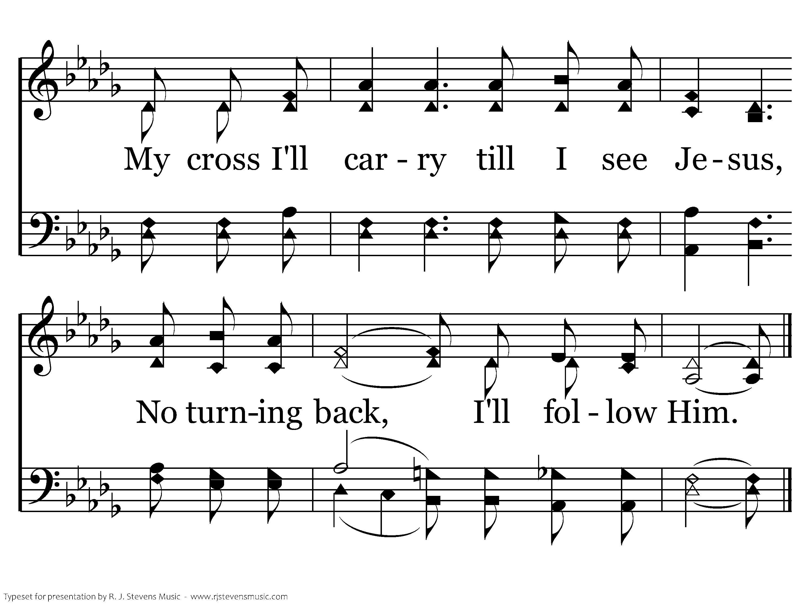
280 - I Have Decided To Follow Jesus - 3.2
End of Song

