Slide 2
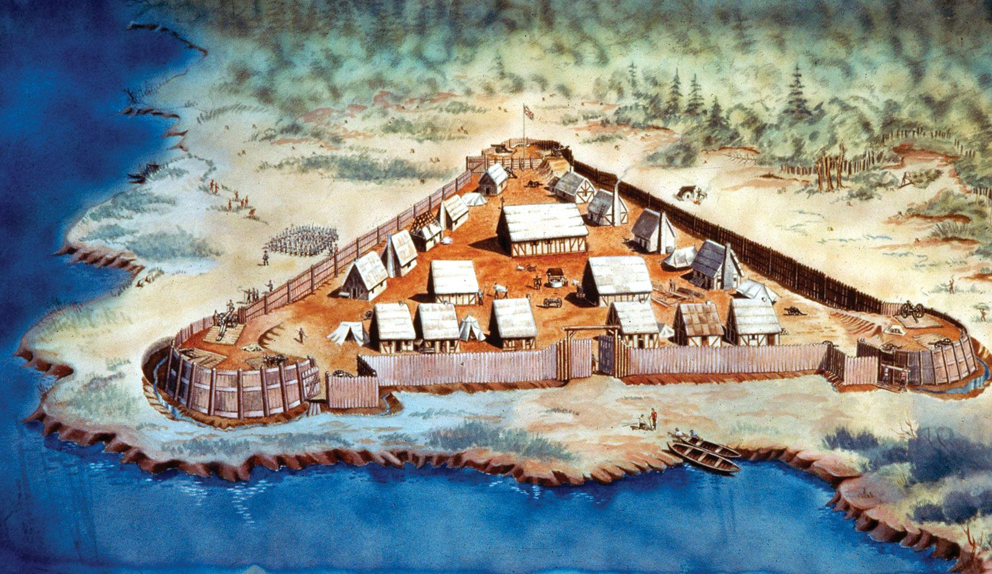
Whatever Happened to Sin?

Slide 3
The Bible reveals the true nature of sin.
Romans 7:13
“so that sin through the commandment might become exceedingly sinful” (NKJV).
“and through the commandment might become sinful beyond measure” (ESV).
“that through the commandment sin might become utterly sinful” (NASB).

Slide 4
The devil seeks to minimize the impact of sin.
Genesis 3:3-4
But of the fruit of the tree which is in the midst of the garden, God has said, “You shall not eat it, nor shall you touch it, lest you die.”
Then the serpent said to the woman, “You will not surely die.”

Slide 5
How We Try to Minimize the Seriousness of Sin
Familiarity - Jer. 6:15
Euphemisms
Humor - Prov. 17:22
Pop Psychology - Gen. 39:7-9
False Doctrine - Ezek. 18:20; Gal. 5:4
Comparisons - Rom. 3:10

Slide 6
The Little Sins
Greed
White Lies
Envy
Gossip
Cowardice
Indifference

Slide 7
The Little Sins that Killed Jesus
Greed of Judas - Matt. 26:15
White Lies of false witnesses - Matt. 26:60
Envy of religious leaders - Matt. 27:18
Gossip among crowd - Matt. 27:20
Cowardice of Pilate - Matt. 27:22-24
Indifference of the crowd - Luke 23:35

Slide 9
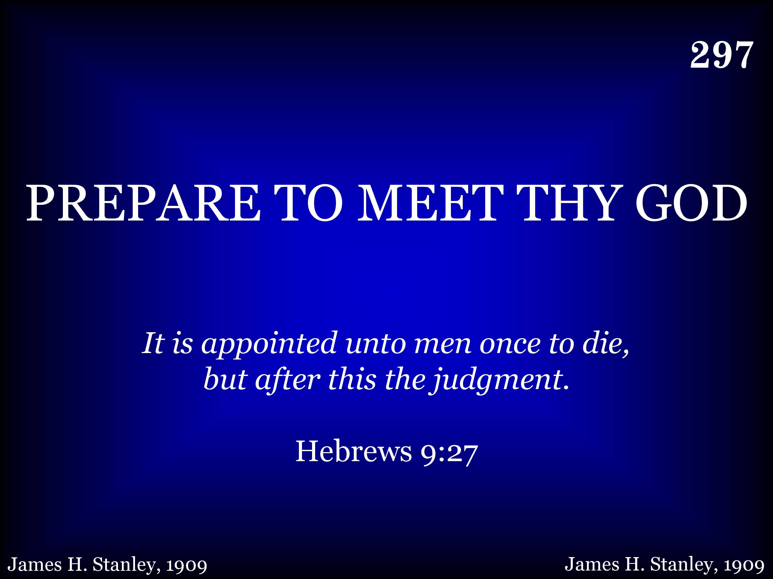
297 - Prepare To Meet Thy God - Title

Slide 10
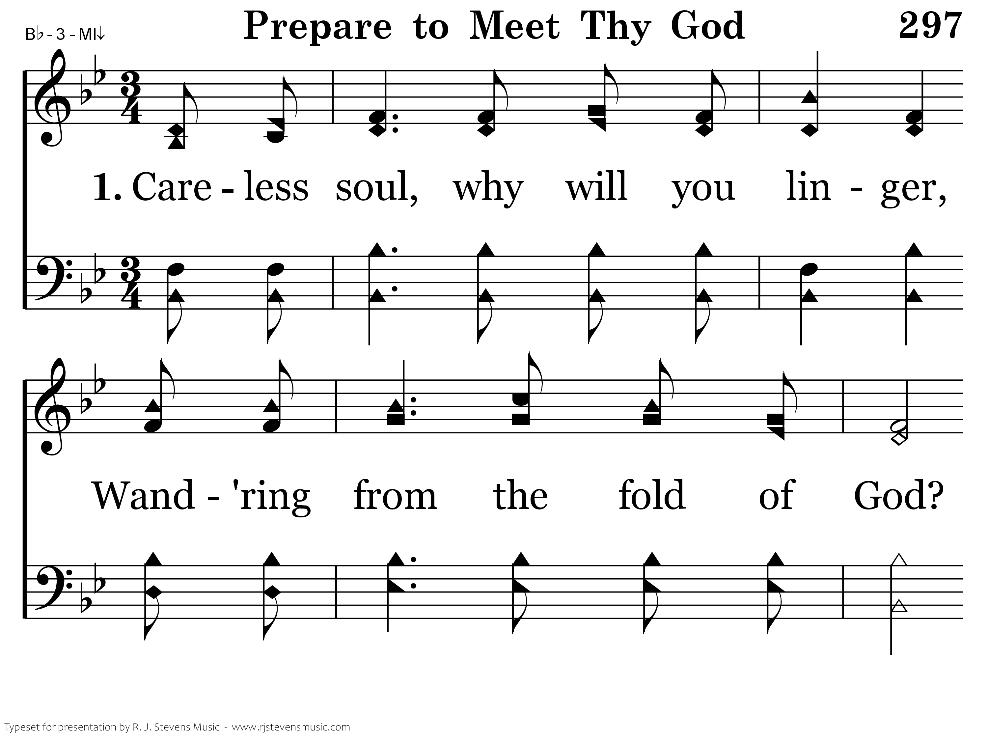
297 - Prepare To Meet Thy God - 1.1

Slide 11
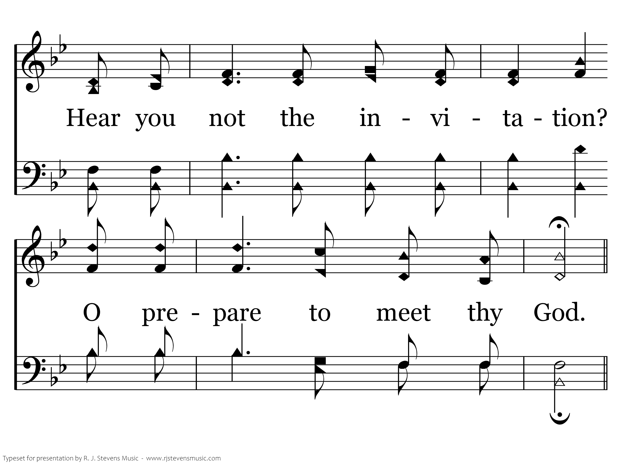
297 - Prepare To Meet Thy God - 1.2

Slide 12
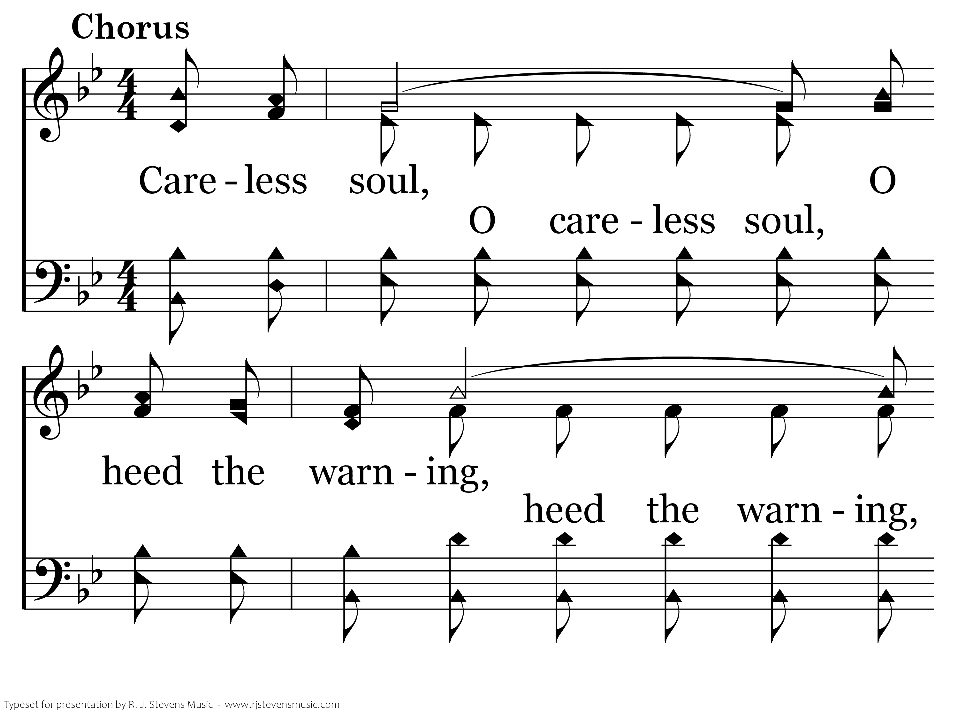
297 - Prepare To Meet Thy God - C.1

Slide 13
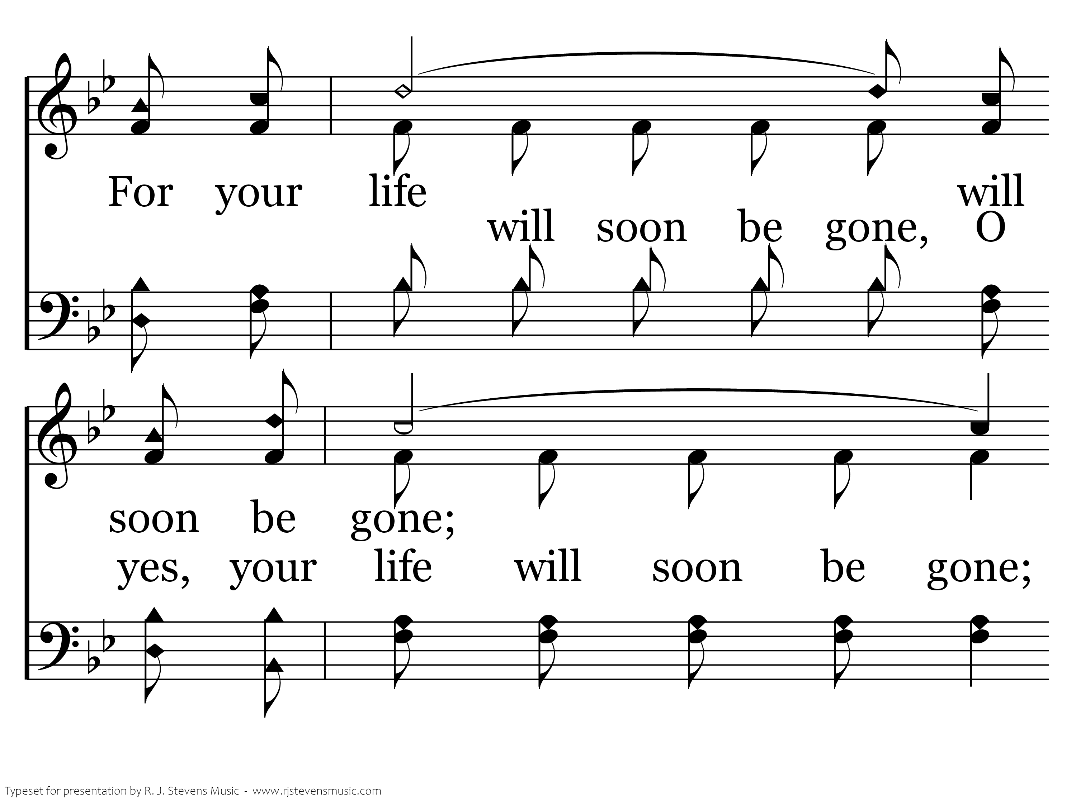
297 - Prepare To Meet Thy God - C.2

Slide 14
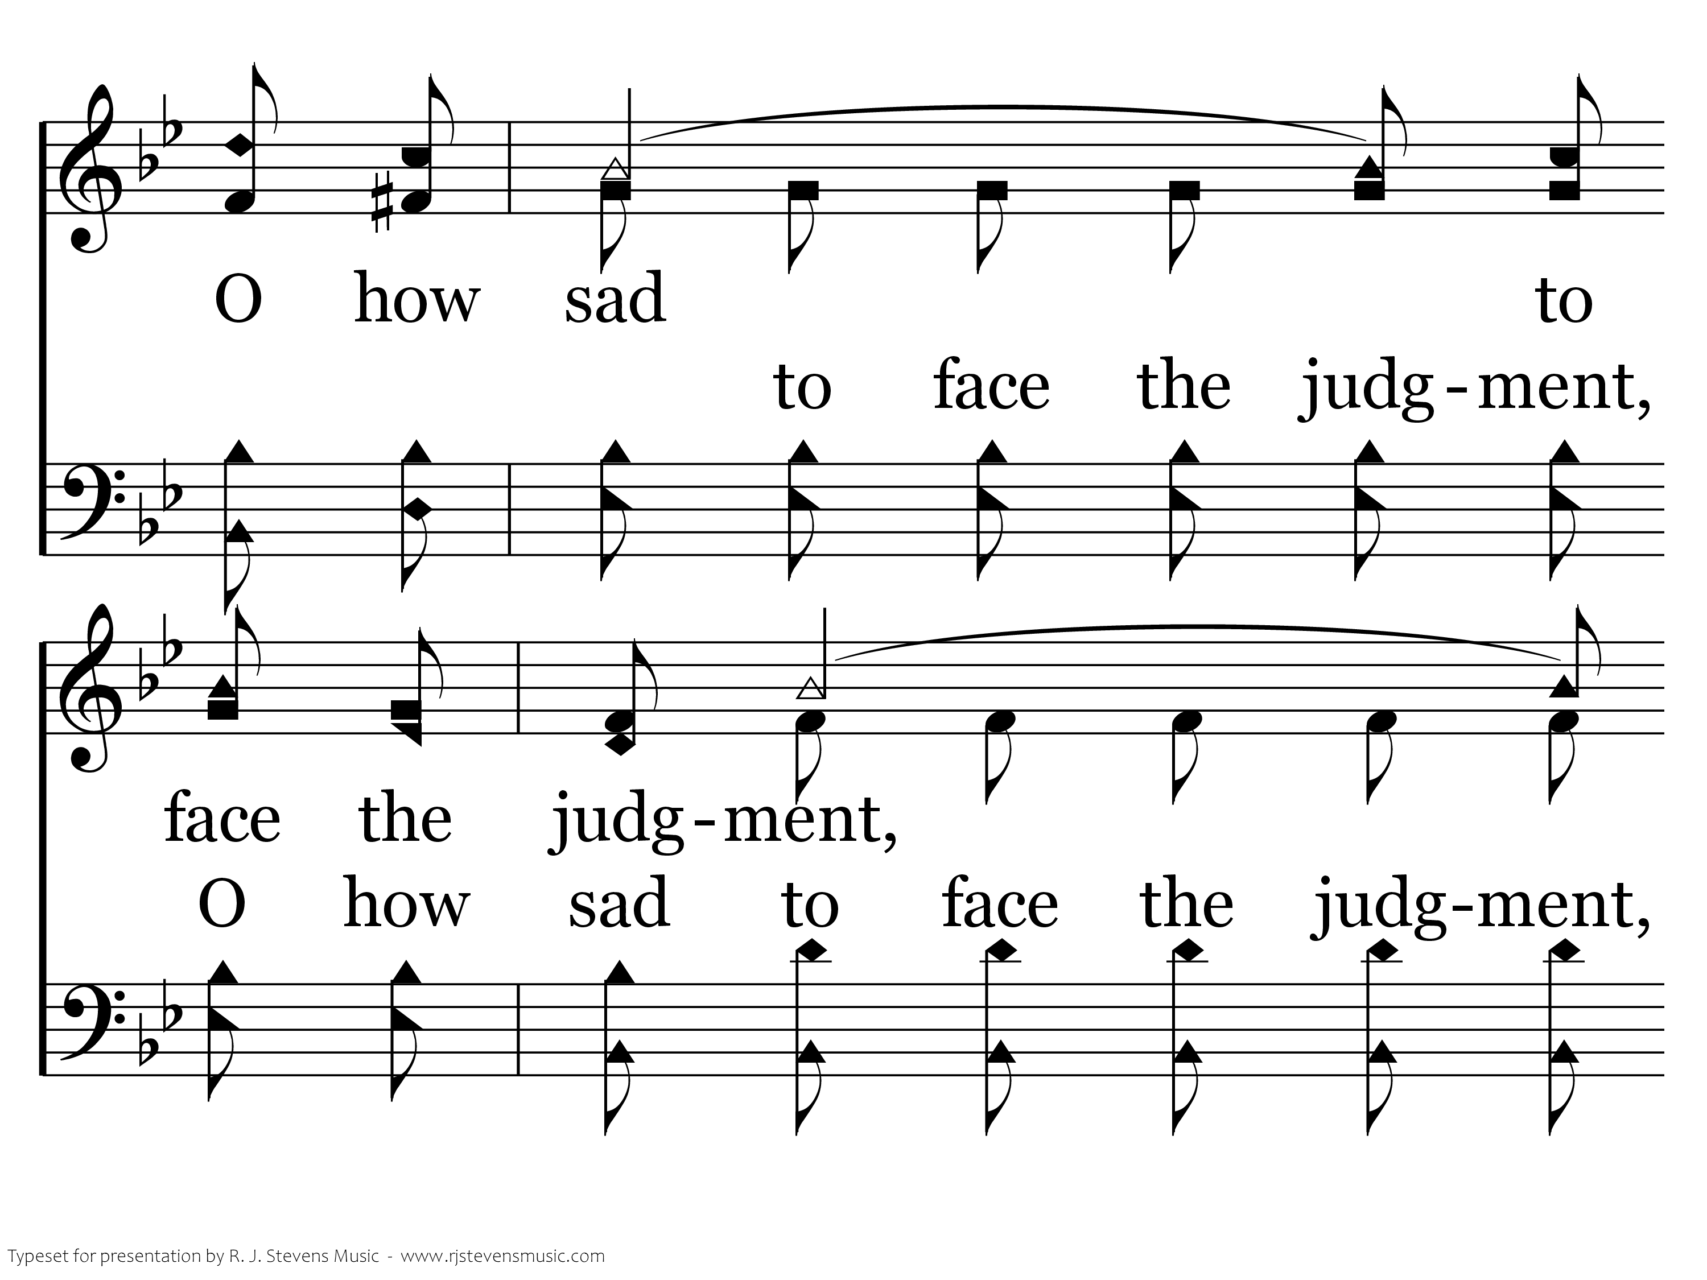
297 - Prepare To Meet Thy God - C.3

Slide 15
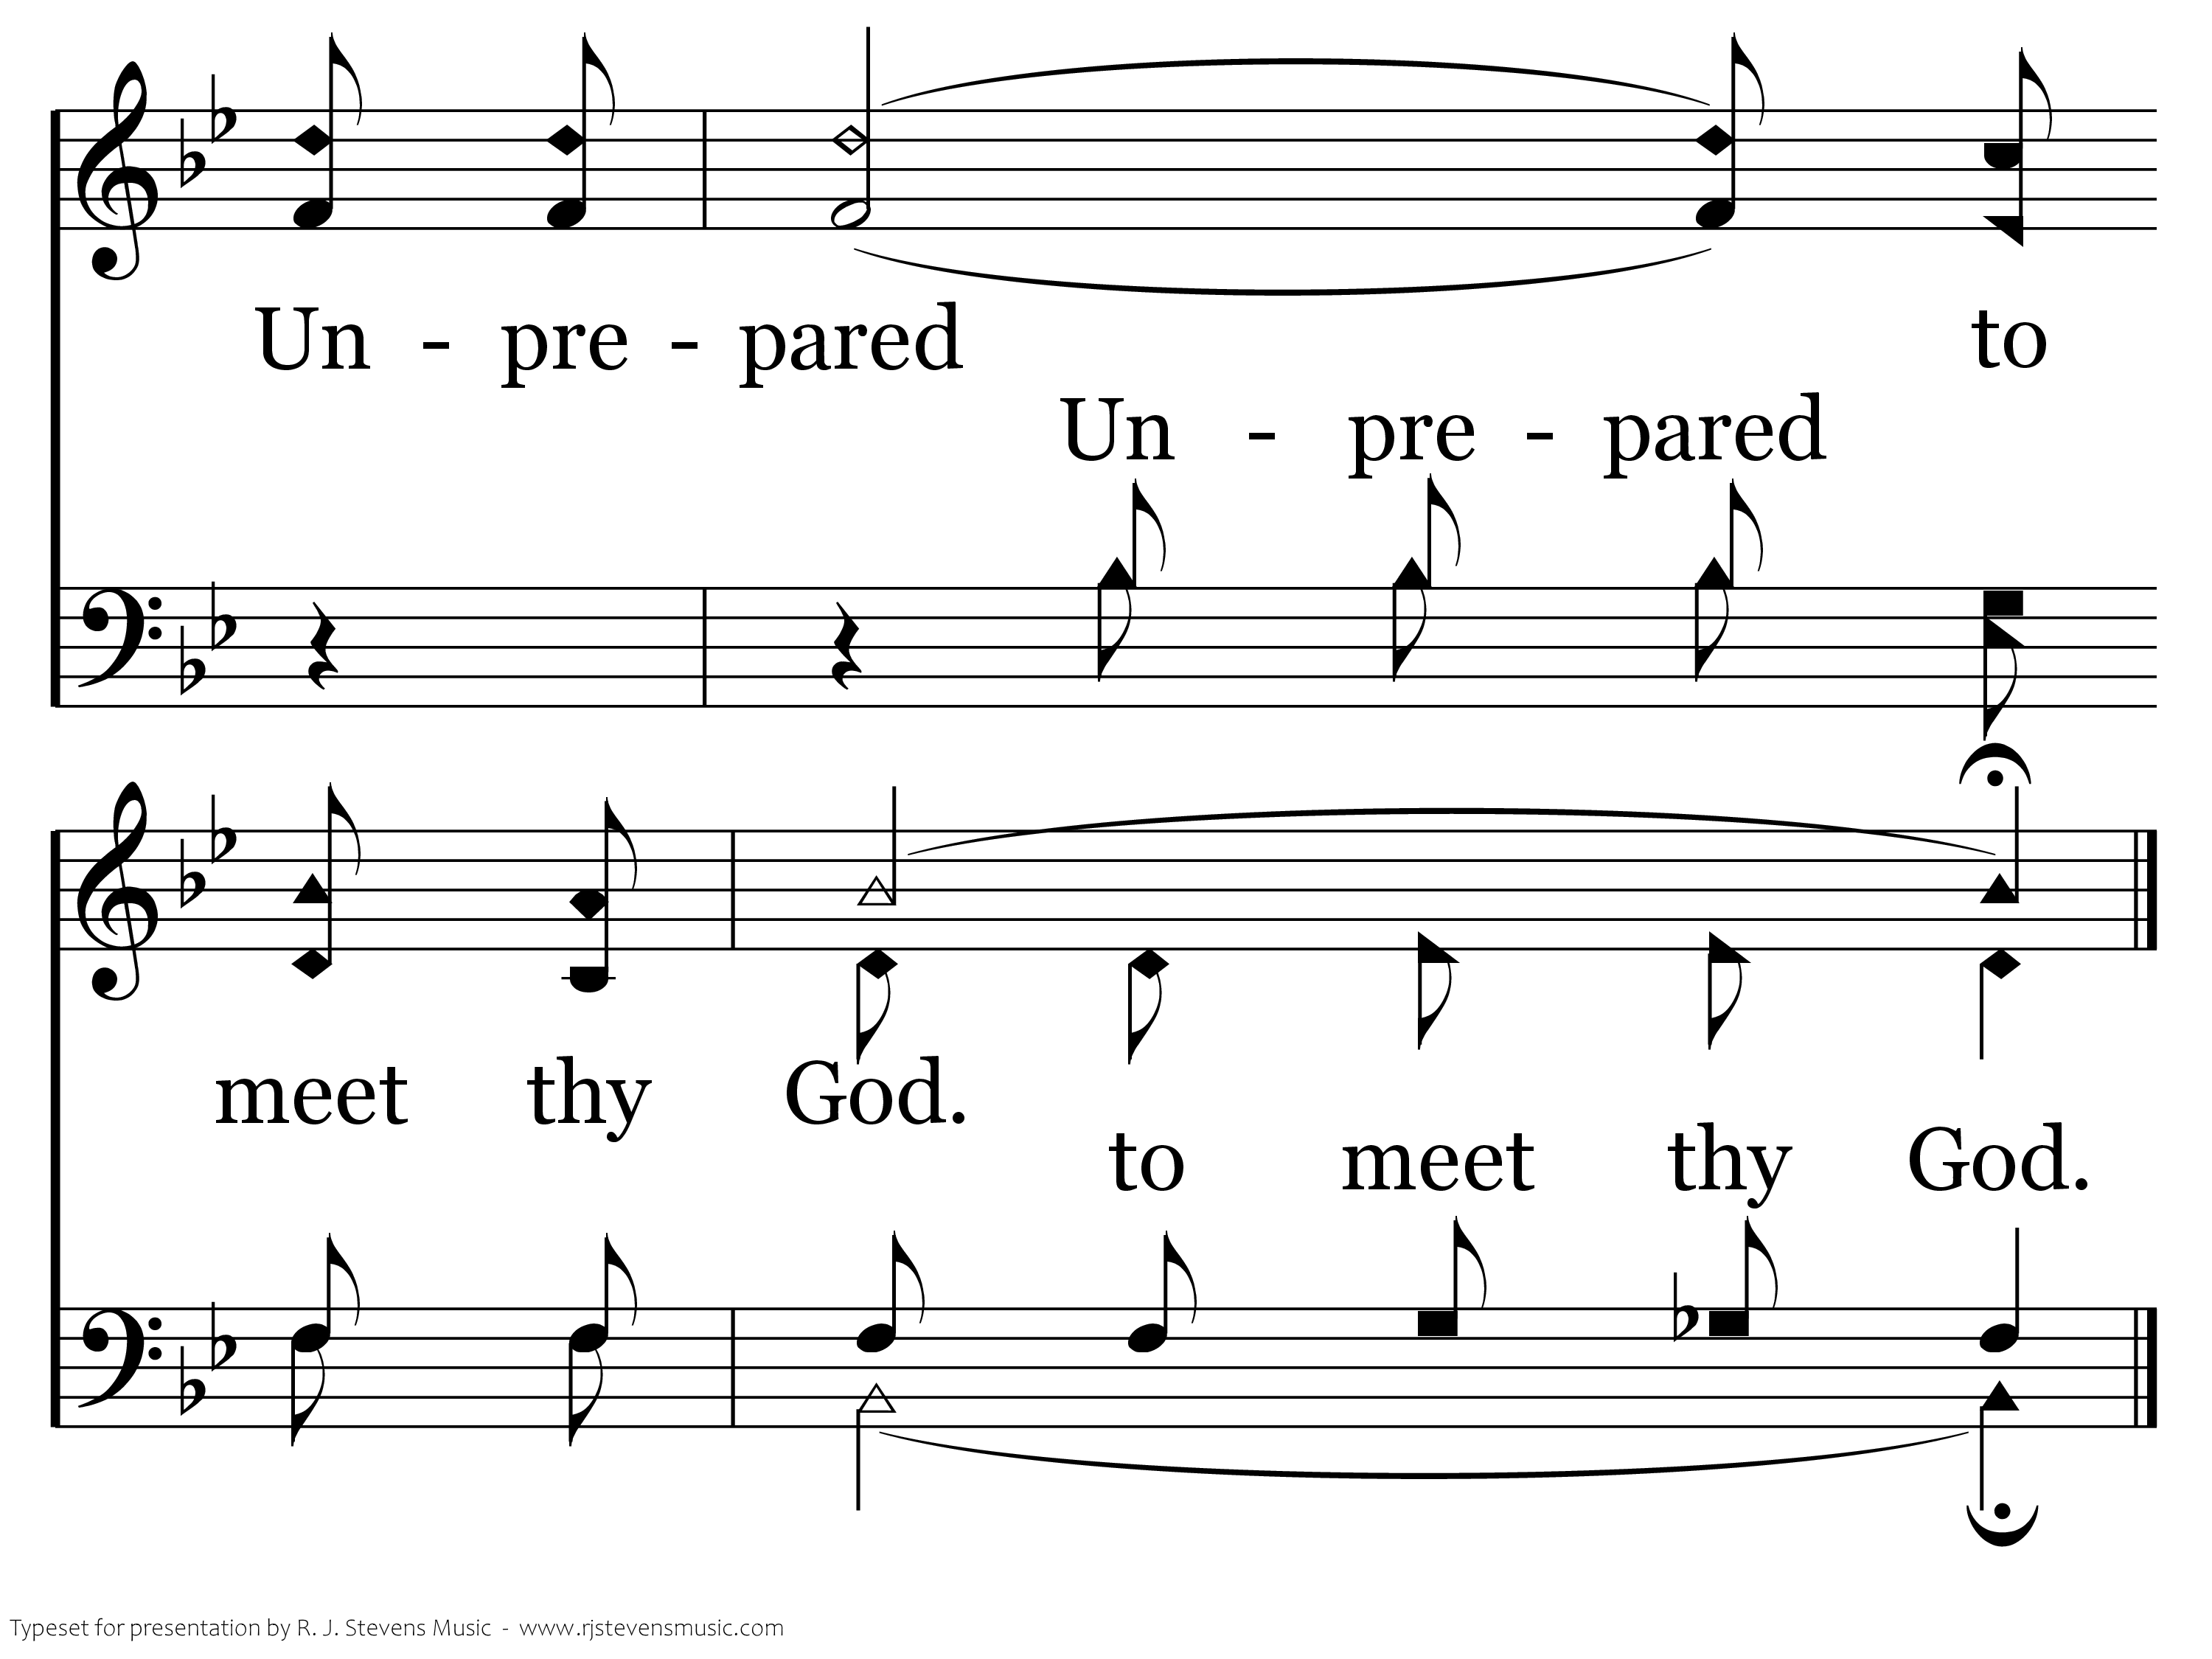
297 - Prepare To Meet Thy God - C.4
End of Verse 1

Slide 16
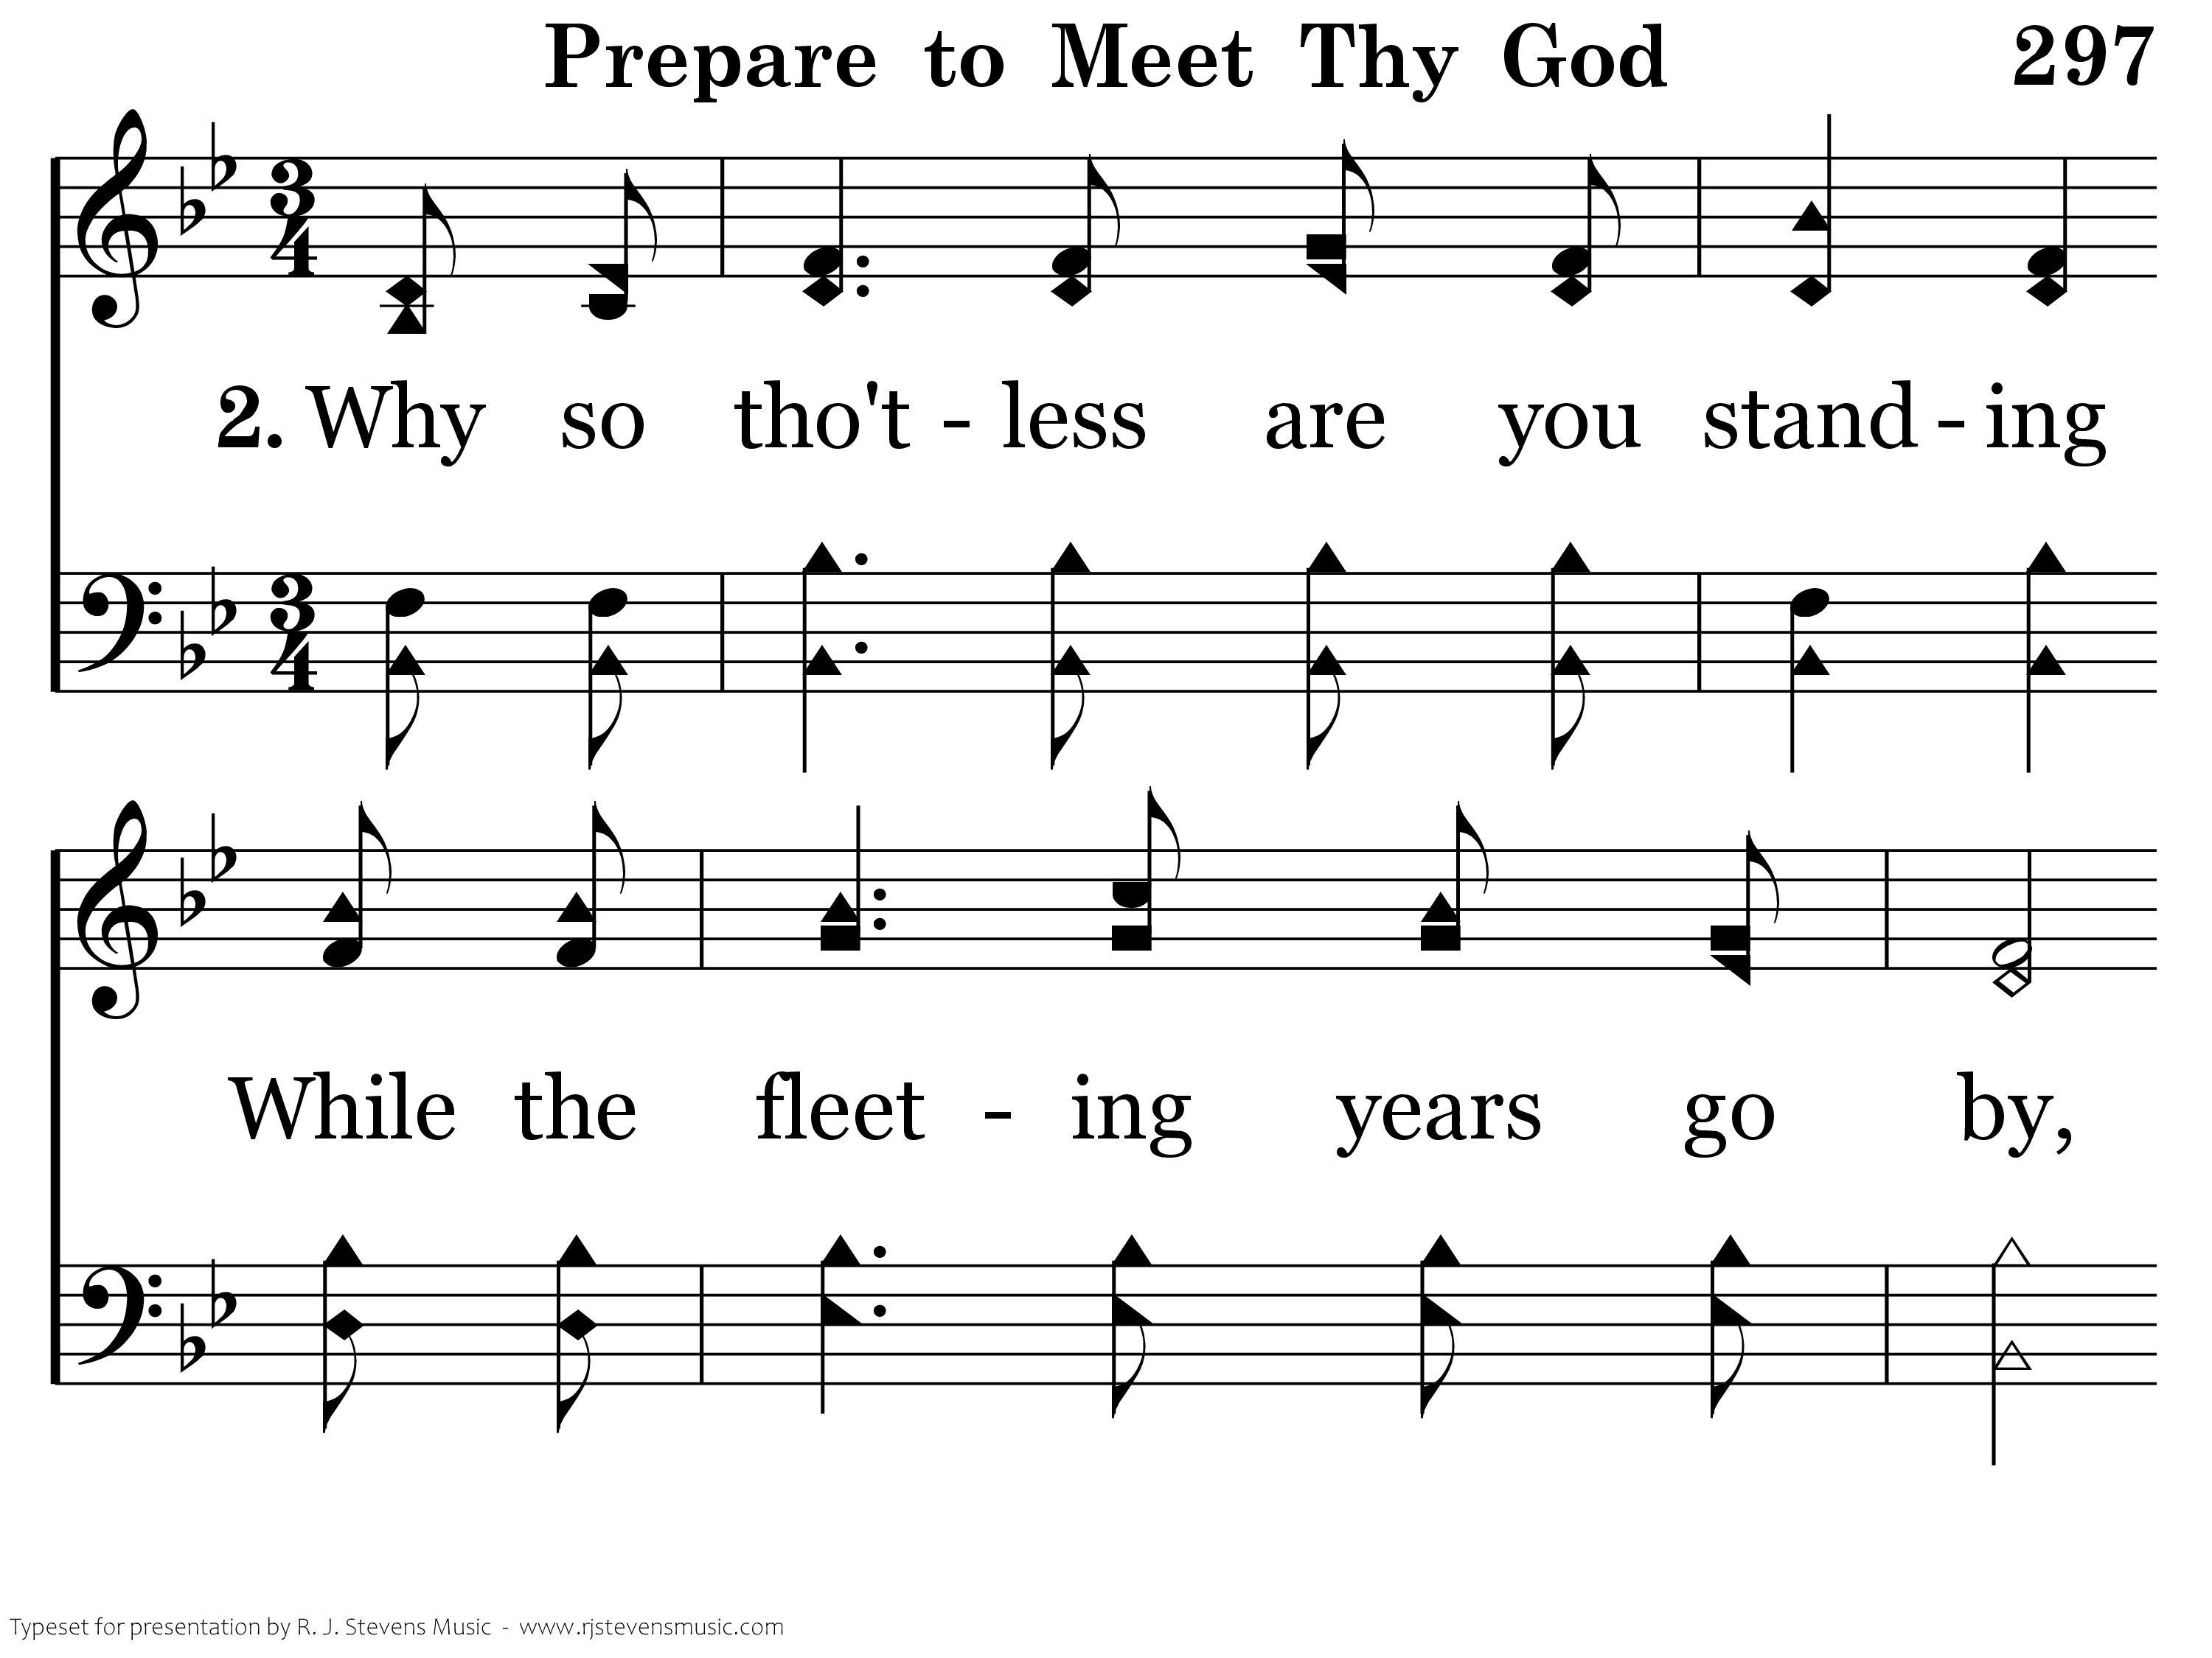
297 - Prepare To Meet Thy God - 2.1

Slide 17
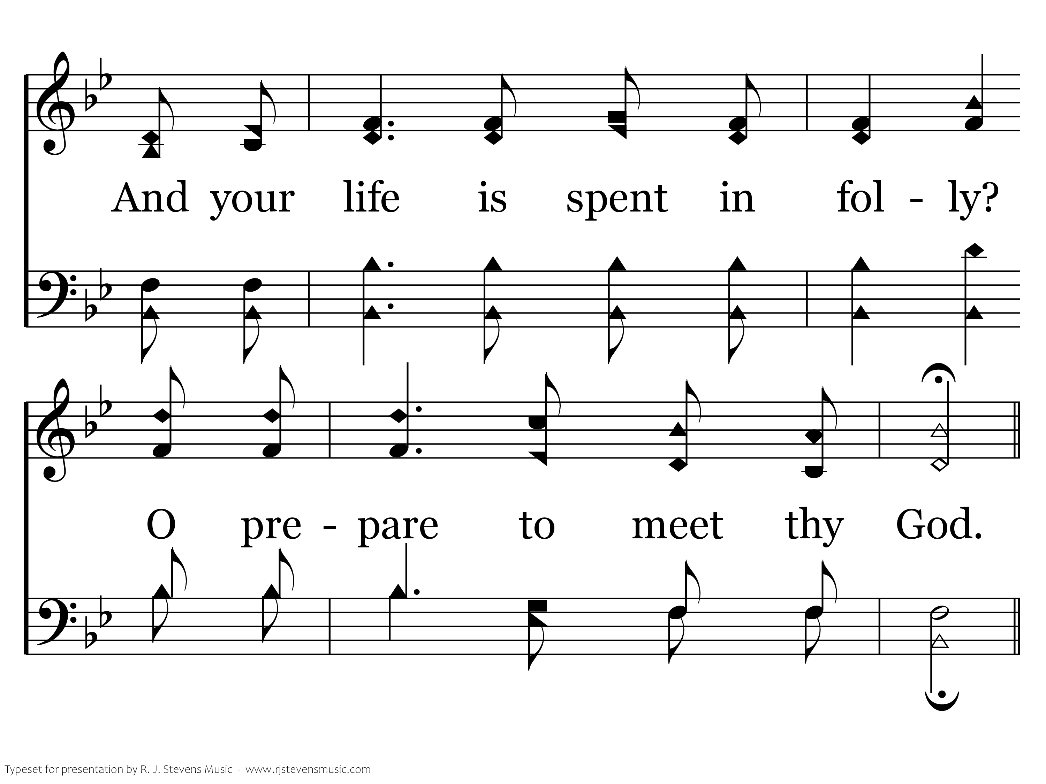
297 - Prepare To Meet Thy God - 2.2

Slide 18
297 - Prepare To Meet Thy God - C.1

Slide 19
297 - Prepare To Meet Thy God - C.2

Slide 20
297 - Prepare To Meet Thy God - C.3

Slide 21
297 - Prepare To Meet Thy God - C.4
End of Verse 2

Slide 22
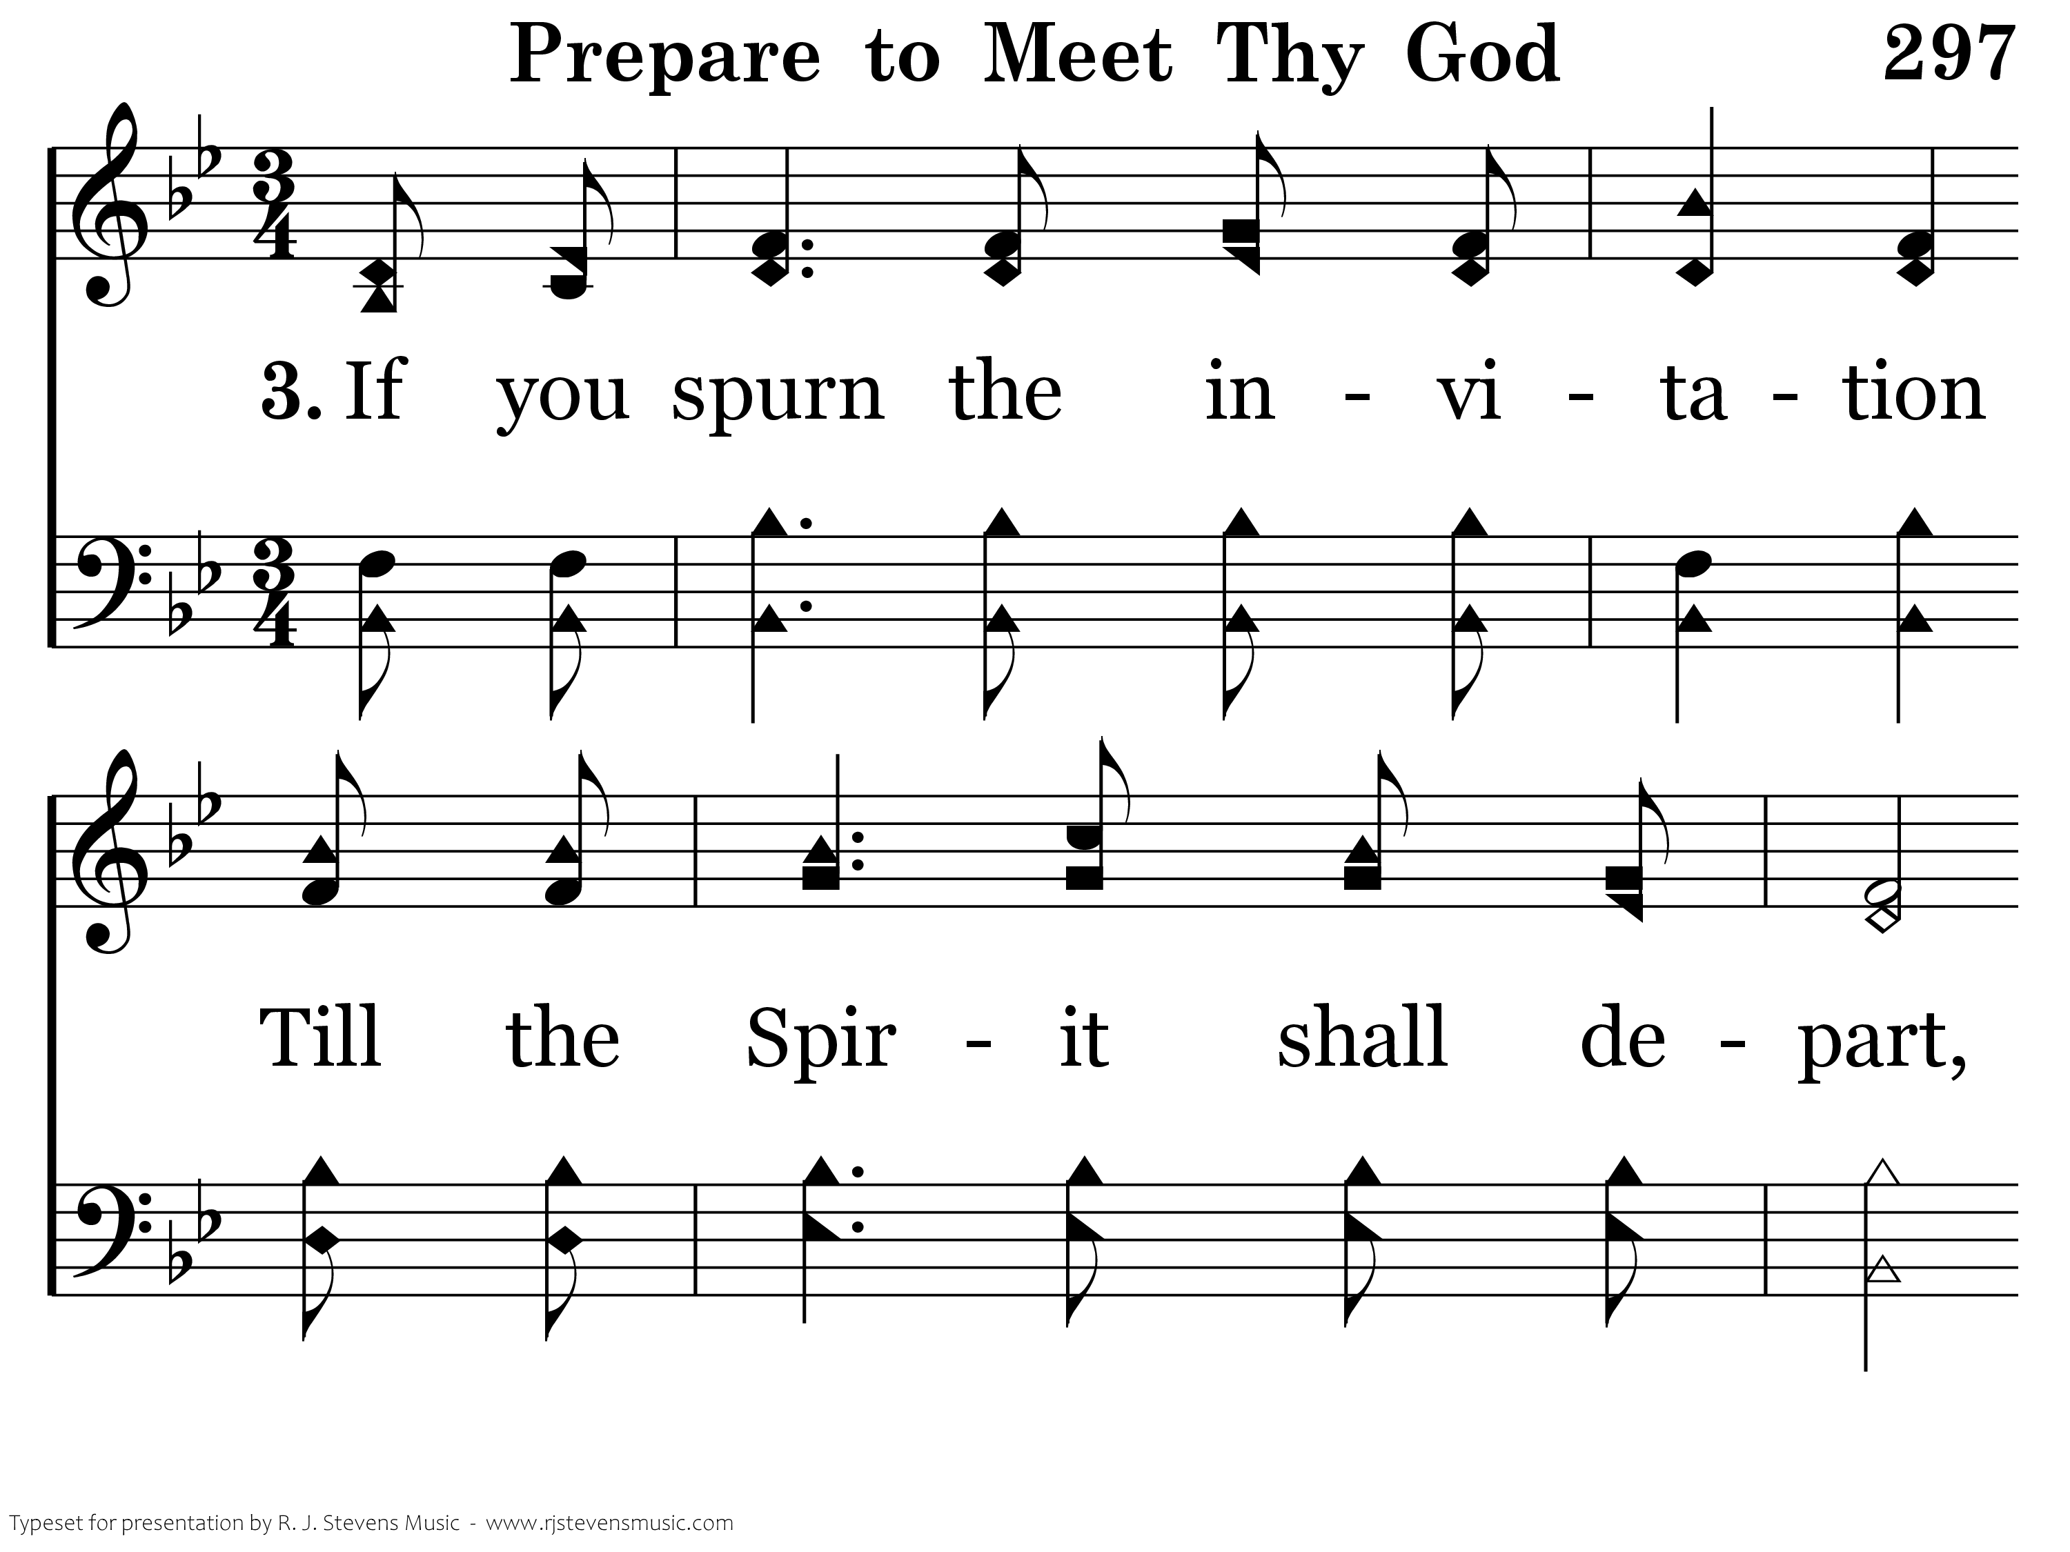
297 - Prepare To Meet Thy God - 3.1

Slide 23
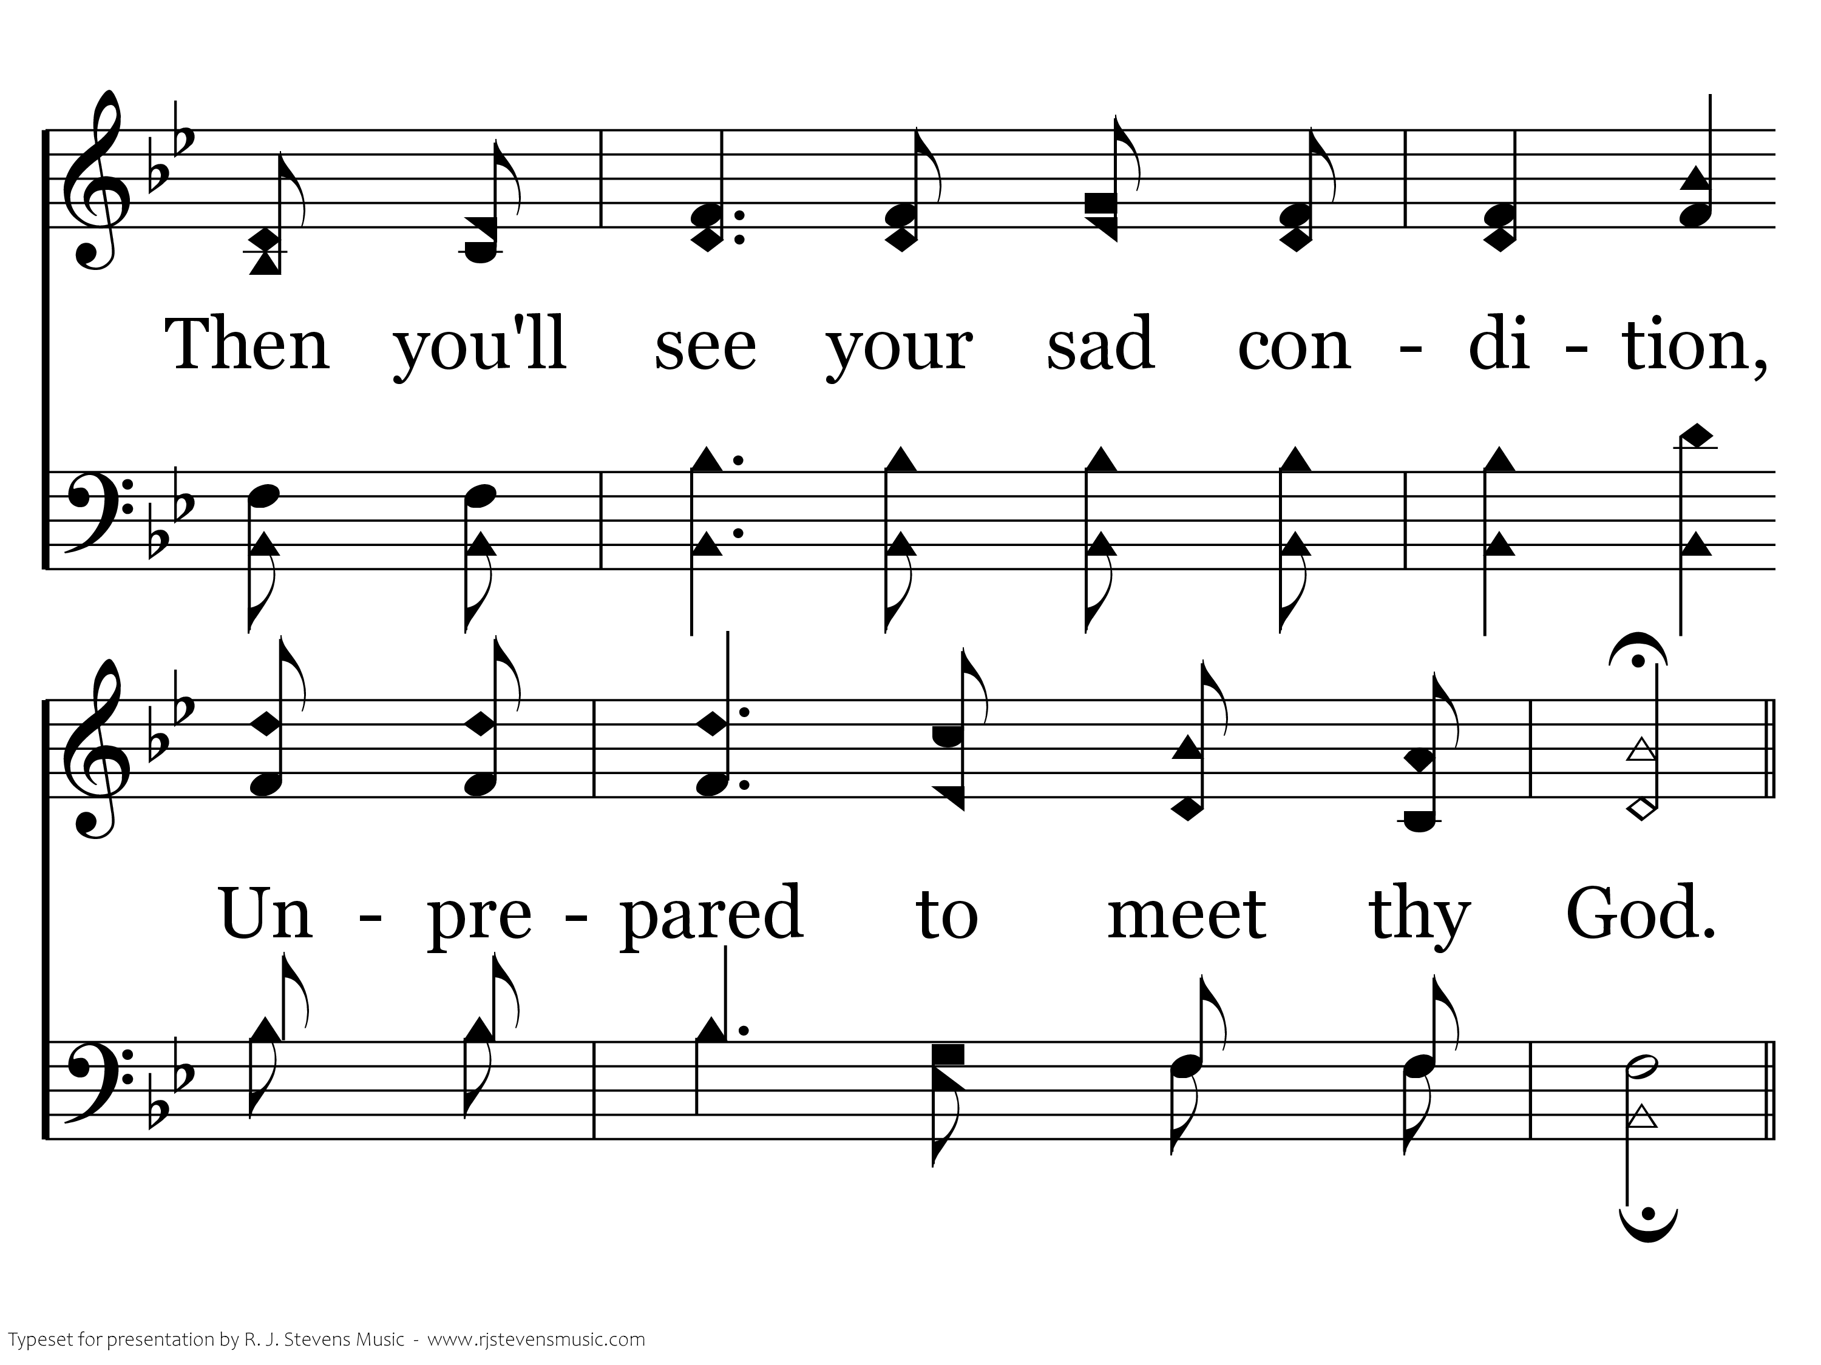
297 - Prepare To Meet Thy God - 3.2

Slide 24
297 - Prepare To Meet Thy God - C.1

Slide 25
297 - Prepare To Meet Thy God - C.2

Slide 26
297 - Prepare To Meet Thy God - C.3

Slide 27
297 - Prepare To Meet Thy God - C.4
End of Song

